Slide 1
Starter Game:
Sit down….stand up

Slide 2
If you have a piercing

Slide 3
If you tell your family you love them

Slide 4
If you’ve ever lied to a friend

Slide 5
If you have ever trumped in public

Slide 6
If you’ve ever ate a bogie

Slide 7
If you haven't brushed your teeth this morning

Slide 8
If you have ever skived a lesson

Slide 9
If you have ever cheated in a test

Slide 10
If you have a tattoo

Slide 11
If you’ve ever kicked a dog/cat

Slide 12
If you’ve ever stolen from a shop

Slide 13
If you’ve ever stolen from a family member

Slide 14
If you have a piercing
If you still tell your mum/dad you love them
If you’ve ever lied to a friend
If you have ever trumped in public
If you’ve ever ate a bogie
If you haven't brushed your teeth this morning
If you have ever skived a lesson
If you have ever cheated in a test
If you have a tattoo
If you have ever kicked a dog/cat
If you’ve ever stolen from a shop
If you’ve ever stolen from a family member
Notes:
You don’t have to admit it out loud, but did you lie on any of these questions, why? Was it because the majority of the people stood up/sat down? Was it because you know it is not a socially acceptable thing to admit?

Slide 15
What you need to be able to do…
Provide different explanations of conformity including informational and normative social influence, compliance and Internalisation.
Provide different explanations for obedience including situational and individual factors.
Evaluate Mori and Arai (2010)
Evaluate Milgram (1963)

Slide 16
What is conformity?
Zimbardo et al (1995) described it as “A tendency for people to adopt the behaviour, attitudes and values of other members of a reference group”.
Notes:
Pupils to copy this definition down

Slide 17
Conformity examples
In your jotter list where you might see everyday conformity.
Notes:
Pupils to copy this definition down

Slide 18
Everyday conformity: Uniforms

Slide 19
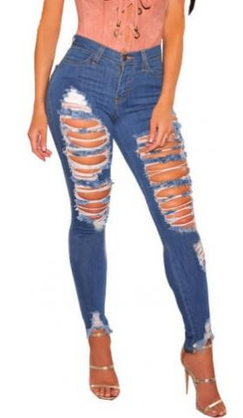
Fashion

Slide 20
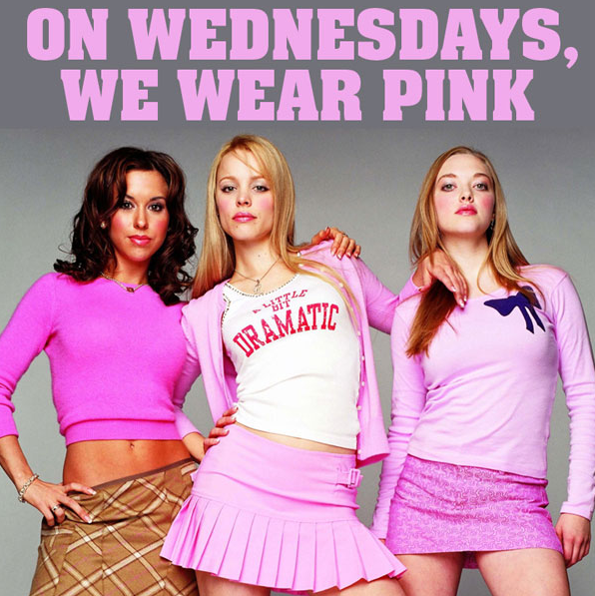
Studying social behaviour...
A group is a collection of people who share a common identity.
Group norms are the informal ‘rules’ that everyone who is part of a particular group follows. They might be implicit and unspoken, or in certain cases they might be explicit.

Slide 21
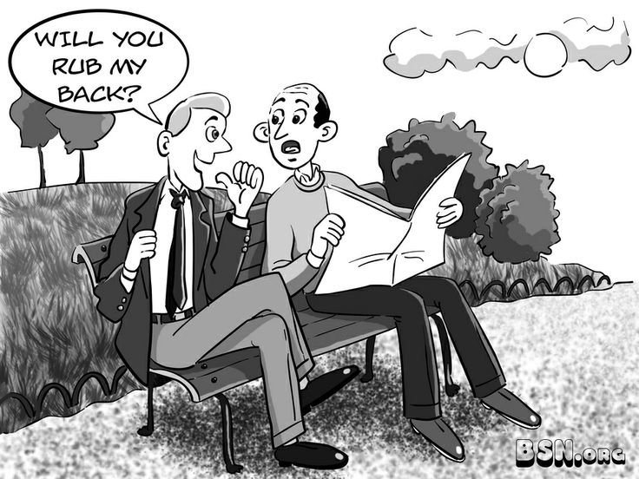
Breaking social norms
Sometimes, we might be unaware of social norms until we consider the situation where they are broken. It can lead to uncomfortable or confusing situations.

Slide 22
Which social norms would you feel most uncomfortable breaking?
Wearing an unironed school uniform
Going out with socks and sandals on
Whispering instead of talking
Facing the wrong way in a queue in shop
Saying ‘I love you’ at the end of every conversation

Slide 23
Is all conformity the same?
Is conforming to wear a uniform to school the same as becoming vegan because all your friends are?
Is changing which political party you vote for because of all your family the same as pretending to like the same band as your friends?

Slide 24
Is all conformity the same?
Kelman (1965) believes there are three different levels of conformity:
Compliance
Identification
Internalisation

Slide 25
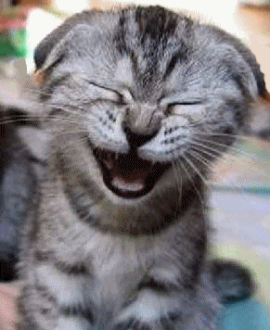
Compliance
Compliance is the lowest form of conformity.
This is when you going along with another person while privately disagreeing with them.
An example of this might
be laughing at the jokes
of a person you like but
not really finding them
funny.
It can be seen in Asch’s study which we will look at.

Slide 26
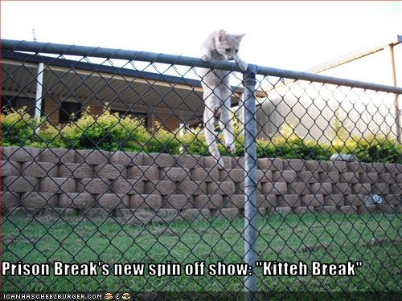
Identification
Identification is a deeper form of conformity.
It is when an individual changes their private views as well as their public behaviour to fit in with a group they admire but it is probably TEMPORARY.
An example may be seen when a person adopts a new football team every time they move town.
It is shown in Zimbardo’s Prison Experiment which we will also look at later.

Slide 27
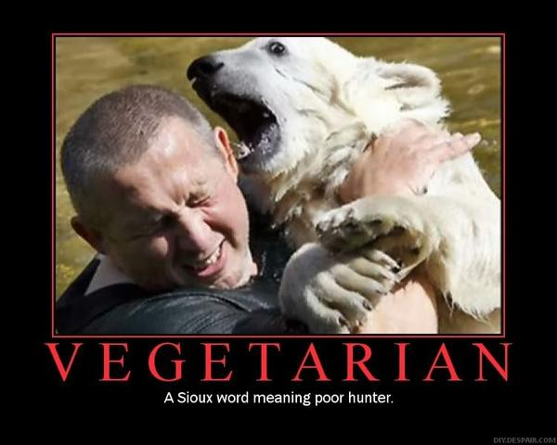
Internalisation
Internalisation is the deepest level of conformity.
The beliefs of a group are taken on and become a permanent part of that person’s world-view.
(Internalisation can also be known as ‘conversion’.)
An example might be Vegetarianism

Slide 28
Types of Conformity
In your groups try and come up with examples of each type of conformity.
You should be prepared to share your ideas with the rest of the class.
These ideas should help prompt your memory of the types later on.
Notes:
Pupils should discuss types of conformity

Slide 29
Match the examples
When Taylor is in school he agrees with his friends that Love Island is a terrible programme and shouldn’t be watched. However, when he goes home he loves to binge watch all the old seasons of Love Island (Season 2 is his favourite).
Compliance
Identification
Internalisation

Slide 30
Match the examples
Rachel started at a new school and became friends with a group of girls who believe aliens exist. Rachel is now convinced aliens exist and has now became an alien enthusiast
Compliance
Identification
Internalisation

Slide 31
Match the examples
Liam has grown up with a family who are all vegan. He believed it was the best way to live your life. However, when he moved to uni he moved into a flat with people who ate meat. He decided he would now become a meat eater and no longer lives as a vegan
Compliance
Identification
Internalisation

Slide 32
Timed condition
‘Explain how compliance differs from internalisation’ (4 marks)
(8 minutes)
Notes:
Students to attempt this question – they can use their notes from last lesson but the explanation must be in their own words. They then need to mark each other’s answers. Students can be given this example of a mark scheme when marking:
“2 marks for correctly identifying what compliance and internalisation, up to two further marks for specifically noting the difference”
i.e. compliance is going along with something because you want to be like the majority. Internalisation is going along with the majority because you agree. (2 marks) So the main difference is that compliance is just public, but internalisation is public and private. (4 marks)

Slide 33
Now swap your answers so we can do peer-marking!

Slide 34
Marking Scheme
“2 marks for correctly identifying what compliance and internalisation, up to two further marks for specifically noting the difference”
i.e. compliance is going along with something because you want to be like the majority. Internalisation is going along with the majority because you agree. (2 marks) So the main difference is that compliance is just public, but internalisation is public and private. (2 marks)
Notes:
If extra time questions on page 10. If not, assign as homework.

Slide 35
Factors affecting conformity
Informational social influence
Normative social influence
Individual factors
Gender
Self- Esteem
Situational factors
Group size
Group unanimity
Task difficulty
Cultural factors
Collectivist
Individualistic

Slide 36
Why do we conform?
Informational social influence: Believing the majority is right.
Normative social influence: In order to be liked.
Notes:
Notes in handbook

Slide 37
Informational Social Influence
Informational Social Influence - we consider other peoples views to be valid and reliable. It might be because we are unsure of how to behave or what is correct, and so we go along with a majority, or because we perceive others to have more expertise than us.
Informational influence motivates us to conform because we want to be right.

Slide 38
Informational Social Influence
Informational Social Influence - we consider other peoples views to be valid and reliable.
Informational influence motivates us to conform because we want to be right.
In your jotter think of as many examples as possible of when people might experience Informational Social Influence

Slide 39
Normative Social Influence
Normative Social Influence - we want to gain approval from others, so we go along with a certain behaviour. This concerns a need for social acceptance. We are not in doubt of the correct belief or behaviour, but feel pressure from the group and go along with it in order to be accepted.
Normative influence motivates us to comform because we want to be liked.

Slide 40
Normative Social Influence
Normative Social Influence - we want to gain approval from others, so we go along with a certain behaviour. Normative influence motivates us to comform because we want to be liked.
In your jotter think of as many examples as possible of when people might experience Normative Social Influence.

Slide 41
Individual Factors
What makes some people conform when others don’t?
There are factors which differ from person to person.
Gender and self-esteem are the mandatory factors which we need to know.
Can anyone think of any other individual factors which may impact if someone conforms or not?

Slide 42
Higher or Lower
We are going to consider some individual factors which may or may not affect conformity.
You need to say whether there is a higher or lower chance of conformity dependent on the factor.

Slide 43
Higher or Lower
Self -Esteem (High self-esteem)
LOWER

Slide 44
Self-Esteem
Self-Esteem is believed to have an impact on whether or not a person will conform.
Santee & Maslach (1982) found that people who have higher levels of self esteem are less likely to conform.
People who like to be in control are also less likely to conform, as this personality trait would not allow it.

Slide 45
Higher or Lower
Gender (women)
HIGHER

Slide 46
Gender
Historically women have been more likely to conform than men because they have taken on the role of promoting harmony. However, due to this massive shift in gender roles this may now be different in our culture.
Mori & Arai (2010) found that women were still more likely to conform even though this was only 8 years ago. However, this could be due to the cultural expectations in Japan.

Slide 47
Higher or Lower
Age (getting older)
LOWER

Slide 48
Age
Younger individuals are more likely to conform than older individuals, perhaps due to lack of experience and status.
Steinberg & Monahan (2007) found that conformity levels seem to remain the same between the ages of 10 and 14. However, after this age the conformity levels appear to continue to drop until the age of 18 where it remain steady into early adulthood.

Slide 49
Higher or Lower
Thought processes (strong feelings about an issue)
LOWER

Slide 50
Thought processes
Hornsey et al (2003) found that if someone has strong feelings regarding an issue they were less likely to conform.
They studies Australian university students who had stated that they were in favour of same sex marriages, and showed them fake results of other students having opposing views.
Those who held strong beliefs regarding same sex marriages were much less likely to conform and I actually shown counter-conformity.

Slide 51
Situational Factors
There are some occasions when we are more likely to conform than others.
There are factors which differ from situation to situation.
Group size, group unanimity and task difficulty are the mandatory factors which we need to know.
Can anyone think of any other situational factors which may impact if someone conforms or not?

Slide 52
Higher or Lower
We are going to consider some situational factors which may or may not affect conformity.
When you are copying down the evidence for these factors you will not understand the statistics as we have not went over the study yet. This will make more sense soon.

Slide 53
Higher or Lower
Group size (larger group)
HIGHER

Slide 54
Group size
Asch re-ran the exact same research but this time varying the amount of confederates which were used.
One confederate = 3% confomity
Two confederates = 12.8% conformity
Three confederates = 33.3% conformity
Increasing the size of the majority beyond three did not increase the levels of conformity found.

Slide 55
Higher or Lower
Group unanimity (someone agrees with you)
LOWER

Slide 56
Group Unanimity
When there is a totally unanimous decision amongst participants there is more pressure conform and conformity levels increase. On the other hand, if you have social support and someone agrees with you, conformity is lower.
Asch (1951) conducted another variation of his study where he instructed one confederate to act as an ally to the true participant by disagreeing with the others. The ally answered before the true participant. This produced a sharp drop in conformity (fell to 5.5%)

Slide 57
Higher or Lower
Task difficulty (if the task is hard)
Higher

Slide 58
Task difficulty
When an answer is not clear conformity will increase. It may be because if a task is more difficult then it is less embarrassing to conform to those around you.
Asch (1956) found that when he made the lines more similar to each other confomity levels rose

Slide 59
Higher or Lower
Secrecy of response
LOWER

Slide 60
Secrecy of response
In another replication of Asch’s experiment the real participant was told that they had arrived late and would have to write their answers down on a piece of paper.
Meaning they would still hear everyone’s responses but would not need to say their own answer out loud.
Conformity dropped to only 5%, showing that being able to keep your response secret lowered conformity rates.

Slide 61
Cultural Factors
There are some cultures who install views which promote conformity more than others.
Collectivist cultures and Individualistic cultures are the mandatory ones which we need to consider.
Can anyone think of where we may find these cultures and how they may influence conformity levels?

Slide 62
Higher or Lower
Collectivist culture (Central America, south east Asia etc)
HIGHER

Slide 63
Collectivist culture
Collectivist cultures value family and society more than the needs of themselves. It is believed that because of this that these cultures show higher levels of conformity.
Smith & Bond (1993) found that Belgians have the lowest levels of conformity and Fijian Indians have the highest.

Slide 64
Research showing Normative Social Influence
Research into normative social influence comes from Asch (1951) and Mori & Arai (2010).
Before we look at either of these studies… Remind yourself what normative social influence is.
Occurs in situations where we want to gain approval/acceptance.... When we think/believe something different from the group.

Slide 65
Asch (1951)
Aim: To see if people will conform to group pressure when they do know the correct answer
Method: He got participants in a room to do an ‘eye test’. They judged the length of a line but the rest of the group were actors who would say the wrong answer. The real participant went at the end to see if they would conform
Results: Conformity happened 1/3 of the time. 75% of participants conformed at least once.

Slide 66
A
B
C

Slide 67
A
B
C

Slide 68
A
B
C

Slide 69
A
B
C

Slide 70
A
B
C

Slide 71
A
B
C

Slide 72
A
B
C

Slide 73
A
B
C

Slide 74
A
B
C

Slide 75
A
B
C

Slide 76
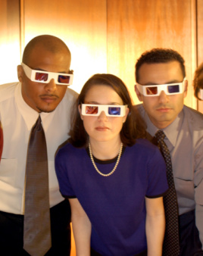
Research showing Normative Social Influence
Key study: Mori & Arai (2010)
The researchers wanted to replicate Asch’s study but this time remove the need for confederates.
They gave the participants filter glasses and asked them to match the example line to another identical line.
This time the all the participants but one had the same type of filter glasses on.

Slide 77
Mori and Arai (2010)
Aim: To see if both male and females would conform in an unambiguous task
Method: Groups of participants wore glasses to look at a line task. The 3rd in the group saw a different image. They were asked a question to see if they would conform
Results: For women only the results matched closely to the results of Asch, with the minority being swayed 4.41 times out of 12. Male participants were not swayed at all.

Slide 78
Mori and Arai (2010)
Conclusion: Cultural differences could be a reason why the men’s results differed from Asch. It could also be due to the fact in this study he participants knew each other whereas in Asch’s study they did not.
Evaluation: Strength; Using familiar people creates more important results. Weakness; Only conducted in Japan therefor cannot be generalised to other cultures.

Slide 79
Research showing Informational Social Influence
Research into normative social influence comes from Jenness (1932)
Remind yourself what informational social influence is.
Occurs in situations where we don’t know the correct answer and assume those around you would have more information than you.

Slide 80
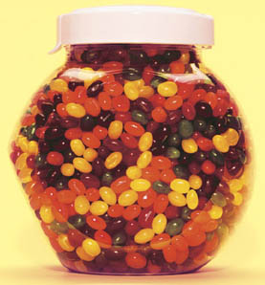
Jenness (1932)
Asked participants to estimate the number of beans in a glass jar - it was ambiguous and they couldn’t know the correct answer.
Initially, participants estimated individually, and guesses varied greatly.

Slide 81
Jenness (1932)
They were then put into groups, and asked to provide a group estimate.
After this, they were once more asked if they would like to stick with or change their initial answer.
The majority changed their individual guesses to be closer to the group estimate. Providing evidence for informational social influence

Slide 82
1. Which type of social influence motivates people to conform in order to be liked and accepted?
2. Explain 2 reasons for the differences in the results between Asch’s study and Mori and Arai’s study
3. What percentage of Asch’s participants conformed at least once?
4. Identify two differences between the experiments carried out by Asch (1951) and Mori and Arai (2010)

Slide 83
Knowledge checker
Which type of social influence motivates people to conform in order to be liked and accepted? Normative
Explain 2 reasons for the differences in the results between Asch’s study and Mori and Arai’s study
One reason could be the difference in time period. Asch’s study took place in the 50s which was a period of high conformity rates. Conformity rates have dropped as we travel through the decades, so this could explain why there was no conformity in males in Mori and Arai’s study.
Another reason could be the presence of females in Mori and Arai’s study. When the men were only surrounded by other men in Asch’s study they conformed because they wanted to fit in with the group. However, when they were with females they did not put as much importance on fitting in and more importance on impressing the females.

Slide 84
Knowledge checker
3. What percentage of Asch’s participants conformed at least once?
75%
4. Identify two differences between the experiments carried out by Asch (1951) and Mori and Arai (2010)
Mori and Arai used male and females
Asch in USA, Mori and Arai in Japan
Asch used people who didn’t know each other, Mori and Arai used people who did
5. If you laugh at a joke that you don’t find funny, because everyone else is laughing, what type of conformity is occurring? Compliance

Slide 85
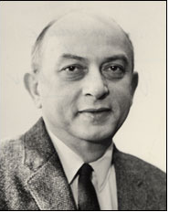
Solomon Asch (1951) Line Experiment

Slide 86
Solomon Asch (1951) Line Experiment
Solomon Asch believed that conformity was a rational process where people work out how to behave from other peoples actions.
How would people react when being confronted with a majority who were plainly wrong in their judgements.

Slide 87
Solomon Asch (1951) Line Experiment
25% of participants remained independent and gave the correct answer on each trial.
The overall conformity rate was 37%
5% conformed on every trial – most conformist
When questioned participants said they felt self conscious and anxious about their responses and some reported feelings of stress.
They knew inside that they were giving incorrect answers
Notes:
Conformity rate based on the number of trials in which naïve participants gave the same wrong answer as the confederates

Slide 88
Strengths & Weaknesses
Strengths – Future research
Weaknesses
Lack of ecological validity
Timing
Biased sample
Ethical issues
Confederates
Notes:
What do I mean by the following weaknesses statements

Slide 89
Mori & Arai (2010)
Replication of Asch’s line comparison task.
104 Japanese participants in groups of 4
This time wore filter glasses (3 wearing identical glasses, 1 wearing different)
Results: Women = 4.41 times out of 12 were swayed by majority; Men, not swayed by majority.
Conclusion: These results could be due to cultural differences between Japan and America, or could be due to the fact the participants knew each other.

Slide 90
Strengths & Weaknesses
Strengths
Both genders
People who knew each other
Weaknesses
Lack of ecological validity
Timing
Biased sample
Ethical issues
Notes:
What do I mean by the following weaknesses statements

Slide 91
Timed condition
Analyse two or more research studies that have investigated conformity and/or obedience, one of which must be Mori and Arai (2010).
Within your analysis you may want to consider one or more of the following:
• Research Method, Design and Results
• Strengths and Weaknesses
• Ethics
(40 minutes)

Slide 92
Knowledge checker
Who suggested the 3 types of conformity?
How many participants were involved in Asch's study?
What type of conformity is when a true attitude change formed?
What year was Asch's study conducted?
What’s the word given to people who take part in a study but are not participants?
Kelman (bonus point for 1995)
50 (bonus point for all males)
Internalisation
1951
Confederates

Slide 94
You will need a pen/pencil and your piece of paper. The following instructions are the only instructions you will get.

Slide 95
Write your name on the top of the piece of paper.
Draw a circle at the bottom of the piece of paper.

Slide 96
Put a triangle around the circle.
Take your piece of paper and rip it in half...
Tear it into strips...

Slide 97
Pass approximately half to the person on your left whilst saying ‘Thanks for accepting my paper strips’.
Number all the strips in your possession...
Pass the odd numbers to the person on your right whilst saying ‘these are all odd’.

Slide 98
Count the pieces of paper in your possession. Remember this number.
Put the paper in the very centre of your desk and make sure when you are sat up straight in your chair that you cannot reach the paper.
Remember the number from above.

Slide 99
On the count of 3 shout the number as loud as you can.
1… 2… 3…

Slide 100
obedience
Higher Psychology

Slide 101
Obedience - definition
Discuss with your partner what obedience means.
If you can’t think of a definition, try and explain it in terms of a scenario.

Slide 102
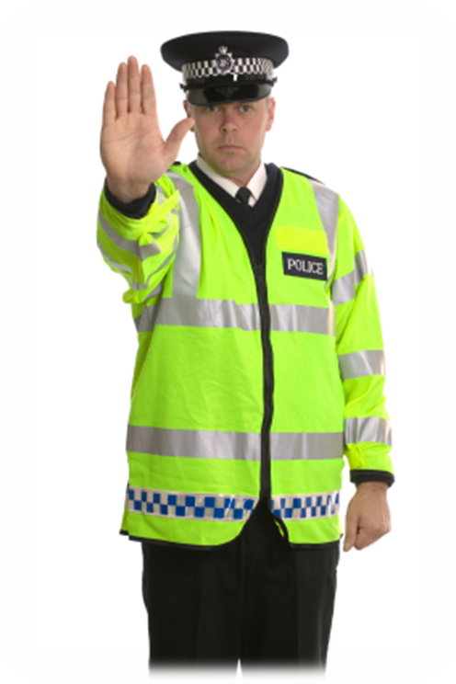
Obedience - definition
Obedience is a form of social pressure, but unlike conformity it normally involves a direct command or instruction. Conformity results from peer pressure, obedience often is the result of an authority figure telling you what to do.
Notes:
Pupils should copy the definition into their jotter

Slide 103
Obedience - definition
Obedience is normally a useful thing, as following instructions and rules helps society to function. However, problems arise when an authority gives a harmful instruction and people obey it.
What could this be an example of?
Notes:
Pupils should copy the definition into their jotter

Slide 104
Obedience
One of the biggest questions for social psychologists since the mid-20th century has been why people followed instructions to commit atrocities such as the Nazi Holocaust.

Slide 105
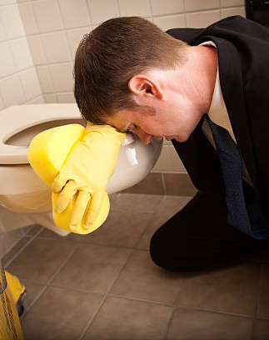
Obedience
If your boss at work tells you to clean the toilet – you will probably do it, even if you don’t really think it’s fair that you should have to.
What is this similar to? (think conformity!)

Slide 106
 | Conformity | Obedience
What is it? | Going along with the crowd/yielding to group pressure | Changing our behaviour to follow the demands of an authority figure
Who ‘asks’? | Nobody actually has to ask! We act to please peers, friends, social group, or to resolve ambiguity. | Authority figures: parents, teachers ,police, government etc.
Why do we do it? | To be accepted, liked or just to fit in, to avoid feeling silly or in a situation when we don’t know what to do. | To avoid punishment or unpleasant consequences
Why is it not conformity?

Slide 107
Group Task
Think of real life examples that can be applied to obedience to support the ideas presented in the table.

Slide 108
Discuss with your partner
Would you pick up a piece of litter if told to do so by a fellow student?
What about if I told you to pick it up?
The head teacher?
If it was a fellow student, would it matter what year they were in – if they were older or younger than you?
Think about why you answered in the way you did
Notes:
Pupils should discuss and prepare to feedback

Slide 109
Factors affecting Obedience
Effects of society
Perceived legitimate authority
Autonomous vs agentic levels of behaviour
Socialisation
Authoritarian parenting
Effects of the situation
Proximity
Location
Wearing uniform

Slide 110
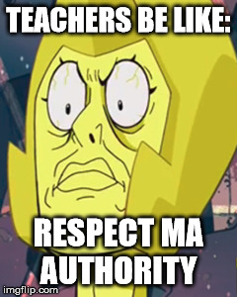
Perceived legitimate Authority
Many parts of society are structured as hierarchies, meaning that people in lower ranks or status are expected to obey those in higher positions, for example teachers and managers. These people are considered to be legitimate authority figures.
Notes:
Pupils should copy the Bickman (1974) study into their jotter for reference

Slide 111
Perceived legitimate Authority
Sometimes, the legitimacy of an authority figure is not clear. Someone might give you an order and you might be unsure of whether you need to listen to it or not.
Can you think of any examples of when this might be?
Student teachers, baby sitters, someone who has worked in your workplace for longer but is in the same position as you, etc.
Notes:
Pupils should copy the Bickman (1974) study into their jotter for reference

Slide 112
Legitimate Authority
Discuss with your partner who are the legitimate authority figures in your life?

Slide 113
As a group try and think of reasons why we obey those who we perceive to be legitimate authority figures?

Slide 114
Autonomous vs Agentic state
Milgram believed that one of the reasons we obey those who we perceive to be legitimate authority figures is due to the mental state which we find ourselves in.
When we are in an autonomous state of mind we are able to act based on our own wishes. However, at times of stress and conflict, there is a tendency to look to for the person in charge and follow their orders. This happens because we are used to hierarchies in society where there are both leaders and followers.
Notes:
Pupils should copy the definition into their jotter

Slide 115
Autonomous vs Agentic state
When people are under moral strain, they relinquish their own moral responsibility and act on the basis of the authority figure’s commands. At this point they leave behind their autonomous state and enter into an agentic state.
Autonomous state: seeing yourself as being in power, acting on your own wishes and morals.
Agentic state: seeing another person as having power; acting on behalf of their principles/commands.
Notes:
Pupils should copy the definition into their jotter

Slide 116
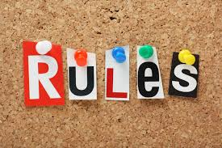
Socialisation
One of the reasons that people find themselves entering into an agentic state is because society has taught us to respect and obey authority figures.
When you are growing up you learn the rules of society, including who is considered to be an authority figure and who isn’t.
What kind of rules did you learn?
Notes:
Pupils should copy the definition into their jotter

Slide 117
Socialisation
The effect of childhood experiences on making us behave according to according to social norms is called ‘socialisation’.
It is the result of collective social pressures from family, teachers, peers and anyone else significant in our life when we are growing up.
Notes:
Pupils should copy the definition into their jotter

Slide 118
Parenting
One of the biggest influences on a child’s socialisations is its parents. The way we are raised has a massive influence on how likely we are to obey as we grow up and when we are adults.
Can anyone think how parenting may affect if someone is likely to obey or not?
Notes:
Pupils should copy the definition into their jotter

Slide 119
Parenting
It is hard to put parents into one category, this may change as their children grow up, or as different situations emerge.
Also as we grow older our peers start to have a lot more influence on us than our parents do.
However, it is thought that the beliefs about the world that we learn in childhood tend to stay with us.
Notes:
Pupils should copy the definition into their jotter

Slide 120
Parenting
There are two different styles of parenting; democratic parenting and authoritarian parenting.
Democratic parents allow their children to think for themselves and make rational choices. Rules are not absolute, children are encourages to negotiate boundaries.
Authoritarian parents teach their children being obedient and having respect for authority is top priority. They do not allow rules to be discussed.
Notes:
Pupils should copy the definition into their jotter

Slide 121
Practice question
“Explain 3 factors which affect obedience” (9 marks)
Notes:
Pupils should copy the definition into their jotter

Slide 122
Effects of the situation
We like to believe that we have choice over our actions and that whether we obey an immoral command or not is is due to our own moral values.
However, research has shown that people don’t obey because of their personality, but because of the social situation they find themselves in.
Before we can discuss the effects of the situation we need to understand the Migram study.
Notes:
Quickly go over Milgram, will take notes later.

Slide 123
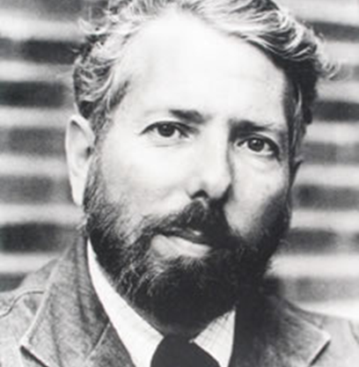
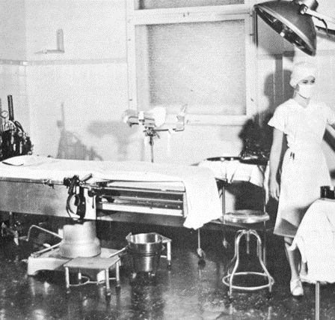
Research into Obedience

Slide 124
Milgram’s Study of Obedience (1963)
Milgram believed orders can result in a clash between a person’s morals and the social situation, and he wanted to discover through his experiment, if there was something uniquely obedient about Nazi soldiers and concentration camp guards during the Second World War.

Slide 125
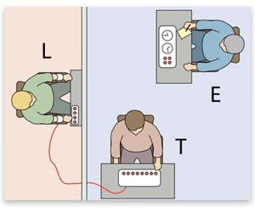
Milgram’s Study of Obedience (1963)
Milgram devised an experiment in which participants were asked to deliver increasing levels of electric shocks on the demand of an experimenter – although the shocks would be faked, the participants would think they were real.

Slide 127
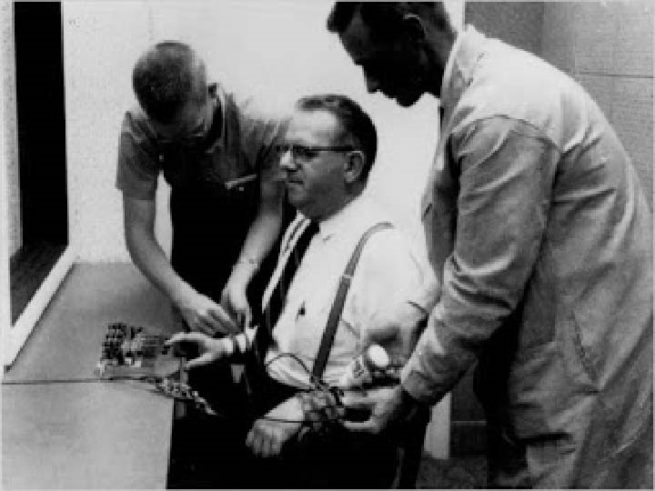

Slide 128
The premise of the study
There is a teacher and a learner
The learner is strapped to a chair with electric shock plates.
The learner answers Qs
For any incorrect answers the teacher must give an electric shock by pressing a switch on a generator
For each incorrect answer the voltage of shock must be increased
From 15 to 450 Volts

Slide 129
The premise of the study
The TEACHER heard a dialogue from the LEARNER next door
Statements including
“Ow, I can’t stand the pain. Don’t do that”
“Let me out of here. My heart’s bothering me!”
“Let me out - my heart’s bothering me, let me out!”
After this the LEARNER falls ominously Silent (as if he is dead!)
The experimenter encourages the teacher to continue:
Prod 1: please continue.
Prod 2: the experiment requires you to continue.
Prod 3: It is absolutely essential that you continue.
Prod 4: you have no other choice but to continue

Slide 130
Milgram’s Study of Obedience (1963)- RESULTS
Results: 65% (two-thirds) of participants (i.e. teachers) continued to the highest level of 450 volts. All the participants continued to 300 volts.
Before the study – Milgram asked experts how far people would go – the consensus was that most pps would stop at 150 volts

Slide 131
Effects of the situation
Milgram believed that Nazi soldiers were no different from anyone else and if any of us were put in the situation that the Nazi soldiers were we would also respond in the same way.
According to Milgram there are certain different factors that would affect obedience. He repeated his experiment 20 times, using 40 different participants each time.
Notes:
https://youtu.be/y6GxIuljT3w

Slide 132
Location
What is it?
Location relates to where the experiment is carried out and the prestige of this location (e.g. a university is more prestigious and conveys a more legitimate impression than a run down office block.
What is its effect?
Location should have the following effect: obedience should be higher in a more prestigious and legitimate location, BECAUSE ps’s are likely to feel the experiment is more important and feel like they should obey.

Slide 133
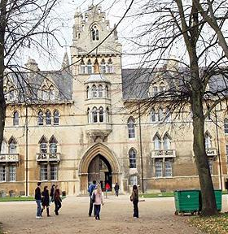
Research
Evidence for factor: Milgram – variation of same experiment, but carried out in run down office block instead. Obedience drops to 47.5%
CONCLUSION: This suggests that the location and prestige of location influences obedience, as a location which is more legitimate leads to increased obedience.

Slide 134
Proximity to victim
What is it?
Proximity refers to the distance between the teacher and the learner (e.g. the teacher and learner being in different rooms as in the original study)
What is its effect?
Proximity should have the following effect: obedience should be higher when the teacher cannot see the learner, as they will be able to ignore the ‘pain’ they are causing.

Slide 135
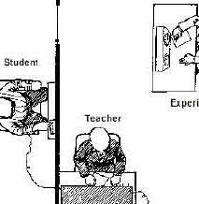
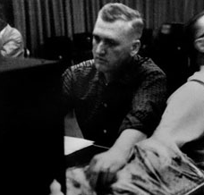
Research
Evidence for factor: In the original study, the teacher and learner (victim) were seated in separate rooms. But in this variation they were seated in the same room. The obedience level dropped to 40%.
Conclusion: This suggests the teacher being able to experience the pain/consequences being inflicted on the learner directly will reduce obedience.

Slide 136
Proximity to authority
What is it?
Proximity refers to the distance between the teacher and the experimenter (e.g. the teacher and experimenter being in the same room as in the original study)
What is its effect?
Proximity should have the following effect: obedience should be higher when the teacher is in direct contact with the experimenter.

Slide 137
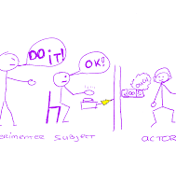
Research
Evidence for factor: Milgram created another variation of his study which involved the experimenter giving the demands over the phone. The majority defied the experimenter and only 21% gave the maximum shock level.
CONCLUSION: This suggests that without a physical authority figure present the teacher felt less pressure to obey. They may have considered themselves under less scrutiny which led to feeling less fear.

Slide 138
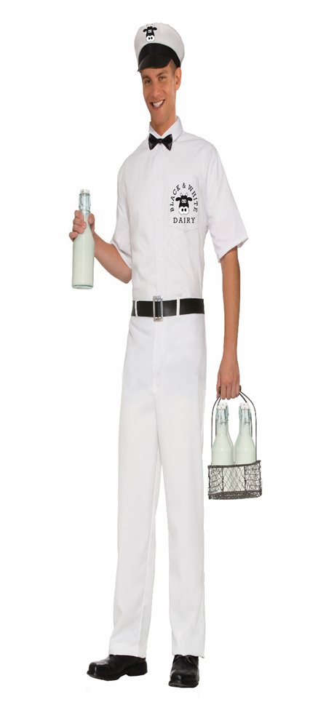
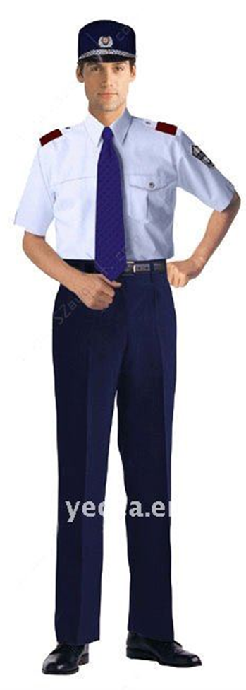
Pick up that litter!
Give him a dime
Wearing a uniform
Bickman (1974)
Notes:
Bickman (1974) conducted a study where actors gave orders to passers-by, such as ‘pick up that litter’ or ‘give that person a dime’. There were three conditions – actor dressed as security guard, in a milkman’s uniform or in casual clothes. The security guard outfit led to the greatest level of obedience – even though a security guard is not a legitimate authority, their uniform conveyed a sense of power and authority.

Slide 139
Research for wearing a uniform
Bickman (1974) conducted a study where actors gave orders to passers-by, such as ‘pick up that litter’ or ‘give that person a dime’. There were three conditions – actor dressed as security guard, in a milkman’s uniform or in casual clothes. The security guard outfit led to the greatest level of obedience – even though a security guard is not a legitimate authority, their uniform conveyed a sense of power and authority.
Notes:
Pupils should copy the Bickman (1974) study into their jotter for reference

Slide 140
Back to Milgram
He asked his colleagues, researchers and PhD students whether people would obey, and most said only a tiny minority of people would, and these people would be psychopaths.
Experts predicted that American participants would not obey immoral instructions, but his volunteers proved highly obedient to authority.

Slide 141
Milgram’s Study of Obedience (1963)- Conclusion
Ordinary people are extremely obedient to authority, even when asked to behave in an inhumane manner. It is not evil people who commit atrocities, but ordinary people obeying authority.

Slide 142
Confidentiality Deception Consent
Debrief
Right to withdraw
Protection from harm

Slide 143
Evaluating the Study – Ethical Issues
Informed consent –
Right to withdraw:
Protection from harm:
Deception:
Informed consent – was not obtained from pps – this means they weren’t aware of what they were going to be doing.
Right to withdraw: If pps tried to leave the experimenter issues a number of prods to make them continue
Protection from harm: Milgram’s pps suffered from stress of the experiment, one even had convulsions – no long term effects reported but still the case that ppl had to live with the knowledge that they would have obeyed to the extent of killing someone!
Deception: PPs had to be deceived in order to avoid demand characteristics, this raises the issue of whether pps would still have been happy to take part if they knew what the study was really about beforehand.

Slide 144
Evaluating the Study – Methodological Issues
Sample was purely American men this means that we cannot necessarily generalise results and assume all people will behave in the same way – however, the study has been replicated across cultures and found similar results.
Potentially the pps may have displayed demand characteristics, having guessed the experimental hypothesis – however a lot was done to convince pps that the experiment was really about learning, so this seems unlikely
Lacks mundane realism- not an everyday obedience task
Low ecological validity- lab environment

Slide 145
Milgram’s Study of Obedience (1963)
Although Milgram’s study was an interesting display of obedience, the experiment lacked ecological validity – in that it might not be comparable to everyday life.
Orne (1962) doubted that the participants believed the electric shocks, and predicted such a high level of obedience in the face of true harmful consequences would not exist in the real world.

Slide 146
Milgram’s Study of Obedience (1963)
Work with your group to discuss Milgram’s study of obedience.
Explain the method of his study.
Outline his key findings
Can you see any problems with the study?
Fill out the study summary for Milgram’s experiment
Notes:
Pupils should also use pages 50 of Oxford Revision guide and pages 24&25 of Psychology A Level to help with evaluation

Slide 148
Hofling et al (1966)
However, Hofling et al (1966) found a very high level of obedience in a real world situation, through a field experiment using nurses.
A fake drug labelled ‘Astroten’ was left in the ward and each nurse received a phone call from an unknown doctor, calling himself ‘Dr Smith.’
The doctor told the nurse to prepare a dose of the drug (which was double the maximum dosage indicated on the label) and give it to a patient, ‘Mr Jones’.
Despite having the opportunity to refuse, 21 out of 22 nurses prepared the medication and they were going to administer it until stopped by the experimenter.
Notes:
Pupils should copy the Hofling et al (1966) study into their notes.

Slide 149
Zimbardo et al (1973)
Another experiment, the Stanford Prison Experiment conducted by Zimbardo et al also shows the importance of the situation. Here student volunteers were randomly divided into two groups – prisoners and guards – and put into a mock prison (in the basement of the university).
The researchers observed the students changing their behaviour to suit their new roles, with prisoners becoming demoralised and depressed, while many guards became aggressive and demeaning, and used their power to humiliate the prisoners.

Slide 150
Real life implications
Abu Ghraib
In 2003 The USA invaded Iraq under the belief from CIA intelligence that there were weapons of mass destruction present in the country. US troops took control of Abu Ghraib prison near Bagdad in April of 2003, then in January of 2004 Army Specialist Joseph Darby handed over a computer disc to a military investigator containing pictures of abuse taking place at Abu Ghraib.
In April 2004 CBS decided to broadcast the pictures of the abuse, this caused an international uproar with the Bush administration condemning the abusive soldiers as a few bad eggs.

Slide 151
Real life implications
Abu Ghraib
The abuse which took place at Abu Ghraib was similar to behaviours which were seen during Zimbardo’s Stanford Prison experiment.
Milgram’s (1963) obedience study can also be used as a possible explanation for why the behaviour of the soldiers at Abu Ghraib was so extreme. The soldiers claimed that they were told by superiors to ‘soften up’ the prisoners; however the army denied this

Slide 152
Exam Questions
Explain two factors related to obedience that influence behaviour. (6 marks) – specimen
Evaluate strengths and weaknesses of Milgram’s studies of obedience. (8 marks) – specimen
Explain the concept of obedience, referring to research evidence and factors that affect behaviour. (20 marks) - textbook

