Slide 1
Relationships
Higher Psychology

Slide 2
Evolutionary theory
Filter theory
Social exchange theory
Rusbult’s investment theory
01
Virtual relationships in social media
03
McKenna and Bargh et al (2002) – Absence of gating
04
Parasocial relationships
05
Buss (1989) ‘Sex differences in human mate preferences’
02

Slide 3
What do you know about love?

Slide 4
One study on the psychology of love has found that over ______ years of marriage the facial features of couples became more similar, as judged by independent observers.

Slide 5
One study on the psychology of love has found that over 25 years of marriage the facial features of couples became more similar, as judged by independent observers.

Slide 6
A new three-year study finds that divorce rates were more than halved by ________

Slide 7
A new three-year study finds that divorce rates were more than halved by watching movies about relationships and discussing them afterwards.

Slide 8
Wolves, swans, gibbons, black vultures, albatrosses and termites have what in common?

Slide 9
Wolves, swans, gibbons, black vultures, albatrosses and termites have what in common?
They all find a mate for life – monogamy

Slide 10
It takes ____ minutes to decide if you like someone.

Slide 11
It takes 4 minutes to decide if you like someone.

Slide 12
Research has found that couples who are in love and bond in a romantic relationship synchronize their _______ after gazing into each others’ eyes for three minutes.

Slide 13
Research has found that couples who are in love and bond in a romantic relationship synchronize their heart rates after gazing into each others’ eyes for three minutes.

Slide 14
Falling in love is much like taking a dose of _____, as both experiences affect the brain similarly and trigger a similar sensation of euphoria.

Slide 15
Falling in love is much like taking a dose of cocaine, as both experiences affect the brain similarly and trigger a similar sensation of euphoria.

Slide 16
Oxytocin, the so-called love or cuddle hormone, is produced during an embrace or cuddle. Research has found that a dose of oxytocin decreases ______ significantly, and for some it even makes the pain go away completely after 4 hours.

Slide 17
Oxytocin, the so-called love or cuddle hormone, is produced during an embrace or cuddle. Research has found that a dose of oxytocin decreases headaches significantly, and for some it even makes the pain go away completely after 4 hours.

Slide 18
Research shows that long-term couples with deep, strong connections can successfully soothe each other in stressful situations or when one of them experiences pain simply by ______.

Slide 19
Research shows that long-term couples with deep, strong connections can successfully soothe each other in stressful situations or when one of them experiences pain simply by holding hands.

Slide 20
_______ show your attraction to someone and makes you more attractive

Slide 21
Dilated pupils show your attraction to someone and makes you more attractive

Slide 22
One study of more than 5000 people found that one in every 50 people found their soul mate on ______

Slide 23
One study of more than 5000 people found that one in every 50 people found their soul mate on a plane

Slide 24
On a piece of paper answer the questions.
Answer the best you can from personal experience, they will remain private so be honest!
Put your answers in the envelope provided and seal it
We will look back on these at the end of the unit to see how the theories fit.
Thinking about your current or desired partner, why do you like them? What drew you to them and why did you start to date?
What is the most important thing you may gain from this relationship
What would make you break up with this person?
Do you believe in love? Describe love in a couple of sentences.
Do you believe you will get married one day? What will that decision be based on?
Draw a picture of your partner. Describe their physical features.
5 Minutes

Slide 25
Evolutionary theory

Slide 26
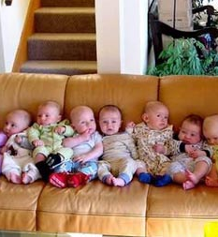
Evolutionary theories
The evolutionary approach suggests we have a basic need to form social relationships.
This is shaped by Darwinian natural selection. It implies people will engage in behaviour which will maximise their reproductive success, whether this is producing a lot of offspring, or fewer offspring who can be cared for well.

Slide 27
Evolutionary theories
One of the implications of evolutionary theory is that physical attractiveness ‘advertises’ an individuals fertility and therefore, males in particular seek physically attractive mates to ensure their reproductive success.

Slide 28
Individual task
Before we begin to look at the differences of parental investment, take some time to complete the two tables found on page 5 of your booklet.

Slide 29
Different parental investment
Parental/reproductive investment means investing resources in raising offspring at a cost to the parent.
One aspect of the evolutionary theory is that for biological reasons, males and females invest different amounts of resources in having and raising children and that these differences have led the two sexes to evolve different behavioural strategies in terms of relationships (Trivers, 1972).
Human females biologically invest a great deal more in their offspring than males, being pregnant for nine months (with considerable health risks to themselves involved), typically followed by a period of breastfeeding.
This differential parental investment is increased if the mother is also the main caregiver.
Notes:
Pupils should take notes

Slide 30
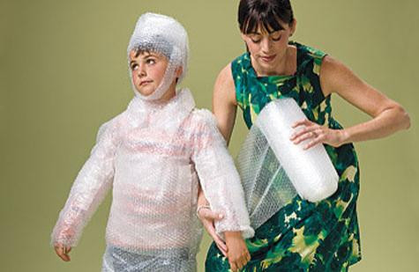
Different parental investment
Another sex difference is that women can have fewer offspring over the lifespan than a man can, meaning that, theoretically, the best evolutionary strategy, in terms of survival of her genes would be to look after the children well and seek a partner who is willing to provide support.
Notes:
Pupils should take notes

Slide 31
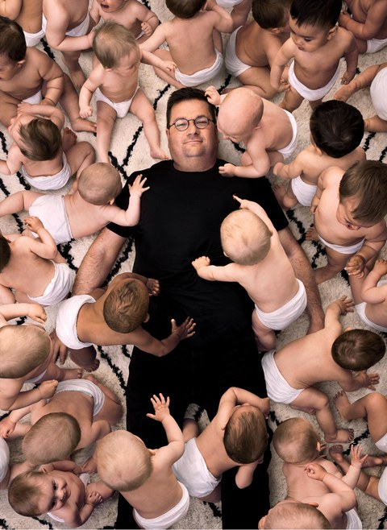
Different parental investment
Male reproduction is less constrained biologically and males could potentially have large numbers of offspring with many women – but doing so might come at a cost in terms of reduced ability to care for the children, thus not ensuring their survival.
Notes:
Pupils should take notes

Slide 32
Individual task
Anisogamy refers to the differences between male and female sex cells.
Read page 6 and the start of page 7 to ensure you are clear about the differences.

Slide 33
Selecting a partner
Evolutionary theorists believe anisogamy is also important in selecting a partner. They believe there are two different mating strategies.
2. Intrasexual Selection – this is within each sex – such as the strategies between males or between females to be the one that is selected.
1. Intersexual Selection – this is between the sexes, the strategies that males use to select females or females use to select males.

Slide 34
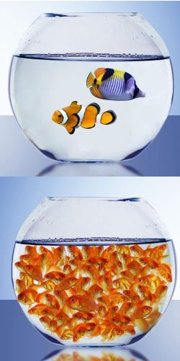
Intersexual Selection
Intersexual selection refers to the preference a person of one sex has for a person of the opposite sex due to certain qualities.
This is the preferred strategy for females.
Quality over quantity because the consequence of making the wrong choice of partner are much more serious for the female than for the male.

Slide 35
Intersexual Selection
A women may have historically been more likely to choose a partner who could provide them with resources such as food, territory and protection.
Doing so will enhance her child’s chance of survival.
This might not be the case in modern times. What might a women look for now?

Slide 36
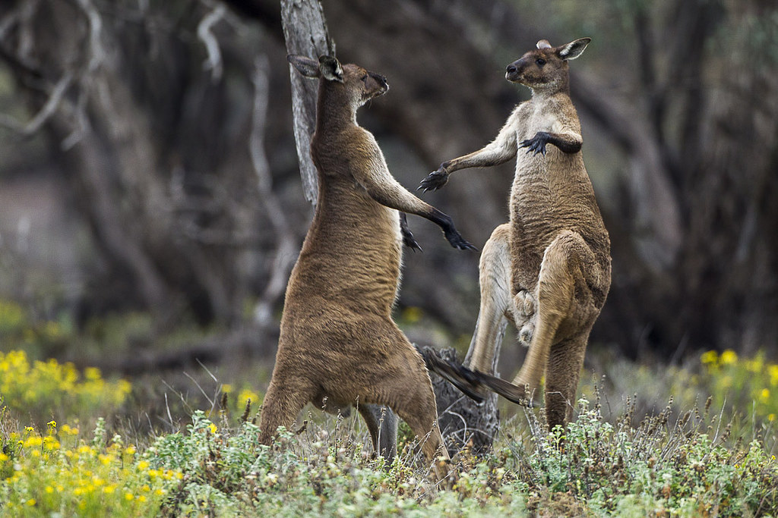
Intrasexual Selection
Intrasexual selection refers to the competition between males to be able to mate with a female.
This is the preferred strategy for males. Quantity over quality because the more opportunity a male has to reproduce the higher the chances he will have off spring who will survive.

Slide 37
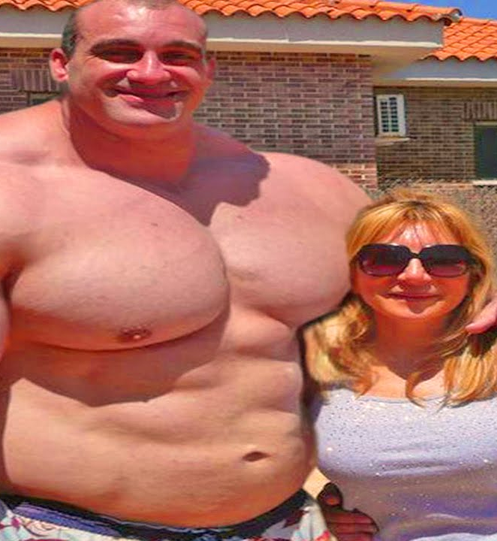
Intrasexual Selection
The differences between the two preferred selection methods is thought to be a reason for the obvious differences between the sexes.
For example – in most physical competitions between males, size matters. Larger males have the advantage and therefore likely to mate. On the other hand, females do not compete for reproductive rights so there is no evolutionary drive towards favouring larger females.

Slide 38
Individual task
Complete the task on Page 9 of your booklet.

Slide 39
Mandatory study
Buss (1989)
‘Sex differences in human mate preferences’

Slide 40
THIS IS BUSS…
How can I find out about male and female mate preferences
I know, I’ll do a questionnaire
…HE’S INTERESTED IN FINDING OUT WHAT MEN AND WOMEN GO FOR IN A MATE

Slide 41
Fill in your age, gender and marital status
17, Female, single
32, Female, Married
29, Male, single
25, Male, single

Slide 42
Buss also asked participants to say…
At what age they wanted to marry
How big they like the age gap to be between themselves and their partner
How many children they want
How important 18 characteristics were to them, including…
Good job
Good looks
Chastity
Ambition
Which characteristics were most desirable including…
Good earning capacity
Physical attractiveness

Slide 43
Let’s go to Europe, America, Africa, Iran, New Zealand, and many more…
Let’s go and see if we get different results in other cultures
Pack your bags and hold tight…

Slide 44
MANY DIFFERENT TYPES OF PEOPLE WERE USED…
…AND THEY WERE GAINED USING DIFFERENT SAMPLING TECHNIQUES

Slide 45
Buss used 37 samples from 33 countries

Slide 46
In all 37 samples males and females preferred the male to be older
In 36/37 samples women rated good financial prospects higher than men did
In all 37 samples men rated good looks in their mate more than women

Slide 47
Good financial prospects was rated low in the Netherlands and Great Britain
In 34 samples we rated ambition as more important than men did
This was high in Indonesia and Nigeria

Slide 48
In Scandinavian countries chastity was seen as irrelevant
Good looks were particularly important for men in Bulgaria and Nigeria
But China, India and Indonesia see this as important

Slide 49
Wow, that was a big study! Time for a cup of tea!

Slide 50
Comparing Buss to other studies.
Clark & Hatfield (1989) – Attractive person asks 3 questions and noted who said yes.
Would you go on a date with me? Males – 50%, Females – 50%
Would you go back to my apartment? Males – 69%, Females – 6%
Would you have sex with me? Males 75%, Females – 0%
Chang (2011) compared partner preferences over 25 years and found that some changes and others stayed the same. Maybe a combination of evolutionary and cultural influences.
Waynforth & Dunbar (1995) looked at 900 lonely hearts adverts. Found that women described their physical qualities and indicators of youth and men described the resources they could provide.
Notes:
Pupils should take notes

Slide 51
Individual task
Complete the evaluation on Page 11 and 12 of your booklet.
Work through pages 14-17 to increase understanding of Inter/Intrasexual selection.
Fill in first 3 key terms.
This will be marked when completed.

Slide 52
Attractiveness

Slide 53
Attractiveness
Evolutionary explanations of attractiveness state that traits associated with attractiveness act as indications of good health.
Therefore, choosing an attractive partner is the best way of ensuring a healthy partner and a healthy child.
Why is perceived health an advantage when selecting a partner?

Slide 54
Attractiveness
Firstly, that partner is going to be physically able to bear children (women) or provide for the family (men).
It also means that there is a good chance that the genes that they carry will produce healthy offspring.

Slide 55
Individual task
What do you consider attractive and unattractive traits.
Complete the tasks on Page 18 & 19

Slide 56
Attractiveness
What influences if we find someone attractive?
Good looks
Money
Personality

Slide 57
The Halo Effect
Physical attraction is powerful enough in itself, however it also influences the assumptions we make about potential partners.
An example of the Halo Effect would be judging a good-looking person as more intelligent. Lesser criminal sentences.

Slide 58
Support for the Halo effect
Palmer and Peterson (2012) – Attractive people seen as more politically knowledgeable and competent than unattractive people.
How could this cause problems?
Notes:
Pupils should take notes

Slide 59
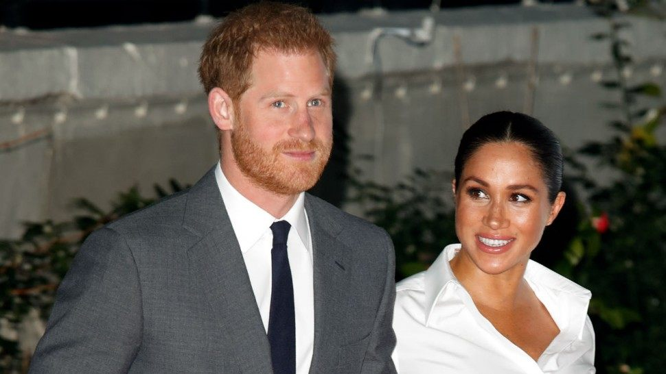
Similarity - Matching hypothesis
The theory that people will tend to select romantic partners of the same level of physical attractiveness as themselves
This is because the choice of a potential partner may be affected by the likelihood of success in the relationship as well as desirability
In other words, people tend to make realistic choices

Slide 60
Similarity - Matching hypothesis
The more desirable a person is in terms of attractiveness, social standing etc the more desirable they would be expected to be in a relationship
It is thought that couples who are matched are more to have happy, enduring relationships

Slide 61
Analyse Buss (1989)
Link – Evolutionary theory (sexual selection, parental investment). Matching hypothesis.
Compare – Clark & Hatfield (uni campus) and Waynforth & Dunbar (lonely hearts ad)

Slide 63
Pairs task
Look at the 6 Tinder Profiles.
As part of a group, match the female to the male that you think they would choose based on the matching hypothesis.

Slide 64
Evaluation of the Matching Hypothesis
Support
Feingold (1988) – meta-analysis of 17 studies showed correlation between attractiveness and romantic partners in real life.
Against
Walster (1966) – Computer dance study. Information about themselves put into a computer to produce an ‘ideal match’ date. They were actually just randomly assigned to someone. After spending two hours with their date students were asked how much they liked their partner.
Those who were physically attractive were liked the most. Men asked out a partner if they found her attractive, regardless of how attractive they were.
Notes:
Pupils should take notes

Slide 65
Individual task
Complete the evaluation on attractiveness found on pages 22-23 of your booklet.

Slide 66
Filter Theory

Slide 67
Filter Theory
When choosing a partner, people start by looking at the options that are available.
However, not everyone who is available will be equally attractive, so people usually apply some criteria to narrow down the ‘pool of availabilities’ to make sure they choose the right person.

Slide 68
Pairs task
What would be your criteria for narrowing down the ‘pool of availabilities’

Slide 69
Filter Theory
Kerckhoff and Davis (1962) studied student couples (mainly in short-term relationships of fewer than 18 months) and discovered several important criteria people use to choose a partner. They call these criteria ‘filters’, as they help people to sift through all potential partners to choose the right one.

Slide 70
Filter Theory
The first level is that of sociodemographic characteristics.
The second level of filters that relates to similarity of attitudes.
The third filter, complementarity, plays a much more important role in long term relationships

Slide 71
Filter Theory
The first level is that of sociodemographic characteristics,
physical proximity,
level of education,
social class,
religion

Slide 72
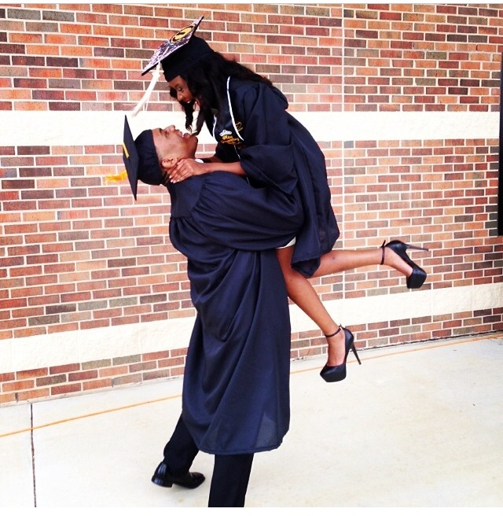
Filter Theory - Sociodemographic characteristics
These factors are important, because people are more likely to build relationships with people who are geographically close, and whom they are meeting frequently, as this gives them a greater chance to find out more about one another.
People also find similarities in education, social class and religious beliefs attractive, as this gives them assurance that relationships are more likely to move forward.

Slide 73
Filter Theory
The second level of filters that relates to similarity of attitudes,
Views on careers,
Importance on family,

Slide 74
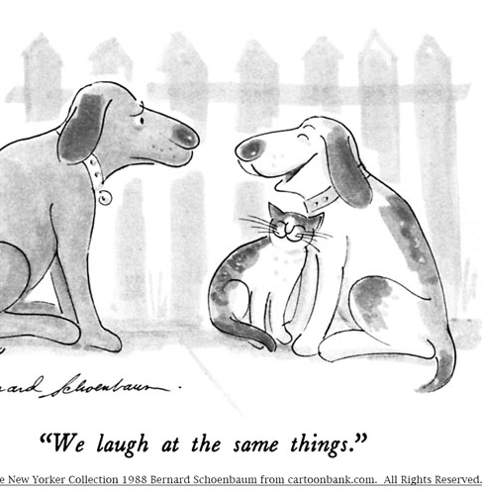
Filter Theory - Similarity of attitudes
People tend to view others as more attractive if they share the same core beliefs and values.
Byrne (1997) noted that similarity of attitudes is especially important in earlier stages of relationships, for couples who have been together fewer than 18 months. Presence or absence of similarities is discovered through self-disclosure, which leads to greater feelings of intimacy in a couple. If partners have very little in common, however, relationships rarely develop beyond the first few dates.

Slide 75
Filter Theory
The third level, complementarity
One has traits that the other one lacks
Opposites attract

Slide 76
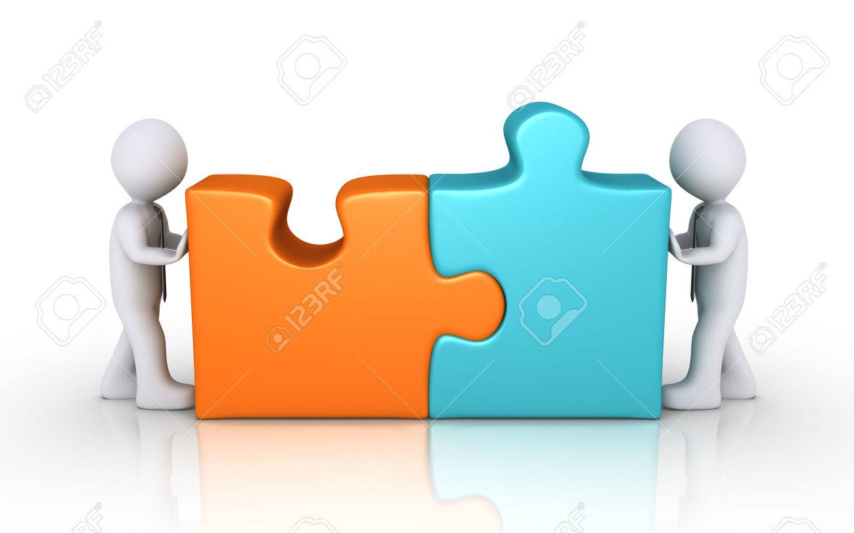
Filter Theory - Complementarity
If similarities are crucial at the early stages of relationships, it seems that for long-term couples the third filter, complementarity, plays a much more important role.
Complementarity refers to each of the partners having some traits that the other partner lacks, and helping each other to fulfil their needs.
For example, one partner may enjoy meeting new people and being socially proactive, and the other may enjoy being introduced to people rather than initiating social encounters themselves, and thus these two people would complement one other.

Slide 77
Evaluation of The Filter Theory
Support
Festinger et al (1950) Observed friendships formed in a block of apartments. Students were 10x as likely to form a friendship with people who lived in their own building, rather than the other 16. Most popular next to staircases and post-boxes.
In another study, Newcomb (1961) offered participants free accommodation for a year. They were assigned a room mate, and he found that a stable friendship developed if roommates had a similar background and similar attitudes to life.
Against
Levinger (1974) said 18 months cut off doesn’t define a more committed, deeper relationship. Only been investigated in heterosexual couples not homosexual.
Anderson (2003) found that people aren’t attracted to each other because they are similar but that people who live together grow to become more similar over time. Don’t go out with people who are similar to us but become more similar over time/
Notes:
Pupils should take notes

Slide 79
Try to work out the five factors Kerckhoff and Davis highlighted as being important in the filtering process. Match up the key term, the definition, and the symbol to help you remember.
Put the filters in order of importance, most important first!
Factor | Description | Revision Aid

Slide 80
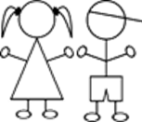
Factor | Description | Revision Aid
Similarity | Most people will come into contact with people from the same social or cultural background. This can also be the case for internal characteristics such as attitudes, or personality traits.
Complement of Needs | Most people will form a relationship with people close to them geographically. This is mainly due to chance they will meet, speak or generally become aware of one another.
Proximity | How good looking someone is has been found to be one of the most important factors in initial relationship formation, as well as longer lasting relationships.
Physical Attraction | How intelligent and competent one appears can be influential in how attractive they are.
Competence | Not all personality characteristics need to be the same, we are often attracted to people who can give us what we lack. A dominating person may like a submissive person.
7/10
7/10

Slide 81
Factor | Description | Revision Aid
Proximity | Most people will form a relationship with people close to them geographically. This is mainly due to chance they will meet, speak or generally become aware of one another.
Physical Attraction | How good looking someone is has been found to be one of the most important factors in initial relationship formation, as well as longer lasting relationships.
Similarity | Most people will come into contact with people from the same social or cultural background. This can also be the case for internal characteristics such as attitudes, or personality traits.
Complement of Needs | Not all personality characteristics need to be the same, we are often attracted to people who can give us what we lack. A dominating person may like a submissive person.
Competence | How intelligent and competent one appears can be influential in how attractive they are.
7/10
7/10

Slide 82
Filter Theory- Evaluation
One strength of Filter Theory is that it is supported by research studies. For example, Gruber-Baldini et al. (1995) carried out a longitudinal study of couples aged 21 and found that those who were similar in educational level and age at the start of the relationship were more likely to stay together and have a successful relationships.

Slide 83
Filter Theory- Evaluation
This demonstrates the importance of sociodemographic factors, such as age and location, supporting the idea that people are more likely to meet and build relationships with people who are geographically close and share similarities in terms of age, education, etc..

Slide 84
Filter Theory- Evaluation
One weakness of Filter Theory is people nowadays are more able to develop relationships with someone who is not in their geographical proximity or from the same culture through the use of social media etc.

Slide 85
Filter Theory- Evaluation
This may mean sociodemographic factors, in particular, may not play as big a role in the development of relationships nowadays, as the development of technology, (such as dating websites and apps) greatly affects modern relationships compared with 20-30 years ago.

Slide 86
Question
“Evaluate both the Evolutionary theory of relationships and the Filter theory of relationships” (8 marks)
Try and give at least 1 strength and 1 weakness for both theories.

Slide 87
Evaluate both the Evolutionary theory of relationships and the Filter theory of relationships” (8 marks)
A strength of the evolutionary theory is it can give an explanation of why relationships begin. This is a strength because it gives a clear explanation of every day behaviours.
Another strength of the evolutionary theory is it is backed up by research evidence. Buss (1989) supports the idea that men are more likely to choose their partner based on looks and women are more likely to choose their partner based on financial stability.
A final strength of the evolutionary theory is it gives us an explanation for stereotypical relationships where males are older than the females. This allows the theory to have high ecological validity.

Slide 88
Evaluate both the Evolutionary theory of relationships and the Filter theory of relationships” (8 marks)
A weakness of the evolutionary theory is they do not take into consideration anything apart from heterosexual relationships. Which means their ideas cannot be generalised to the whole population.
A further weakness of the evolutionary theory is that it ignores the impact of social and cultural factors. This makes the theory too simplistic.
A final weakness of the evolutionary theory is it is no longer relevant in this time period. As medical treatments have advanced people who may have been unable to carry a child now can, also women are more prominent in the work place which may mean they no longer need a man who will provide for them.

Slide 89
Evaluate both the Evolutionary theory of relationships and the Filter theory of relationships” (8 marks)
A strength of the filter theory is it is supported by research evidence. Research has found that couples who are in an 18 month long relationship are more likely to have similar social demographics, which supports the idea of the first level of the filter theory.
Another strength of the filter theory is it gives an explanation as to why couples tend to have similar social class, education levels and live close to each other, as the theory predicts this is the first filter in selecting a partner.
A final strength of the filter theory is it gives more details regarding relationships. The third filter ‘complementarity’ explains what keeps people in a relationship.

Slide 90
Evaluate both the Evolutionary theory of relationships and the Filter theory of relationships” (8 marks)
A weakness of the filter theory is that as technology is getting more popular people are able to meet partners who don’t live close to them. Therefore, the theory can’t explain online relationships.
Another weakness of the filter theory is that there is the possibility that we do not choose our partner based on having similar values to us, however, we may end up with similar values after spending time together which could explain why couples in long term relationships seem to have these similarities.

Slide 91
Social Exchange Theory

Slide 92
The social exchange theory
The social exchange theory is an example of what is generally called the ‘economic theories’
Economic theories of relationships emphasise that commitment to a relationship is dependent on the profitability of a relationship i.e. seeking the best deal for oneself.
Supporters of these theories suggest that relationships are like economic transactions – an assessment of the costs and rewards of interacting with others.
They are influenced by the cognitive approach and view humans as essentially rational.

Slide 93
The social exchange theory
This theory was proposed by Thibaut and Kelley (1959) and suggests that human relationships can be looked at as a series of exchanges between partners.
So when we ask someone to go on a date, form a relationship or move into together, we are essentially weighing up what we will gain and what we will lose.
Every individual will try to minimise their costs and get as much benefit as possible out of the relationship.
This might change as the relationship progresses – great familiarity could cause some costs to reduce (e.g. less risk) but also some benefits to reduce (e.g. not new, so less exciting).

Slide 94
Individual task
Think of previous relationships, or a hypothetical relationship and fill in the table below
Rewards | Costs

Slide 95
Task
Rewards | Costs
Love Social Support Childcare Companionship Fun Sex Money Improved reputation | Effort Time Money Missed opportunities with other partners Life experiences Other family Compromising

Slide 96
Comparison Level
Initially, this theory does not explain why people have much more successful relationships than others do and why people stay in bad relationships.
However, Thibaut and Kelley explained that a person judges their relationship against a comparison level (CL), a schema for relationships that is unique to the individual.

Slide 97
Comparison Level
We develop a CL which is a product of our experiences in other relationships and our general expectations
A relationship will form if the potential profit exceeds our CL
What will affect our Comparison Level?

Slide 98
Stages in the development of a relationship
According to Thibaut and Kelley, the costs and benefits of relationships change over time. This leads to a series of four stages that a relationship will progress through:
Sampling.
Bargaining.
Commitment.
Institutionalisation.
Notes:
Pupils to take notes on each area

Slide 99
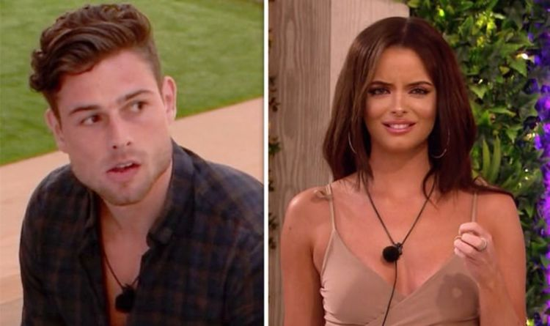
Relationship Development
Sampling
We consider the potential rewards and costs of a relationship and compare it with other relationships available at the time.

Slide 100
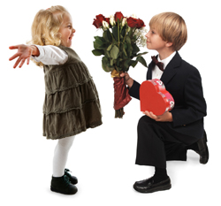
Relationship Development
Bargaining
We give and receive rewards to test whether a deeper relationship is worthwhile.

Slide 101
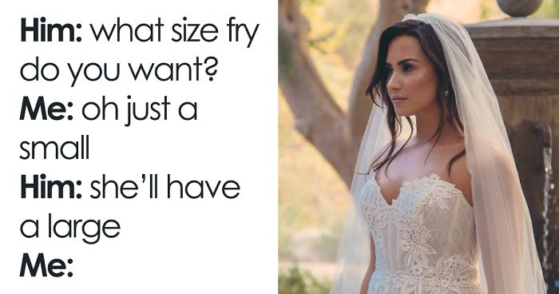
Relationship Development
Commitment
The relationship increases in predictability so each partner knows how to elicit rewards from the other, which lowers costs.

Slide 102
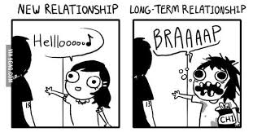
Relationship Development
Institutionalisation
The relationship norms are developed which establishes the patterns of rewards and costs for each partner.

Slide 103
Individual task
Eric and Arianna found each other on an online dating site, and have just spent their first day together in the real world. They are both very keen on each other, and both think the other is very attractive.
But everywhere they went together, Arianna was totting up how much each of them had spent. It was her idea to split the bill in the restaurant. And every time Eric said something nice to her, she had to do the same to him. But Eric just can’t be doing with all that, so he isn’t sure he wants to continue the relationship.
Question
Which of Eric and Arianna is behaving in the ways predicted by the Social Exchange Theory?
Explain which concepts described by SET are particularly important in the scenario and why.

Slide 104
Rusbult’s Investment Theory

Slide 105
Rusbult’s Investment Theory
The Investment Model was put forward by Rusbult et al. (2001), as a development of Social Exchange Theory.
The idea for developing SET further was that many couples stay together despite the costs outweighing the rewards, so there must be some other factors that keep them together.

Slide 106
Rusbult’s Investment Theory
According to Rusbult's proposal, there are three major factors that maintain commitment in relationships:
1. satisfaction level
2. comparison with alternatives
3. investment size

Slide 107
Satisfaction level
Satisfaction level is based on the idea of comparison levels from Social Exchange Theory.
People will have a high level of satisfaction with relationships if they have more rewards and fewer costs.
What might be classed as a reward in a relationship?
Companionship, attention and emotional support etc.
What might be classed as a cost in a relationship?
Arguments and time etc.

Slide 108
Comparison with alternatives
Comparison with alternatives is also based on the idea of comparison levels from Social Exchange Theory.
People will tend to be committed to relationships if, when asking themselves, 'Is there a better alternative to satisfy my needs?' the answer is ‘no’.
Alternatives can include staying on their own and not engaging in romantic relationships at all, as well as finding a new partner.

Slide 109
Investment size
Investment is considered the most important factor.
Investment refers to the number of resources, both tangible, like money or possessions, and intangible, like happy memories, that people will lose if they leave relationships.
The model proposes two types of investment: intrinsic and extrinsic. Intrinsic investment comprises the things we put directly into the relationship, such as effort, money, possessions, self-disclosure. Extrinsic investment refers to the things that are brought to people's life through the relationships, such as children, friends and shared memories.

Slide 110
Rusbult’s Investment Theory
Because both intrinsic and extrinsic investments can potentially be lost if relationships end, Rusbult et al. concluded that the bigger the investment, the more likely people are to stay in relationships. Therefore, it is the investment size that influences commitment to relationships, rather than just the level of satisfaction or existence of potential alternatives.
What might be considered a big enough investment to stay in a relationship?

Slide 111
Rusbult’s Investment Theory
In addition to the factors influencing partners’ commitment, Rusbult et al. also identified maintenance mechanisms partners use to keep relationships going.
These mechanisms are:
Accommodation
Willingness to sacrifice
Forgiveness
Positive illusions
Ridiculing alternatives

Slide 112
Rusbult’s Investment Theory
Accommodation – acting in a way that promotes relationships, rather than keeping a tally of costs and rewards.

Slide 113
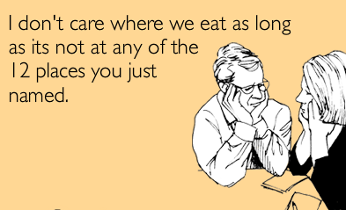
Rusbult’s Investment Theory
Willingness to sacrifice – putting partner's interests first.

Slide 114
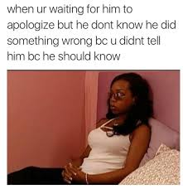
Rusbult’s Investment Theory
Forgiveness – willingness to forgive partner's mistakes, both minor and serious ones.

Slide 115
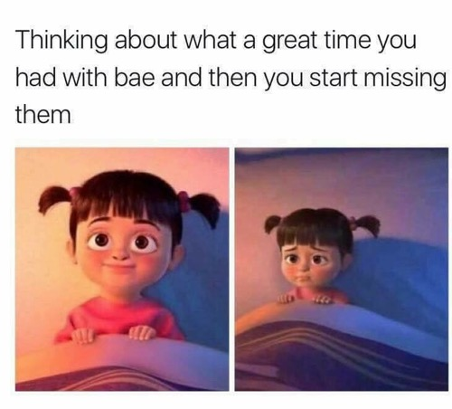
Rusbult’s Investment Theory
Positive illusions – being unrealistically positive about partner's qualities.

Slide 116
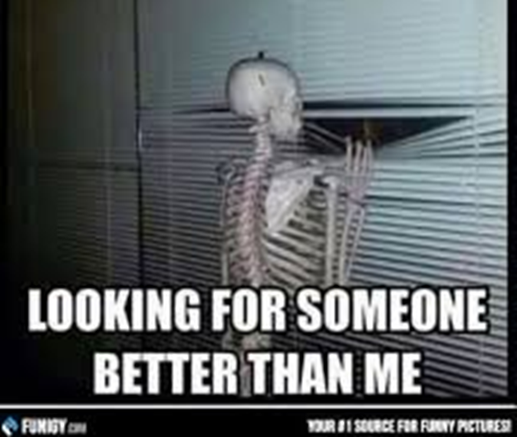
Rusbult’s Investment Theory
Ridiculing alternatives – minimising the advantages of potential alternatives and viewing them in a negative light.

Slide 117
Rusbult’s Investment Theory - Research
Impett, Beals and Peplau (2002) conducted a longitudinal study using a large sample of married couples over an 18 months period. They found that stability of the relationships positively correlated with commitment shown by the partners.
Rhahgan and Axsom (2006) studied a group of women and found that all three factors identified by Rusbult et al. (satisfaction, comparison with alternatives and investment) featured in participants' decision to stay with their partner.
Le and Agnew(2003) conducted a meta-analysis of 52 studies, featuring 11,000 participants in total, and discovered that satisfaction, comparison with alternatives and investment greatly contributed to commitment; and that commitment was a defining feature of long-lasting relationships.

Slide 118
Evaluation
The Investment Model provides a plausible explanation for why people stay in abusive relationships.
According to the model, if a partner feels that the investment they made into relationships will be lost if they leave, they are more likely to stay in a relationship even when the costs are high (such as physical or emotional abuse) and rewards are few.

Slide 119
Evaluation
Some psychologists think that Rusbult’s idea of relationship investment is oversimplified.
For example, Goodfriend and Agnew (2008) argue that it is not just things we bring to the relationships that could count as investment, but also a couple's plans for their future.
In their view, partners will be committed to staying in the relationships because they want to see these plans realised. This shows that investment in romantic relationships is a complex phenomenon, consisting of many different factors, which makes the Investment Model reductionist.

Slide 120
Evaluation
The fact that the evidence for the Investment Model is found across cultures may suggest that the human need for investment and commitment to relationships developed through the process of natural selection to help people survive and reproduce.
For example, parents who are committed to their relationship and invest in it will have a higher chance of ensuring their children's survival and therefore of passing on their genes. This means that the Investment Model supports the nature side of the nature-nurture debate.

Slide 121
Individual task
Use your knowledge of the investment model to complete pages 45 & 46

Slide 122
Virtual relationships in social media

Slide 123
Virtual relationships in social media
During the last decade, social media has increasingly become an important part of everyday life. Websites such as Instagram and Twitter have millions of people logging in every day; many of them communicate daily with people with whom they have never met face-to-face.

Slide 124
Analyse your social media contacts
How many of your social media contacts are actual friends whom you see regularly and how many are just acquaintances?
Design a table to analyse your contacts, adding as many columns as is appropriate for your contacts e.g.

Slide 125
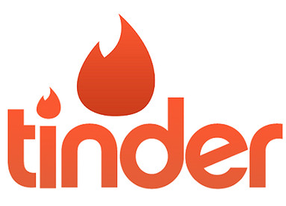
Key Question
Does self disclosure differ between virtual
(computer mediated communication CMC)
And face to face (FtF) relationships?

Slide 126
More SD Less SD
On your tables – can you think of reasons why there might be more and less SD in virtual relationships

Slide 127
More in SD Less in SD
Anonymity
They don’t know
your friends
Time to think about
What to say
Less embarrassment
More editing
Worry of
blackmailling/ trolling
/catfishing

Slide 128
Virtual relationships in social media
One prominent difference between face-to-face and virtual relationships is the fact that self-disclosure tends to occur much faster.
One reason for this is the anonymity associated with online relationships; people tend to hold off disclosing personal information in real life for fear of ridicule or rejection, unless they are confident that they can trust the person and that information won't be leaked to mutual friends. However, there is much less risk of this in virtual relationships, so people can share personal experiences and thoughts without much risk of the intimate information getting to the people they know.

Slide 129
Individual task
What are the potential benefits and dangers of an online friendship?
How many ways can you think of to communicate electronically with someone?
Why are electronic relationships understudied?
Notes:
https://www.dailymotion.com/video/x6ou0c8

Slide 130
CLASS LEAGUE
1st: Column C - 82
2nd: Column E – 71
3rd: Column A – 68
4th: Column D - 55

Slide 131
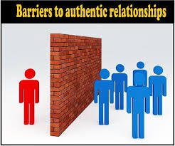
Gating
In real life, our attraction to other people is greatly influenced by their appearance, mannerisms and factors such as age and ethnicity, limiting our choice of potential partners.
In virtual interactions, however, these barriers ('gates') are absent; this creates more opportunities for shy and less attractive people to develop romantic relationships. Even when these factors are discovered later, when relationships move from virtual to the face-to-face phase, they rarely decrease an already-developed attraction, as a result of the feeling of intimacy brought by more open self-disclosure.
The absence of gating also means that people can establish virtual identities they could never create face-to-face. A shy person can become outgoing and extraverted, for example.

Slide 132
Two opposing Theories
Reduced Cues Theory
Sproull and Kiesler (1986)
Self Disclosure is lower
The Hyper personal model Walther (1996)
Self Disclosure is higher

Slide 133
Sproull and Kiesler’s reduced cues theory
Sproull and Kiesler (1986) suggested that online relationships might be less open and honest than face-to-face ones, because in real life we are relying on a lot of subtle cues, such as facial expressions and tone of voice, and these cues are absent in virtual communications (Reduced Cues Theory).

Slide 134
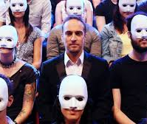
Sproull and Kiesler’s reduced cues theory
According to this theory, reduction in communication cues leads to de-individuation because it diminishes people's feelings of individual identity and brings on behaviours that people usually restrain themselves from displaying, such as aggression.
This may make online communications more aggressive, and the consequence of this is less self-disclosure from other people, as they may fear becoming victims of verbal violence.

Slide 135
Are all cues totally missing?
Do you think there is any NVC in CMC?

Slide 136
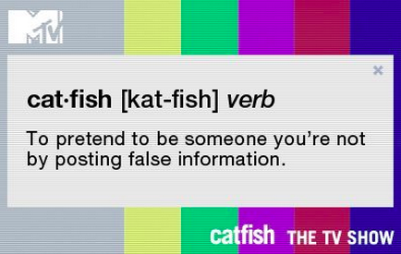
Walther’s Hyperpersonal model
Walther’s hyper personal model, argues that actually Computed Mediated Communication (CmC) relationships encourage self-disclosure much earlier than Face to Face (FtF) interactions, due in part to the sender of messages’ ability to alter and manipulate exactly how they come across to the other party.

Slide 137
Walther’s Hyperpersonal model
Walther says that this selective self-presentation means that the lack of cues serves to increase the speed and intensity of relationships as people are able to portray themselves in the best possible light. The deindividuation which occurs in CmC relationships can make people feel less accountable for their actions and therefore less inhibited, making disclosure much more likely.

Slide 138
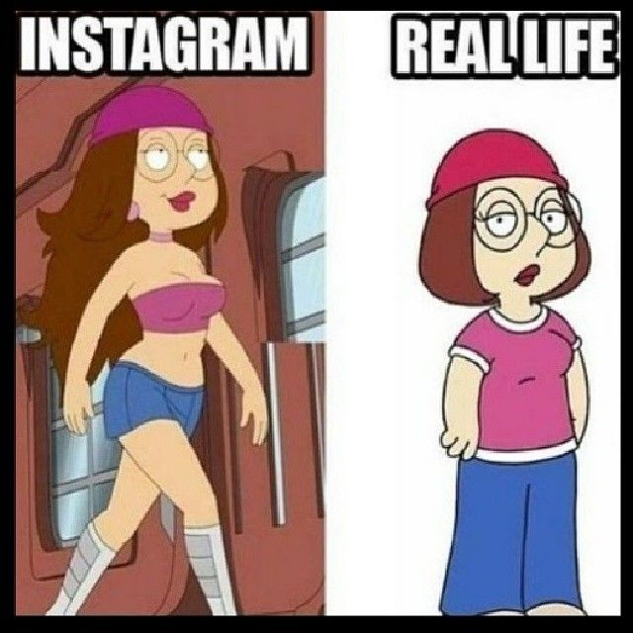
Walther’s Hyperpersonal model
Selective self-presentation.
Anonymity

Slide 139
Exam style question
“Using the hyperpersonal model explain why Mairead chose not to use her own profile picture in The Circle” (4 marks)
Notes:
https://youtu.be/Rd08nVB2Xxg

Slide 140
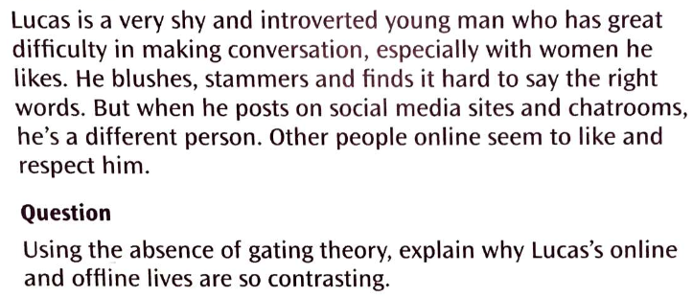
Applying your knowledge – A02
Discuss this in pairs and write it up as a 4 mark response.

Slide 141
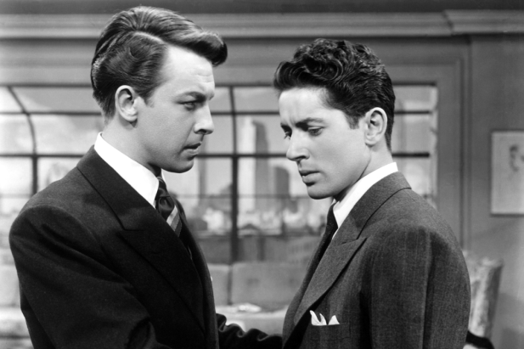
Absence of gating in virtual relationships:
Create an online profile that is totally unlike the real you.
Tell your potential partners all about yourself: likes, dislikes, opinions, habits, hobbies, hopes, dreams etc.
But your online profile said you enjoyed wearing hamster costumes on a Thursday – now you tell me that’s not true!...

Slide 142
Mandatory study
McKenna et al (2002) – Absence of gating

Slide 143
Individual task
Complete the evaluation of virtual relationships on pages 50 – 53.
This will be marked on completion.

Slide 144
Parasocial Relationships

Slide 145
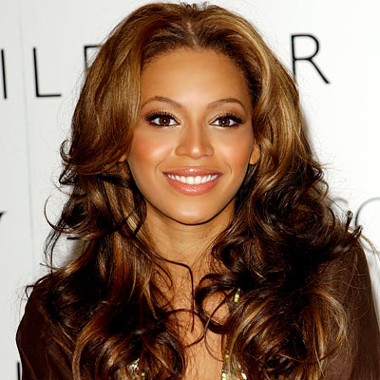
Tell me everything you know about…

Slide 146
Tell me everything you know about…

Slide 147
Tell me everything you know about your favourite celebrity

Slide 148
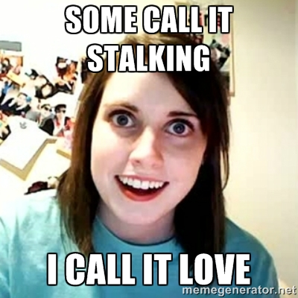
Parasocial relationships
Parasocial relationships refer to one-sided relationships with celebrity, a prominent person in the community or a fictional character, when a fan knows everything about the subject of their adoration and feels very close to them, but there is no chance of reciprocity.

Slide 149
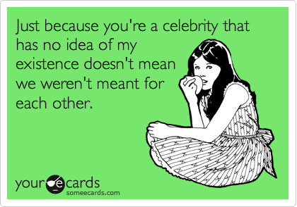
Measuring attraction to celebrities
One way in which attraction to celebrities is measured is through the Celebrity Attitude Scale which was created by McCutcheon in 2002. The scale consists of 23 items which are scored on a Likert scale ranging from 1 to 5.

Slide 150
Levels of parasocial relationships
Giles and Maltby (2006) identified three levels of parasocial relationships, using the Celebrity Attitude Scale in a large-scale survey.
Stage 1: Entertain – Social
Stage 2: Intense – Personal
Stage 3: Borderline pathological

Slide 151
Stage 1: Entertain – Social
Giles and Maltby suggest that most people engage in parasocial relationships at some point in their lives, but most stay at the first level (Entertainment – Social), where celebrities are seen as a source of entertainment and as a topic for light-hearted gossips with friends. This is the least intense level of celebrity worship.

Slide 152
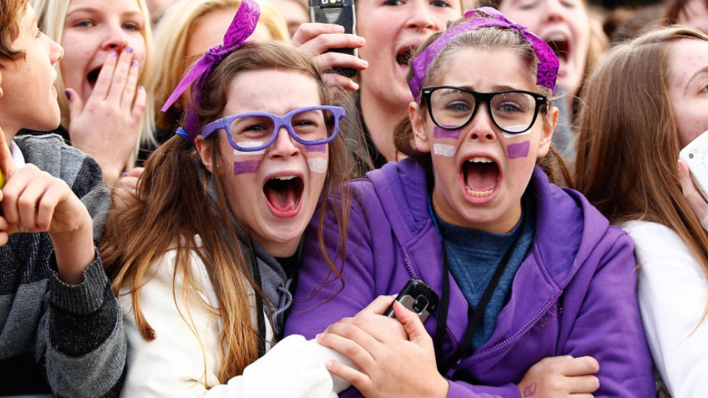
Stage 2: Intense – Personal
This is a deeper level of parasocial relationships. At this level a person has a more intense relationship with a celebrity. For example, they may see them as a soulmate and they have an intense interest in the celebrity’s personal life, such as their dress sense, food they like and entertainment in which they take part. This type of parasocial relationship is typical for teenagers who seem to be obsessed with every little detail of their favourite celebrity’s lifestyle.

Slide 153
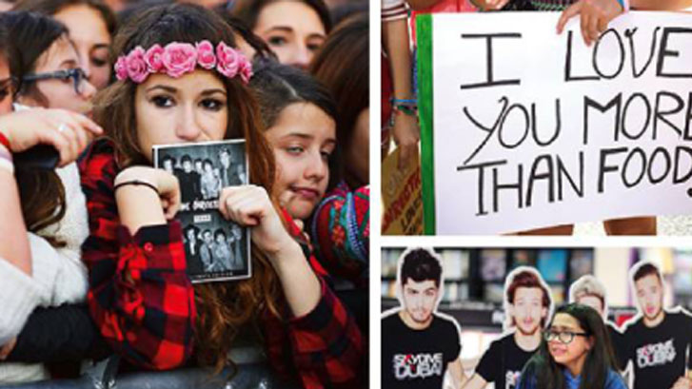
Stage 3: Borderline pathological
This is the most intense level of parasocial relationships. At this level, a person takes celebrity worship to an extreme, has obsessive fantasies about the celebrity, spends large sums of money to obtain memorabilia and may engage in illegal activities such as stalking. At this level, it is also usual for people to believe that if only they were given a chance to meet their favourite celebrity in person, their feelings would be reciprocated.

Slide 154
Individual task
Fill in the levels of Parasocial relationships on page 57.
Complete the The celebrity attitude scale (McCutcheon, 2004) on page 58.

Slide 155
Absorption – Addiction model
McCutcheon (2002) proposed the Absorption-Addiction Model to explain parasocial relationships. She suggests that people engage in celebrity worship to compensate for some deficiencies in their life, such as difficulty forming intimate relationships, poor psychological adjustment and lack of identity. Forming parasocial relationships with a celebrity allows them to achieve the fulfilment they lack in everyday life and adds a sense of purpose and excitement.
McCutcheon explains that looking for satisfaction in celebrity worship makes a person focus intensively on parasocial relationships and achieving a sense of fulfilment motivates them to become even more intensely attached to the celebrity. This is the first stage of the model, absorption.
This sense of fulfilment then becomes addictive for the person, leading them to engage in more risky behaviour such as stalking, in order to get mentally, and sometimes physically, closer to the celebrity they worship.

Slide 156
Linking
Maltby et al. (2005) measured the relation between celebrity worship and body image in teenagers. They found that teenage girls who were at the intense-personal level of celebrity worship tended to have a poor body image, especially if they particularly admired a celebrity’s physical appearance
Schiappa et al. (2007) found a significant positive correlation between the amount of TV participants watched, the degree to which they perceived a TV character as ‘real’ and the level of their parasocial relationship
Research also supports a link between loneliness and engaging in parasocial relationships. For example, Greenwood and Long (2009) found some evidence that people may develop celebrity worships as a way of dealing with a recent loss or loneliness

Slide 157
Evaluation
The Absorption-Addiction Model is better suited to describing levels of celebrity worship than explaining how people develop these attitudes.
This model attempts to establish universal principles of behaviour (nomothetic approach) and as such misses out on deep insight into the reasons for behaviour. An idiographic approach, looking into particular instances of parasocial relationships, may be better suited to the reasons for why people develop them..

Slide 158
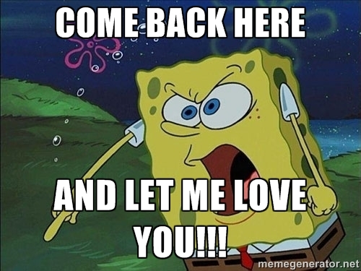
Attachment theory
Other psychologists use Bowlby’s attachment theory and Ainsworth’s types of attachment to explain celebrity worship. Bowlby’s theory predicts that individuals who didn’t form a strong bond with a primary caregiver in early childhood will try to find an attachment substitute as adults, and engaging in parasocial relationships allows them to do so.

Slide 159
Attachment theory
Ainsworth suggests that individuals who formed insecure-resistant relationships with their caregiver in early childhood will be more likely to form parasocial relationships, as they are too afraid of the criticism and rejection that are a part of real life relationships.
According to Hazan and Shaver, this behaviour translates into clingy and jealous behaviour in adulthood, making it difficult for such people to developed committed and lasting romantic relationships. Intensive celebrity worship allows them to engage in fantasy about the perfect relationship, without heartbreak and rejection.

Slide 160
Linking
Criticism
Kienlen et al. (1997) supported the idea that disturbed attachment in childhood may lead to the development of borderline-pathological level of parasocial relationships. They investigated the experiences of stalkers and found that 63% of their participants experienced a loss of a caregiver in early childhood while 50% experienced emotional and physical abuse.
Cole and Leets (1999) investigated parasocial relationships that adolescents developed with TV personalities, and found that teenagers with insecure-resistant attachment types were more likely to develop
McCutcheon et al. (2006) examined the correlation between attachment type and celebrity worship levels using 229 participants, and found no link between insecure-resistant attachment and more intense levels of parasocial relationships. This contradicts the claim made by attachment theory explanations and suggests that there is no link between attachment type and parasocial relationships.

Slide 161
Parasocial Relationships Evaluation
Maltby (2003) linked types of personality (extravert, psychotic and neurotic) to levels of parasocial relationships.
He found that extraverts were more likely to be at the entertainment-social level, neurotics at the intense-personal level and psychotics at the borderline-pathological level, supporting the absorption-addiction model
This suggests that research into parasocial relationships can be used to improve professionals' understanding of psychological disorders and help people struggling with psychological disorders.

Slide 162
Parasocial Relationships Evaluation
However, most research into celebrity worship/parasocial relationships is correlational.
This means that cause and effect cannot be clearly established, lowering the scientific explanatory power.
For example, while a significant correlation was found between poor body image and intensive celebrity worship in teenage girls (Maltby et al., 2005), this does not mean, however, that intense celebrity worship causes poor body image. It may as well be that girls who already have a poor body image tend to engage in a more intensive level of parasocial relationships to enhance their self-esteem.

Slide 163
Individual task
Complete the evaluation on Parasocial relationships on pages 61 - 64

Slide 164
You answered these questions in February
Think back to the theories we have looked at, can any of your answers now be explained.
Attempt to link each of your answers to one thing you have learned during this topic.
Thinking about your current or desired partner, why do you like them? What drew you to them and why did you start to date?
What factors do you think matter in your decision to stay with someone or to break up?
Describe the physical features of your ideal romantic partner.
Do you believe in love? Describe love in a couple of sentences.
Do you believe you will get married one day? What will that decision be based on?
5 Minutes

Slide 165
Your own real life scenario
1. Thinking about your current or desired partner, why do you like them? What drew you to them and why did you start to date?
Use of each of the theories into developing and maintaining a relationship to explain your answer (feel free to say how your answer contradicts a theory also).
- Evolutionary
- Filter
- SET
- Investment

Slide 166
Your own real life scenario
2. What factors do you think matter in your decision to stay with someone or to break up?
Use both the Social Exchange Theory and the Investment Theory to explain your answer.

Slide 167
Your own real life scenario
3. Describe the physical features of your ideal romantic partner.
Does the Evolutionary Theory explain what your answer? Explain why/why not.

Slide 168
Your own real life scenario
4. Do you believe in love? Describe love in a couple of sentences.
Knowing everything you do now about the theories behind relationships, do you have the same answer?

Slide 169
Your own real life scenario
5. Do you believe you will get married one day? What will that decision be based on?
Where do you think your beliefs regarding marriage come from?

