Slide 1
Labour Reforms

Slide 2
Learning Intentions
Describe how the Labour government of 1945 tried to deal with each of the ‘five giants’
Explain what is meant by a welfare state that looks after people ‘from the cradle to the grave’
Make a decision about how successful each of the reforms were

Slide 3
“From the Cradle to the Grave”
The Arrival of the Welfare State, 1945 -51

Slide 4
Definition
The Welfare state is a system of state help and benefits. It was started in 1945 by the Labour government and aimed to do away with the causes of poverty.
It was a universal scheme that applied to everyone.
Benefits were centrally organised and given out by the Government
People were now entitled to benefits having paid National Insurance.

Slide 5
Task
Write down a definition for ‘Welfare State’.

Slide 6
Remember Beveridge
At the end of the Second World War Labour won a landslide election and the new Prime Minister, Clement Attlee, planned to create a welfare state which would tackle all ‘Five Giants’ identified in the Beveridge Report:
Want – A lack of money
Disease – Illness and poor health
Squalor – Poor quality housing
Ignorance – Lack of education
Idleness - Unemployment

Slide 7
Task
As we go through the PowerPoint, use the information provided to fill in the tables on the Labour Reforms on your worksheets.

Slide 8
Want

Slide 9
Want
Social security became universal and compulsory
Insured population would be entitled to unemployment, sickness, maternity and widows’ benefits, pensions and death grant to cover funeral costs.

Slide 10
Want – The family Allowance Act 1945 (This act was passed by the wartime coalition government, but implemented by Labour)
Family allowances were one of Beveridge’s ‘three assumptions’ (i.e. three things which were needed to make the social security system workable, the others being an NHS and an avoidance of mass unemployment).
5s per week was to be given for each child after the first.
It was the legal entitlement of the mother, not the father.
The amount was very small, even by 1945 standards, but it was hoped that it would help to keep wage demands down.
Criticised because would only buy 1lb of tea, a tube of tooth paste and a mars bar.

Slide 11
Want – The National Insurance Act 1946
This was the most important of all the acts to tackle want and it is what most of Beveridge’s recommendations were about.
This was an extension of the previous system of National Insurance introduced in 1911. This time, however it was UNIVERSAL and COMPREHENSIVE.
Contributions were at a flat-rate of 4s 11d per week (about 5% of average)

Slide 12
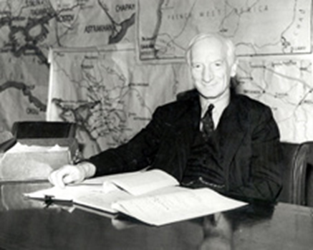
Want – The National Insurance Act 1946
There were 7 benefits:
Unemployment (between 180 and 492 days)
Sickness (after 156 contributions)
Maternity
Widow’s Pension
Guardian’s Allowance
Retirement Pension
Death Grant.
Benefit levels were 26s per week (42s for a couple)

Slide 13
National insurance Act 1946
Man paid 4s 11d per week in contributions
Women and under 18s paid less
Weekly stamps stuck on card
Single man received 26s
Married man 42 s
16s for wife
7s 6d for first child

Slide 14
Want – The Industrial Injuries Act 1946
This was an extension of previous legislation, but it was UNIVERSAL and COMPULSORY.
Workers were covered for this through their existing National Insurance contributions.
Benefit levels were 45s per week, which was generous.
This was paid by the government, not employers.

Slide 15
National insurance ( industrial injury) 1946
Injured worker entitled to same benefits for six months
If injury lasted beyond this entitled to a pension.

Slide 16
Want – The National Assistance Act 1948
This act was designed to be a safety net for those who could not make National Insurance contributions, and therefore would not receive the benefits of the National Insurance Act (e.g. the disabled, the long-term sick, pensioners)
National Assistance Boards were set up.
Claimants would be means-tested and benefits would be in the forms of one-off discretionary grants.

Slide 17
Want – The National Assistance Act 1948
This came to be relied on much more than the Labour Government expected it would be, as National Insurance benefits were low.
Payments low either weekly or one off grants.
Did away with the workhouse but old people often needed help because pension was low.

Slide 18
5th July 1948
Ministry of National Insurance set up in Newcastle
40,000 civil servants needed to administer the scheme to keep records of 25 million workers.
Scheme made a surplus in the first few years because unemployment was so low.

Slide 19
Analysis
Compared to the past this was a marked improvement. However benefits were paid only after contributions had been received.
The levels of benefit were fixed for five years and by the time of implementation they were well below subsistence levels so people still had to apply for national assistance. Still a long way to go to address poverty.

Slide 20
Successes
The National Insurance, Industrial Injuries and National Assistance Acts meant everyone would be given help ‘from the cradle to the grave’.

Slide 21
Problems
The schemes needed a lot of people to administer them.
Not everyone was covered by the National Insurance Act – only those with a certain level of contributions. This meant the ‘safety net’ did not cover everyone.

Slide 22
Disease

Slide 23
Disease
The National Health Service bill was piloted through parliament by Aneurin Bevin.
Under the previous system only 21 million workers were covered.
Not covered were
Dependents
Self employed
Uninsured
They had the additional anxiety of postponing treatment or facing bills

Slide 24
Disease – The NHS 1946
The Act was passed in 1946 and implemented on the ‘Appointed Day’ - 5 July 1948.
Aneurin Bevan was Minister for Health and Housing.
9% of the funding for the NHS came from National Insurance, the rest came from taxation.
At first, 2/3 of doctors were opposed to the scheme, but Beveridge got over this opposition by allowing consultants to retain their private patients and guaranteeing them a fee per patient.

Slide 25
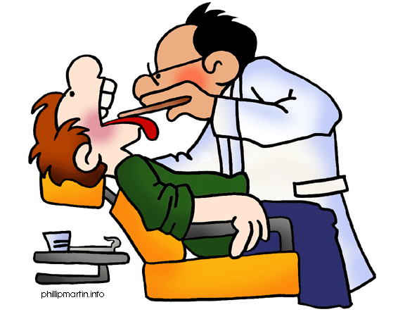
Disease – The NHS (contd.)
The NHS was to be free at the point of use and provided:
GPs
Specialist treatment
Hospital treatment
Dentists
Opticians
Prescriptions
By 1950 the cost of the NHS was £358m
In 1951 charges had to be introduced for prescriptions, dental care and eye care.
Bevan resigned as Health Minister when this happened.

Slide 26
5th July 1948
The service proposed was universal
No limitation on the type of assistance and free
The NHS came into being on the “ appointed day”
July 5th 1948

Slide 27
Doctors
Doctors were initially against the NHS
40,814 voted against it and only 4,734 for it.
In the end doctors were bought off they would get 15s per NHS patient , money for prescription drugs and could keep their private patients.
90% of doctors agreed to join.

Slide 28
Analysis
Demand for the health service was huge.
Prescriptions rose from 7 million to 14 million per month
In the first year 5 million spectacles were dispensed and 8million dental patients treated.
The expense was enormous and was supposed to be met by general taxation.
By 1950 it cost £358 million.
Labour had to introduce prescription charges
Bevan resigned.
Despite the criticism the NHS was arguably the greatest single achievement in the story of the welfare state.

Slide 29
Successes
NHS gave free medical, dental and eye services to all.
The NHS was a huge improvement in the lives of ordinary people.

Slide 30
Problems
Many of the hospitals were old and not suitable for modern health care.
Financial pressures on the government meant that most hospitals were not replaced. The building of new hospitals did not really begin until the 1960s.
The Health Service was a victim of its own success. So many people used the Health Service that it became too expensive for the Government to fund out of taxes alone. Prescription charges were introduced in 1951.

Slide 31
Squalor

Slide 32
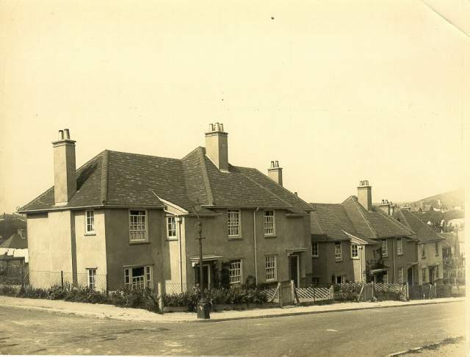
Squalor – Council Housing
It was estimated that 469,000 new homes were needed in Scotland.
Responsibility for housing was given to the Ministry of Health.
Bevan (Minister for Health and Housing) restricted private house building so that materials and labour could be used for council house building.
From 1945 – 51 four council houses were built for every one private house
500,000 council houses were built in total.

Slide 33
Squalor - Prefabs
These were intended to be a temporary stop-gap to the housing shortages.
The houses would come ‘pre-fabricated’ from a factory and be assembled quickly on site.
157,000 were built in total and many lasted for decades.
Bevan gave priority to council housing

Slide 34
Squalor - Squatting
In the summer of 1946 there were still serious housing shortages.
Desperate families took to squatting in disused army barracks and camps.
The Government did not prosecute them. In fact, Local Authorities were ordered to provide basic services (gas, water etc.) to these squatters.

Slide 35
Squalor – New Towns
The New Towns Act of 1946 tried to solve the problem of overcrowding in the cities by planning new communities.
Good quality housing and a good environment with shops and leisure facilities.
Twelve New Towns were planned. Four were built in Scotland (East Kilbride, Glenrothes, Cumbernauld and Livingston)
The Town and country planning act 1947 gave councils more power to buy land and redevelop areas.

Slide 36
1949 Housing Act
1949 Housing act local authorities were allowed to buy up homes for improvement or conversion . They got grants of 75% from the government and 50% for private homes.
700,000 homes were built but 750,000 homes still needed.

Slide 37
Analysis
New house building was limited because of lack of skilled workers and materials.
4 council houses were built for every private home.
Some families had to squat on disused army camps
Prefabs were supposed to be a temporary measure but were still being used 50 years later.
750,000 homes were still needed.
Labour failed to solve the housing problem but this was due more to the scale of the problems facing the country after the war.

Slide 38
Successes
It was a main aim of the Labour Government. Bevan, the minister in charge, made sure that prices for building goods and labour were not allowed to become too expensive.
New Towns Act, 1946; twelve new towns planned. 1949 Housing Act; help given to councils and private home owners for home improvements.
Between 1948-1951, around 200,000 homes a year were built.
The number of houses built does not compare with the amount built in the 1930s or 1950s, but the Labour Government made real progress at a time when it was short of materials, workers and money.

Slide 39
Problems
Many of the houses built were temporary buildings – prefabs.
Many families, especially in London, were forced to squat illegally.
The Government even had to make use f aerodromes which had housed servicemen.
There was not enough housing to cope with the demobilisation of nearly five million servicemen and women.

Slide 40
Ignorance

Slide 41
Ignorance
In education, the biggest problem was shortage of schools, partly because of the bombing.
By 1950 1,176 schools, mostly primaries, were built.
Few technical schools built
Two tier system divisive
Only 20% of places were available at grammar schools so most children were classed as non academic and had no access to university or the professions.
Labour have been criticised for doing little to offer greater access to education for the working class.
It was 1964 before the idea of comprehensive education became party policy.

Slide 42
Ignorance – Butler’s Education Act 1944
Labour implemented this act passed by the wartime coalition.
The most important terms of the Act were:
The school leaving age should be raised to 15, and 16 as soon as possible (although this didn’t happen until 1972).
There were to be three stages of education – Nursery, Primary and Secondary. Primary and Secondary education were compulsory (and free).
Pupils should sit an examination at 11 in England (the 11-plus), or 12 in Scotland (the ‘qualy’). Their results would determine which type of Secondary school they would go to. Those that passed would go to a grammar school (England) or a Senior Secondary school (Scotland) for an academic education. Those who did not pass would go to a Secondary Modern school (England) or a Junior Secondary (Scotland) for a more practical education.

Slide 43
Criticism
Set up divisions in the education system.
Allowing selective grammar schools to continue to exist.
Child’s future determined by the type of school they went to when they were 11 or 12.
Young people from poorer backgrounds were discriminated against because they were more likely to go to a secondary modern school and so have their future choices limited.

Slide 44
Education – School Building
A school building programme was a priority because:
Many schools had been damaged or destroyed during the war.
The school leaving age was raised and secondary education was made compulsory.
By 1950 1,176 schools had been built or were under construction.

Slide 45
Children Act 1948
Tried to give a better service for children who needed state help and protection.
Local councils now had to appoint Children’s Officers to ensure decent care for children under the authorities supervision.

Slide 46
Successes
Butler Education Act 1944 was a radical advance in education. It raised the school leaving age. A proper definition of the different stages of education.
Appropriate education provided for every school pupil.
Ambitious school building programme.

Slide 47
Problems
In practice, the education act was not fair. Few working-class children had the chance to go on to an academic school. The type of school you went to tended to affect your later opportunities for jobs.
No attempt to solve differences in educational provision across the country.
The school building programme concentrated on primary schools to cope with the ‘baby boom’. Only 250 secondary schools had been built by the 1950s.

Slide 48
Idleness

Slide 49
Idleness
Unemployment rose from 1945 – 47 when demobilised servicemen and women came home. It peaked at 480,000 in 1947 and fell thereafter.
Without full employment, poverty could not be tackled through provision of social services alone.
Unemployment never returned to the massive levels of the 1930s.
The Labour Chancellor – Hugh Dalton described low unemployment as ‘the greatest revolution brought about by the Labour Government’

Slide 50
Idleness (contd.)
Labour do deserve some credit for this:
Negotiating Marshall Aid from the USA and using this money to subsidise the rebuilding of Britain’s infrastructure, thereby creating jobs.
Nationalizing certain industries (coal, electricity, steel, gas, railways, the Bank of England), although this did more to protect than create jobs.

Slide 51
Nationalisation
Labour believed the state should take over industry and run them for the benefit of the people.
Bank of England, civil aviation, coal, communications, transport, electricity, gas, iron and steel were all nationalised.
The government owned 20% of Britain’s industries.
Unfortunately many were inefficient and out of date and cost taxpayers’ money rather than make profits.

Slide 52
Idleness (contd.)
However, many of the reasons for low unemployment were nothing to do with what Labour did.
The ‘Baby Boom’ removed many women from the workforce.
Export industries boomed (cars, motorcycles, chemicals) and this created many jobs.

Slide 53
Successes
Government actively promoted a policy of full employment to help support the welfare state.
Nationalisation of key industries to help full employment.
There was almost full employment after war despite the post-war economic depression and shortages of goods ands materials.
Unemployment was around 2.5%

Slide 54
Problems
The British economy and jobs depended heavily on the loans and aid from America.
Women found themselves out of jobs which demobbed servicemen came home. Many women were happy to become housewives again but some found themselves excluded from jobs that they would have liked to continue doing.

Slide 55
Assessment of the Labour Reforms Overall

Slide 56
Assessment of the Labour reforms
In a sense Labour were completing the reforms begun a long time before.
The welfare state had evolved from the time of the surveys of Booth and Rowntree and the liberal reforms of David Lloyd George( some times called the father of the welfare state)
Attitudes had changed
Welfare support was believed to be a right, free of the shame of the poor law.

Slide 57
Labour’s achievement was more of modernising, improving and greatly extending an existing structure than building a completely new one.
Poverty had been reduced not eliminated
Rowntree completed another survey, now only 2.7% of the population were poverty stricken

Slide 58
Benefits
The reforms involved large sums of money but a fit and healthy workforce would benefit the country
Family allowances were a cost effective way of relieving hardship
many millions were benefiting

Slide 59
Criticisms
The cost of welfare was so great that other priorities like industry were ignored.
Health and education reforms benefited the middle classes more than the working class
The reforms were not radical enough but Atlee did not want the reforms to be reversed by the next conservative government.

Slide 60
Success?
Atlee was successful, the conservatives largely accepted the welfare state
The attack on the five giants were underway
The state was now providing a safety net which protected all people from the cradle to the grave

Slide 61
Task
Summarise the benefits, criticisms and overall success of the Labour Reforms as a whole.

Slide 62
Exam Practice – Homework – 26/04/16
To what extent were the Labour Reforms successful in making a Welfare State that met the needs of the British people? (8 marks)

