Slide 1
A Divided Society
British Society around 1900

Slide 2
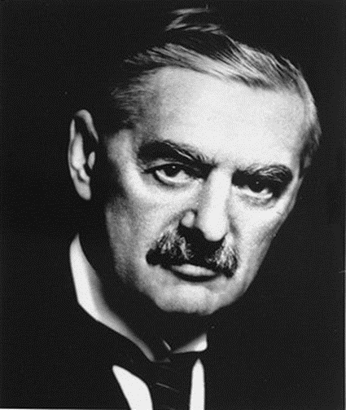
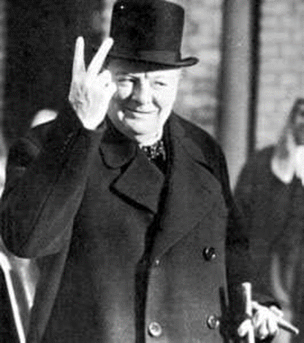
Course Jargon

Slide 3
What is Capitalism???

Slide 4


United Kingdom is a capitalist country!
USA is a capitalist country!!!

Slide 5
Capitalist societies are characterised by existence of private property.
Individuals have the right to set up business and to make profit.
In advanced capitalist societies the state plays a role in the provision of health care, education and defence.

Slide 6
What is a democracy???

Slide 7
A political system where citizens have rights and responsibilities
Main characteristics of modern democracies are universal suffrage, regular elections, freedom of speech and association, free press and elections free from corruption
Democracies develop over time

Slide 8
What is Communism???

Slide 9
Ideal society characterised by common ownership, by the state, of industry, land etc.
Developed by Karl Marx who saw capitalist societies as EXPLOITATIVE
He identified 2 distinct classes BOURGEOISIE (the wealthy owners) and PROLETARIAT (the workers)
He claimed the proletariat should overthrow the bourgeoisie and create a fairer communist society

Slide 10
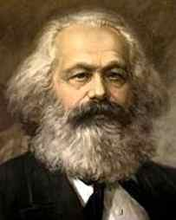
M
A
R
X
K
A
R
L

Slide 11
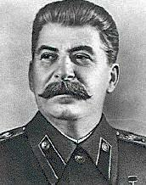

Slide 12
What is socialism???

Slide 13
An ideology developed in the 19th century.
It regards collective action as preferable to individualism.
This means the state taking control of key areas of the economy or welfare system.
Emphasises the need for the introduction of a fairer social system.
After World War II socialism developed in Britain through the creation of the Welfare State.
Socialism allowed for the existence of the private sector.

Slide 14
What are left and right wing political parties???

Slide 15
Left -wing political parties believe in the creation of a fairer society by using the state to do so.
Usually means taxing the rich at higher rates and redistributing wealth to the poor in the form of welfare benefits.
Communism is an extreme form of a left-wing party.
Right- wing political parties believe in low taxation and minimal government interference in the lives of ordinary people.
Right-wing parties believe that too much government involvement in people’s lives leads to tyranny.
Extreme right parties are sometimes accused of being racist.

Slide 16
What is Liberalism???

Slide 17
An ideology which emphasises the individual and his or her rights to freedom.
Central to liberalism is the belief in freedom of conscience, speech and opinion.
Liberalism campaigns for parliament, constitutional government and independence of the judiciary.

Slide 18
What is Industrialisation???

Slide 19
The Industrial Revolution began in the 18th century and changed the nature of societies.
It is the process where industry (cotton mills, shipbuilding, coalmining) replaced agriculture and the main source of employment.
Britain first country to undergo industrialisation which had many implications.
It resulted in the growth of a large middle class Britain who sought political reform.

Slide 20
What is Urbanisation???

Slide 21
Is a by-product of industrialisation.
As new industries grew in towns, population shifts took place.
Migration from the countryside to the towns and cities took place from 18th century onwards – this process is called URBANISATION.
It resulted in overcrowding and disease.
Also resulted in growth of working class movements who emerged in response to harsh conditions.
Trade Union and Labour movements emerged in response to industrialisation and urbanisation.

Slide 22
Learning Intentions
To explain what the phrases ‘laissez-faire’, ‘self-help’ and ‘deserving poor’ mean.
To explain why the Booth and Rowntree reports changed attitudes towards poverty and the poor.
To describe the reasons why the Liberal Government decided to pass a series of social reforms.

Slide 23
Britain 1850-1951

Slide 24
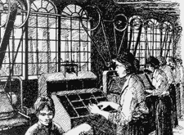
Britain By 1850
An Overview

Slide 25
TASK
Your task will require you to write a notes to answer the following question.
Describe the social and political climate in Britain by 1850

Slide 26
What was Britain like by 1850?
One of the world’s richest and strongest powers:
Had a large empire, controlling land in India, Africa, Austrialia and Canada
The INDUSTRIAL REVOLUTION brought wealth and urbanisation
Factory, mill and mine owners amassed large fortunes (new middle class)

Slide 27

What was Britain like by 1850?
Wealth was concentrated in the hands of a small number of people.
Most of the population were working class. Even here there were divisons:
Skilled engineers and craftsmen lived well but manual labourers did not.

Slide 28
Social Problems
Industrialisation brought masses of people to the towns and cities which led to poor conditions:
Overcrowded tenements – dimly lit, damp, ill-ventilated
No piped water or indoor toilet
Drinking water polluted by sewage and industrial waste
Rapid spread of disease

Slide 29
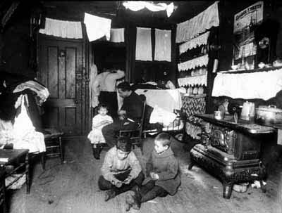

Slide 30
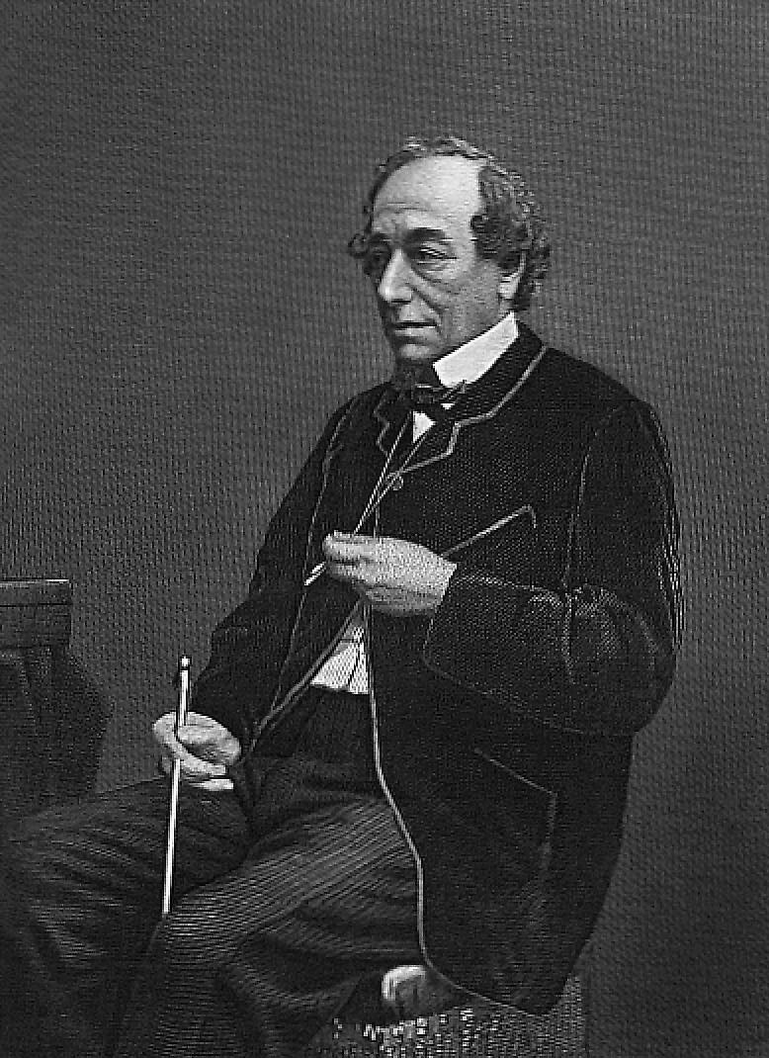
Benjamin Disraeli, in 1845 described the rich and poor as two nations “between whom there is no sympathy, who are as ignorant of each others habits, thoughts and feelings as if they were dwellers in different zones……”

Slide 31
Idea of Self Help
Middle class people tended to be ignorant of the way working people lived.
Attitude – the poor were only poor because they were lazy or spineless.
Samuel Smiles summed this up in his book ‘Self Help’ (1859)
His answer to poverty was hard work and thrift (saving)

Slide 32
Ignorance
Unemployment in an industrial society is only unavoidable if economic factors dictate so.
Many working class families could not afford to feed and clothe their family let alone contribute to Friendly Societies or trade unions to insure against illness or old-age.

Slide 33
The Government
Mid to late 19th century government dominated by the upper classes.
New middle class still excluded from real political power.
Most Cabinet positions held by men with titles.
Conservatives and Liberals (Whigs) dominated 19th century politics.

Slide 34
Laissez-faire
Government did not think it was their duty to provide welfare/assistance to lower/poorer classes
Main role to keep peace and organise country’s finances
This was a policy of ‘LAISSEZ-FAIRE’ – to ‘not interfere’

Slide 35
Laissez-faire
If government did not give help to people they would become self-reliant
If people were supported by the state then they will sink into dependency
Government believed the individual person was responsible for his or her own life and should not expect help from the state.

Slide 36
Exceptions
Only exception was the workhouse est. in 1834 – strict discipline, terrible food, bare accommodation and monotonous work.
Some reform of working conditions in 1850. Mainly result of paternalistic concern by the upper class rather than organised working pressure.
Socialism was in its infancy in Britain in 1850.

Slide 37
Task
Copy the definitions of the following words:
Poverty: a lack of money that leads to bad housing, poor education and other social problems.
Deserving poor: those people such as the old and the young who were poor through no fault of their own and who deserved help.
Laissez-faire: a French phrase meaning leave alone. Around 1900 the government did not think it was its responsibility to help the poor.
Self-help: an idea that people should help themselves to get out of poverty through their own hard work.

Slide 38
TASK
Use the notes you have taken to answer the question below:
Describe the social and political climate in Britain by 1850

Slide 39
Task
Read through the first part of your handout on Poverty and answer the questions that follow.

Slide 40
Why did Attitudes towards Poverty change?

Slide 41
Pressure from reports on poverty
New Liberalism
National Efficiency
Why were the Liberal reforms introduced?
Political Advantage
National Security
Municipal Socialism

Slide 42
Watch the clip…
http://www.bbc.co.uk/education/clips/zbmmhyc
Think about…
What were the problems facing the poor?
Why did the British Empire and armed forces need fit and healthy men?
What was asked for by the report after the Boer war?

Slide 43
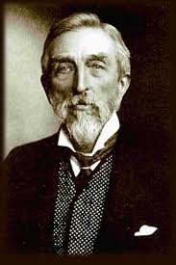
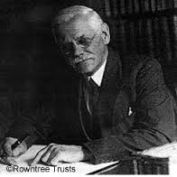
Booth and Rowntree
Charles Booth and Seebohm Rowntree carried out investigations into poverty.
The two investigations at the end of the 19th Century revealed the true levels of poverty in Britain. They proved that poverty had causes, often beyond the control of the poor themselves, which restricted the ability of men, women, children and the elderly to control their lives.

Slide 44
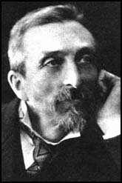
Charles Booth
Booth was a social researcher who carried out a study of poverty in London & published a book of his findings Life and Labour of the People in London in 1899
He concluded that 30% of London’s population was living in poverty.

Slide 45
Why was his work important?
Booth used scientific methods to put people into a social class.
He worked out a poverty line (a level of income needed to stay beyond starvation)
Provided statistics that showed how widespread poverty was.
He demonstrated that the scale of poverty could not be helped by charitable aid alone

Slide 46
Watch the clip…
http://www.bbc.co.uk/education/clips/zhkkjxs
Think about…
What did Rowntree’s report identify?

Slide 47
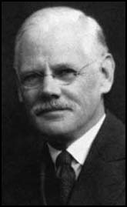
Seebohm Rowntree
Inspired by Booth he undertook a study of poverty in York.
Published Poverty, A Study of Town Life (1901)

Slide 48
Why were his findings important?
Showed poverty not just a problem in London.
Identified 2 types of poverty PRIMARY POVERTY and SECONDARY POVERTY.
He put a figure on the amount of money a worker needed to earn in order to maintain a family in a minimum standard of living.

Slide 49
Important Outcomes
These social investigations found that poverty was not always the fault of the individual.
The ill, elderly and unemployed lived poor lives. What could any individual do about low pay, sickness and old age?
There was a growing awareness of poverty by the middle class

Slide 50
How did the reports of Booth and Rowntree help lead to reform?
Growing awareness of poverty among the middle and upper class
Descriptions of poverty shocked many
Highlighted causes of poverty that many had not previously considered
Showed that charity alone was not enough to deal with poverty
Part of wider changing of attitudes in society – from ‘laissez-faire’ to idea government should take some role in peoples lives

Slide 51
NATIONAL EFFICIENCY
One of the reasons for the introduction of the Liberal Reforms was worries over National Efficiency in Britain.
What is National Efficiency?
National Efficiency was an idea put forward by reformers in the early twentieth century who worried about Britain’s ability to keep up with its competitors in industry.
Britain was facing competition from newer industrial nations such as Germany, who had now overtaken Britain in iron and steel production

Slide 52
What is National Security?
National Security is the need for a country to protect itself and ensure its survival. Today various measures are in place in order to keep countries secure including using diplomacy, economic power and intelligence services to identify and deal with any threats. Another important measure of National Security is the maintenance of the armed forces.

Slide 53
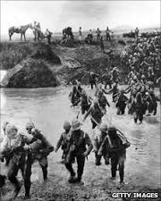
The Boer War
The Boer War was a conflict between the British Empire and Dutch settlers of independent regions of Boer in Africa. When the war started in 1899 volunteers in Britain rushed to join up, but almost 25% of these volunteers were rejected on the grounds that they were not fit enough.

Slide 54
The Boer War
In Manchester 11,000 men volunteered and 8,000 of these were found to be physically unfit. In the end Britain needed 400,000 troops to defeat 35,000 Boer soldiers.
If men of military age were so unfit for service, the government worried about Britain’s future ability to defend itself against a stronger enemy.
The war highlighted the need for a fit, healthy population. Social reformers argued that this was evidence of British decline and the urgent need for reform.

Slide 55
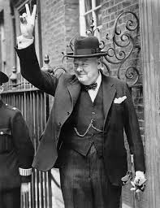
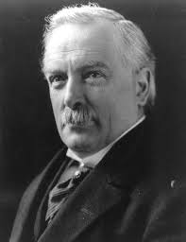
New Liberalism
New Liberalism emerged as a direct result of the concerns highlighted by the writings and studies by Booth and Rowntree. New Liberals actively campaigned within the party for the introduction of reform.
Lloyd George was made Chancellor of the Exchequer in 1908, when Asquith took over as Prime Minister.
Churchill took over at the Board of Trade
The Liberal Government had now gained a great reforming ministry.

Slide 56
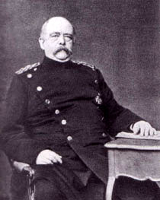
The German Chancellor, Bismarck, had introduced a social welfare system in Germany at the end of the 19th century. Bismarck wanted to gain the support of the German working classes and prevent them from turning to socialism and communism. Germany’s social welfare system was the first in Europe.
‘New Liberal’ politicians including Lloyd George visited Germany and were impressed by what they saw.
The German model helped to influence the Liberals to introduce reforms in Britain

Slide 57
Political Advantage
The growth of the Labour Party, set up in 1906 helped to convince the Liberal Government to introduce their social reforms.
It was to the political advantage of the Liberal government to offer social reforms. If the Liberals were seen to be unsympathetic to the poor, what might happen at elections in the future?

Slide 58
The growth of the Labour Party helped to convince the Liberal Government to introduce their social reforms.
It was to the political advantage of the Liberal government to offer social reforms. If the Liberals were seen to be unsympathetic to the poor, what might happen at elections in the future?

Slide 59
Municipal Socialism
Some Liberal-controlled local town councils became involved in improving the welfare of the people in their town.
Local authorities that did try to tackle issues linked to poverty were used as a model to persuade national government that political intervention was both possible and desirable on a national scale.
These services were paid for by local taxation.
Increasingly, social reformers saw that the answer to poverty lay with the willingness of national government to tackle the national problem.

