Slide 1
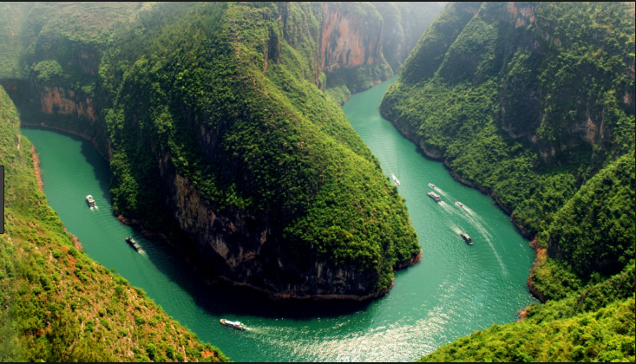
Rivers

Slide 2
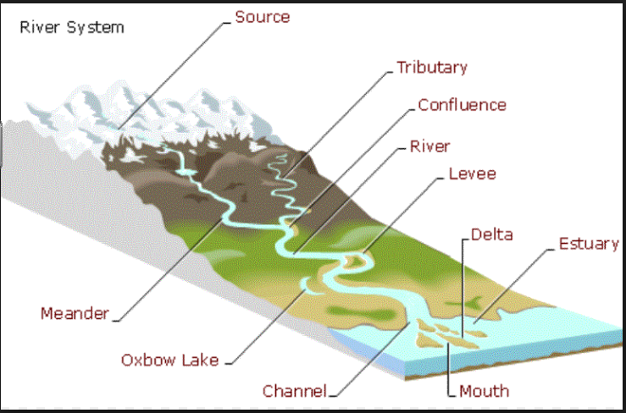
River Features

Slide 3
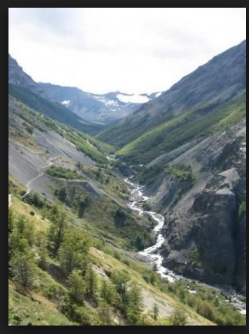
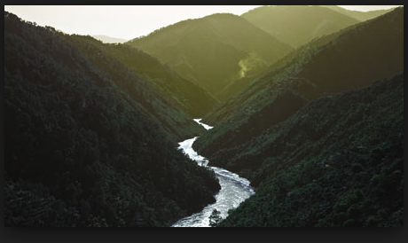

Slide 4
V Shaped Valley
Rivers begin high up in the mountains so they flow quickly downhill eroding the landscape vertically.
Valleys in the upper course are narrow and steep sided.
The river cuts a deep notch down into the landscape using hydraulic action, when the sheer force of the water gets into small cracks and breaks down the sides of the river valley.
Corrasion (abrasion) also occurs which is when the river bed and banks are eroded by the load hitting against them.
Another type of erosion that happens is corrosion (solution), when the river water dissolves minerals from the rocks and washes them away.
As the river erodes downwards the sides of the valley are exposed to freeze-thaw weathering which loosens the rocks (some of which will fall into the river) and steepens the valley sides.
The rocks which have fallen into the river assist the process of corrasion and this leads to further erosion.
The river transports the rocks downstream and the channel becomes wider and deeper creating a V-shaped valley between interlocking spurs.

Slide 5
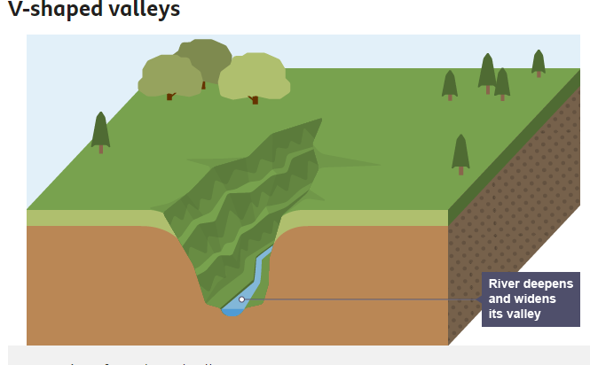
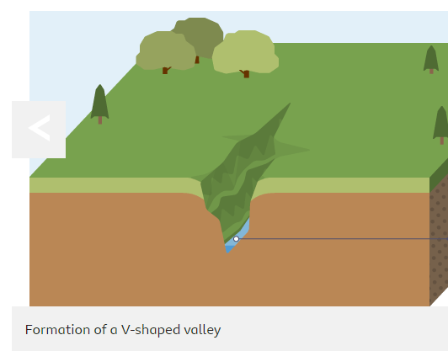
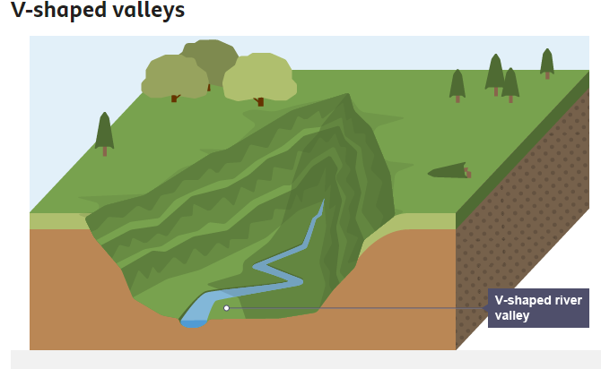

Slide 6
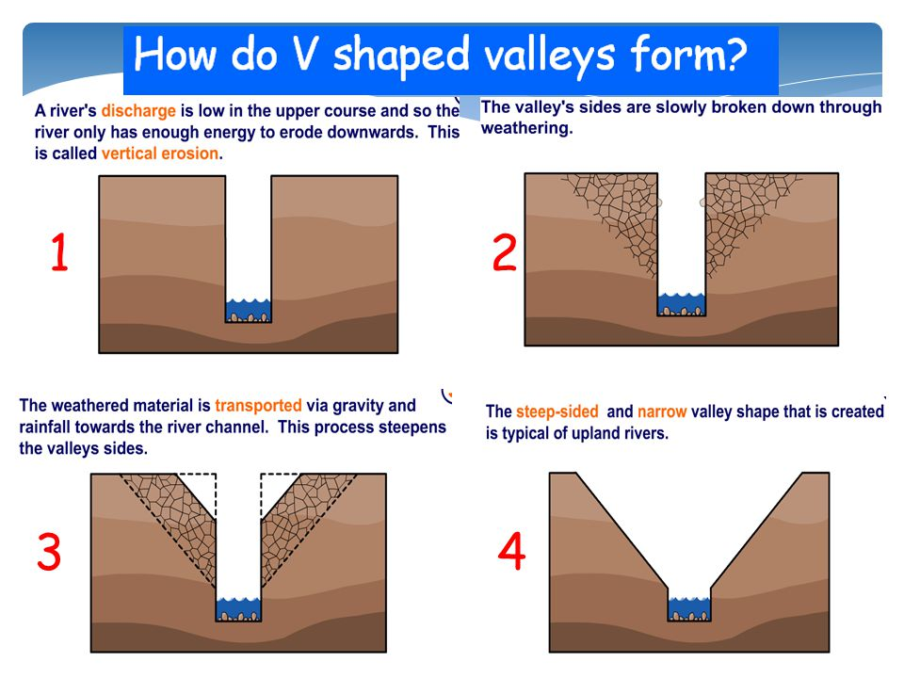

Slide 7
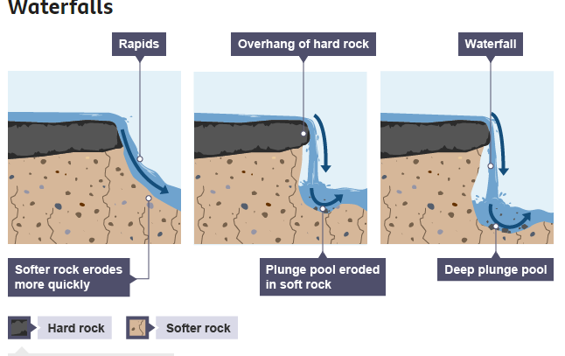
Waterfall

Slide 8
Waterfall
The river flows over bands of less resistant (softer) and resistant (harder) rocks.
Harder rock is overlying softer rock.
The less resistant/soft rock is more quickly worn away due to differential erosion.
The river erodes the rocks in three main ways:
Hydraulic action – when the sheer force of the water gets into small cracks and breaks down the rock.
Corrasion – when the river bed and banks are eroded by the load hitting against them.
Corrosion – when the river water dissolves minerals from the rocks and washes them away.
The river undercuts the harder rock leaving an overhang which becomes unsupported and collapses into the plunge pool below.
After the overhang falls, some of the rocks are swirled around by the river and this helps to form a deep plunge pool below the waterfall. The plunge pool is also deepened during times of high discharge when hydraulic action is most powerful.
The waterfall is moved/retreats upstream, the process continues and a steep-sided gorge is cut back into the hillside.

Slide 9
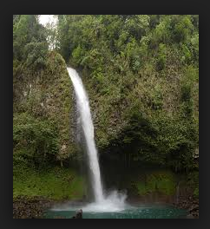
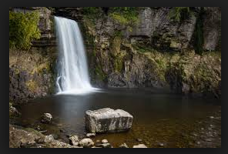

Slide 10
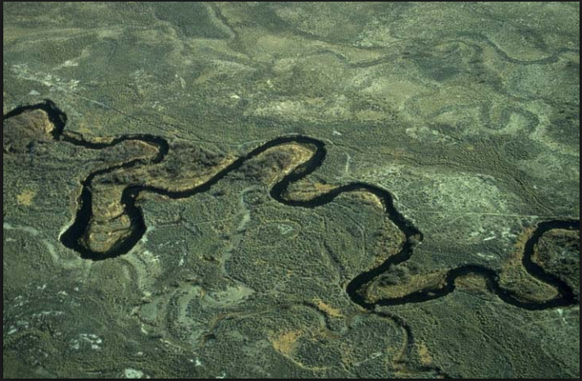
Meander

Slide 11
Lateral erosion takes place in the middle/lower course of the river as the land is flatter.
In a straight river channel pools and riffles will develop as water twists and turns around obstructions such as large boulders. This results in areas of slower and faster water movement.
Pools are areas of deep water and greater erosion (energy build-up due to less friction). Riffles are areas of shallow water created by deposition of coarse sediment.
Once pools and riffles have developed, the river flows from side-to-side in a winding course.
A corkscrew-like flow of water called Helicoidal Flow moves material from the outside of one meander bend and deposits it on the inside of the next bend.
Water moving faster has more energy to erode. This occurs on the outside of the bend and forms a river cliff.
The river erodes the outside bends through hydraulic action, corrasion and corrosion.***
Water moves slowly on the inside of the bend and the river deposits some load, forming a gently sloping river beach (also called a slip-off slope).
Continuous erosion on the outer bank and deposition on the inner bank forms a meander in the river, which will migrate downstream and change shape over time.

Slide 12
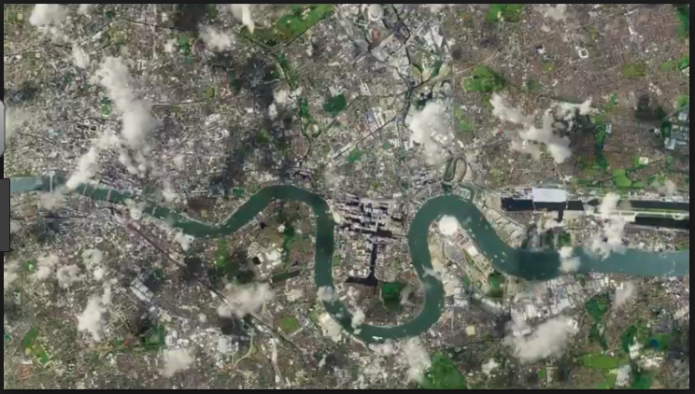
Ox – Bow Lake

Slide 13
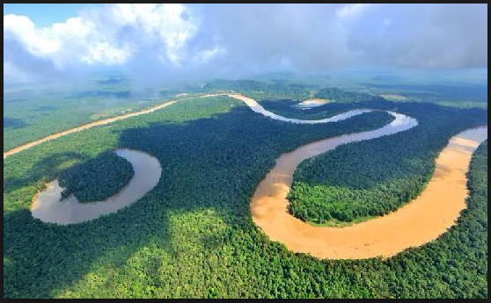

Slide 14
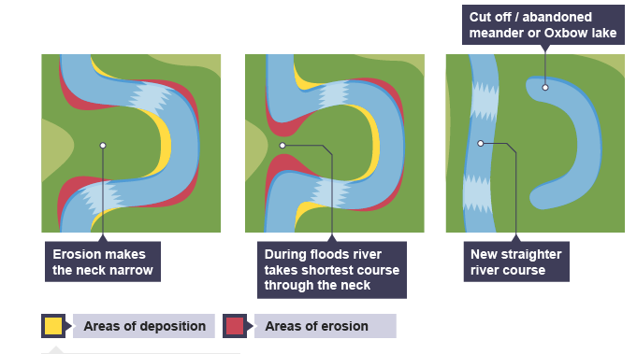
Ox-Bow Lake

Slide 15
Formation of an oxbow lake
The river is meandering across the valley and erodes laterally.
Most water is directed towards the outside bend.
The fast flowing water erodes the outside bends using hydraulic action, when the sheer force of the water gets into small cracks and breaks down the rock, corrosion, when the river water dissolves minerals from the rocks and washes them away and corrasion, when the river banks are eroded by the load hitting against them.
There is less water on the inside bend, an increase in friction and a decrease in velocity. As the river has less energy, it deposits material so its course is changing.
Over time, continual erosion and deposition narrows the neck of the meander.
Often during a flood the river will cut through the neck of the meander.
The river continues on its straighter path and the meander is abandoned.
The fastest current will now be flowing in the centre of the river channel and deposition is more likely to occur beside the banks.
New deposition seals off the ends and the cut-off becomes an ox bow lake that will eventually dry up, except during periods of very heavy rainfall.

