Slide 1
Advanced Higher Art and Design
Lockdown Learning

Slide 2
Course Structure
Unlike Higher Art and Design, Advanced Higher encourages pupils to manage their own learning.
There is NO EXAM for this course. The award is made up from producing a Portfolio and a Dissertation.
Pupils will choose to produce EITHER an Expressive Portfolio or a Design Portfolio but not both.
PORTFOLIO | DISSERTATION
This portfolio will be made up of a minimum of 8 A1 sheets and a Maximum of 16 A1 sheets (or equivalent). It is strongly encouraged that pupils keep a sketchbook as well throughout the project which supports their body of work. | The dissertation is 2000 words and will be based on the chosen artist/designer and their work, which supports the development of your own.

Slide 3
HOW SHOULD I START?
Collate images, lots and lots of images, artist images, designer images, images that inspire, images unrelated to each other but mean something to you.
Collect quotes, written extracts that have meaning to you or that make you stop and think.
Record these. Put them in a sketchbook or on a power point. Are common styles or themes coming together? Are you moving towards design or expressive? Is it still unclear?
Then, draw. DRAW DRAW DRAW DRAW!!! EXPERIMENT; Explore techniques, explore the visual elements; line shape pattern texture tone form colour.
Make Mistakes. Embrace the mistakes. Don’t create a photographic piece of art – THIS IS NOT HIGHER. While the process in similar to Higher, you need to loosen up for Advanced Higher.
If you have a sketchbook or you are able to buy a sketchbook, this is a great place to work and gather everything – almost like a mood book instead of a mood board. Just use paper if you are not comfortable with a sketchbook – whatever works for you.
Use the media you have around you. Look at Pinterest for ideas.

Slide 4
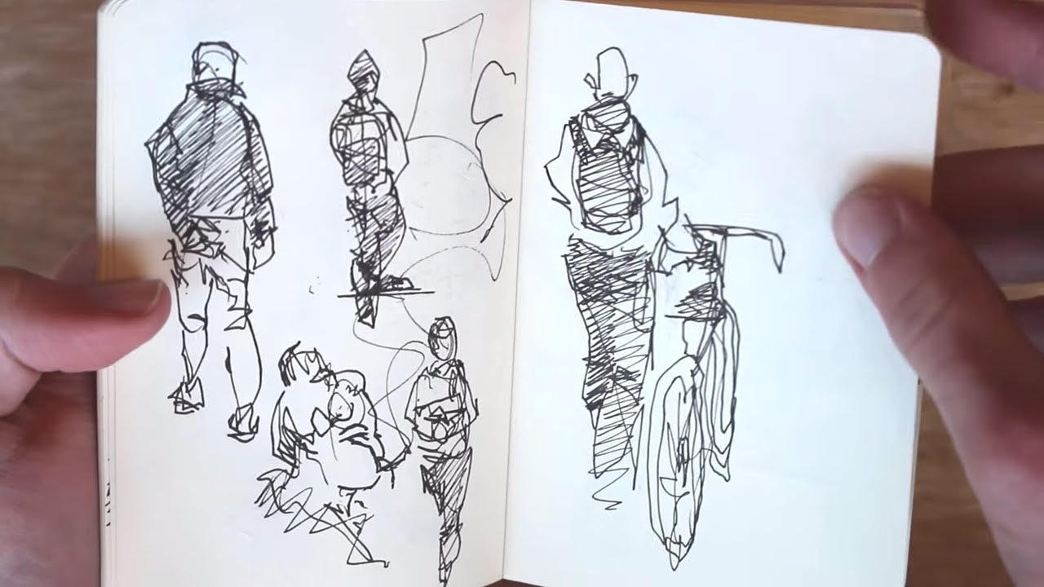
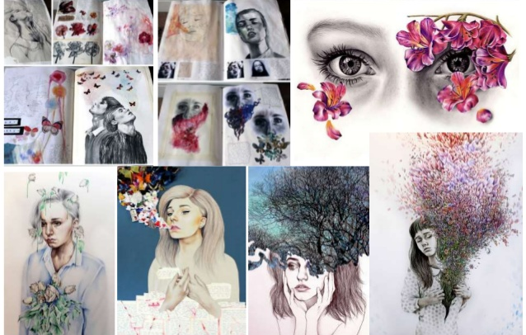
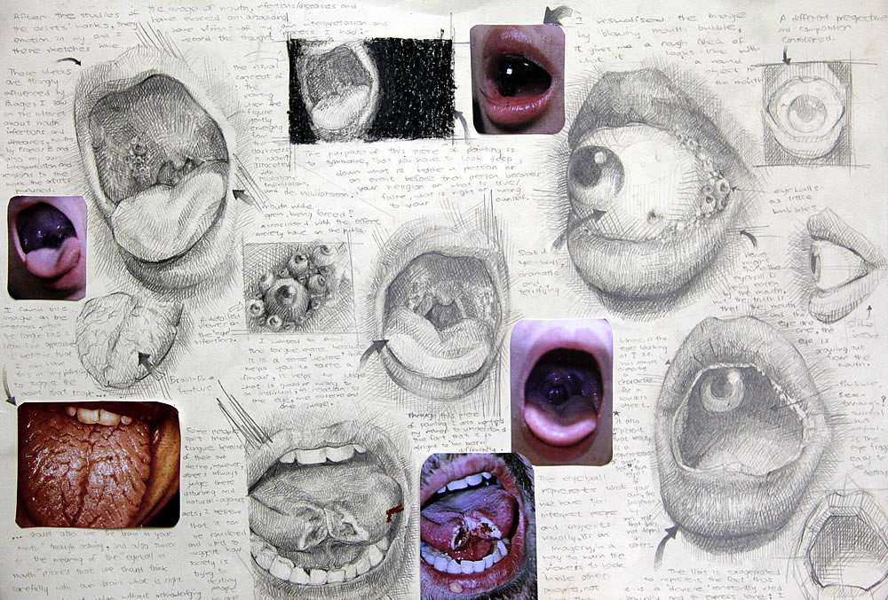
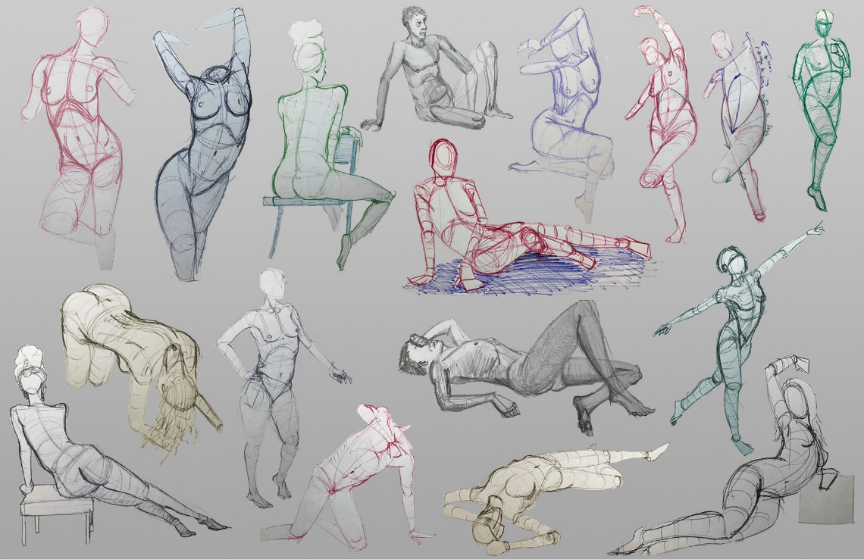
RESEARCH INSPIRATION

Slide 5
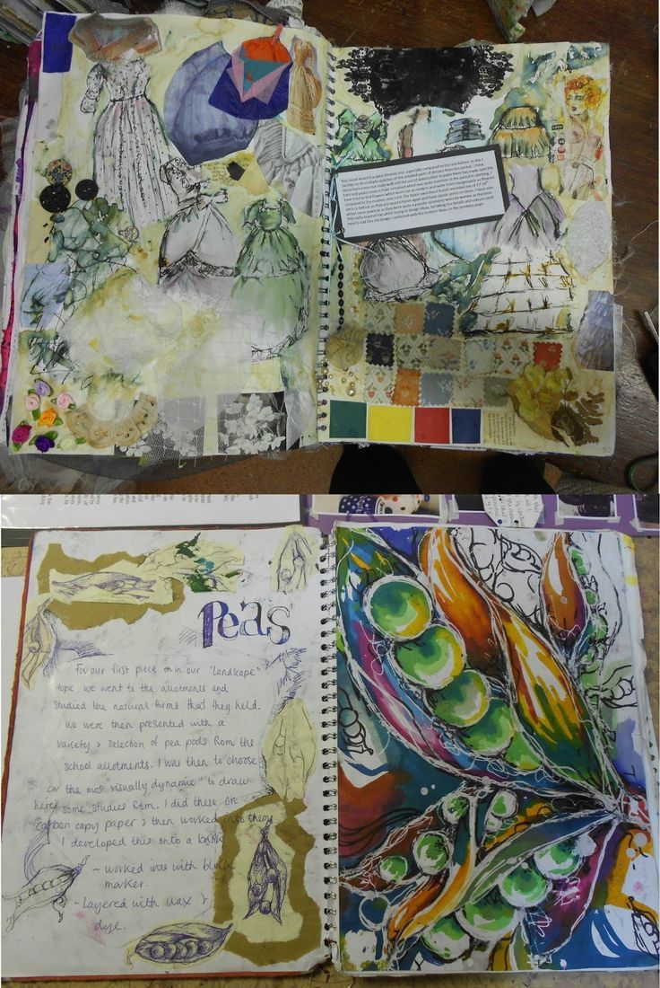
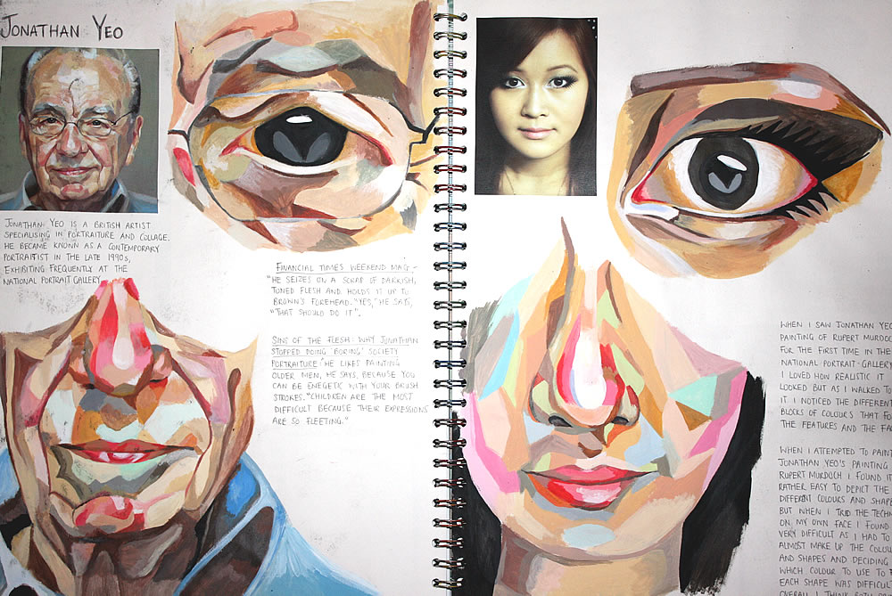
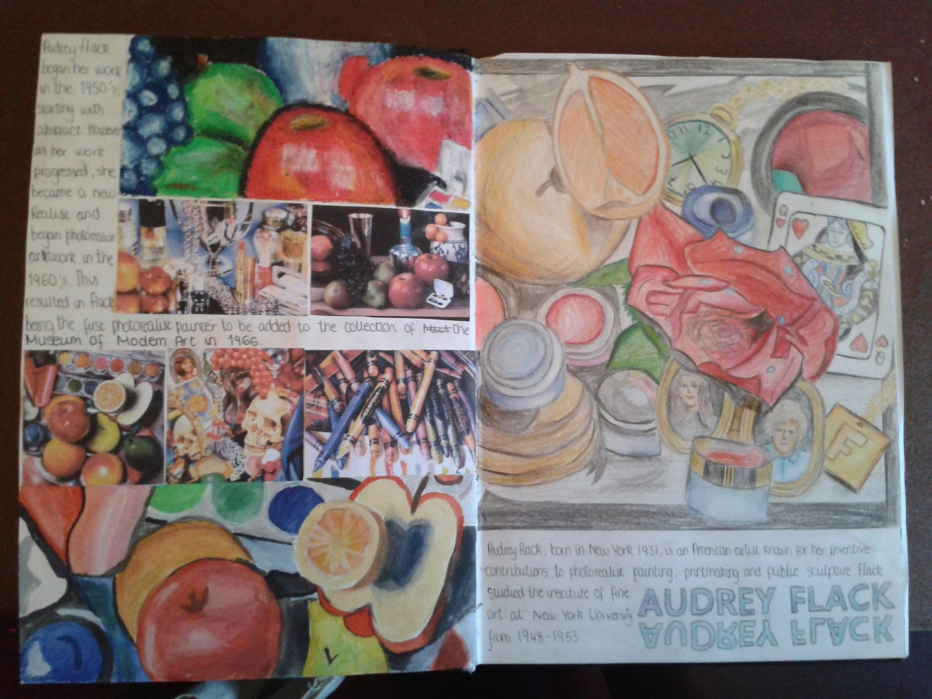

Slide 6
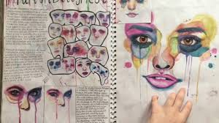
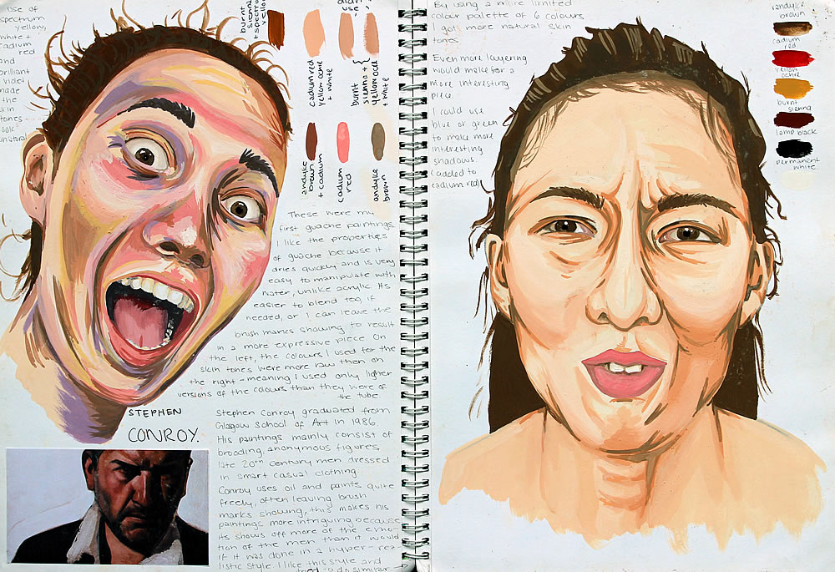
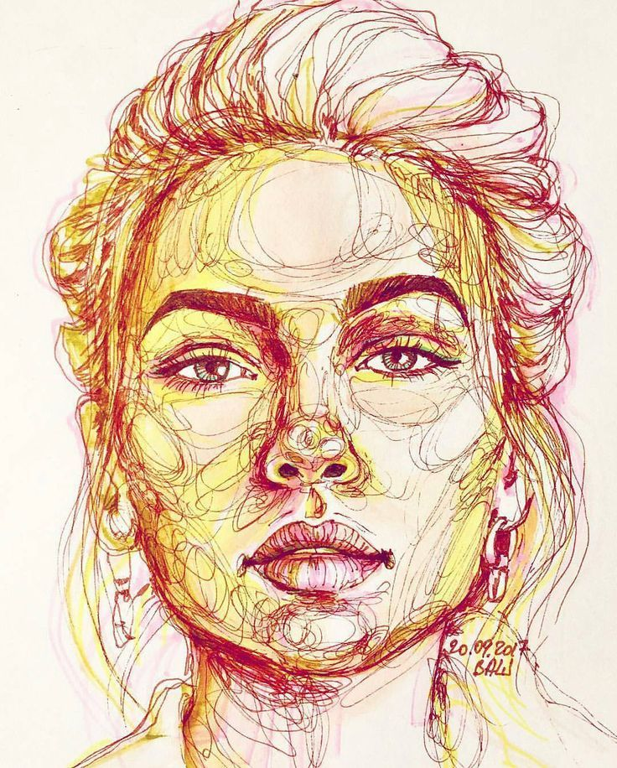
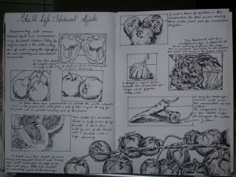
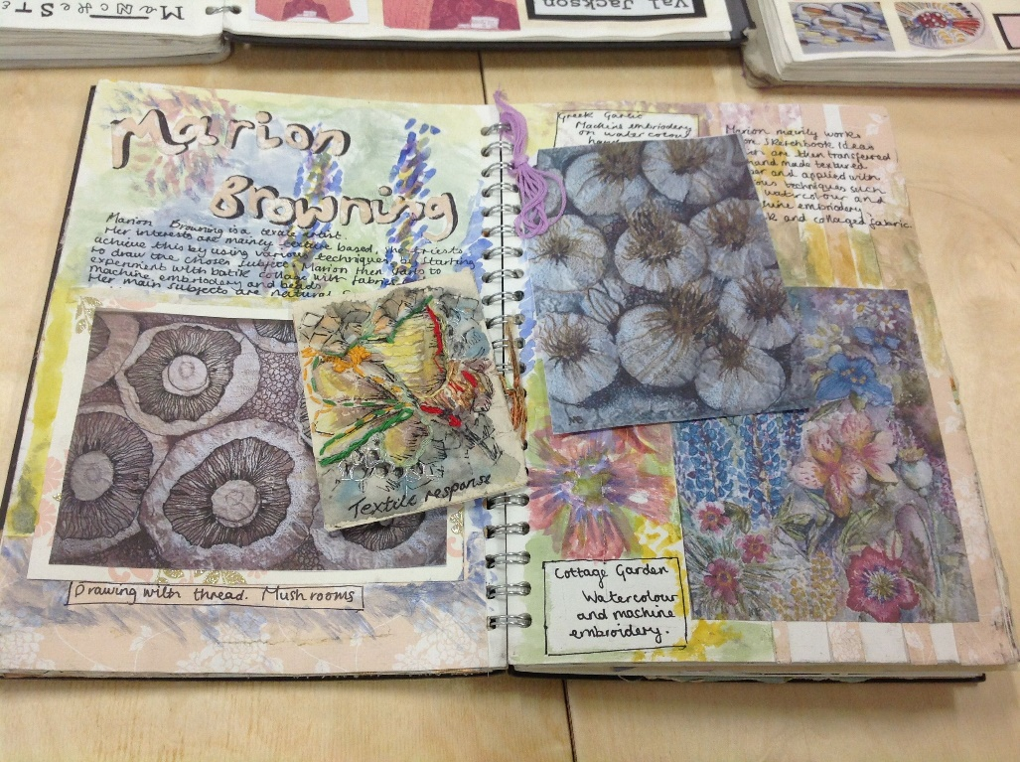

Slide 7
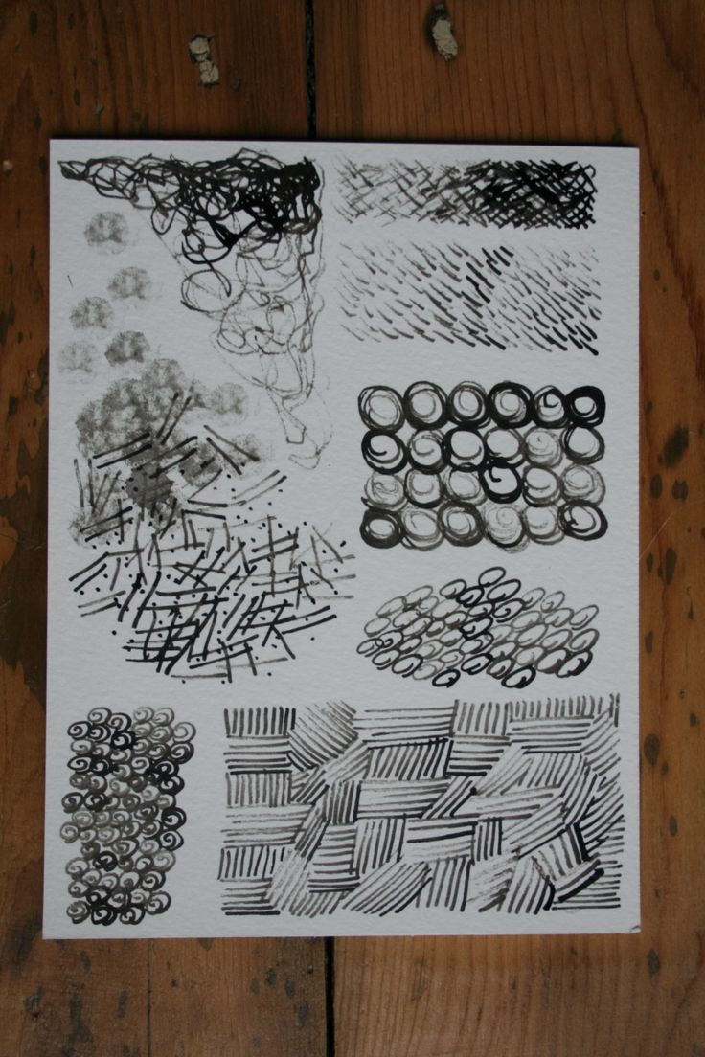
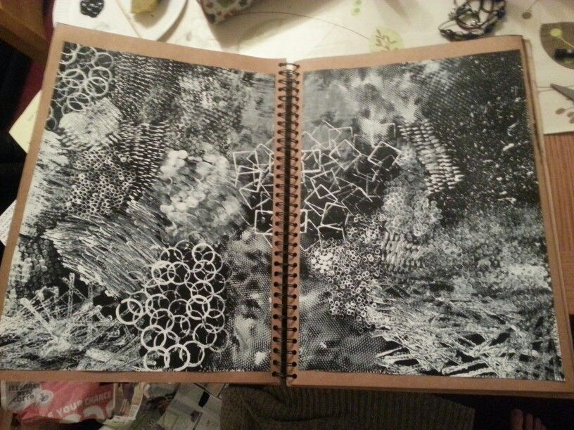

Slide 8
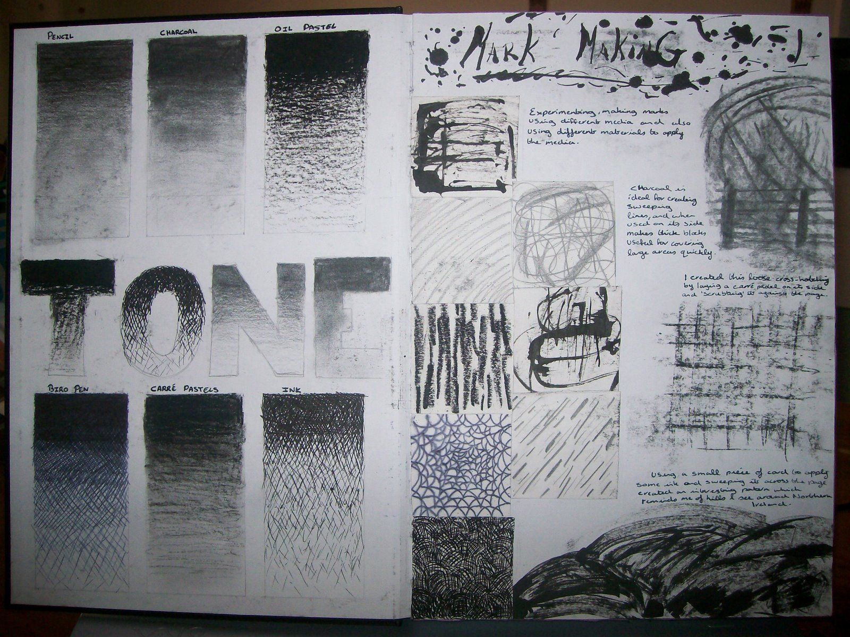
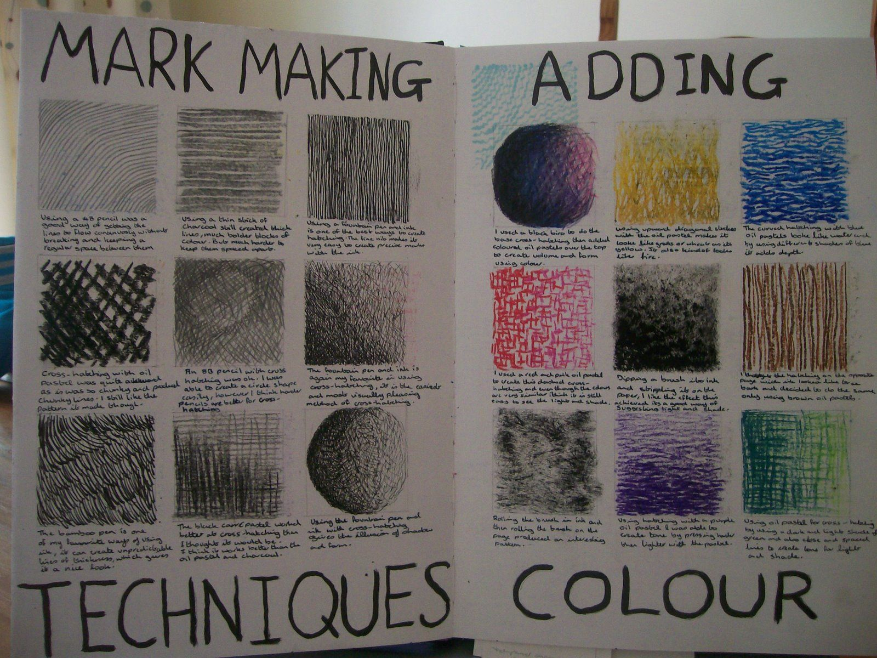
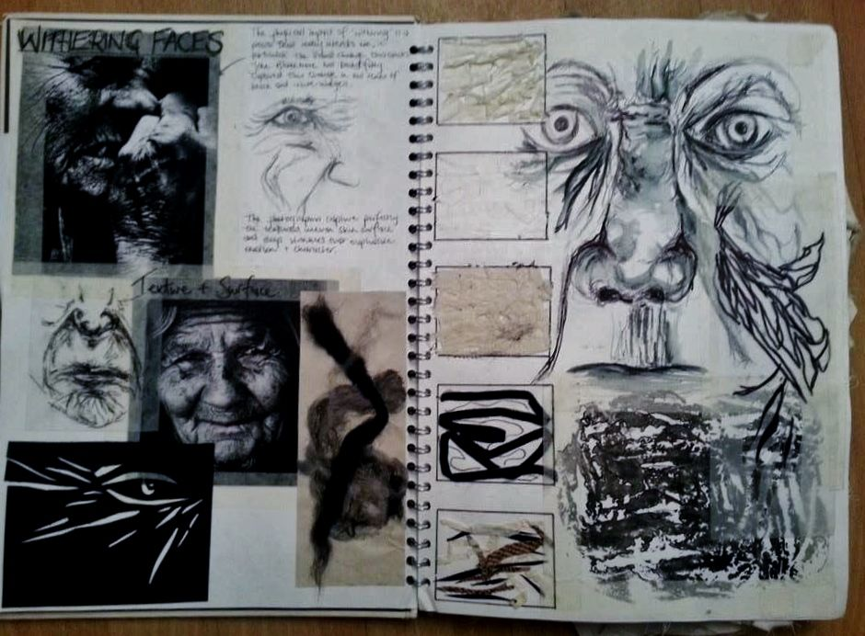

Slide 9
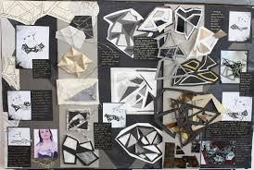
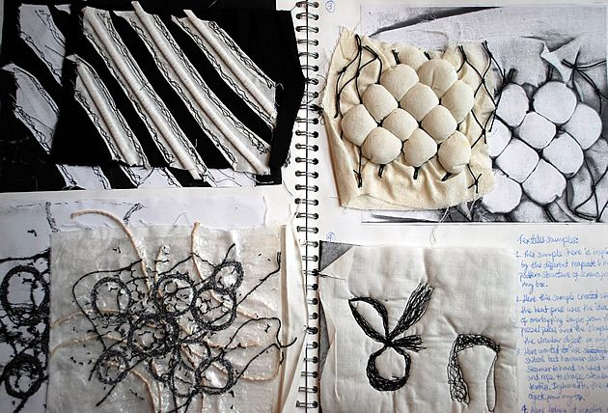
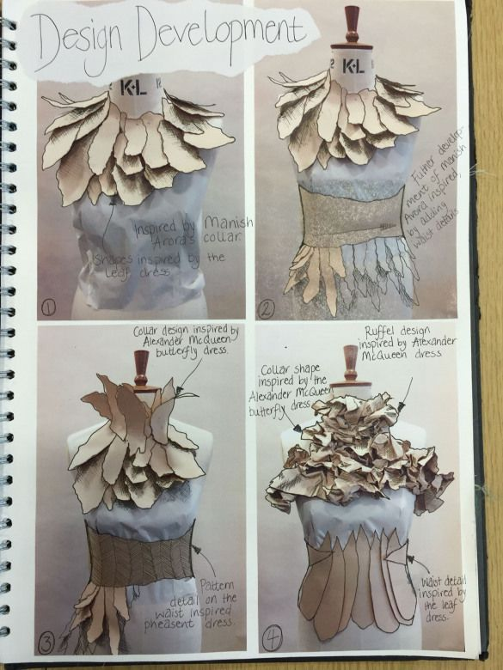
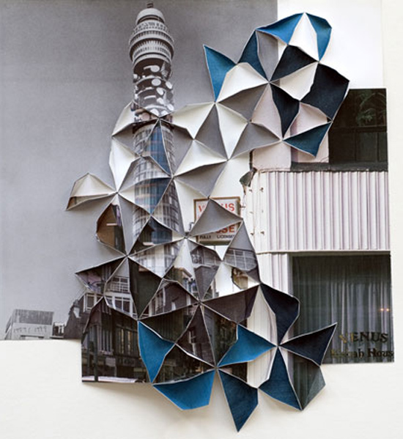
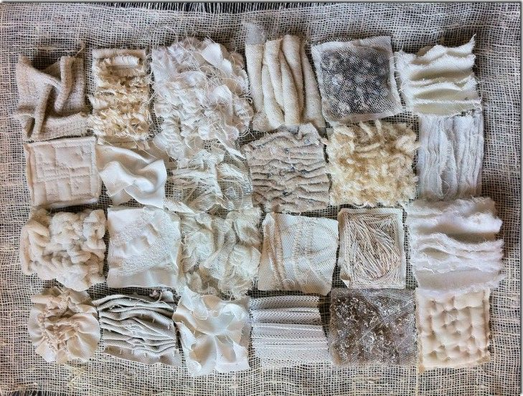
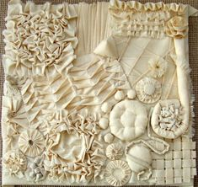

Slide 10
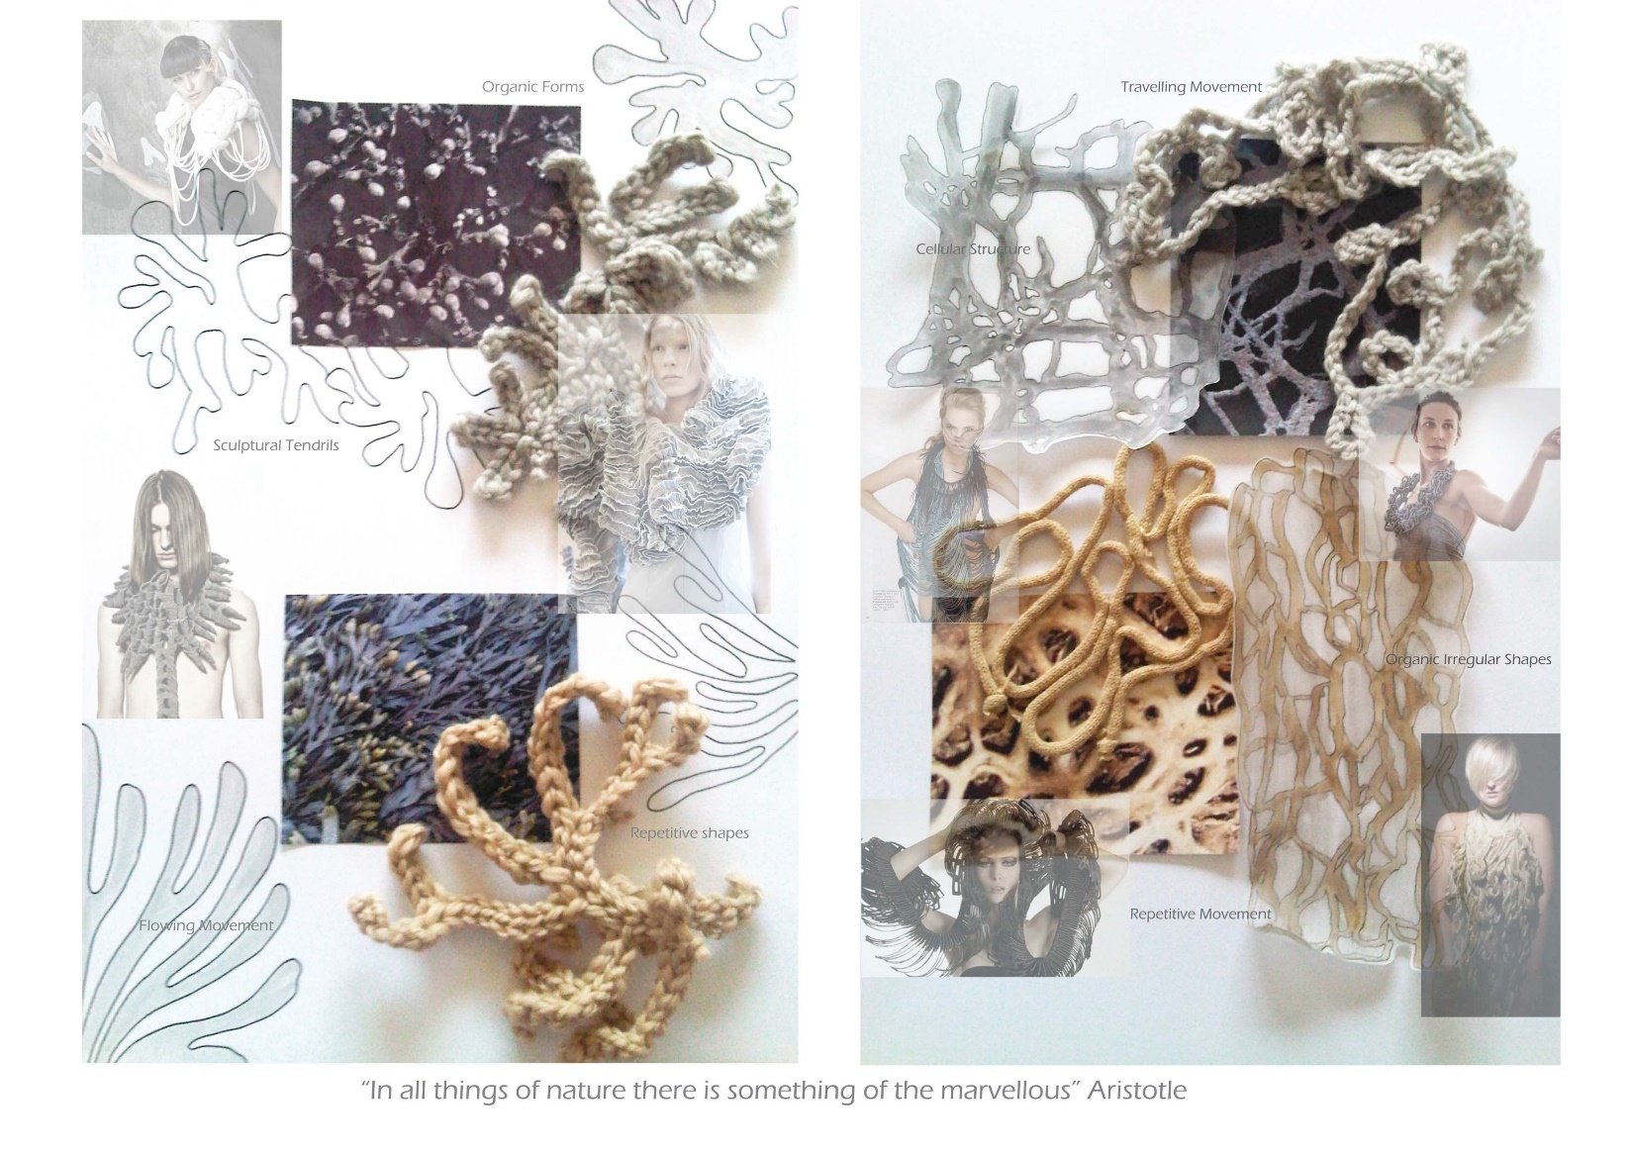
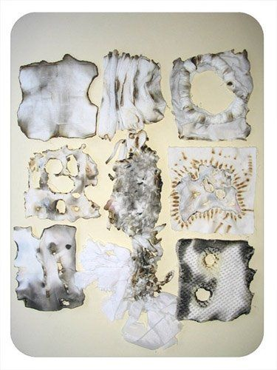

Slide 11
What should you do NOW?
Fill sketchbooks, paper, experiment let go of worrying about where ideas will go.
Access whatever resources and materials you can.
Be creative, relax, experiment and ENJOY!
Contact me through the team if you have any questions or issues.
Please keep in touch and show me what you are up to, so I can keep you right.

