Slide 1
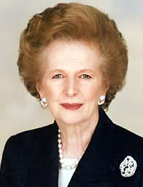
THATCHER 1979 CAMPAIGN
BY MICHAELA, GEMMA & SHAY

Slide 2
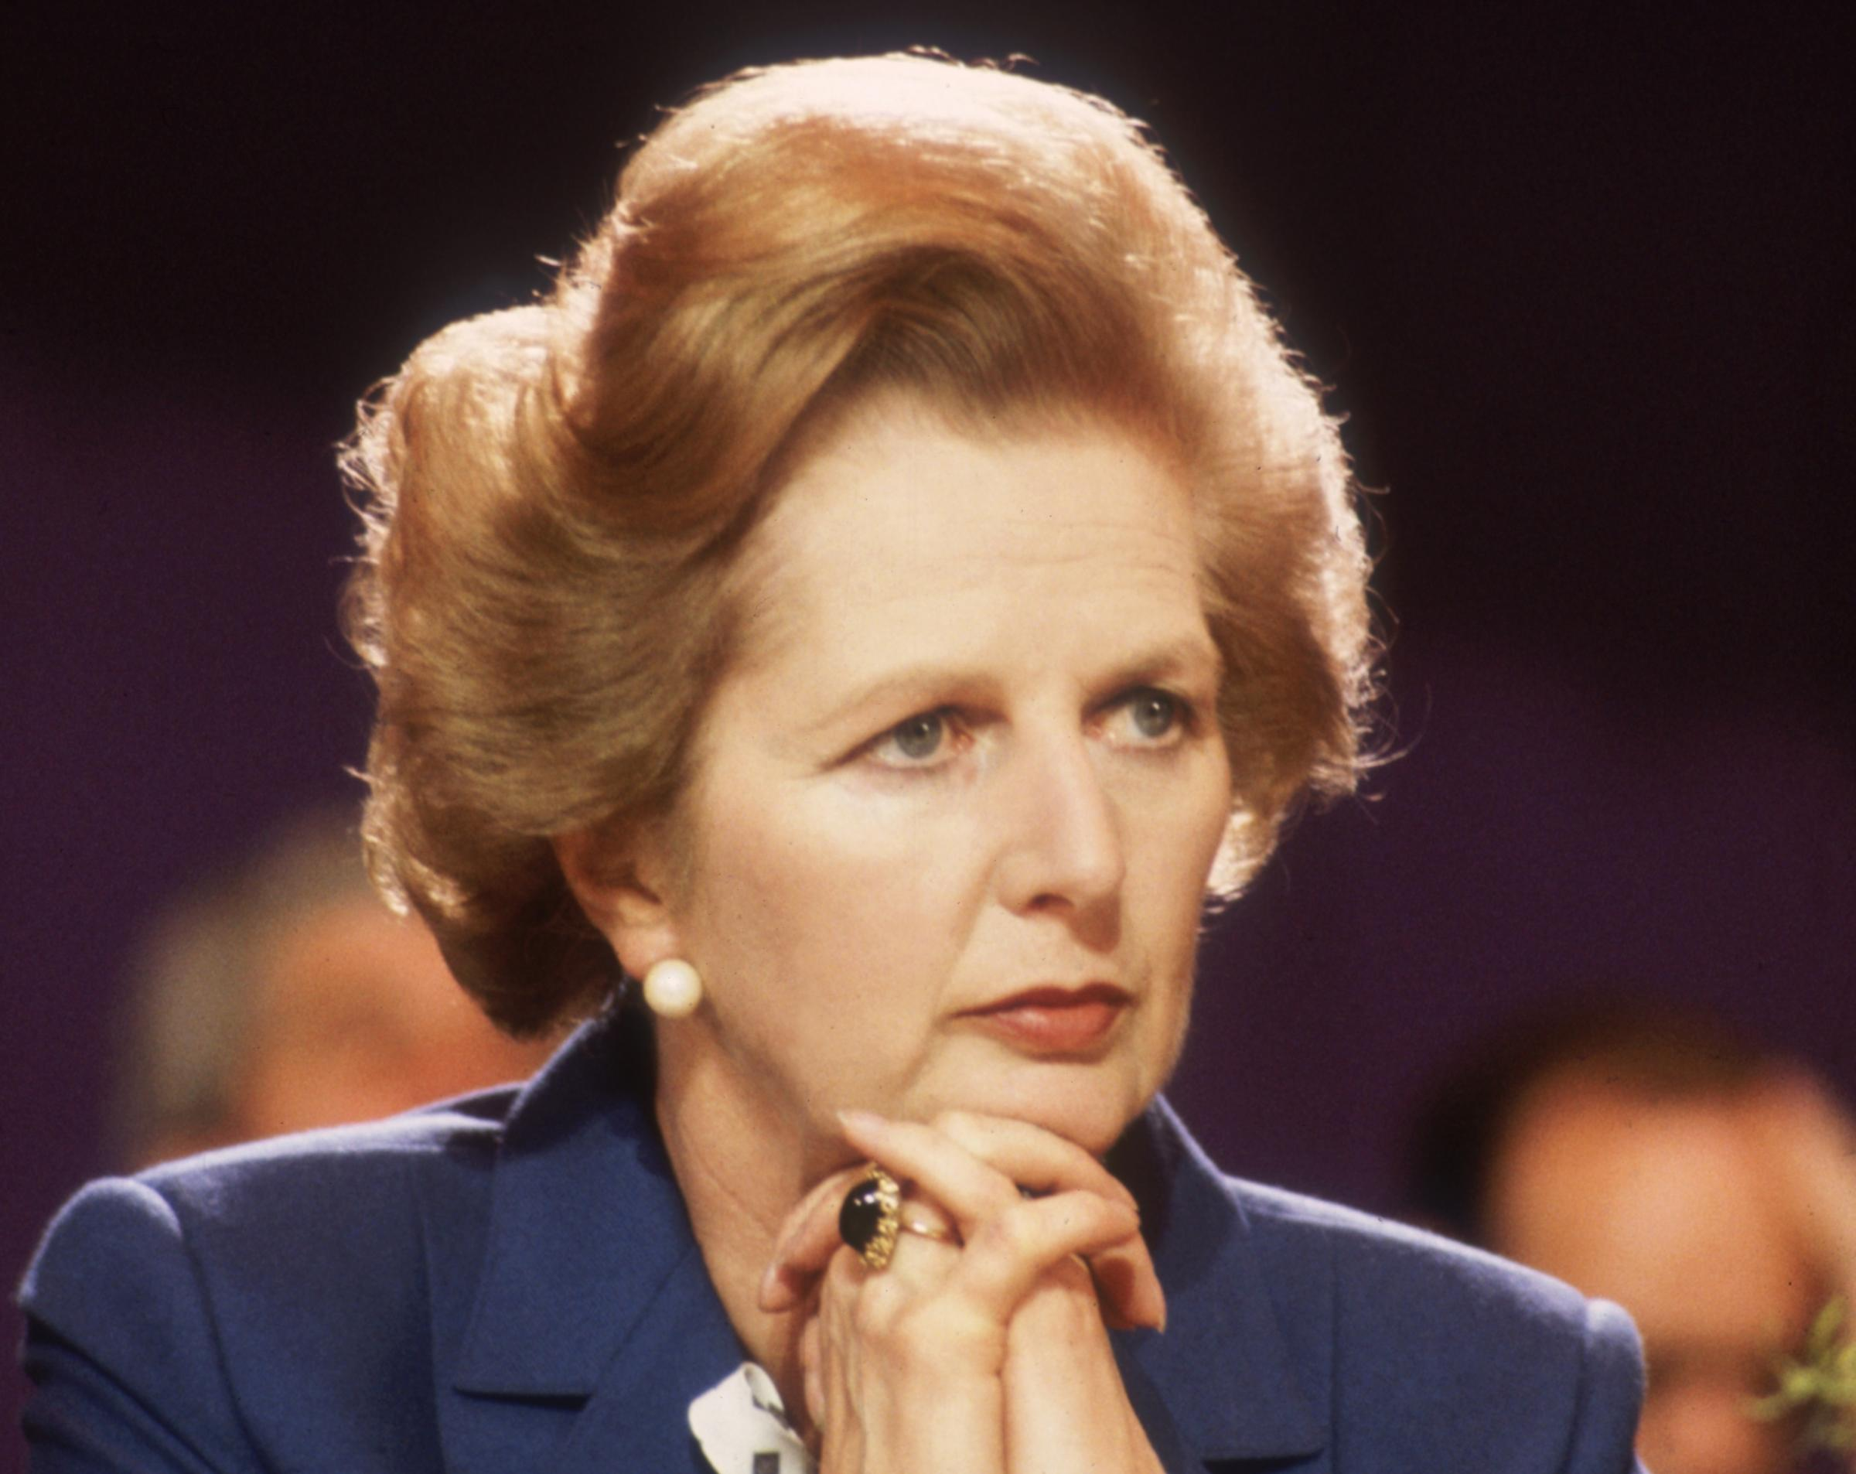
THATCHER’S LEADERSHIP
Thatcher became the leader of the Conservative opposition on 11th February 1975, taking over from Edward Heath.
Branded ‘The Iron Lady’ – she had a decisive leadership in the Falklands War, and was undeniably a strong figure who commanded respect.
Thatcher may be described as an autocratic leader, ruling with her own opinions and initiative. She never took the advice of her Cabinet fully and never truly considered them.
Thatcher was a determined figure, and was previously the Secretary of Education, giving her a standing role in the government itself.

Slide 3
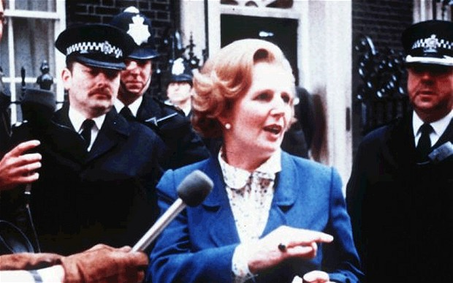
PRE-1979 ELECTION
The government in charge before the election was a Labour government that was firstly led by Harold Wilson, who resigned within 18 months. He was succeeded by James Callaghan as Prime Minister.
The Winter of Discontent; there were widespread strikes by trade unions, and workers fought for pay rises. There was an industrial unrest due to James Callaghan’s pay caps of 5% to control inflation in Britain. This happened during the coldest Winter in Britain for 16 years.
The tank-drivers won a 14% pay rise, causing further workers to demand a pay rise, and employers had agreed with their employees on new wages.
Devolution Referenda were held on the 1st March 1979 where Wales voted ‘No’ and Scotland voted ‘Yes’, establishing the ideas of devolved power and a Scottish government yet a low turnout removed the possibility of devolution.
On the same day, the previous Labour government had lost two seats to the Conservatives due to the referendums.
An election was called as it was five years after the previous UK general election.

Slide 4
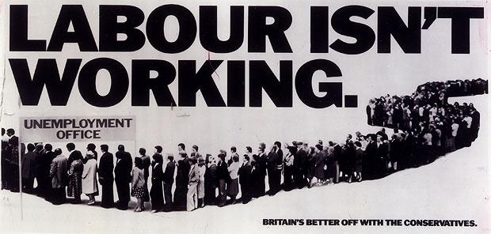
THATCHER’S CAMPAIGN
Margaret Thatcher led the Conservative Party, opposing James Callaghan (Labour) and David Steel (Liberals) in the general election of 1979. She refused to appear on television alongside the other leaders.
She promised the electorate that the Winter of the Discontent was the fault of the previous government, and she would move on from their mistakes. Thatcher used the company, Saatchi & Saatchi, to make posters and advertisements: “Labour Isn’t Working.’
The Conservative Party were popular from the beginning, with 10 points ahead in the electoral opinion polls. However, he reputation as the ‘Milk Snatcher’ and her own personal unpopularity was a worry.

Slide 5
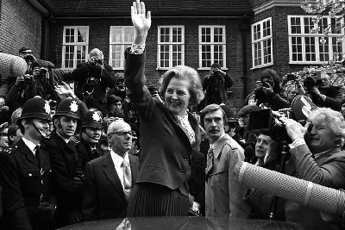
THATCHER’S POLICIES
She pledged to control inflation and remove the power of trade unions, to restore balance in Britain (which she did).
She wished to cut income tax, so as to make the country a more prosperous and capitalist state; a property-owning democracy.
Thatcher aimed to remove nationalisation in Britain, and break away from the previous Labour policies and governments.
Thatcher aimed to establish the supremacy of Parliament in Northern Ireland, to combat the presence of the Irish Republican Army and the calls for Irish unity.
She aimed to sell council houses, revive the private renting sector, and make sense of social security in her own views.
Thatcher aimed to create a strong Britain in a free world, by bolstering defences, working with the European Community, and improving trading relationships in the Commonwealth.

Slide 6
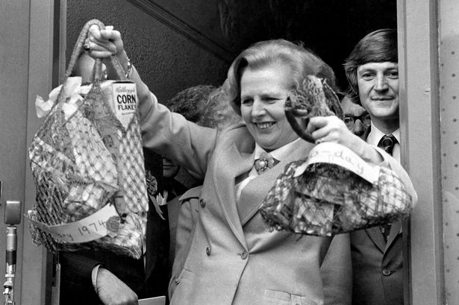
MEDIA IN 1979
Television coverage dominated the 1979 campaign as it never had before, parties hosting morning press conferences, aiming to impress the cameras.
Thatcher worked hard to give the media photo opportunities and create her ow image, such as swinging her shopping basket, drinking tea in a factory and cuddling a new-born calf.
However, David Steel was camera-friendly BUT the newspapers were heavily critical of him and held a bias for Thatcher. They accused him of manipulating photographs by filming in narrow streets – this gave him the image of widened support.

Slide 7
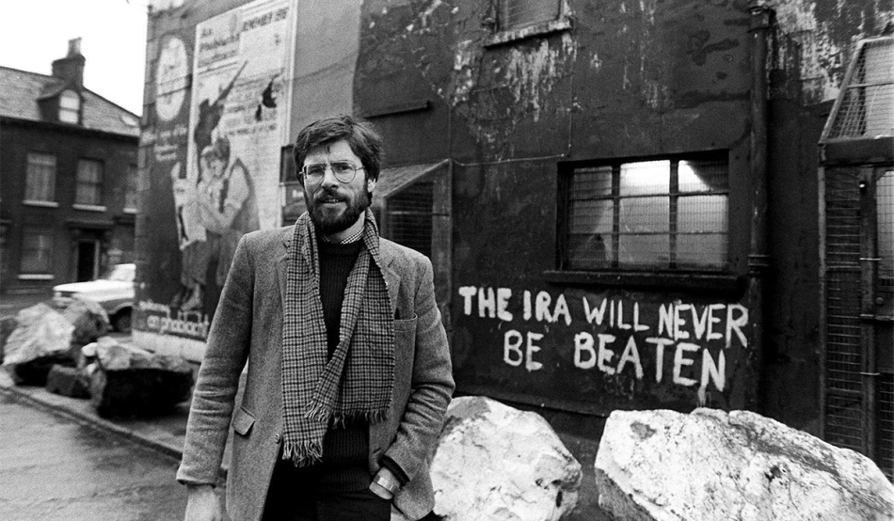
WORLD EVENTS IN 1979
The Troubles in Ireland dominated headlines: the bloody war between the IRA and the British army led to many deaths, and eventually, an (unfortunately?) unsuccessful assassination attempt of Margaret Thatcher.
The US Embassy attacked Pakistan, while the USSR was invading Afghanistan.
Lord Mountbatten and 3 others are assassinated by the IRA.
Iran becomes an Islamic Republic.
China institutes their ‘one-child’ policy rule so as to prevent overpopulation.
Trivial Pursuit is launched for the first time.
Pope John Paul II visits Poland, becoming the first Pope to visit a Communist state.
Saddam Hussein becomes the President of Iraq.

Slide 8
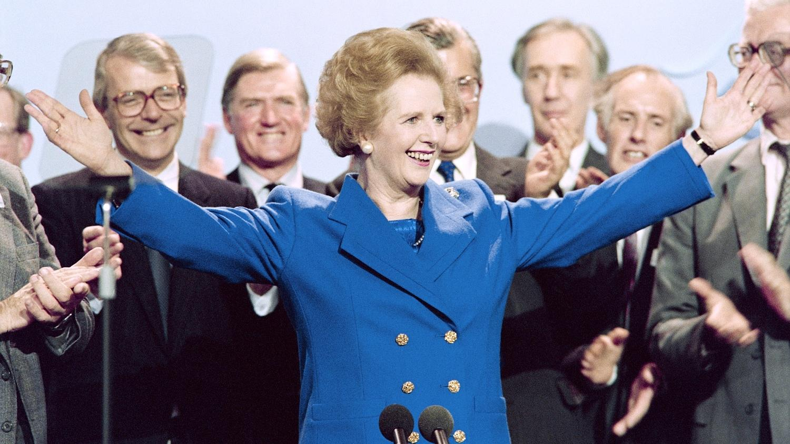
THE ELECTION RESULTS
Margaret Thatcher became the country’s first female Prime Minister, leading a Conservative government with 339 seats out of 635 seats. 318 seats were necessary to win.
The Labour Party won 269 seats, losing the Conservatives by 70 seats. The Liberal Party won only 11 seats.
The swing to the Conservatives from Labour was 5.2%, the largest voter swing since 1945.
The Scottish and Welsh Nationalists also fared badly, losing 10 out of their 14 constituencies.
Thatcher won dominantly and changed the face of Britain forever – for the worst of course. You all know the horrible things she did. Margaret, you have been evicted from the Big Brother house. Goodbye!

