Slide 1
Models of voting behaviour

Slide 2
Past paper questions
SQA 2016
Analyse the relevance of the Sociological Model in explaining voting behaviour. (12)
SQA 2015
Evaluate the relevance of the Rational Choice model in explaining voting behaviour. (12)

Slide 3
models
The Rational Choice Model believes voting behaviour is best explained by voters deciding to make a choice based on what is best for their personal social/economic circumstances.
The Sociological Model believes voting behaviour is best explained by long term factors such as social class, gender and race.
The Dominant Ideology Model believes voting behaviour is best explained by the influence dominant ideas or the narrative portrayed through the media.
In reality, modern elections are so volatile and the factors are so complex that no one model can explain or predict all elections. All three models have their strong and weak points.

Slide 4
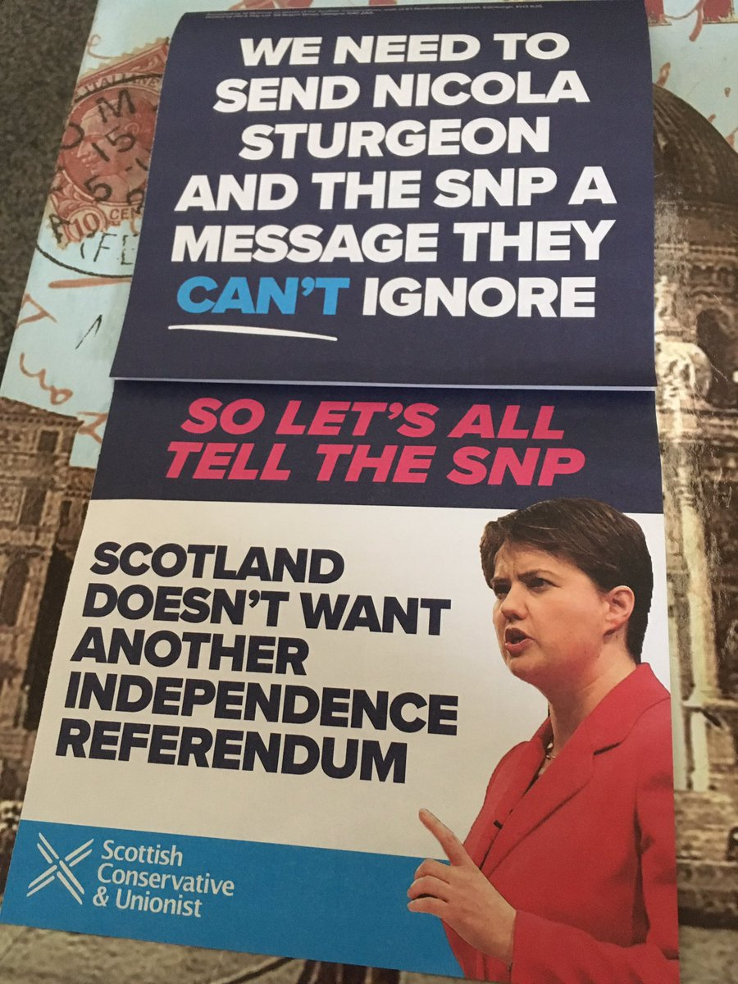
Rational choice: the constitution
The Scottish Conservatives did well in 2017.
The party won 28.6% of the vote in Scotland and 13 seats, up 12 from 2015.
The Scottish Conservatives campaigned almost exclusively against a 2nd Scottish independence referendum.
Some voters may have felt that voting against a second Independence referendum was a rational choice which trumped all the other influences.
Scottish politics

Slide 5
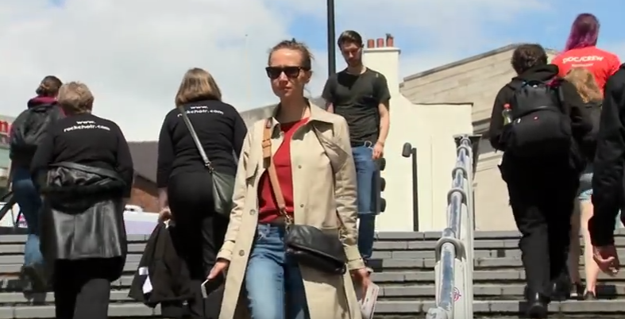
Rational choice: Tuition FEES
Other voters may vote for the SNP because of its promise never to introduce tuition fees for Scottish students at Scottish universities.
Labour’s promise to end tuition fees in England and Wales was widely seen as a popular policy with young voters.
Labour and tuition fees

Slide 6
Longer term influences
Others though do not believe that voters exist in a vacuum.
They believe there are powerful long term influences which shape how we view the world.
We may make a rational choice when we vote, but our social class, gender, race, age and the media we consume shapes how we form this rational choice.

Slide 7
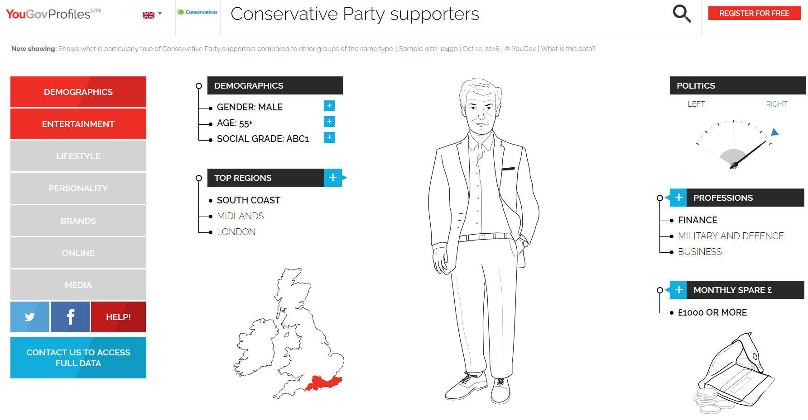

Slide 10
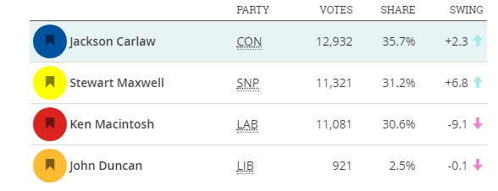
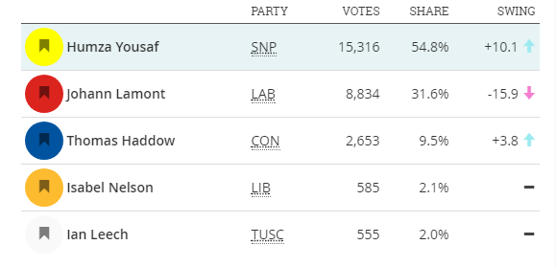
social class
Social class remains a factor in voting behaviour. The First Past the Post voting system reflects the class divide in society. Some constituencies are solidly middle class and affluent; and more likely to be won by the Conservatives and others are working class and less affluent and more likely to be won by the SNP or Labour.
These two Scottish parliamentary seats border one another. These were the results in the 2016 Scottish parliament constituency elections. (Source: Democratic Dashboard)
Eastwood
Glasgow Pollok

Slide 11
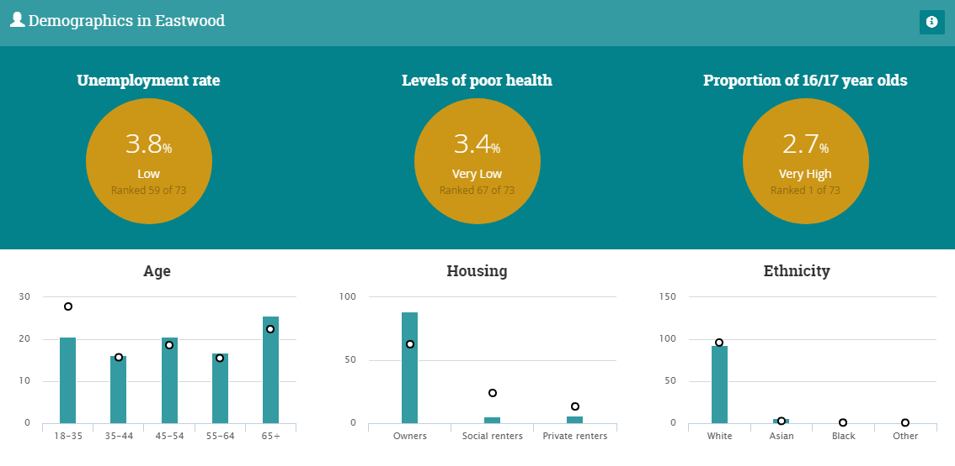
Affluent eastwood

Slide 12
Less Affluent Glasgow pollok

Slide 13
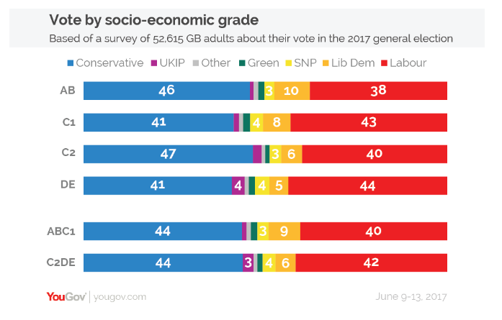
social class
Social class is clearly a factor in how people vote, but its influence is changing.
What has been noticeable in recent elections is how the Conservative Party has increased its share of the vote among traditional Labour voters.

Slide 14
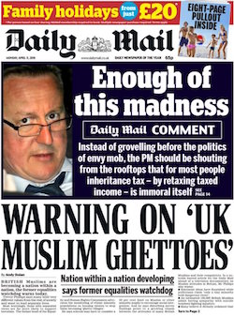
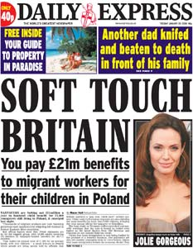
social class
Conservative policies, such as cutting welfare payments, leaving the EU and limiting immigration may have an appeal for lower income voters who resent the ‘workshy’ and are fearful of losing their jobs to EU and non-EU immigrants.
Better-educated people are now more likely to vote for “Left-wing” parties or centrist causes, while those who never went to university are more likely to vote for “Right-wing” or populist parties.
The Labour party is increasingly appealing to educated, cosmopolitan city dwellers, rather than its ‘traditional’ working class.
Are the Tories the party of the working class?

Slide 15
age
Age seems to be the new dividing line in British politics. Amongst first time voters (those aged 18 and 19), Labour was forty seven percentage points ahead. Amongst those aged over 70, the Conservatives had a lead of fifty percentage points.

Slide 16
Age
Younger people find it more difficult to get on the property ladder than older generations.
They have debts.
They are better qualified than previous generations but find it harder to get well paid, secure jobs.
They are having to work longer hours and for longer years.
Many work for zero hours contracts, on minimum wage or worse. Little wonder they want change.
By contrast, many retired voters had the benefit of the pre-austerity years; money in the bank, equity in their houses, good pensions and high living standards. Little wonder they do not want change.
The theory of advancing years and social/economic conservatism would appear to apply to some extent with the Scottish independence referendum and the EU referendum.
60% of those aged 65 or older voted to leave the EU. 73% of 18 to 24 year-olds voted to remain.
Age and 2017

Slide 17
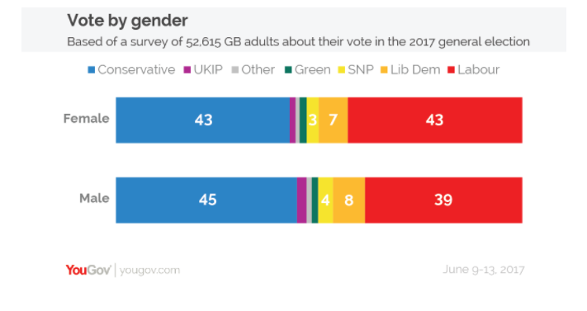
gender
In 2017, as in other recent elections, there was no real significant gender difference in voting behaviour, with men slightly more likely to have backed the Conservatives. (45% to 39%).

Slide 18
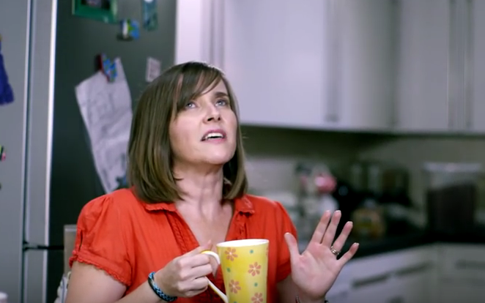
Gender and the Independence referendum
Many Scottish women were active in the Yes campaign. But a larger majority of Scottish women voted No than did men.
56% of Scottish women voted No (44% Yes) whereas the gap between male Yes/No voters was just six points.
Scottish women were targeted by the Better Together campaign in the famous ‘Woman who made up her mind’ broadcast.
Why was there a gender gap in the referendum result?
The woman who made up her mind

Slide 19
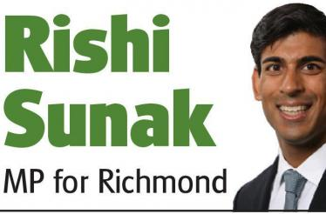
race
Traditionally the Conservatives have struggled to win the support of ethnic minorities. The party’s reputation as the ‘nasty party’, as indifferent to the needs of ethnic minority have been hard for the party to escape from.
This is despite the affluence of many minority voters and the Conservatives having high profile minority representatives.
In 2017, Labour increased its appeal with black and minority ethnic voters.
The party's share of the BME vote rose six points compared with 2015, to take 73% of the vote. The popularity of the Conservatives among BME voters fell by four points on the previous general election.
Conservatives and BME voters

Slide 20
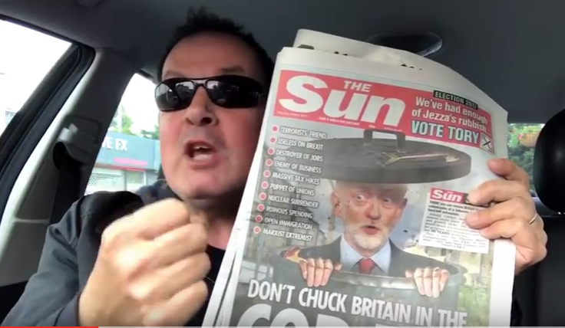
Dominant ideology: the media
Newspapers can be as partisan as they like. In the 2017 general election, the majority of newspapers, the biggest selling ones in the UK, backed the Conservatives.
No one knows for sure how influential they are, but all the political parties want their support.
But in the social media age, political parties and their supporters can bypass traditional media and reach voters.
Chunkymark

Slide 21
The integration of the msm and social media
Many voters engage with both forms of media at the same time.
This explain why political parties seek to co-ordinate their social media messages.

Slide 22
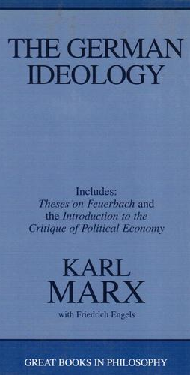
Dominant ideology model
“The ideas of the ruling class are in every epoch the ruling ideas, i.e. the class which is the ruling material force of society, is at the same time its ruling intellectual force. The class which has the means of material production at its disposal, has control at the same time over the means of mental production, so that thereby, generally speaking, the ideas of those who lack the means of mental production are subject to it. The ruling ideas are nothing more than the ideal expression of the dominant material relationships, the dominant material relationships grasped as ideas.”
Karl Marx, The German Ideology, 1846
A number of modern theorists have been influenced by the ideas of Karl Marx. He argued that the media supports the ruling capitalist class who use it for propaganda to dupe the working class.

Slide 23
George Monbiot
“Those who are supposed to hold power to account live in a rarefied, self-referential world of power.
Journalists are always among the last to twig that things have changed. It’s no wonder that the Scottish opinion polls took them by surprise.
Despite the rise of social media, the established media continues to define the scope of representative politics in Britain, to shape political demands and to punish and erase those who resist. It is one chamber of the corrupt heart of Britain, pumping fear, misinformation and hatred around the body politic.”

Slide 24
Scapegoating
Some newspapers have long running themes such as benefits and immigration’
Jones points to a YouGov poll in 2013 which found that people estimated that 27% of social security is fraudulently claimed when the real figure is 0.7%, that 24% of the UK population is Muslim when the figure is 5% and 31% of the population are immigrants when the figure was 15%.
Other themes such as tax avoidance could be adopted but aren’t.

Slide 25
The Bigger the Lie?
Elite theorists claim that the BBC, partly through its position as national broadcaster, its relationship and reliance on government for funding and the social background of its staff projects an ‘establishment’ view of the world; economically conservative and socially liberal.
The Scottish referendum revealed a deep distrust of the BBC and fears of a pro-union bias emerged among some sections of the Scottish public, prompting protests outside BBC Scotland's headquarters in Glasgow. Professor John Robertson monitored BBC coverage of the campaign and alleges that the coverage was biased in favour of a No vote. The SNP is now calling for control of broadcast to be devolved to the Scottish Parliament

Slide 26
Pluralist View
Pluralists reject the dominant ideology model.
They reject the view that there is one dominant class and one dominant media message.
Particularly in the social media age, they argue there is a plurality of media and a plurality of messages.
Pluralists argue that media content is mainly shaped by consumer demand in the marketplace. The newspaper owners therefore are only giving the buying public what they want.
Newspapers are in the business of business. They have to sell papers so they must give the public what the public wants.
The closure of the News of the World in 2011 after public outrage at the phone hacking scandal, they would argue is proof of this.

Slide 27
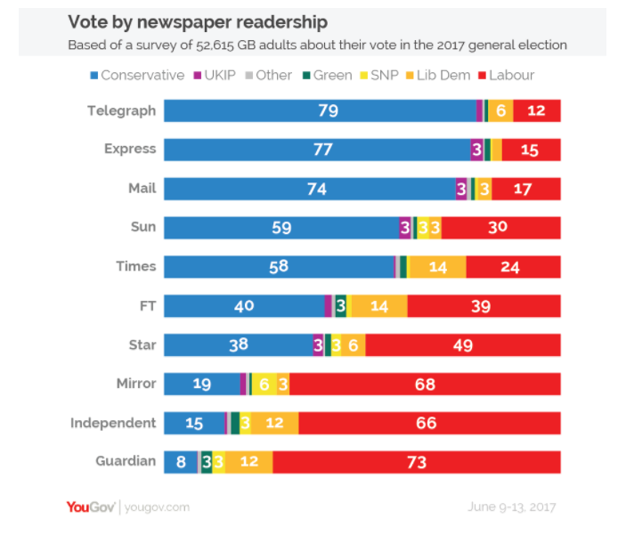
The chicken or the egg?
But, do newspapers influence readers or do readers buy newspapers which reflect their outlook on life?

Slide 28
Newspaper decline
And, most newspapers are in decline. The Daily Record’s sales dropped 12% in 2016.
The Herald’s fell by 10%.
By contrast, social media use seems unstoppable. More than half of the UK population uses Facebook on a regular basis. Its analytical tools allow political parties to identify and target key demographics with their message.
Social media UK 2017 election

Slide 29
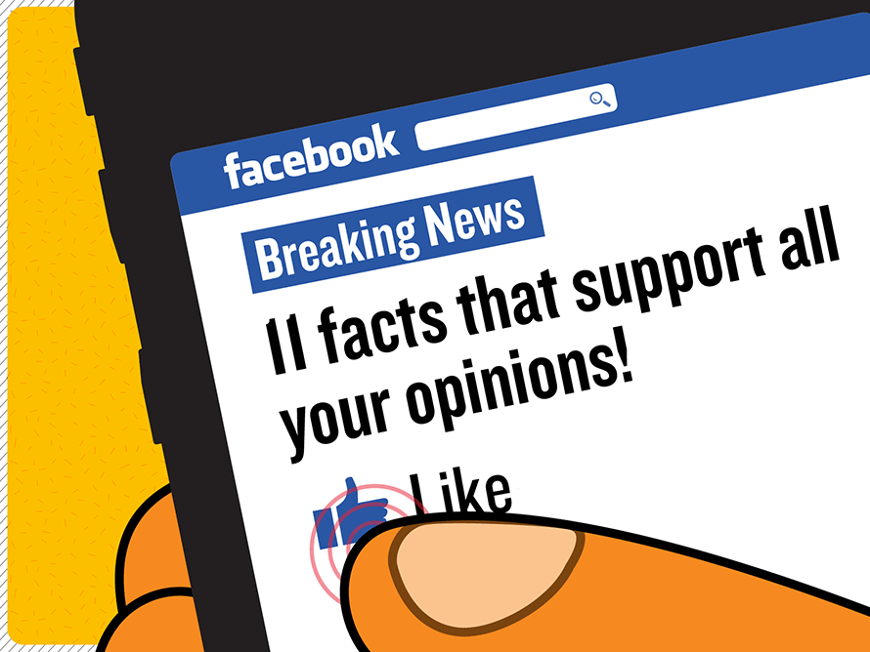
Everyone is talking to themselves
Indeed, it could be argued not just that there is no one dominant ideology or that there is a plurality of media but in the social media age everyone is talking to themselves in a digital echo chamber.
The Echo Chamber

