Slide 1
Models of voting behaviour

Slide 2
SQA Course Specification
Candidates analyse, evaluate and compare the effectiveness of the following:
rational choice model
sociological model
party identification model

Slide 3
Past paper questions
SQA 2019 Paper
To what extent is the rational choice model more relevant in explaining voting behaviour than other models in the UK today? (20)

Slide 4
models
The Rational Choice Model believes voting behaviour is best explained by voters deciding to make a choice based on what is best for their personal social/economic circumstances.
The Sociological Model believes voting behaviour is best explained by long term factors such as social class, gender and race.
The Party Identification Model believes voters see politics through an ideological lens, adopt a certain party as their own and vote for it regardless of its policies or issues.

Slide 5
Line of Argument
There is no argument!
In reality, modern elections are so volatile and the factors are so complex that no one model can explain or predict all elections.
All three models have their strong and weak points.

Slide 6
The Rational Choice Model

Slide 7
Rational Choice
Growth of the middle class
Dealignment
Elections fought over the middle ground
First Past the Post and the importance of ‘floating voters’

Slide 8
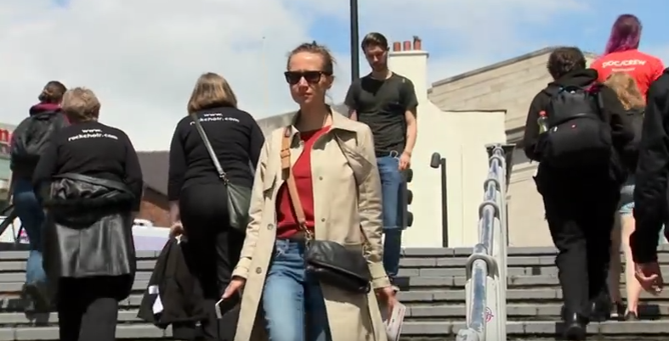
Rational choice: Tuition FEES
Voters may vote for the SNP because of its promise never to introduce tuition fees for Scottish students at Scottish universities.
Labour’s promise to end tuition fees in England and Wales was widely seen as a popular policy with young voters.

Slide 9
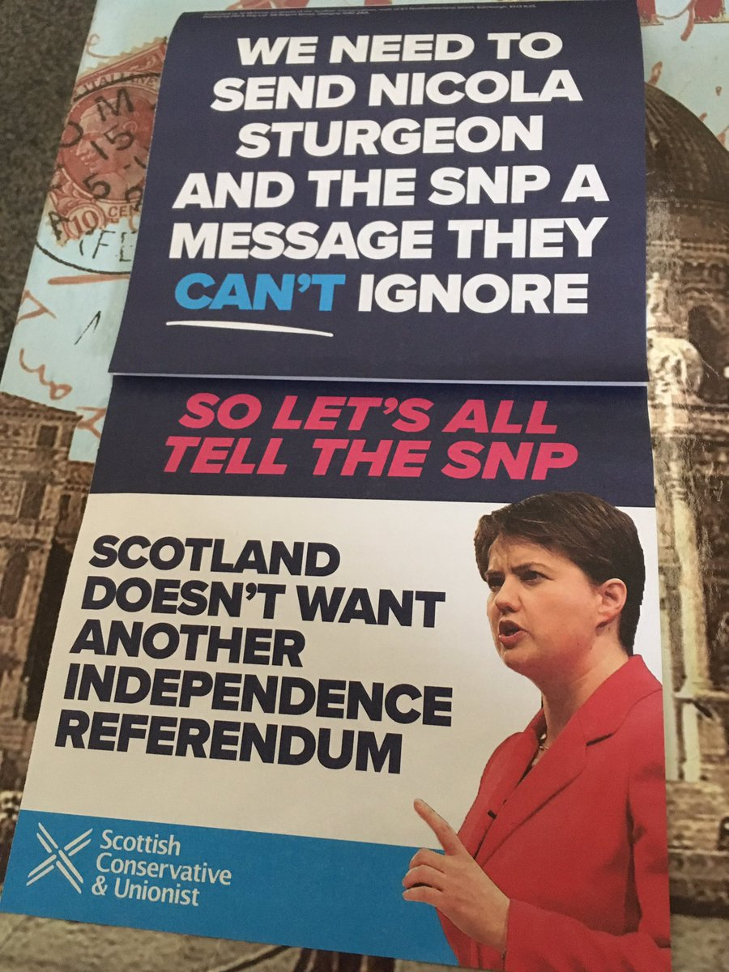
Rational choice: the constitution
The Scottish Conservatives did well in 2017.
The party won 28.6% of the vote in Scotland and 13 seats, up 12 from 2015.
The Scottish Conservatives campaigned almost exclusively against a 2nd Scottish independence referendum.
Some voters may have felt that voting against a second Independence referendum was a rational choice which trumped all the other influences.

Slide 10
Longer term influences
Others though do not believe that voters exist in a vacuum.
They believe there are powerful long term influences which shape how we view the world.
We may make a rational choice when we vote, but our social class, gender, race, age and the media we consume shapes how we form this rational choice.

Slide 11
The sociological model

Slide 12
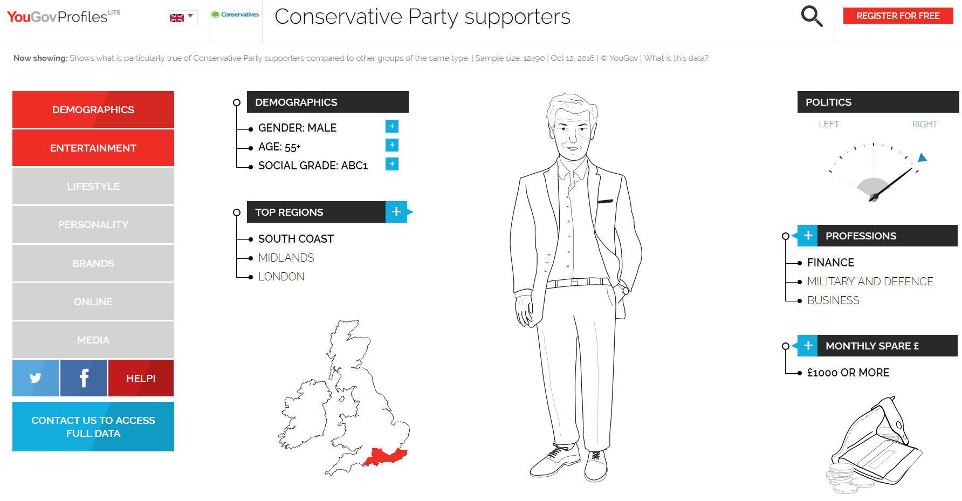

Slide 15
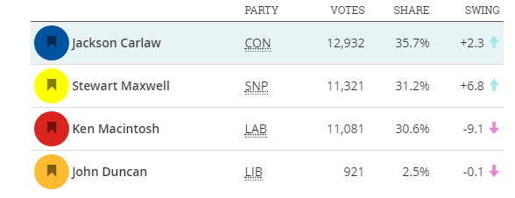
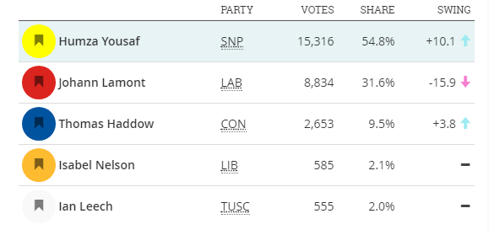
social class
Social class remains a factor in voting behaviour. The First Past the Post voting system reflects the class divide in society. Some constituencies are solidly middle class and affluent; and more likely to be won by the Conservatives and others are working class and less affluent and more likely to be won by the SNP or Labour.
These two Scottish parliamentary seats border one another. These were the results in the 2016 Scottish parliament constituency elections. (Source: Democratic Dashboard)
Eastwood
Glasgow Pollok

Slide 16
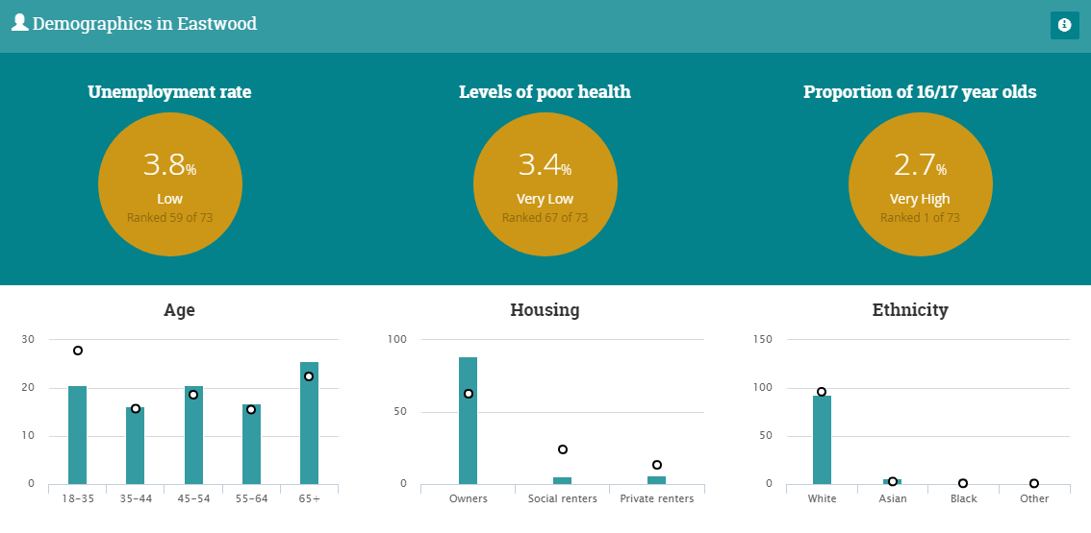
Affluent eastwood

Slide 17
Less Affluent Glasgow pollok

Slide 18
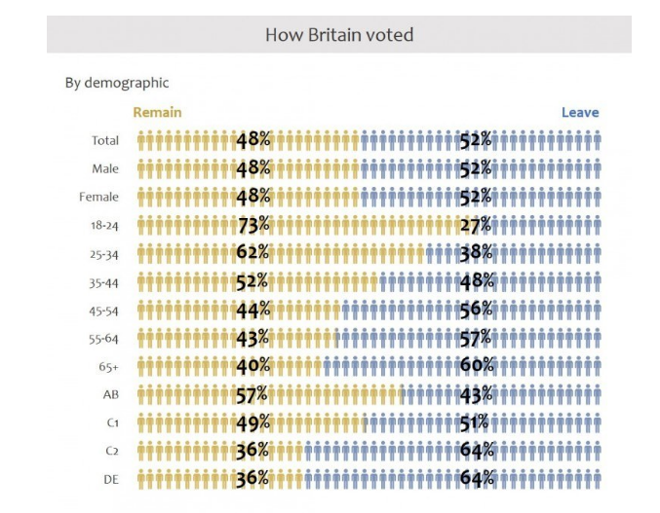
brexit and social class

Slide 19
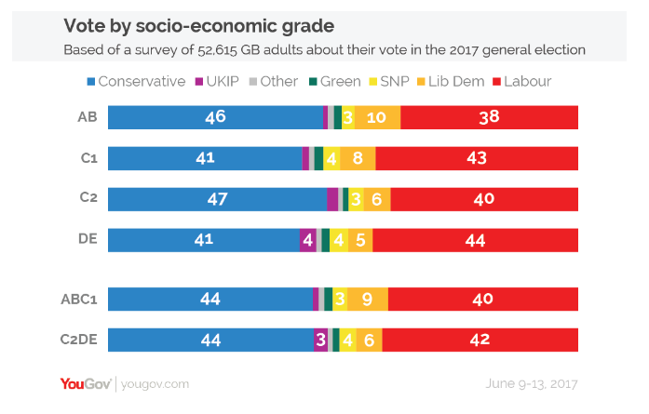
social class
Social class is clearly a factor in how people vote, but its influence is changing.
What has been noticeable in recent elections is how the Conservative Party has increased its share of the vote among traditional Labour voters.

Slide 20
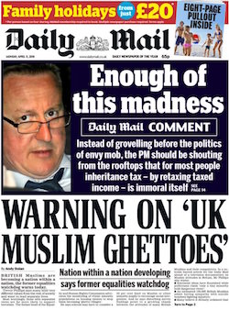
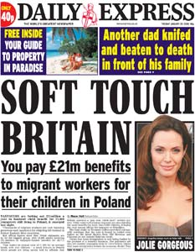
social class
Conservative policies, such as cutting welfare payments, leaving the EU and limiting immigration may have an appeal for lower income voters who resent the ‘workshy’ and are fearful of losing their jobs to EU and non-EU immigrants.
Better-educated people are now more likely to vote for “Left-wing” parties or centrist causes, while those who never went to university are more likely to vote for “Right-wing” or populist parties.
The Labour party is increasingly appealing to educated, cosmopolitan city dwellers, rather than its ‘traditional’ working class.

Slide 21
age
Age seems to be the new dividing line in British politics. Amongst first time voters (those aged 18 and 19), Labour was forty seven percentage points ahead. Amongst those aged over 70, the Conservatives had a lead of fifty percentage points.

Slide 22
race
Traditionally the Conservatives have struggled to win the support of ethnic minorities. The party’s reputation as the ‘nasty party’, as indifferent to the needs of ethnic minority have been hard for the party to escape from.
This is despite the affluence of many minority voters and the Conservatives having high profile minority representatives.
In 2017, Labour increased its appeal with black and minority ethnic voters.
The party's share of the BME vote rose six points compared with 2015, to take 73% of the vote. The popularity of the Conservatives among BME voters fell by four points on the previous general election.

Slide 23
Party identification model

Slide 24
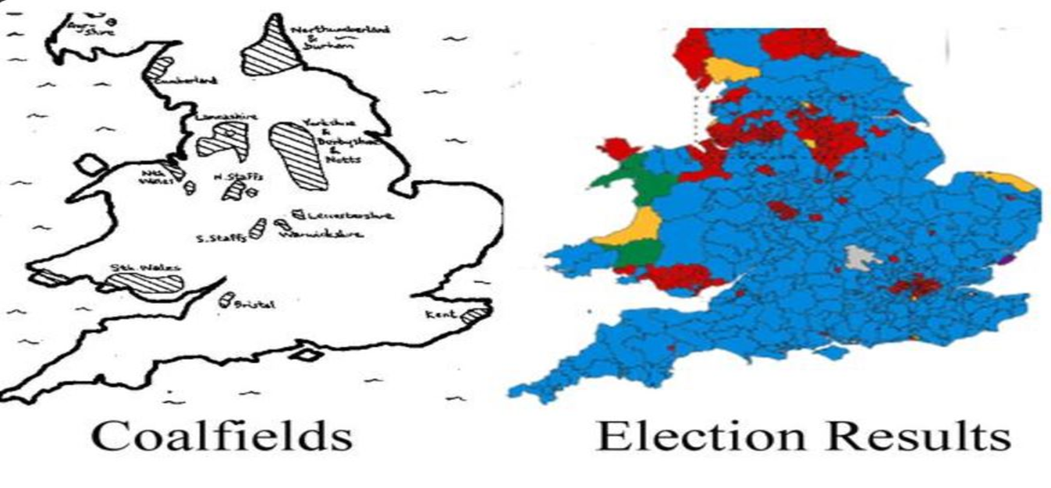
Labour Heartlands
The very clever @VaughanRoderick put together this map of Labour seats in England and Wales with the remaining coalfields. It shows Labour’s vote in the 2015 UK General election holding well in its traditional working class communities of England and Wales.
But not so well elsewhere.

Slide 25
SNP share of vote in Scotland since 1945, 1945-2016
(Scottish parliament elections in red.)
David McCrone, University of Edinburgh, Understanding Scotland.

Slide 27
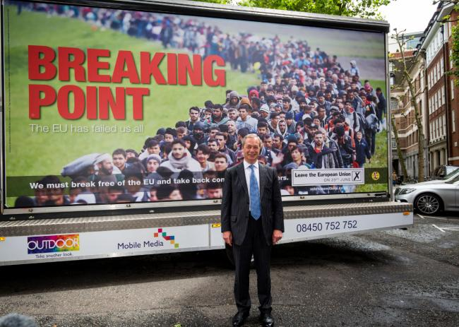
Leave campaigners were accused of ‘dog whistle racism’ during the EU referendum campaign; exploiting racist stereotypes and fears over immigration.
Racial tension undoubtedly played a part in some voters’ decisions. White voters voted to leave the EU by 53% to 47%. Two thirds (67%) of those describing themselves as Asian voted to remain, as did three quarters (73%) of black voters. But social class and a wider disenchantment with the ‘Westminster elite’ may also have had an influence.

Slide 28
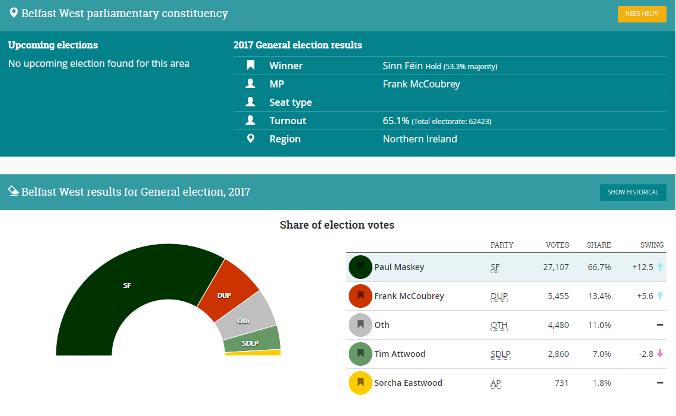

Slide 29
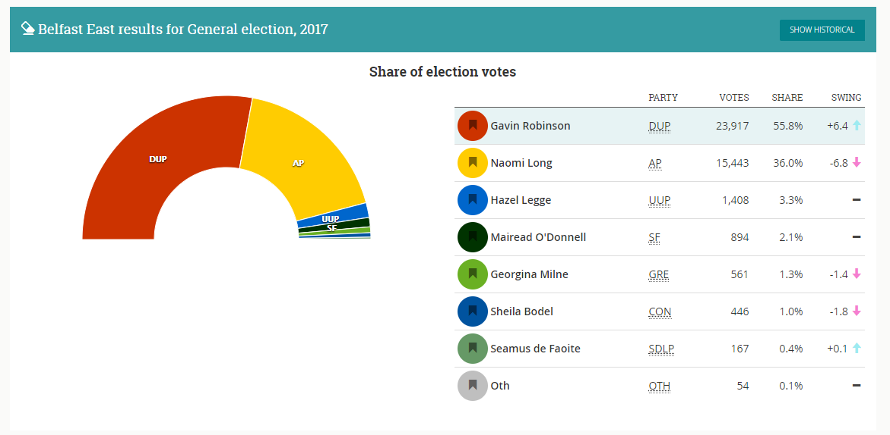

Slide 30
BuT…

