Slide 1
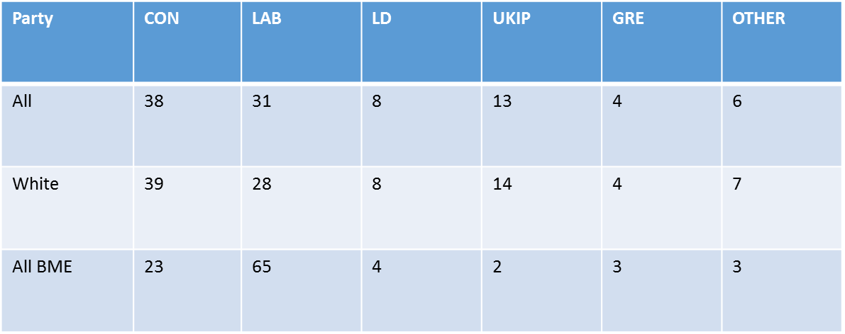
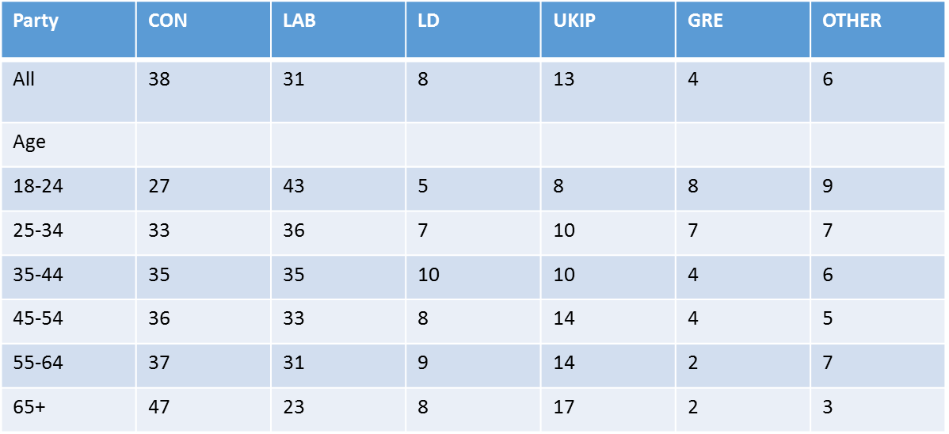
2015 Ethnicity - The statistics are quite conclusive.
2015 Age – the older you become the more conservative you become

