Slide 1
Political systems: executive v legislature part 2

Slide 2
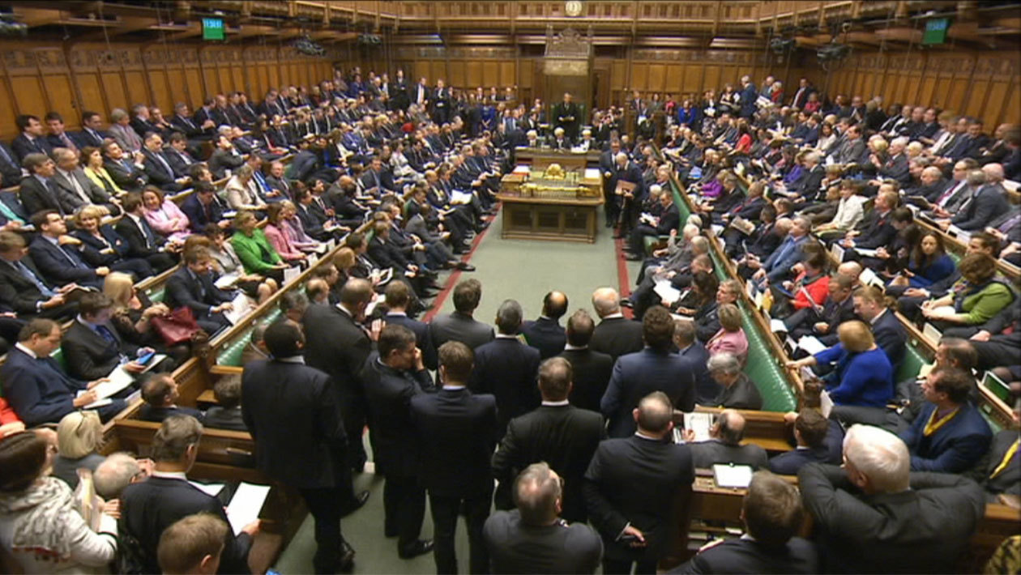
Contrast with uk
The Government motion to deploy military forces in Syria in 2013 was defeated by 13 votes. Despite its defeat the Government stated that it would respect the will of the House, a move that was widely viewed as an assertion of Parliamentary sovereignty.

Slide 3
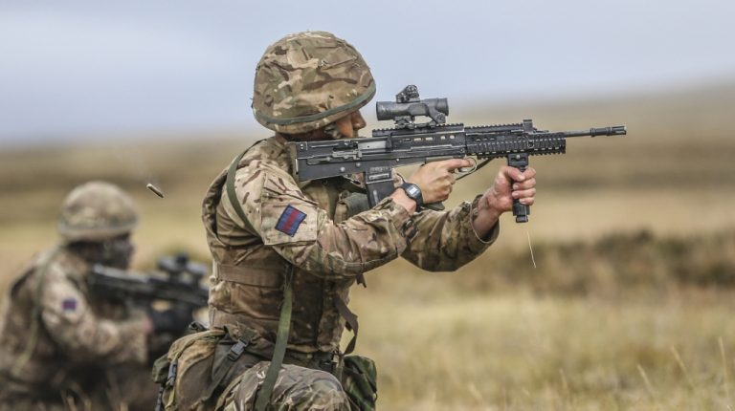
However…
The power to declare war is currently in hands of the Prime Minister alone. They can consult Cabinet. This prerogative is an outdated remnant of the traditional powers of the Crown, delegated since the 18th century to their appointed Prime Ministers. Politically, this may not be so easy to do.

Slide 4
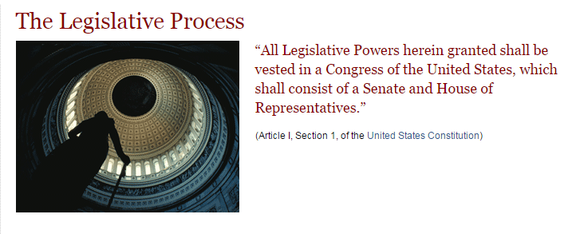

The us legislative process
First, a representative sponsors a bill. The bill is then assigned to a committee for study.
If the bill passes by simple majority (218 of 435), the bill moves to the Senate.
In the Senate, the bill is assigned to another committee and, if released, debated and voted on.
Again, a simple majority (51 of 100) passes the bill.
Finally, a conference committee made of House and Senate members works out any differences between the House and Senate versions of the bill. The resulting bill returns to the House and Senate for final approval. The Government Printing Office prints the revised bill in a process called enrolling.
The President has 10 days to sign or veto the enrolled bill.

Slide 5
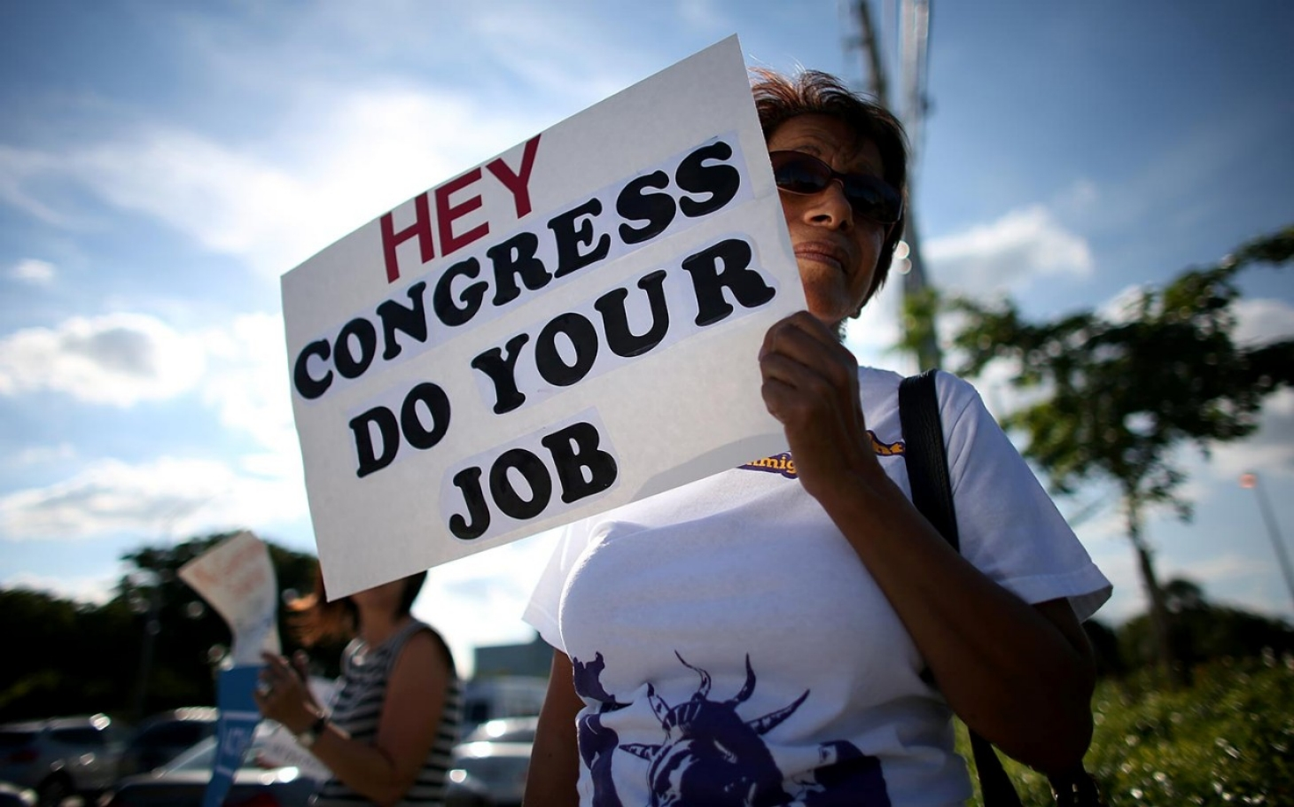
GRIDLOCK

Slide 6
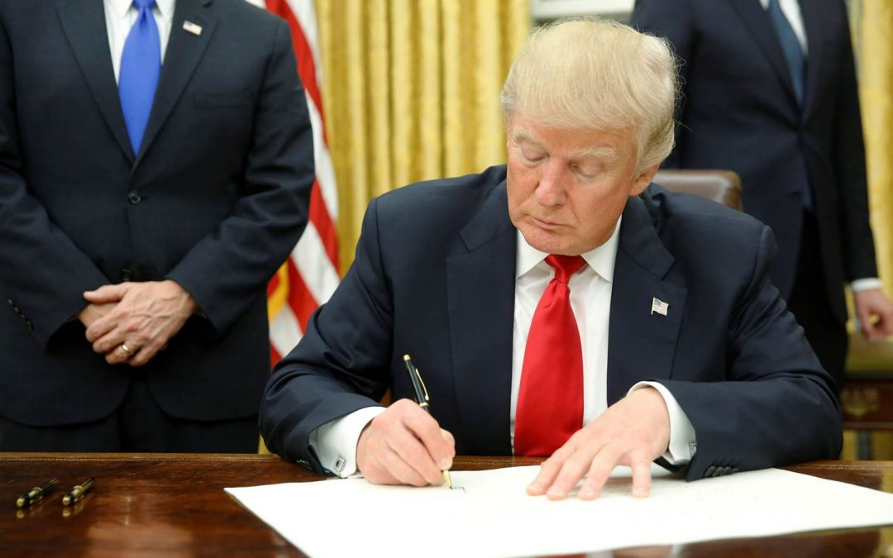
Executive orders
Congress has the power to overturn an executive order by passing legislation that invalidates it. Congress can also refuse to provide funding necessary to carry out certain policy measures contained with the order or to legitimize policy mechanisms

Slide 7
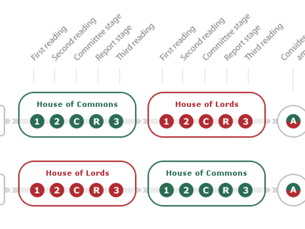

Slide 8

Whip’s role in legislation
Julian smith 2019

Slide 9
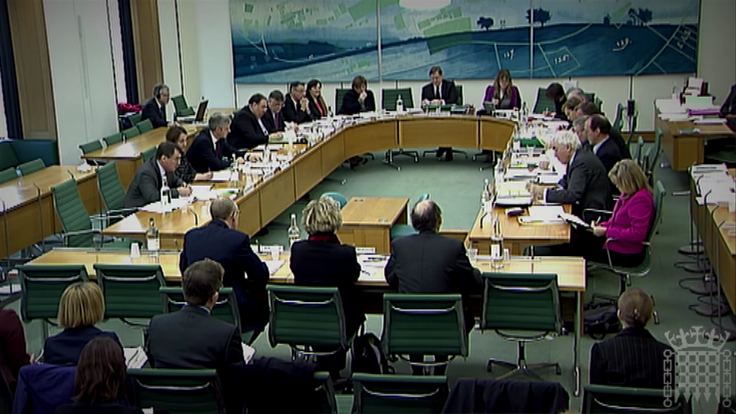
Select and legislative committees
There are Legislative and Select Committees which MPs can join. Away from the theatre, some would say the circus, of the Commons chamber, MPs work seriously on amending and improving legislation.

Slide 10
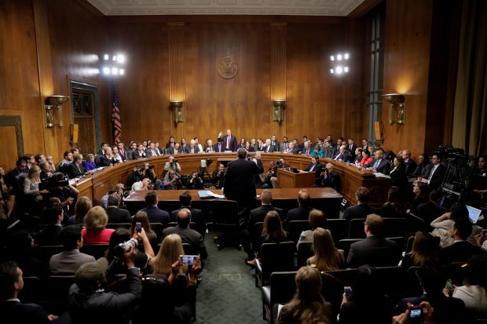
Little legislatures more powerful than UK’s

Slide 11

Donald Trump Jnr
Called before Senate Intelligence Committee investigating Trump Snr’s links with Russia in 2016 Presidential Election.
Expected to ‘plead the fifth’.
Must provide documentary evidence though

Slide 12
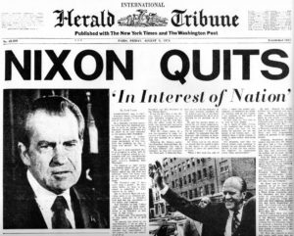
impeachment

Slide 13
Conclusions
Some Executives are more powerful than some Legislatures. For example…. Why…..?
It depends on a range of constitutional and political cards. Such as….
How they play them and how they react to events. For example…..

