Slide 1
CFE Higher Politics Political Theory
Political Ideologies:
CONSERVATISM

Slide 2
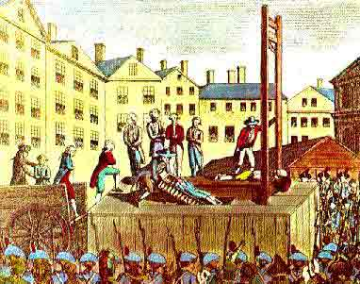
What led to conservatism? Reaction to French revolution
Liberty and equality - problematic
Overthrown of monarchy - creation of Republic
Replacement of religion
Collapse of economy
Terror
Dictatorship
Napoleon

Slide 3
Tradition, security and social order
Revolution had abandoned traditional forms of authority; monarchy, clergy, which had stood the test of time
‘no generation should ever be so rash as to consider itself superior to its predecessors’
French revolution had sacrificed security and order in the name of some abstract ideas…which ended up making things worse and created chaos and disorder

Slide 4
Conservatism - Definition
It is important to distinguish between Conservatives and conservatives.
Conservatives (i.e. big C) is how we refer to the UK Conservative Party
conservatives (i.e. small c) relates to ideas, i.e. a political model.
For instance, someone who is against changing the pound to the euro would be seen as conservative (i.e. resistant to change) however they many not vote for the UK Conservative party

Slide 5
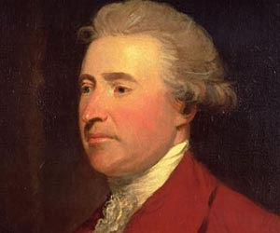
Conservatism - Definition
Conservatism (Latin: conservare, "to preserve") is the belief that traditional institutions work best and that society should avoid radical change.
Some conservatives seek to preserve things as they are, emphasizing stability and continuity, while others oppose modernism and seek a return to the way things were.
The term has since been used to describe a wide range of views.
Political science often credits British politician Edmund Burke with many of the ideas that we now call conservative

Slide 6
Conservatism - Basic features
Human Imperfection
Tradition
Organic society
Hierarchy and Authority
Property
Discuss the meaning of these terms and how they could relate to a description of how the world works and what it should be like in the future

Slide 7
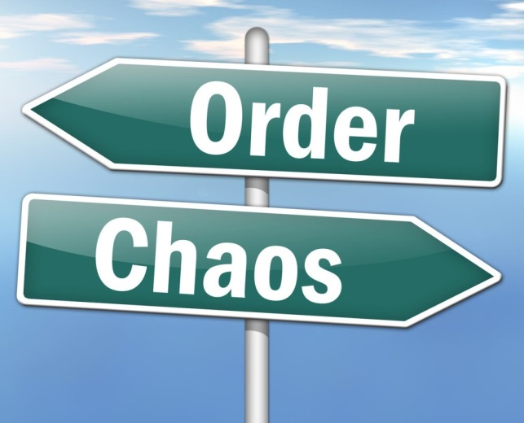
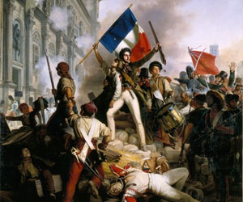
Conservatism - Definition
Many argue that conservatism has no real ideological basis
– instead they regard it as a practical attitude about politics
Conservatism in its modern form, developed in Europe in the 1790’s as a reaction to the Radicalism of the French Revolution.

Slide 8
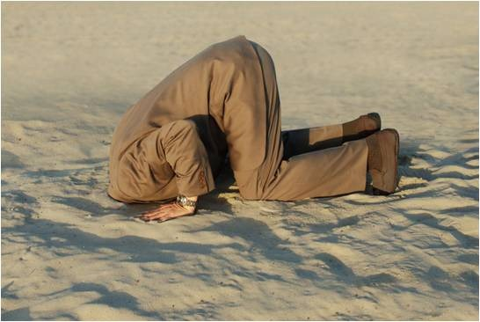
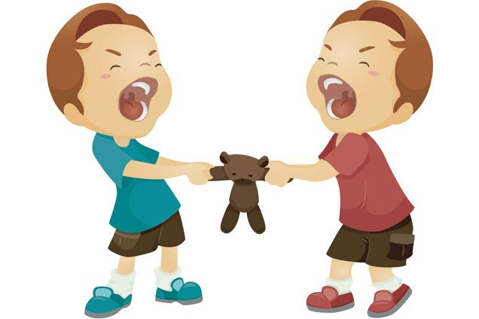
Conservatism - Definition
Conservatism encompasses the following views:
1. Human Imperfection
Selfish
Greedy
Irrational
Motivated by basic instincts

Slide 9
Burke believed the most important quality in society is order
Most people will obey the state as long as it provides order
Any other theorist with a similar view on order and the state?
Thomas Hobbes

Slide 10
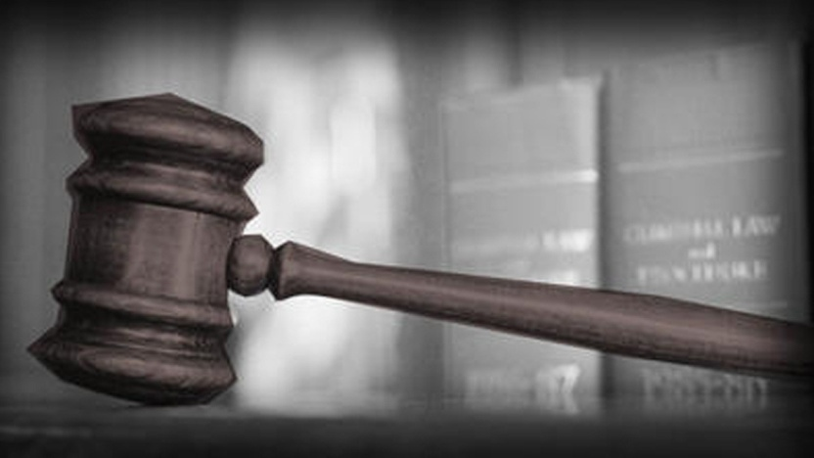
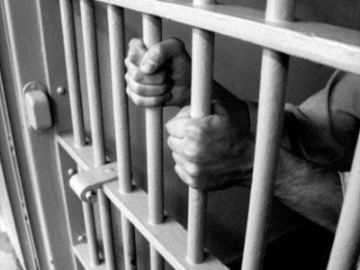
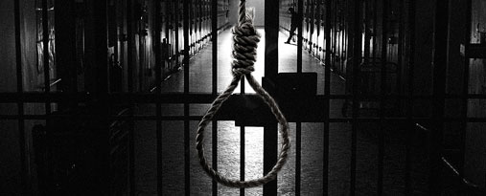
Clear Laws need to be in place
Strong punishments for unacceptable behaviour
What might a conservative say about
Reasons for braking the law?
How to stop people breaking the law?

Slide 11
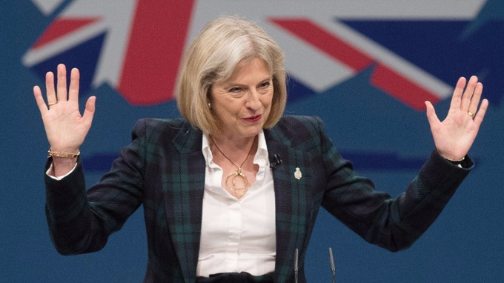
2. Organic Society
Humans are dependent creatures
Fear isolation
Crave security
Natural – not rational
Therefore
Knowing who is in charge is important – more important than freedom, choice and change

Slide 12
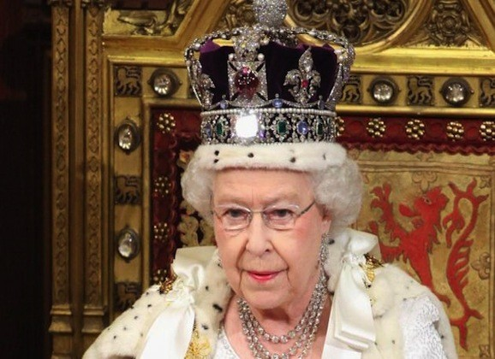
3. Tradition
Support tradition & opposed to change
Support for the Monarchy and Religion

Slide 13
4. Hierarchy and Authority
Society naturally hierarchical characterised by fixed of established social gradations.
Social equality is undesirable and unachievable – are unequally distributed. Burke – “natural aristocracy” – talent and leadership are innate qualities that cannot be acquired through self-advancement.
Authority – from above. Leadership and discipline are crucial. Various classes and groups that make up society have specific roles. Discipline is a willing and healthy respect for authority. Authoritarian conservatives state authority is absolute and unquestionable. Most believe, however, believe authority should be exercised with limits.

Slide 14
People will accept authority
How is order kept?
Courts
Law
Military
Police
School
Workplace

Slide 15
5. Property
Talent is not distributed equally – rewards should reflect this
Property gives people a stake in society
Encourages responsibility
Security and self reliance
Promotes traditions eg inheritance

Slide 16
Any examples of policies in the that are conservative - Discuss
Cuts in inheritance tax
Grammar schools
Privatisation of industries
SNP – cutting air passenger duty
Strong law and order
Right to buy council houses

Slide 17
Read hand out and answer questions

Slide 18
Different strands of Conservatism
conservatism
Traditional
(authoritarian)
Conservatism
Hobbes/Burke
One nation
(paternalist)
Conservatism
Disraeli
The New Right
(neo-Liberal)
Conservatism
Thatcher

Slide 19
One Nation
Paternalistic conservatism
Social conflict could be reduced through social reform
Rich had an obligation to the poor
This would unify the nation - harmony

Slide 20
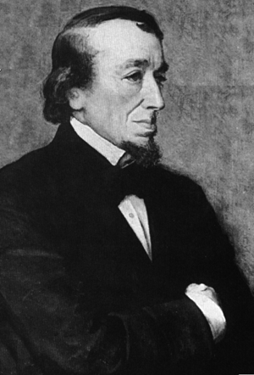
One nation conservatism
Benjamin Disraeli
1804-1881
Emphasized social responsibility as opposed to extreme individualism
Warned against the development of two nations-rich and poor which would lead to conflict, disorder and revolution
The rich had obligations to the poor and government had to rule in the interests of the whole nation and care for the welfare of all classes
Social conflict could be avoided by creating national unity-patriotism, common traditions and provision of social welfare
Conservative governments sought to win working class support for the traditional social order via managing the economy to reduce risky inequalities
Introduced laws to improve public health and conditions for workers

Slide 21
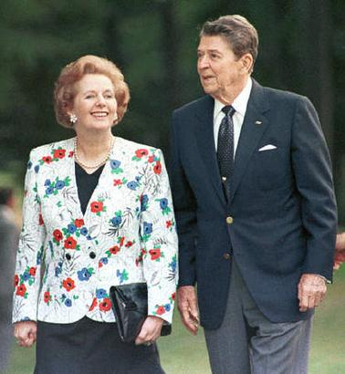
The New Right
Thatcher/Reagan
Cut government interference in economy: deregulation, privatisation, support for free markets
Low taxes to encourage incentives and individual responsibility, cuts in social welfare to end dependency culture
Strong state to maintain law and order, harsh sentences to deter crime
Traditional family values and respect for authority
clip
clip

