Slide 1
Background to the USA

Slide 2
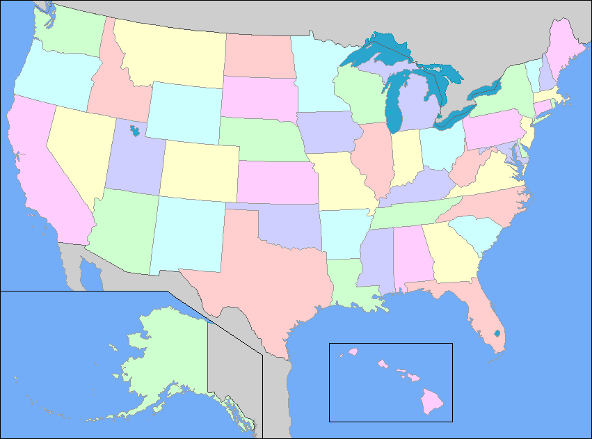
It’s a big country!!
The USA is the third largest country in the world (by area) and has a very diverse population of 316 million people
With an area of 9,632,418 square kilometres, it is slightly larger than China.

Slide 3
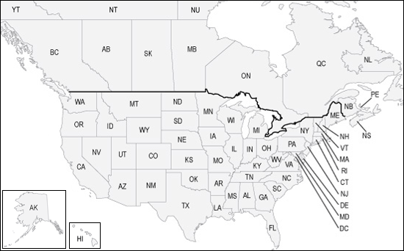
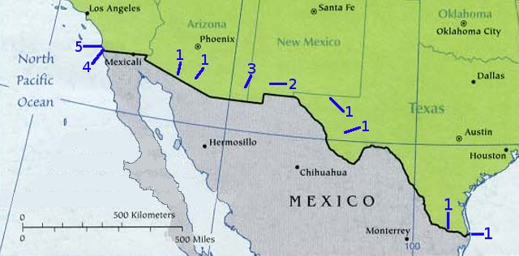
It has very long borders
The US border with Canada is 8,893 km long (including 2,477 km with Alaska). The border with Mexico is 3,141 km long.

Slide 4
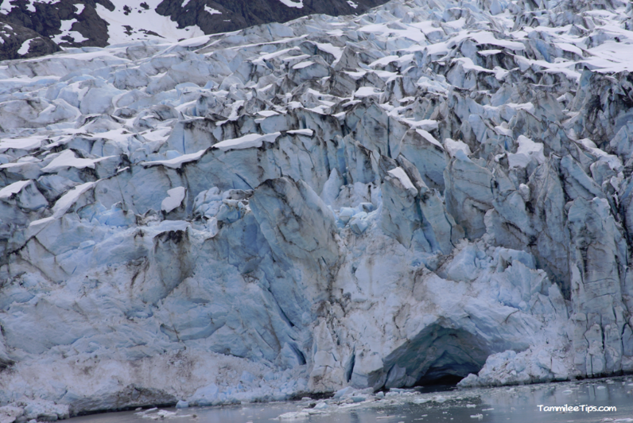
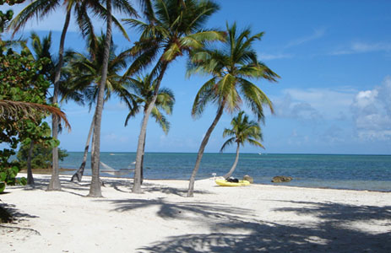
It blows Hot and Cold
The different states in the USA vary greatly in temperature.
In Florida you are likely to find a tropical climate however if you pay a visit to Alaska you will find arctic weather.
Alaska’s lowest ever temperature was –79.8°C in 1971.

Slide 5
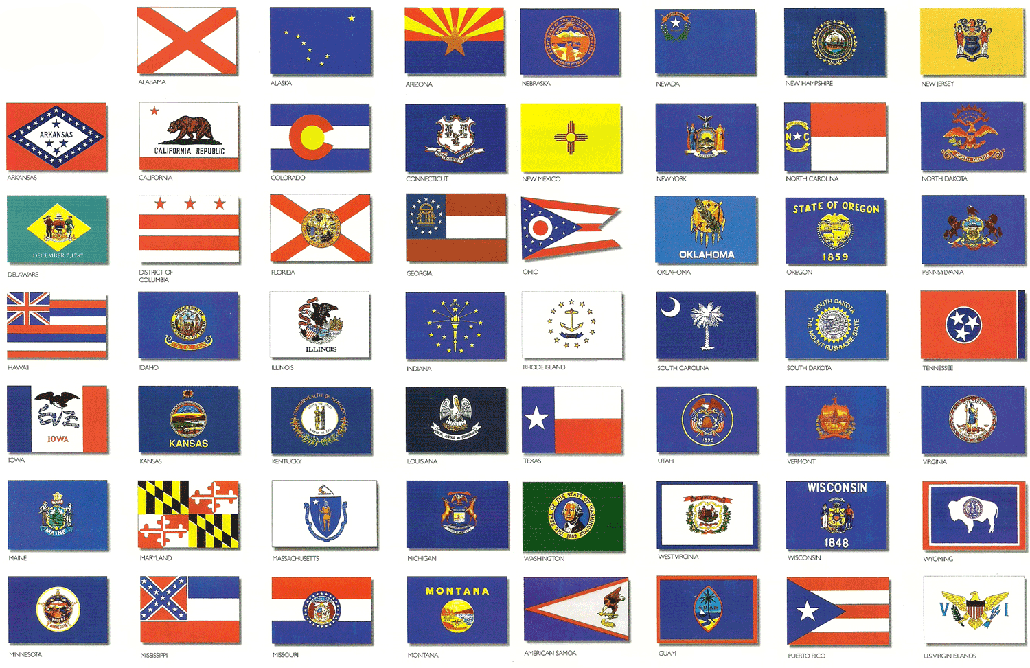
States
The USA has 50 States.
Each state has its own capital, flag, nickname and motto.

Slide 6
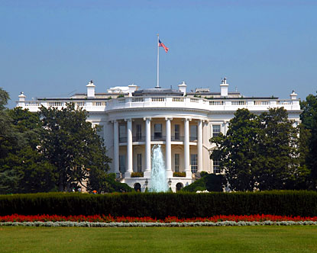
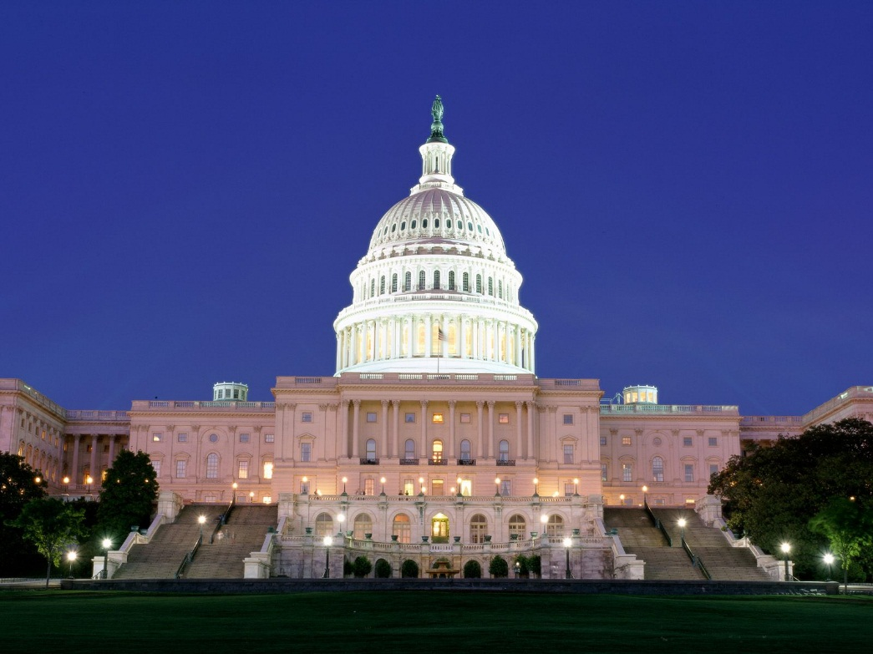
The Capital
The only place in America not in a state is Washington DC as it is the countries Capital.

Slide 7
TASK
How many US states can you name in 10 mins
Using the map that is shown on the board try to name all 50 states.
You can work with a partner or Individually.
You get a point for every state you get correct
DON’T CHEAT- NO PHONES ALLOWED

Slide 8
People
There are several main ethnic groups in the USA.
The main ethnic groups are:
White- who make up around 63 per cent of the population and are the dominant ethnic group.
Black/African American- who makeup around 13 per cent of the population and mainly live in the South

Slide 9
People
Hispanic/Latino- who make up around 17 percent of the population and tend to come from areas such as Mexico, Cuba and Puerto Rico- both legally and illegally.
Asian- Who make up around 5 per cent of the population and mostly come from China, Korea and Japan, which are closer to the west coast of America.
Native American- who now only make up around 1 percent of the population; they are the indigenous population of the USA

