Slide 1
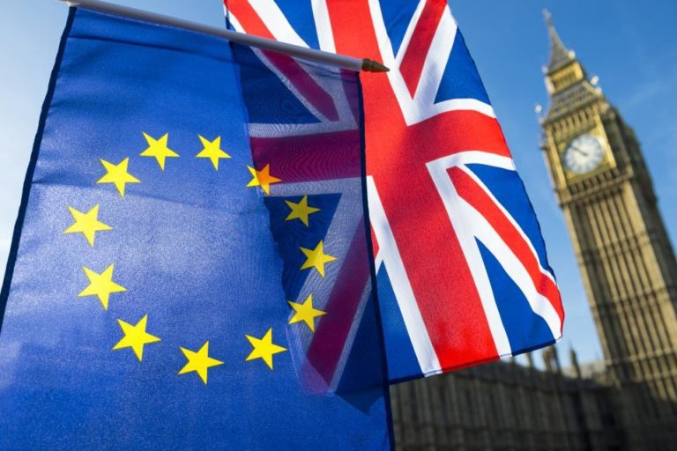
The Journey to Brexit

Slide 2
Lesson number | Title/Content | Resources | Slides
1 | Introduction to topic, mind map and LIs | Jotter | 2-3
2 | What is Brexit and What is the EU | Videos, jotter | 4-5
3 | Who is in the EU and Why does Brexit make such big news? | PPT, Jotter, Diary Planner | 6-7
4 | Important Highlights referendum, result and resignation | PPT, Videos | 8
5 | The referendum in numbers , numeracy tie in, using percentages and voting statistics to reach conclusions | PPT, worksheets,rulers & calculators | 9-11
6 | As above | As above
7 | Watch the Panorama (H/W to research and list 3 good reasons to stay and 3 to leave) issue on SMHW | Jotters, jargon buster if nec. BBC I player | 12
8 | Reasons to leave / remain | Handouts, internet h/w and jotter notes | 14
9 | Class survey and bar graphs – more numeracy | Jotters, graph paper and calculator | 15-17
10 | Brexit timelines background and where we are now ( to be updated as it unfolds)
11&12 | Brexit Letter Assessment, | PPT slide, A4 paper, template | Letter ppt
Possible Extra tasks | Extensions if required - Scottish angle slide 13, Poster for leave or remain protestors - design a placard, Send a tweet with your message

Slide 3
What do you know about Brexit ?
BREXIT
Notes:
Allow the class to do their own mind map – usually teacher led from board – all to copy
Write a short Brexit is a controversial topic. By the end of the next series of lessons you will have an understanding of what it is all about.

Slide 4
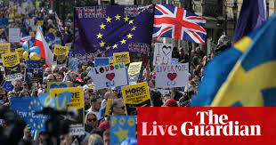
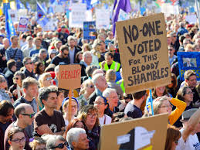
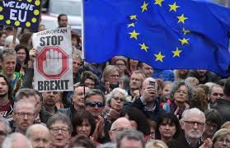
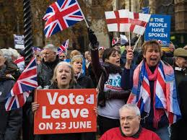
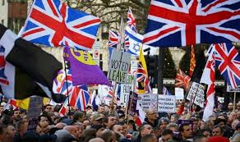
The importance of Brexit
Learning Intentions
To understand some key terms
To understand why it is important
To have enough information to form an opinion
To be able to see both sides of the argument
Remain v Leave
Notes:
Intro to mini topic/ project

Slide 5
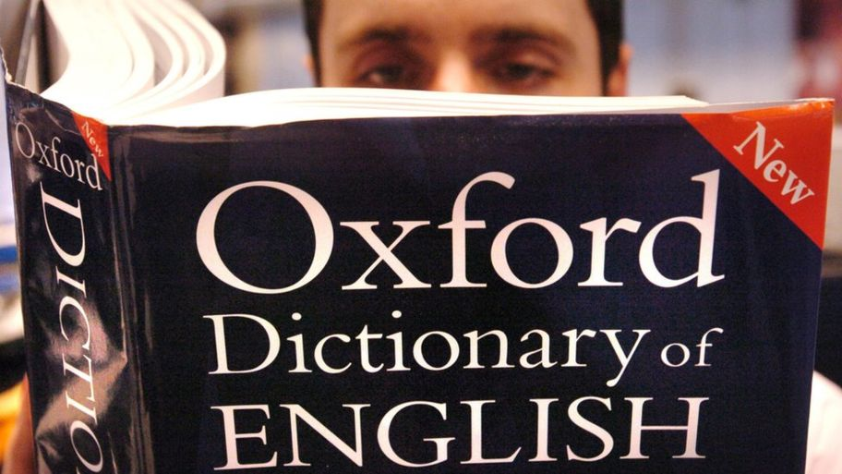
Key Terms
https://www.bbc.co.uk/newsround/38637145
BREXIT
European Union Hard Brexit
Soft Brexit Sovereignty
Article 50 Irish border
Referendum People’s Vote
Majority UKIP
Turnout Single market
Alliance Back Stop
Immigration
Notes:
New page in jotter – heading Key terms we can add to as we progress ? Or double page with BREXIT title page and pics on left hand side and key terms on right hand page ? The word Brexit entered the dictionary in 2016

Slide 6
What is the EU?
https://www.youtube.com/watch?v=p9ptBaL3_ns
Q1.The EU has its own
p________
a ____
m______
Q2.The idea of the EU was to help countries …
Notes:
60 Second explanation of EU then answer 4 quick questions. Parliament, anthem and money. Get along better, or trade

Slide 7
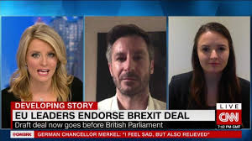
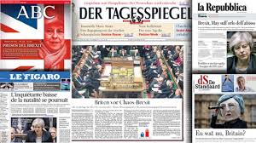
Britain’s exit from the European Union (EU) has become known as Brexit.
Brexit is now a real word and is in the dictionary with the definition
the withdrawal of the United Kingdom from the European Union
The whole world is watching the UK to see what happens next, it has made the news in many countries, not just the EU’s 28 member states.
Q. How many member states can you list ? You have 3 mins
Notes:
Q. Why is rest of world bothered? Why might people be puzzled by the goings on in Parliament? Task 3 mins to name countries as many as poss

Slide 8
Members of the European Union
Austria Italy
Belgium Latvia
Bulgaria Lithuania
Croatia Luxembourg
Cyprus Malta
Czech Republic Netherlands
Denmark Poland
Estonia Portugal
Finland Romania
France Slovakia
Germany Slovenia
Greece Spain
Hungary Sweden
Ireland United Kingdom
Notes:
Correct the answers and see if there is a winner ? Get them to look at their diary planner maps

Slide 9
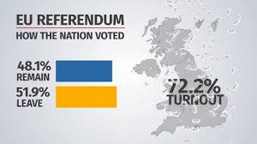
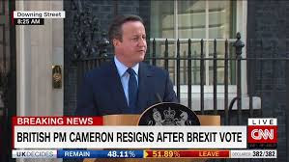
Important highlights
https://www.youtube.com/watch?v=CF6gXybuwUU
Result
Resignation
Notes:
Watch video – copy down result . Prompt – what isn’t likely to change ?

Slide 10
Using the EU referendum results
You will be adding, subtracting and working out percentages
You will use pie charts and bar graphs to show your results
Then ……..
Using the results of the EU referendum and the charts you have created we will look at how fair the result was.
Why were some people were happy about it whilst others were not?
Notes:
Use the separate hand out pages to get the answers into jotters. Heading numeracy task

Slide 11
To get the percentage
Example
number of people who voted
total population
X 100 = %
EU Referendum
Numbers
Across the whole country 33,551,983 people cast their votes.
The total population of the UK is 64,100,000.
1.What percentage of the population voted?
2. Of those who did vote, 52% voted to leave the EU. How many people was this?
3.How many people voted to remain?
4a.In our area of North Lanarkshire, 154,949 people voted. 61.7% of those people voted to remain in the EU.
4b.What percentage of people in North Lanarkshire voted to leave?
4c.How many people in North Lanarkshire voted to stay? And how many to leave?
5.Show the North Lanarkshire numbers on the pictogram below.
Use to represent 5000 people.
Leave
Remain
Notes:
Help the pupils work out the percentages as class check answer before moving on
38.3 voted to leave
Split 60/ 38 – reflected the Scottish total vote – so people in NLC voted exactly as the Scottish averages
154,949 total vote – 95,604 voted to remain , 59,345 voted to leave

Slide 12
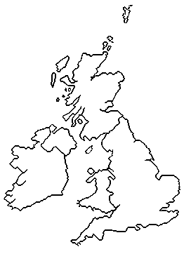
EU Referendum
Numbers
6.Although the final result was to leave the EU, this was not the case in each of the four countries of the UK. This sheet will show how each country differed.
Northern Ireland
Leave = 44%
Remain = 56%
Show these results in a pie chart
Scotland
Leave = 38%
Remain = 62%
Wales
Leave = 52%
Remain = 48%
England
Leave = 53%
Remain = 47%
7.Based on this data - not your personal opinion - do you think it is right that the UK will be leaving the EU? Can you justify your answer ?
Notes:
Colour the countries in – 4 different colours, then complete the graphs and charts

Slide 14
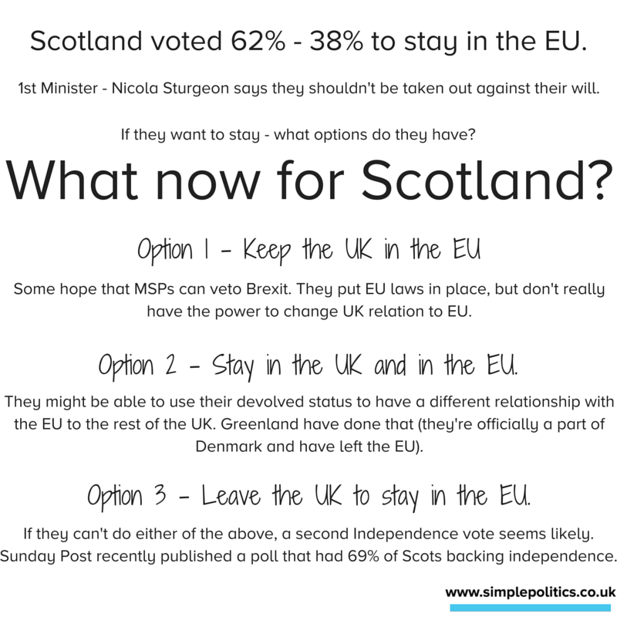
What now for Scotland?
Option I - Keep the UK in the EU. Some hope that MSPs can veto Brexit. They put EU laws in place, but don’t really have the power to change UK relation to EU.
Option 2 - Stay in the UK and in the EU. They might be able to use their devolved status to have a different relationship with the EU to the rest of the UK. Greenland have done that (they’re officially a part of Denmark and have left the EU).
Option 3 - Leave the UK to stay in the EU. If they can’t do either of the above, a second Independence vote seems likely. Sunday Post recently published a poll that had 69% of Scots backing independence. simplepolitics.co.uk

Slide 15
Make a table in your Jotters
Reasons to Leave
Reasons to stay
Using the hand outs and your internet research complete this table into your jotter

Slide 16
Class Survey
In pairs, make up questions you would like to ask the class/ family members about Brexit
Write down the questions and response options in your jotters
Your teacher will help you agree as a class the survey questions you wish to ask

Slide 17
Possible Qs
Q. Did you vote in the referendum? Yes No
Q. Would you change how you voted now there is a lot more information on what might happen? Yes No Don’t Know
Q. In Scotland the result in the referendum on Brexit was
Remain 68 % Leave 32%
Remain 32% Leave 68%
Remain 48% Leave 52 %
Q. Should 16 and 17 year olds been allowed to vote? Yes No Don’t Know
Q. If there was a People’s Vote (Second Referendum) and you were old enough to vote, would you vote
Remain Leave

Slide 18
Once you have carried out the survey, your teacher will help collate the class results
In your jotters write down the results and then turn each into a percentage
Show your results in bar graph form clearly labelling the x and y axis and colour coding your results

Slide 19
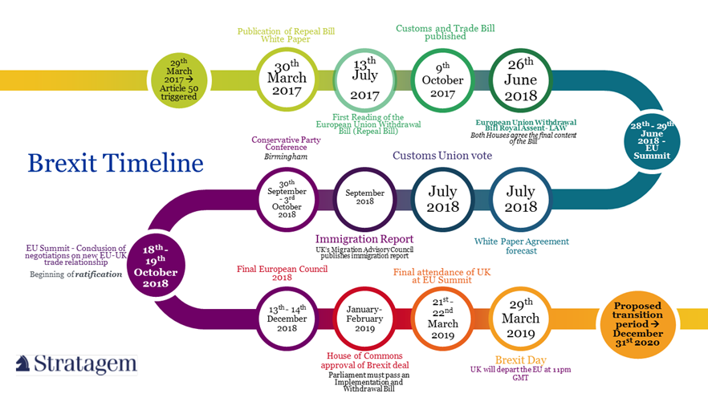
Create a timeline -part 1
Use the dates and the events on the next slide
Put the events in chronological order
Create a timeline for your jotter
Be creative and make it as easy to read and informative as you can

Slide 20
Timeline 2013- 2017
23rd January 2013
7th May 2015
23rd June 2016
24th June 2016
24th June 2016
13th July 2016
29th March 2017
8th June 2017
David Cameron announces idea of referendum
David Cameron wins 2015 election
Referendum date
Referendum Result
David Cameron resigns
Theresa May becomes PM
Article 50 is triggered
Theresa May loses her majority after a snap election

Slide 21
Background Timeline 2013- 2017
Formal negotiations on withdrawal begin between UK & EU
EU moves to 2nd phases of negotiations as agreement made about Irish Border
EU says negotiations must be complete in a years time.
MPs reject May’s withdrawal agreement by 432 to 202
MP’s reject Corbyn’s motion of no confidence by 325 to 306
Commons defeat on more plans against the Gov negotiating stategy
Second time MP’s reject Brexit deal 391-242
MP’s vote to delay Brexit past 29th March
MP’s reject withdrawal agreement 341-286
26th June 2017
15th Dec 2017
31st Oct 2018
15th Jan 2019
16th Jan 2019
14th Feb 2019
12th March 2019
14th March 2019
29th March 2019

Slide 22
Background Timeline 2013- 2017
EU agree extension
Offered New Deal
UK voted in EU elections
May announced stepping down as PM
Boris Johnson becomes PM
Johnson asks Queen to suspend Parliament and she approves
MP’s take control of Commons for the day and back a bill blocking a no deal Brexit
Supreme Court rules Johnsons suspension of Parliament unlawful, void and of no affect
MP’s return to Parliament following Supreme Court ruling
10th April 2019
21st May 2019
23rd May 2019
24th May 2019
23rd July 2019
28th Aug 2019
4th Sep 2019
24th Sep 2019
25th Sep 2019

Slide 23
Background Timeline 2013- 2017
Johnson makes a formal proposal to EU which would allow NI to remain under EU regulations
Deal seen as overwhelmingly unlikely following a phone call between Johnson and the Chancellor of Germany Angela Merkel
Parliament hosted a special session for MPs it was fifth time Parliament has sat on a Saturday in 80 years
Johnson obliged by the Benn Act to send a letter to the EU requesting a 3 month extension.
Parliament will dissolve for 5 weeks of campaigning
General Election will be held
New Brexit deadline unless Parliament passes Johnson’s Brexit Bill sooner
2nd Oct 2019
6th Oct 2019
19th Oct 2019
19th Oct 2019
6th Nov 2019
12th Dec 2019
31st Jan 2020

Slide 24
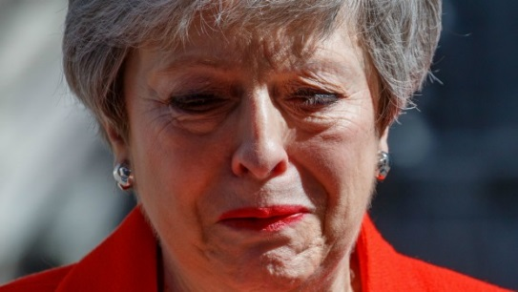
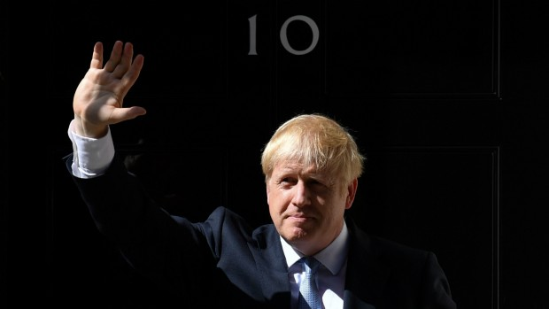
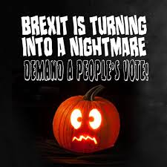
Let’s get right up to date
Theresa May put forward her proposed agreement to Parliament
Agreement gets rejected by Parliament x 3
(Jan 2019-March 2019) https://www.theguardian.com/politics/video/2019/mar/29/mps-vote-against-theresa-mays-brexit-withdrawal-agreement-for-third-time-video
Theresa May resigns June 2019
https://www.theguardian.com/politics/video/2019/may/24/theresa-may-resignation-speech-downing-street-video
Boris Johnson wins leadership contest & becomes PM July2019
https://www.youtube.com/watch?v=rcv_c2wZlsE
Boris Johnson asks Queen to suspend Parliament September 2019
Supreme Court decides decision unlawful September2019
https://www.bbc.co.uk/newsround/49808774

Slide 25
Brexit letter
You can be as passionate in your viewpoint as you wish
Put over at least 3 points of view to support your view
Make the case to be listened to – it is your future!
What do you want the Prime minister to do?

