Slide 1
International Issues – Terrorism
Section 1 - Causes

Slide 2
Political Causes of Terrorism

Slide 4
Terrorism motivated by political grievance.
There are many motivations for terrorism in the modern world. One motivation is because of political grievance.
Many organisations are formed because they believe that they have either exhausted the process of trying to achieve political change or that armed struggle is a necessary part of gaining change. Most of these groups tend to come from a nationalistic background and feel that the state they are protesting against has persecuted and subverted a minority culture.

Slide 5
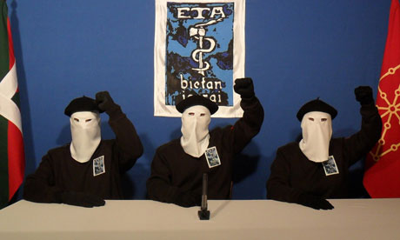
ETA
Grievance: Subversion and marginalisation of Basque culture.
Goal : Basque independence from Spain.
Methods: Attacks on high profile Spanish politicians, bomb attacks and shootings.
Reception: Have received much support and concessions given from Madrid. Some attacks have been met with criticism and protest, leading to their cause being damaged (Spanish government said they would refuse to negotiate).

Slide 6
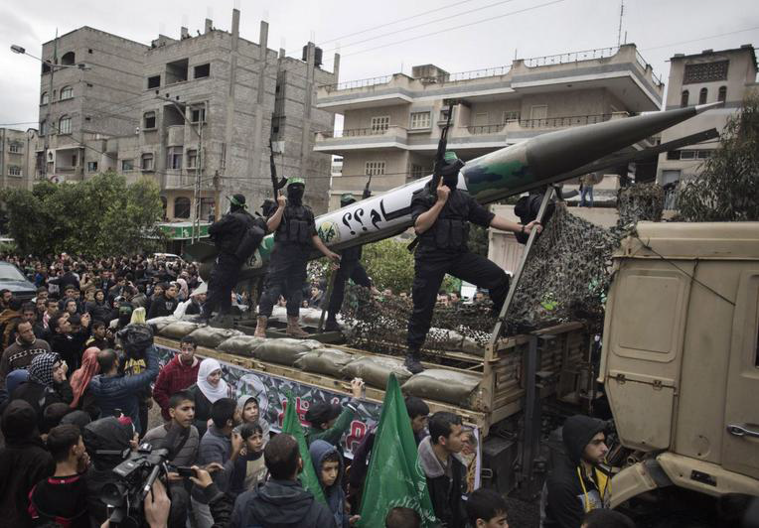
Hamas
Grievance: Israel’s illegal occupation of the Palestinian territories.
Goal : To "liberate" Palestinian territories from Israeli occupation.
Methods: Rocket attacks, bombings and targeting Israeli centres of power.
Reception: Have gained strong support in Palestine, becoming democratically elected government but received widespread condemnation from Western powers.

Slide 7
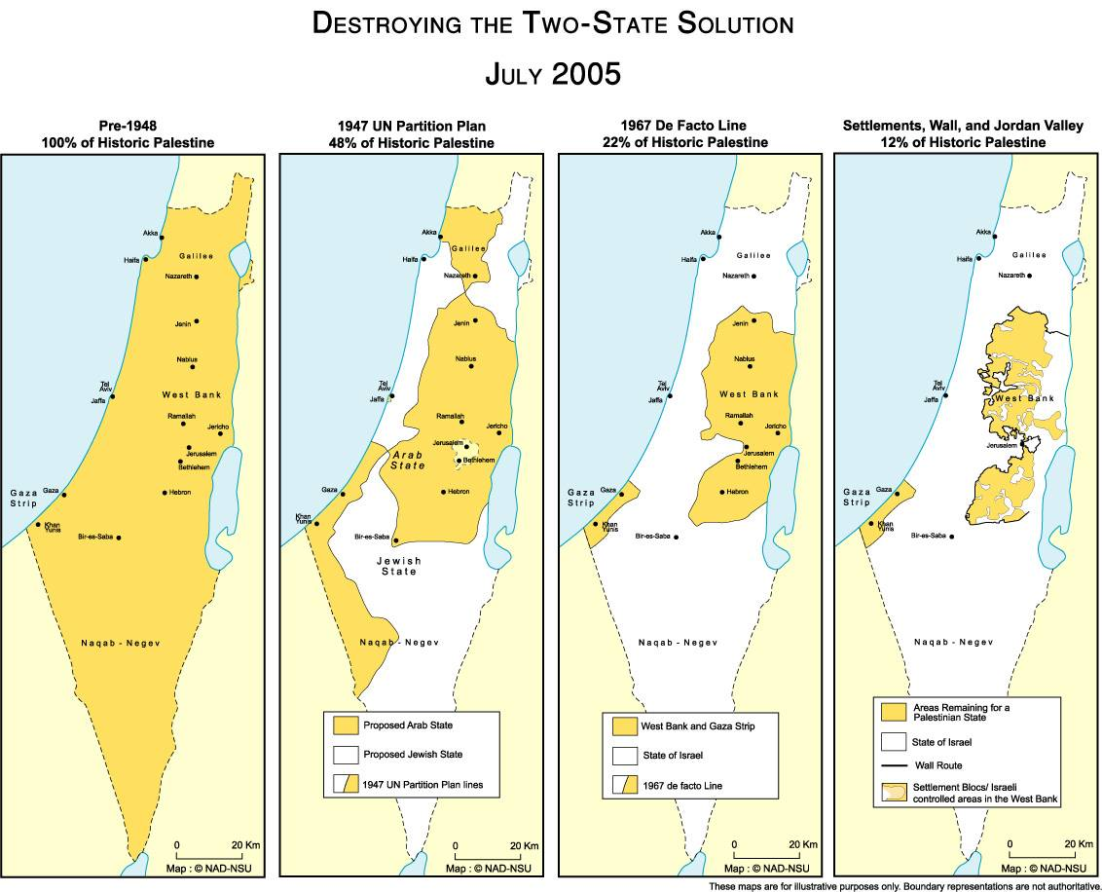

Slide 8
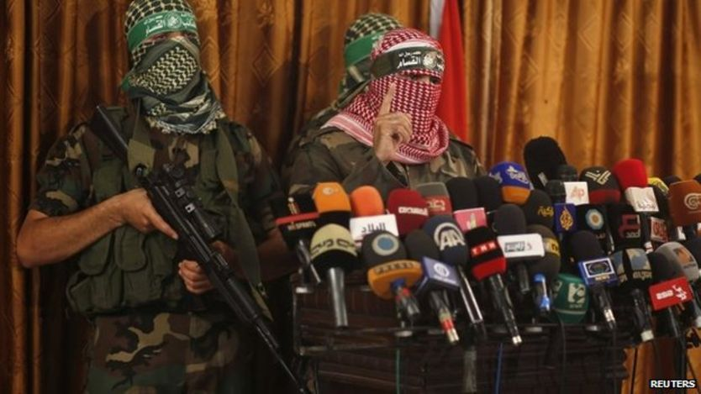
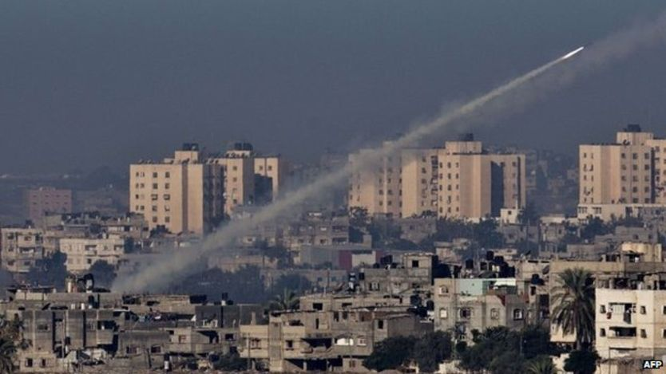

Slide 9
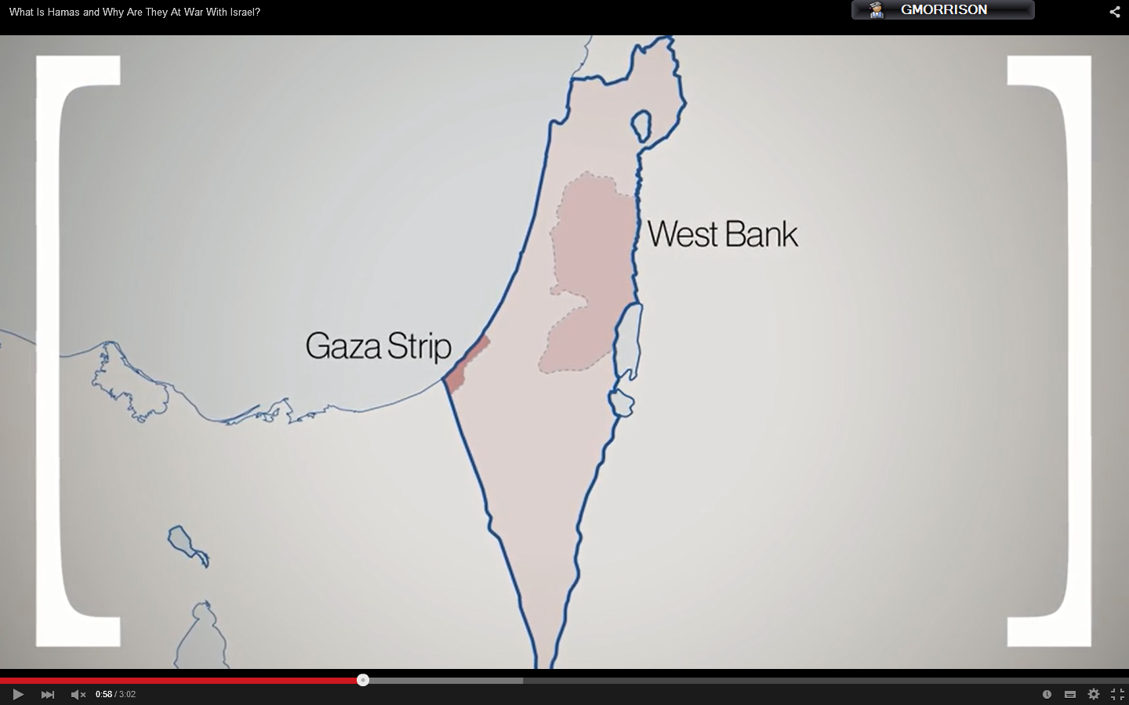
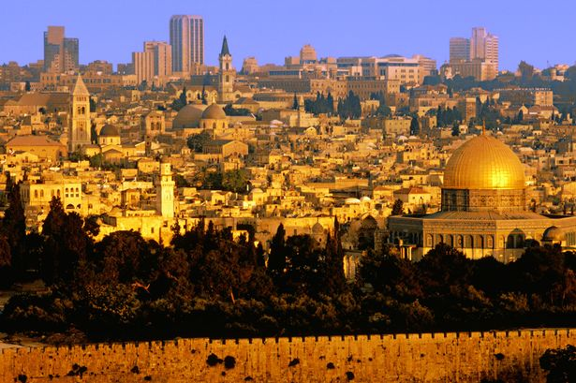
Gaza and the West Bank are controlled by the Palestinians but are occupied by Israel – under military control.
This is a source of great anger among many Palestinians who believe that there should be a sovereign Palestinian state. Israel is also strongly Jewish whereas Palestinians are Muslim.
There is particular contention over Jerusalem – Israel claims it as the city of David and Palestine identifies it as the place where the Prophet Mohammed ascended into heaven.

Slide 10
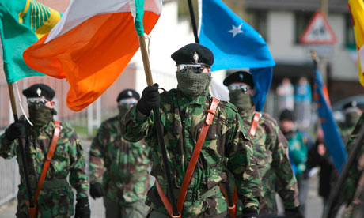
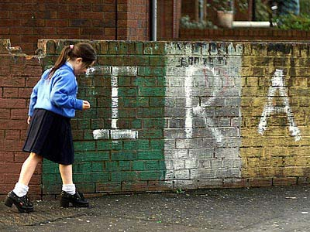
The IRA
Grievance: Britain’s subjugation of Ireland.
Goal : To create a free, independent, republican united Ireland.
Methods: Bombings, armed struggle and attacks on police officers/civilians.
Reception: Has split into many different factions. Largely unsuccessful in recent years in gaining concessions.

Slide 11
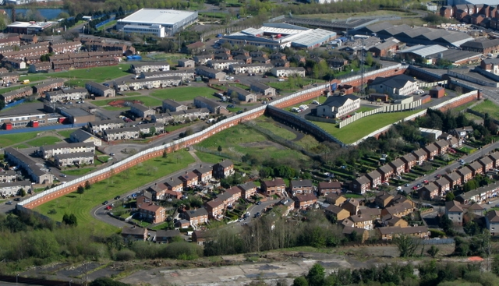

Slide 13
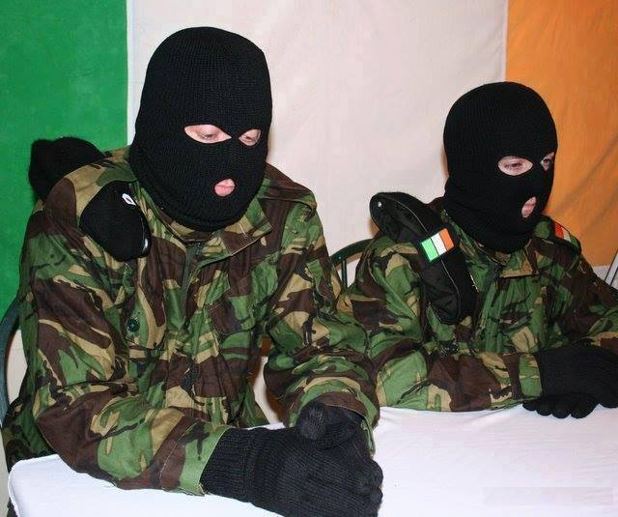
“The terrorist campaign is a war between a nationalist army and an occupying army…the use of the label ‘terrorist’ is designed to stop people thinking about the real situation in Ireland. Too often people fear that to criticise the British Army means ‘supporting terrorism’. But Britain is waging a war in Ireland and the Provisional IRA exists because the nationalist community has had to take up arms to defend itself in that war.”
Taken from a pro-IRA paper during ‘The Troubles.’

Slide 14
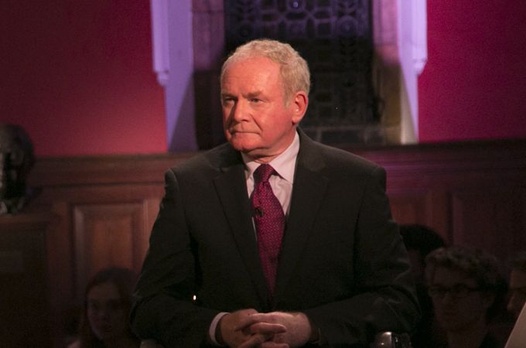
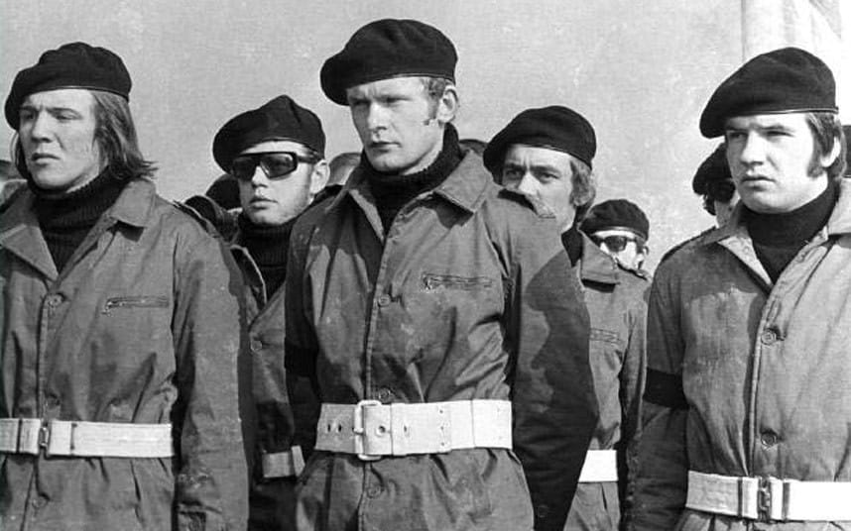
Is one man’s terrorist another man’s freedom fighter?
This is a big question which raises the question of whether terrorism can ever be justified.
Some political perspectives struggle to gain any real attention within mainstream politics. Indeed, they are often ridiculed and called extreme.
Many terrorist groups argue that this is an injustice and this then forces them to take more radical action – intimidation/fear/violence.
WATCH: Mehdi Hasan’s interview with former IRA man Martin McGuiness on YouTube. McGuiness became Northern Ireland’s Deputy First Minister and a man of peace but still maintains the IRA were justified in undertaking violence.

Slide 15
National Consortium for the Study of Terrorism
“Between 1970 and 2011, 32 % of the perpetrator groups [of terror attacks in the USA) were motivated by ethno nationalist /separatist agendas, 28 percent were motivated by single issues, such as animal rights or opposition to war.”
Of 152 terrorist attacks in EU countries in 2013, 84 of them were motivated by ethno-nationalist or separatist beliefs. That’s more than 55 percent.

Slide 16
Daniel Byman considers nationalist terrorism to be the most dangerous:
It easily provokes government over-reaction who see it as an insurgency or domestic problem.
It often produces government concessions (unlike religious terrorism) which are seen as a sign of success.
There is a ready-made audience or constituency (you're either in or out).
You can't trust their cease-fires, peace treaties, or statements of curtailing operations.
It polarises ethnic conflict.

Slide 17
Religious Causes of Terrorism

Slide 18
Faith and Terror
Definition: particular system of faith and worship, usually towards a deity (God).
“I think that the crimes done in the name of religion really do follow from religious faith.” (Sam Harris, Letters to a Christian Nation).
“For good people to do evil things, that takes religion.“ (Nobel Prize winner Steven Weinberg)

Slide 19
In recent years, religious terrorism has dominated discussions among commentators as it has risen in prominence. Indeed since 2001, according to the Global Terrorism Index, religiously motivated terrorism has been the main driver behind terrorist activity.
The prominence of groups like Islamic State and al-Qaeda has raised concerns about the role of religion in terrorist activity. Many scholars urge caution over this because many of the aims of these groups are actually political, but are charged with religious language.
Religious terrorism is when a group feels that a religious truth must be imposed on others and that society must conform to accommodate this religious belief. For example, the al-Qaeda group which carried out a range of attacks in the last two decades (including the 9/11 and 7/7 attacks) have cited the desire to impose Islamic law throughout the world, ending secular states and punishing crimes committed by Christians and Jews against Islam (although could be viewed as political rather than religious).

Slide 20
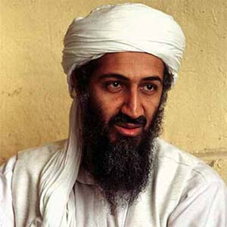
Why is it possible that religious terrorism is more dangerous than other types of terrorism?
Some terrorists (like Osama bin Laden was) are very shrewd individuals and can be manipulative. Bin Laden had very clear political goals which were of great importance to him. Political goals can be so important to people that they will go to great lengths.
It is argued by James Jones that terrorists driven by religion are even more dangerous because they feel that they know TRUTH.
Jones believes that this ‘sacred’ layer is what gives people a motivation to do almost ANYTHING to further their goals.

Slide 21
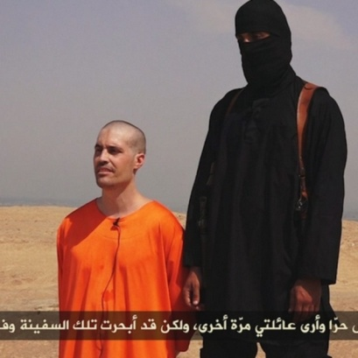
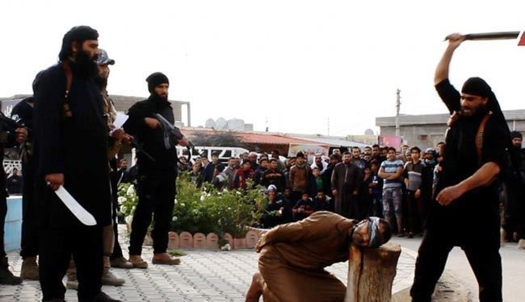
ISIS – Radicalism
Take James Jones’ explanation for a moment:
ISIS have embarked on a number of killings – many of which have been so disgusting in nature that even other radical Islamist groups have rebuked them.
Is it possible to argue that their radical, extremist interpretation of Islam drives this type of activity more directly than other groups. ISIS do have political goals, but does this religious commitment drive the group in a more radical direction?

Slide 22
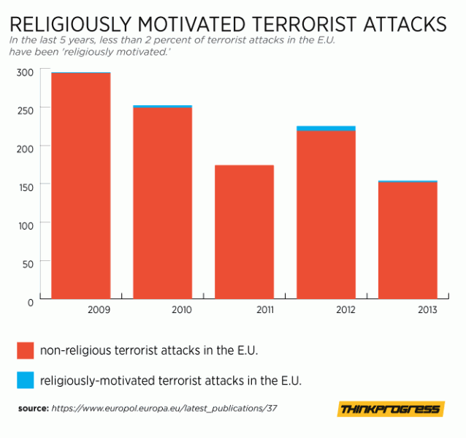
The observation is that today, the incidence of religious terrorism is disproportionately committed by radical Islamists. The evidence contradicts this:

Slide 23
“Credible researchers agree that "religion" neither causes nor explains suicide terrorism. ..... religious rhetoric may help persuade attackers that their cause is either necessary or noble, and that glorifies or renames suicide as martyrdom, but it does not explain why suicide attackers choose that particular tactic.” - Amy Zalman
“Suicide terrorism is not caused by religion…Suicide terrorists are motivated mainly by political goals ... Their 'martyrdom' is, however, frequently legitimized and glorified by reference to religious ideas and values.”
- Root Causes of Terrorism textbook

Slide 24
“Far from being religious zealots, a large number of those involved in terrorism do not practise their faith regularly. .... a well-established religious identity actually protects against violent radicalisation.”
MI5

Slide 25
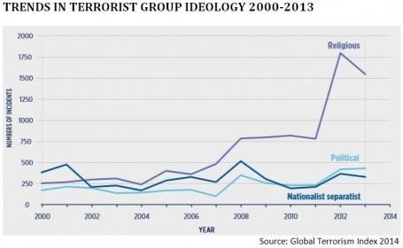
There has been an upward shift in the numbers of groups taking action that are defined as ‘religious’. This is perhaps skewed by the events in the Middle East (and does not for example consider Europe or North America).

Slide 26
Terrorism in Western Countries

Slide 29
Impact of religious terrorism groups - Global
Boko Haram and ISIL were jointly responsible for 51% of all claimed global fatalities in 2014.
78% of all deaths and 57% of all attacks occurred in just five countries; Afghanistan, Iraq, Syria and Pakistan (where ‘religiously-motivated terrorism’ is most prevalent).

Slide 30
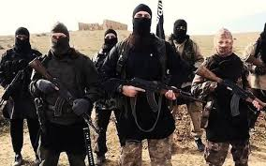
Socio-Economic causes of terrorism
Terrorist groups are all too happy to step into a social economic void. They can offer salaries to their foot soldiers so they can support their families.
ISIL (Islamic State of Iraq and Levant) pay their fighters $500 a month and when this amount is compared to the average salary in Iraq of $150 some individuals may join terror groups as a way out of the poverty they face.

Slide 31
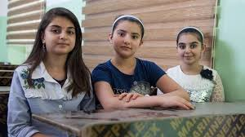
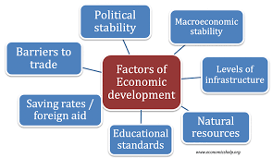
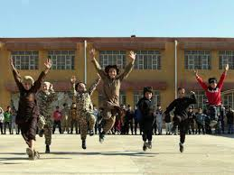
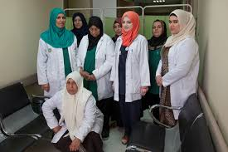
This shows that economic factors may be a cause of terrorism because people must make a choice between surviving and not.
ISIL offer social services-schools and health clinics-to do what local governments cannot or will not do.

Slide 32
Therefore, people may choose to join or support terror groups so that they are able to gain and education and healthcare, and this indicates a politico-social economic motivation.
The terror groups are acting as a de facto government providing a welfare state for some economically disadvantaged people.
HEALTH &
EDUCATION
POVERTY

Slide 33
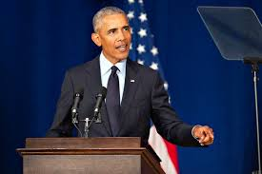
A high proportion of young people in volatile countries, plus a lack of economic opportunities, has long been considered a tinder box for extremism.
In 2014 President Obama announced an expansion of entrepreneurship education, and youth programmes, because he said, ‘these investments are the best antidote to violence’.

Slide 34
It could certainly be argued that a lack of employment opportunities has a role to play in contributing to international terrorism because a disaffected youth that may feel hopeless, humiliated, lack self-esteem and faces prospects for change and development may seek to join terror groups to give themselves purpose in life

Slide 35
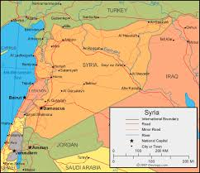
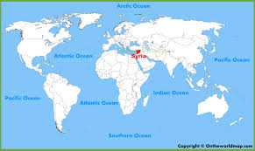
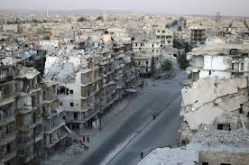
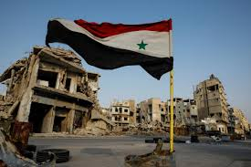
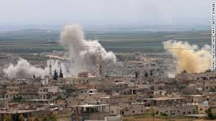
In 2017, Syria was ranked as having the highest levels of unemployment at 50% of its population.
When we consider the fact that Syria is ranked by GTI as the 4th country most impacted by terrorism, we might argue that there is a clear link between economic disadvantage and terrorism.

Slide 36
American Somalis-82% of whom live near or below the poverty line- are the source of the largest groups travelling to fight with jihadist groups abroad.
The New York Times referred to the group of Minnesotans as the largest group of American citizens suspected of joining an extremist movement.

Slide 37
This shows that in these cases there is a potential link between poverty and terrorism, however other factors may also be significant for these individuals such as protection of the religious faith they feel is under attack or possible dissatisfaction with the US.

Slide 38
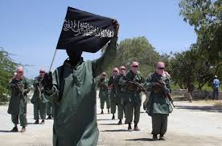
Research findings indicate that social inequality among American Somali participants contributes to motivation to radicalise and join terror groups.
The Trump administration has stepped up military efforts in Somalia, including dozens of drone strikes against al-Shabaab and this may be an additional political motivator for Somali-Americans to join Al Shabaab in retaliation for such foreign policy.

Slide 39
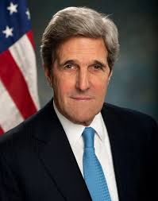
Some would argue that there is a direct link between poverty and terrorism.
In 2014, former US Secretary of State John Kerry claimed that poverty ‘in many cases is the root cause of terrorism.’

Slide 40
However, a World Bank Study on ISIL recruits shows that Kerry’s claim is not entirely accurate.
This study found that poverty is not a driver of radicalisation into violent extremisms. This evidence suggests that socio-economic status is a poor indicator of how likely someone is to support terrorism because there are several countries that demonstrate high levels of poverty but do not generate significant problems related to terrorism.

Slide 41
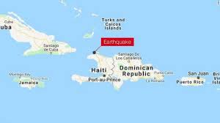
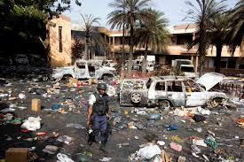
Haiti is an example of this. The levels of poverty in Haiti are generally regarded as among the most severe in the western hemisphere, and yet is ranked by the GTI as a country with some of the lowest levels of terrorism in the world.

Slide 42
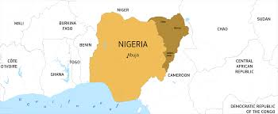
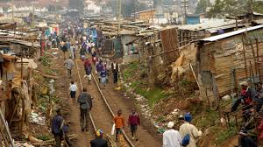
That said, Nigeria, the country with the world’s highest number of people living in extreme poverty is ranked by the GTI as the 8th most impacted country by terrorism which may indicate a link between poverty and cause of terrorism.

Slide 43
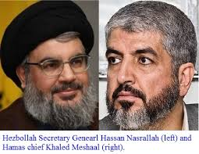
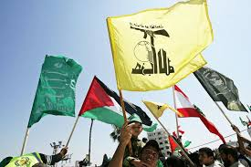
Research undertaken at Princeton University provided evidence gathered from Hezbollah and Hamas suggesting that upper middle class and more educated individuals are slightly over represented in these pro-Palestinian organisations.
This shows that it is over simplistic to suggest that poverty alone causes people to become terrorists or support terror organisations and that there may be other contributing factors.

Slide 44
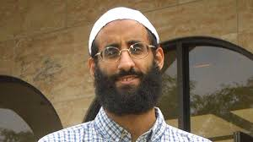
Some Americans involved in terrorism have come from affluent backgrounds: Anwar Awlaki who took on a leadership role in Al Qaeda was the son of a major Yemeni political figure.
Zachary Chesser who was born to a well-off family in the Virginia suburbs was sentenced to 25 years in prison for trying to join Al Shabaab and threatening the creators of South Park over their depiction of Mohammed

Slide 45
Social Isolation causes of terrorism
Some people that resort to terrorism, particularly lone wolf attackers, have backgrounds which suggest a lack of a sense of identity or belonging.
An absence of social identity may result in an individual developing feelings of frustration with their society, government or country. If they feel they are not represented or under represented by their government, they may feel that democratic avenues to express their views may be closed to them.

Slide 46
People who are isolated in a society and want attention or recognition may resort to violence.
It is also possible that some people experiencing social isolation may be more susceptible to radicalisation. Often such vulnerable individuals are targeted on-line by those grooming potential terrorists.

Slide 47
Anders Breivik, responsible for the deaths of 77 people after planting a car bomb in Oslo and opening fire on a large number of young people at a political camp, was an individual who had become extremely isolated from society.

Slide 48
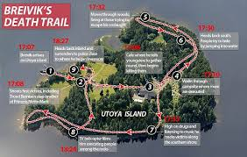
He justified his 2011 terror attack as a response to what he declared as the Islamification of Norway’ and condemned the Norwegian and other European governments for embracing immigration and multiculturalism.
He identified with a far-right political agenda and held strong Christian beliefs.

Slide 49
It has been reported by Journal EXIT-Deutschland that Breivik was dedicated online gaming enthusiast. Playing fantasy online games dominated his daily life during the years leading up to the attack.
Lengthy periods of time playing games resulted in him being isolated from his friends and relatives. The subject of these games may have also contributed.
He was also an active participant in online forums focused on far right or anti Muslim views.

Slide 50
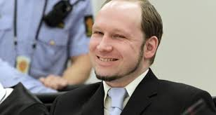
The Perspective on Terrorism journal reported in 201 that such was his revulsion towards his family that he wore an antiseptic mask around his house.
Psychologies have commented that Breivik shows a very high level of self obsession and narcissism.
The Telegraph reports in 2011 that he had plastic surgery to look more Aryan.

Slide 51
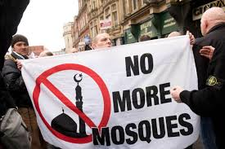
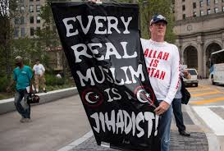
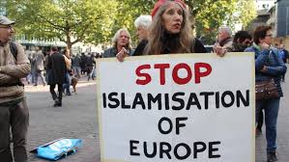
Islamaphobia
The perceived increase in attacks by Islamic extremists has resulted in a surge of violent Islamophobic incidents.
Islamaphobia is defined as the ‘dread or hatred of Islam and therefore (the) fear and dislike of all Muslims.’
Some people may feel like their culture is under threat this may lead to some individuals carrying out attacks in defence of what they hold true.

Slide 52
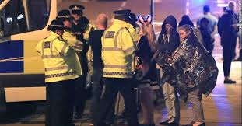
Islamophobic attacks increased by 500% in Greater Manchester after the ISIL inspired attack on the Ariana Grande concert
Think tank Demo reported that almost 7,000 Islamophobic tweets were sent worldwide in English every day in July 2016.
The highest number of Islamophobic tweets sent in a single day 21,190 came the day after a lorry was drove into crowds celebrating Bastille day in Nice.

Slide 53
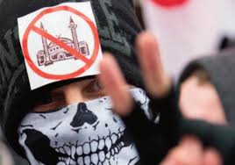
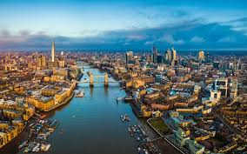
The number of Islamophobic hate crimes in London has soared 40% in 2017.
There were 1,678 anti-Muslim hate crimes reported in London in 2017.

Slide 54
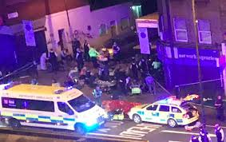
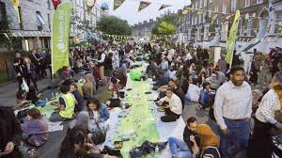
The Finsbury park mosque attack of June 2017 is an example of Islamophobic terrorism, where several worshippers were struck by a van driven by a man from Cardiff.
According to reports US white supremacists celebrated the attack and pro Islamic State channels used it to incite Muslims.

Slide 55
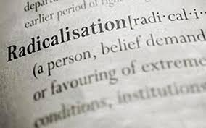
This is significant as it shows that when feel their faith is targeted in a violent manner they will retaliate.
Individuals susceptible to radicalisation are more likely to resort to terrorism if they feel a terrorist attack is the only way to seek vengeance.

Slide 56
Essay Question
To what extent are some factors which cause this issue more important than others?
20 marks

