Slide 1
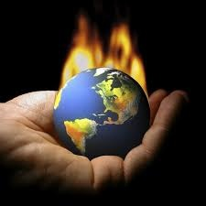
Climate Change
Cfe Higher Geography

Slide 2
To be successful in this unit on climate change you need to be able to do the following:
1 Use a range of graphical and numerical skills and techniques in the context of global geographical issues by:
1.1 Interpreting a range of numerical and graphical information
1.2 Analysing a range of numerical and graphical information
1.3 Synthesising information from a range of numerical and graphical information
1.4 Reaching a conclusion based on evidence about a complex global geographical issue
2 Draw on and apply knowledge and understanding of significant global issues by:
2.1 Giving detailed descriptions and detailed explanations of the interaction of physical and human factors in the context of a complex global geographical issue
2.2 Giving detailed descriptions and detailed explanations of the strategies adopted in response to a complex global geographical issue
You will be learning about
Global climate change
◻ physical and human causes
◻ local and global effects
◻ management strategies and their limitations

Slide 3
Think about the following questions…
What does “global climate change” mean?
Is climate the same as weather?
How is climate change different from “global warming?”
Have your parents / grandparents or ever mentioned any changes they have noticed in the climate?
TASK TIME
Discuss these questions with a partner and be prepared to share your answers with the class. Watch the video links and compare your answers with these.

Slide 4
Climate change vs global warming
Climate change is the changing weather patterns that occur over long periods of time and it is one of the biggest threats to our environment
Global warming is the rise in the average temperature of the Earth's surface

Slide 5
What do you think causes climate change?
Causes of Climate Change
TASK TIME
Complete the spider diagram above in your jotter. We will add to this at a later date so leave lots of space around it.

Slide 6
What do you think causes climate change?
TASK TIME
Watch the clip above and add any extra information to your spider diagram.

Slide 7
Lets examine the role of Carbon Dioxide in climate change…
Since 1958, scientists have measured the amount of CO2 in the Earth's atmosphere from a site on the Mauna Loa volcano in Hawaii, a group of South Pacific islands. This site is one of the best locations in the world for measuring CO2 because there are no plants or human activities nearby to influence the measurements (any volcanic venting of gas is excluded from the record). The Mauna Loa data are considered to be a precise record of the concentration of CO2 in the region.
TASK TIME
Using the data in the table on the next slide, graph the annual average CO2 concentrations from 1959 to 2009.

Slide 8
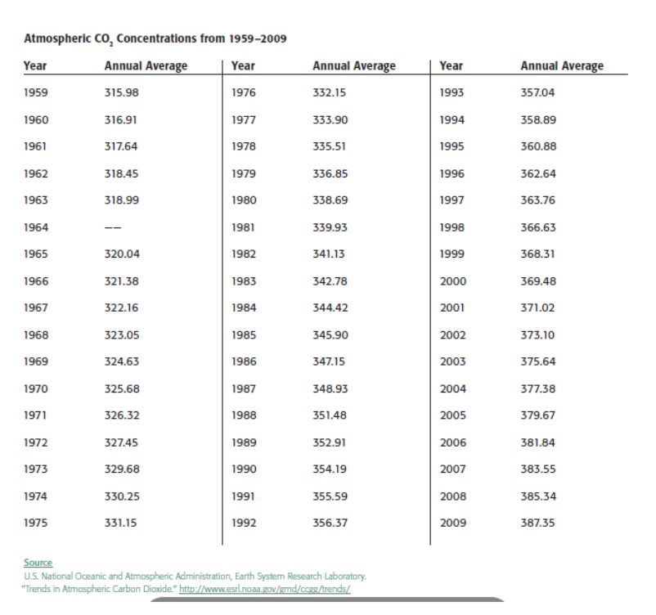

Slide 9
Your graph should start like this…
Remember to include-
An appropriate scale
Labels on both axis
A title

Slide 10
After studying your graph discuss the following questions:
WHAT pattern do you notice in the graph over 50 years?
HOW do the last five years of data compare to the first five years?
The level of CO₂ in the year 1860 was approximately 280 ppm. HOW does the rise from 1860 to 1958 and compare to that from 1958 to 2009?
WHAT do you think caused the increase in CO₂?
Looking at the graph, WHAT do you predict the CO₂ level will be in the year 2020? In the year 2050? WHAT factors could influence these predictions?
HOW might the change in CO₂ affect people and other living things?
TASK TIME
Once you have agreed on the answers write these up in your jotter. Try to include as much detail as you can and remember to include exact figures or simple calculations wherever possible.

Slide 11
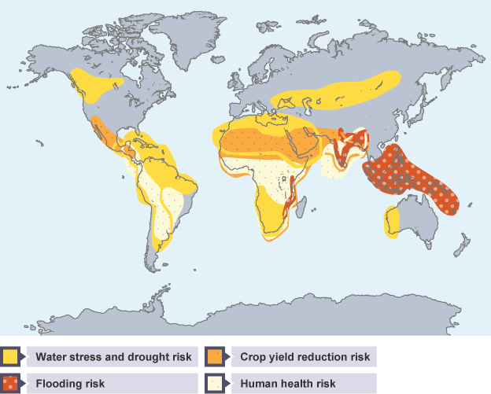
The Physical and Human Causes of Climate Change
By the end of this section I will have:
Looked at the evidence which shows how our climate has changed over time
Examined the physical and human causes of climate change

Slide 12
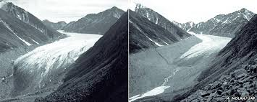
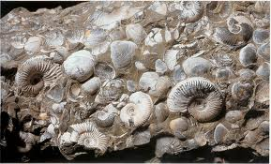
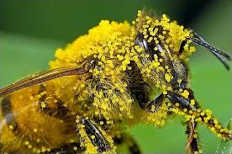
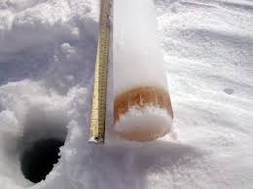
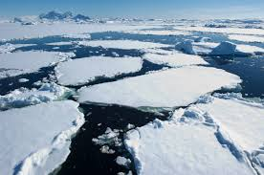
How can we tell the climate is changing?
TASK TIME
For each picture above decide what it represents and explain how it can tell us if the climate is changing.

Slide 13
Watch these two clips from The BBC…
TASK TIME
Use the information in your sheets, the media clips and your discussion from earlier to complete Task 2 in your booklet.

Slide 14
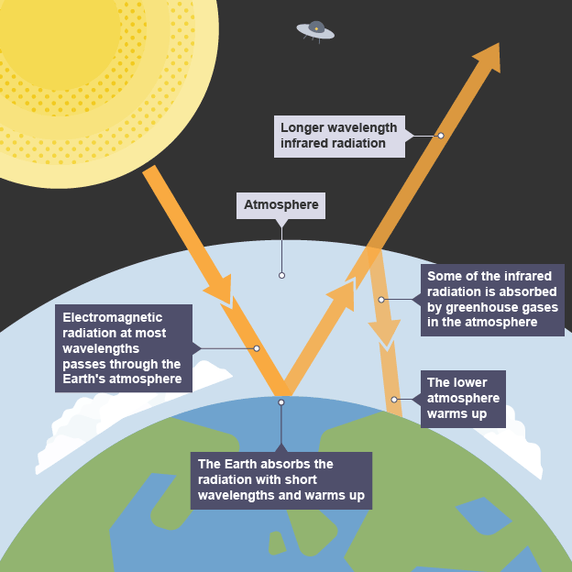
The importance of the Greenhouse Effect
Click to find out more
TASK TIME
Make a copy of this diagram into your jotter. Watch the media clip on the Greenhouse Effect and complete Task 3 from the booklet.

Slide 15
The Local and Global Effects of Climate Change
By the end of this section I will have:
Examined the local and global effects of Global climate change
Considered the environmental, social and economic consequences of climate change by studying looking at a variety of case studies
WHAT’S THE STORY?
CLICK TO FIND OUT MORE

Slide 16
Some recent headlines…
Tories’ scepticism about climate change melts after winter floods – in their constituencies
Tories’ scepticism about climate change melts after winter floods – in their constituencies
Climate change: Global temperatures in May hit an all-time record high
Half of emperor penguins could be 'wiped out by end of the century' due to melting sea ice
Luxury cruise line accused of offering ‘environmental disaster tourism’ with high-carbon footprint Arctic voyage
Climate Change Committee blames Government over slow rate of progress in reducing UK carbon emissions
California drought: America’s golden state runs dry - and its farmers are struggling to survive
World’s first ‘climate change refugee’ has appeal rejected as New Zealand rules Ioane Teitiota must return to South Pacific island nation of Kiribati
Climate change will ‘cost world far more than estimated’
TASK TIME
Read the headlines above and complete Task 6 in your booklet.

Slide 17
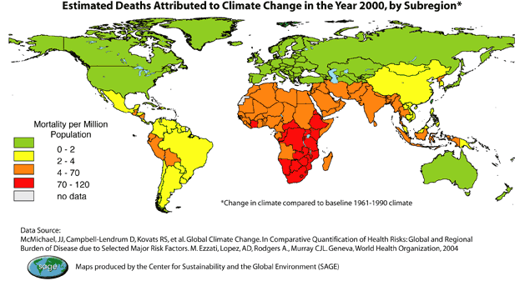
TASK TIME
Think about the pattern of deaths shown above. To what extent do you think climate change is a global problem?

Slide 18
Global Case Study: ELDC Bangladesh
The Cause
ELDC
Bangladesh
Social
Impact
Economic
Impact
Environmental
Impact
Solutions?
TASK TIME
Watch the following program. Write the heading above and copy the spider diagram in your jotter. Use this to take notes while watching the program on Bangladesh.

Slide 19
Local Case Study: EMDC The UK
The Cause
EMDC
The UK
Social
Impact
Economic
Impact
Environmental
Impact
Solutions?
TASK TIME
Watch the following program. Write the heading above and copy the spider diagram in your jotter. Use this to take notes while watching the program on The UK.

Slide 20
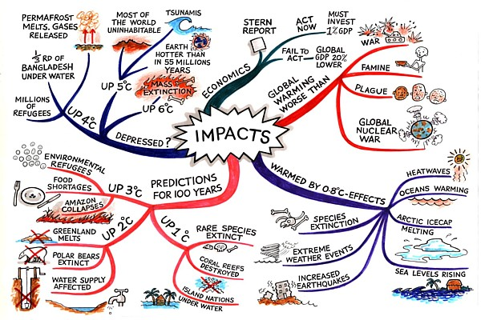
TASK TIME
Use the mind map above to help you create revision mind maps for the other main sections of this topic - Physical and Human causes of Climate Change and Management Strategies and their Limitations

Slide 21
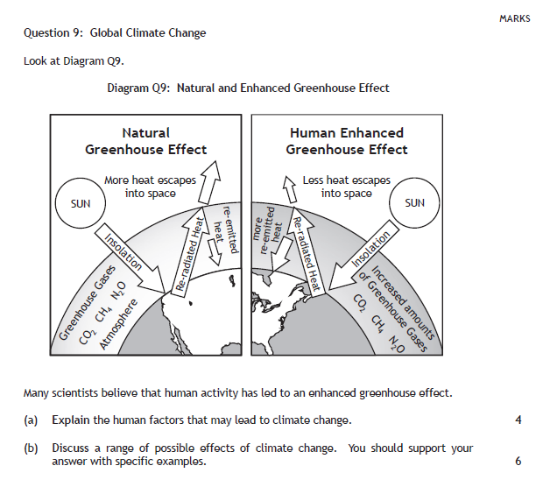

Slide 22
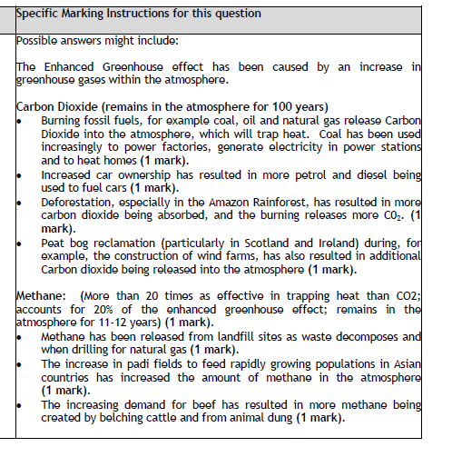

Slide 23
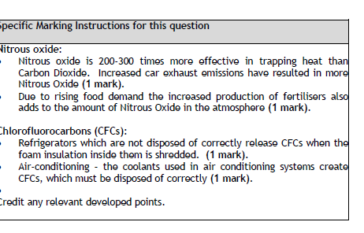

Slide 24
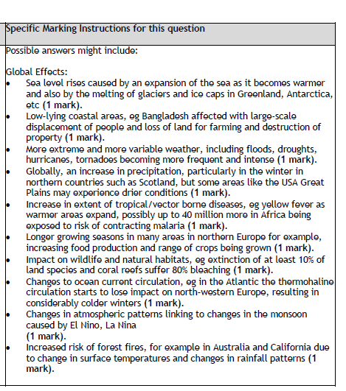

Slide 25
Management strategies and their limitations
Overview:
All countries need to reduce deforestation (cutting down trees) and increase afforestation (plant more trees)
Implement new types of energy which are more sustainable than fossil fuels (last longer and have minimal damage on the environment)
Industry should switch from using fossil fuels to alternative sources of energy e.g. solar, wind, tidal and hydroelectric power (HEP)

Slide 26
Clips on Green energy and hep power loch Lomond
http://www.bbc.co.uk/education/guides/zx666sg/revision/1

Slide 27
Local management strategies
Individuals can reduce, reuse and recycle products so less is sent to landfill sites which reduces the amount of methane in atmosphere
Reduce the amount of carbon dioxide generated by burning fossil fuels by reducing energy in the home e.g. switching lights off/insulation
Use public transport more, walk or cycle instead of just using the car. Also use hybrid/electric cars which cuts down on fossil fuel consumption
Manage fridge disposal to ensure CFC gases don’t escape and no longer emit CFCs

Slide 28
National management strategies
Government policies ‘helping households to cut energy bills’ encourages smart metres improving energy efficiency
Increasing the use of low carbon technologies – wind farms in the UK are committed to creating 15% energy by renewable resources

Slide 29
International management strategies
Paris agreement outlined by leaders in developed and developing countries to limit climate change below 2 degree temperature rise
EU committed to reducing carbon emissions by 20% by 2020 which will reward developing countries financially
Preparing for extreme weather events – flood defences built to hold back water and flood plains used to store excess water

Slide 30
Carbon Market Case Study: Carmelita How changing carbon Dioxide levels impact on the lives of people in Guatemala?
Discuss how the carbon investments work? To what extent is this system the same or different from a town market?
Assess how the carbon investments help reduce carbon dioxide in the atmosphere?
To what extent do you think they might help communities like Carmelita?
Comment on the challenges which there might be with this system?
“People buying credits to offset their own carbon emissions is the best way to solve climate change”. Discuss
TASK TIME
Working in groups of three read through the case study. Each person is responsible for taking notes for one of Qs 1-3. Share your answers with the group before answering Q’s 4 & 5 together.

Slide 32
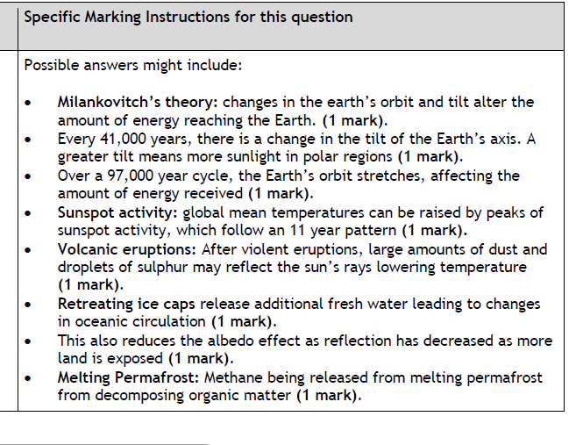

Slide 33
