Slide 1
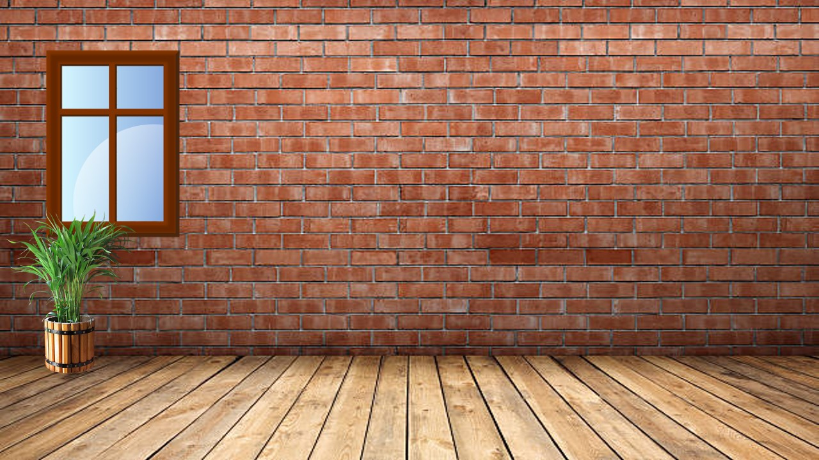
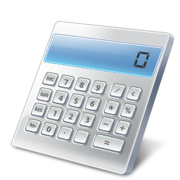
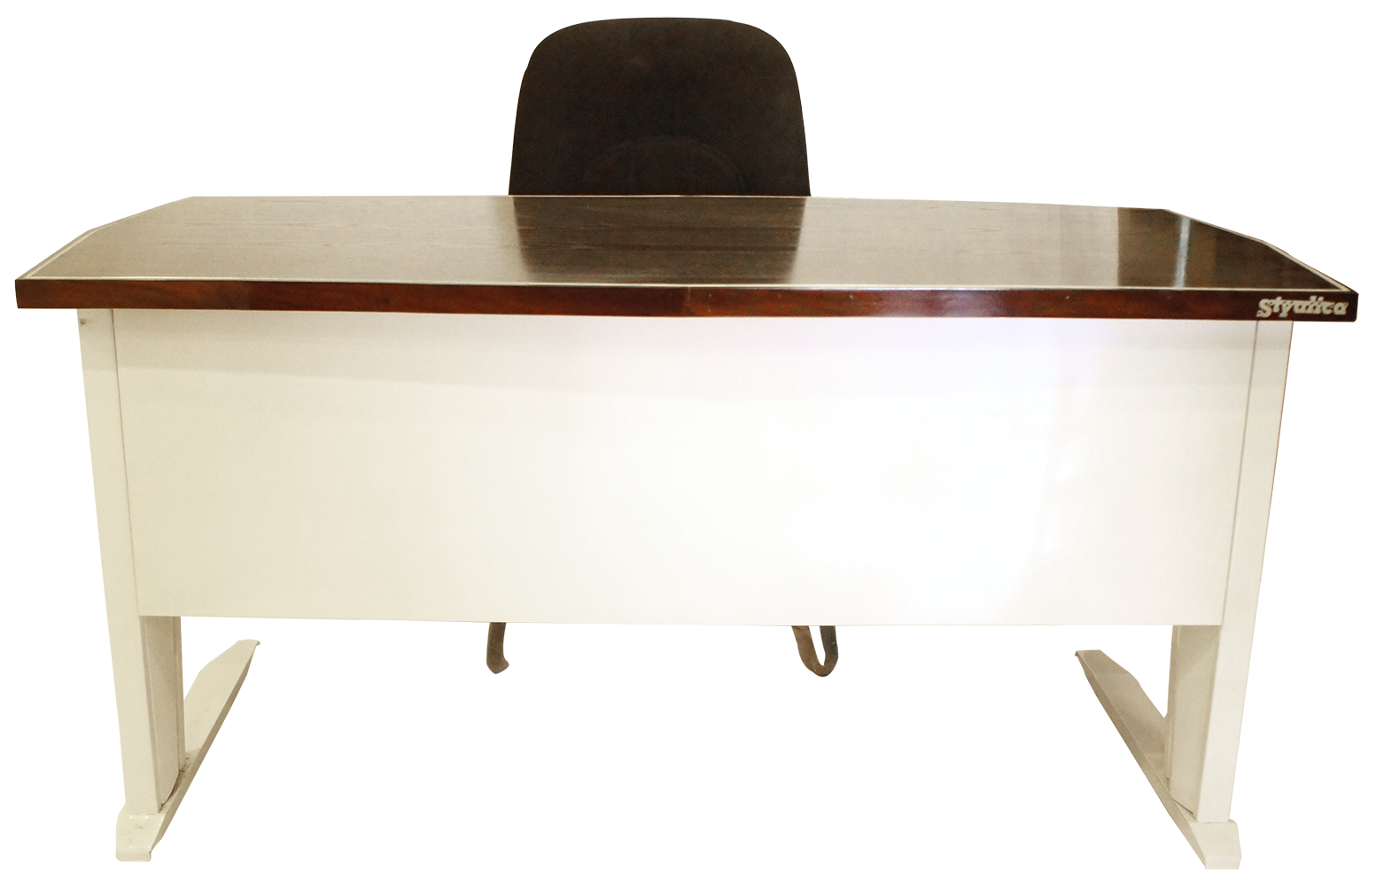
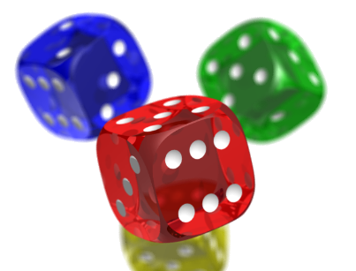
Open in Powerpoint and start the slideshow.
Click on the items below to access the following:
the whiteboard has a video lesson changing tenths into decimals
the books take you to some worksheets involving changing them
the laptop takes you to creating a table with tenths and the decimal equivalent
the dice takes you to a quiz where you are adding decimals mentally within ten.
The calculator gives you more practice adding and subtracting decimals
<iframe width="560" height="315" ></iframe>
Tenths as decimals
Mrs Mathintyre’s
Introduction to tenths as decimals Second level

