Slide 1
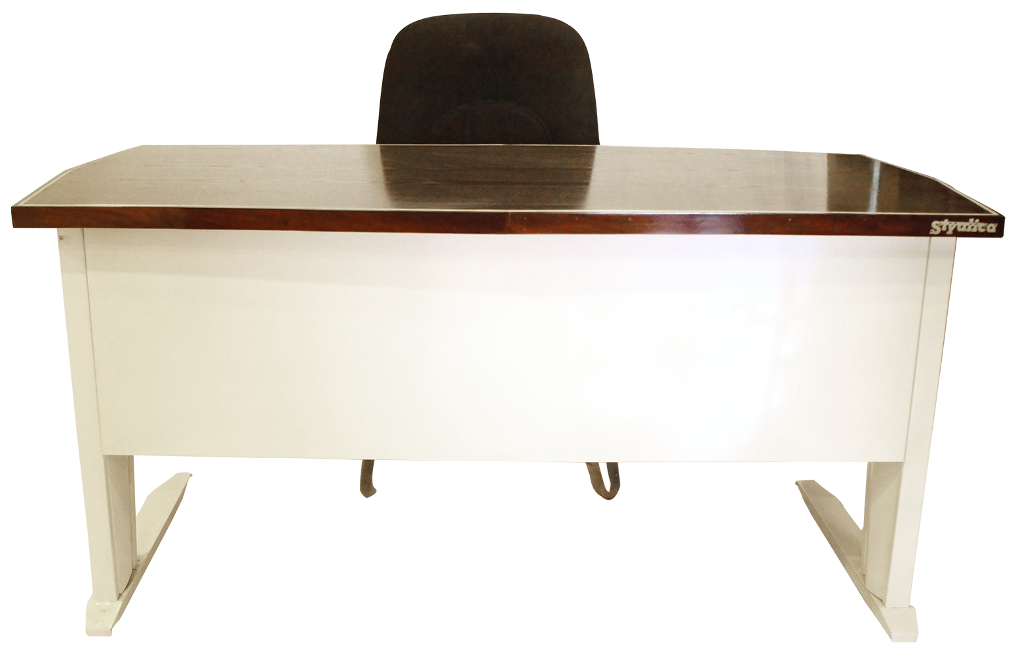
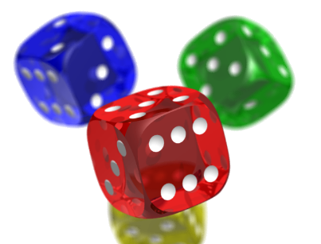
Open in Powerpoint and start the slideshow.
Click on the items below to access the following:
the notepad is where to start with some revision
the whiteboard has a video lesson introducing fractions of an amount when the numerator is more than one
the books take you to a worksheet where you find fractions of an amount where the numerator is more than one
the laptop takes you to BBC Bitesize lesson on fractions of an amount
the dice takes you to fractions of an amount game at various levels of difficulty
<iframe width="560" height="315" ></iframe>
Fractions of an amount
Mrs Mathintyre’s
Fractions of an amount for Second level level

