Slide 1
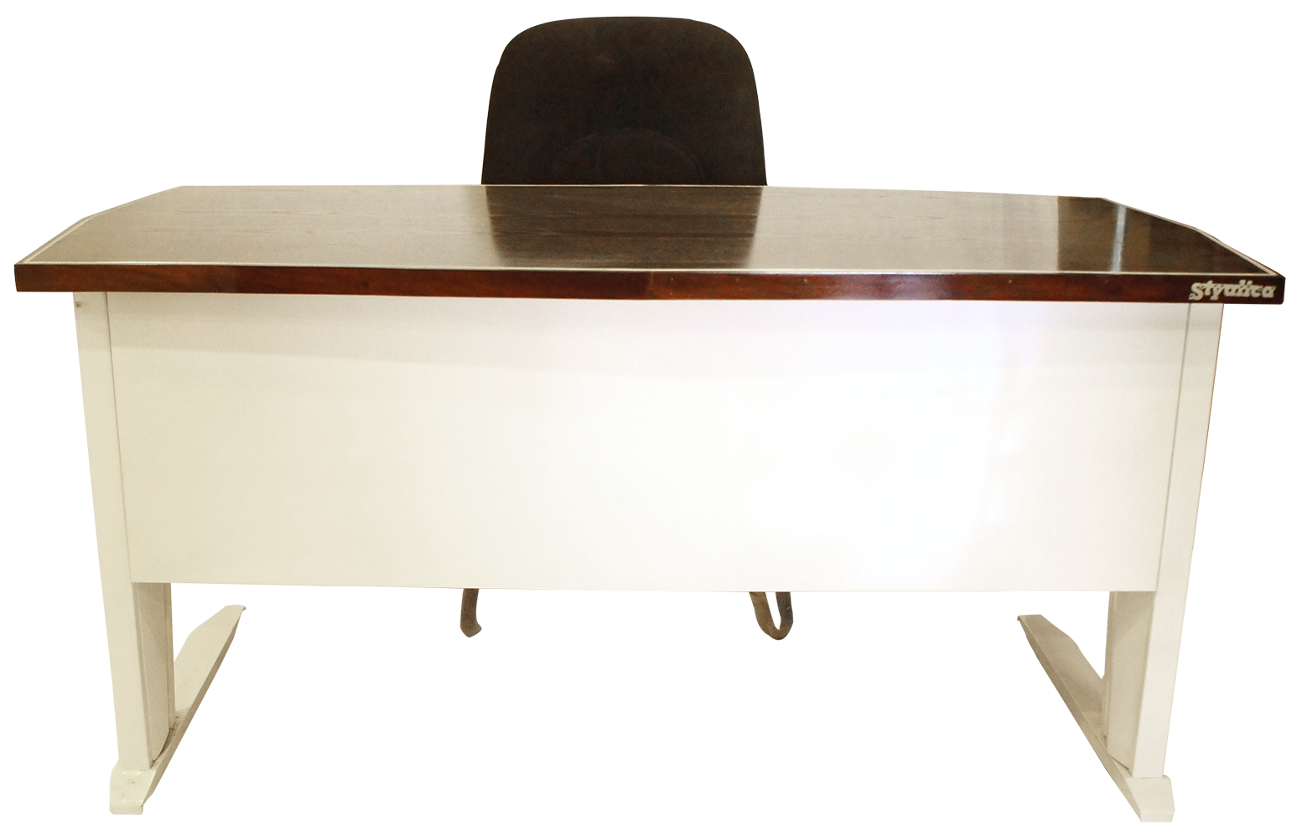
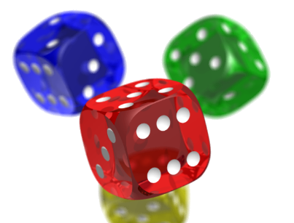
Open in Powerpoint and start the slideshow.
Click on the items below to access the following:
the whiteboard has a video lesson introducing equal fractions rule
the books take you to some worksheets involving equal fractions.
the laptop takes you to BBC Bitesize on rule for finding equal fractions
the dice takes you to a game where you apply your knowledge of equal fractions
the notebook takes you to simplifying of fractions
<iframe width="560" height="315" ></iframe>
Rule for finding equal fractions
Mrs Mathintyre’s
Equal fractions 2 for Second level

