Slide 1
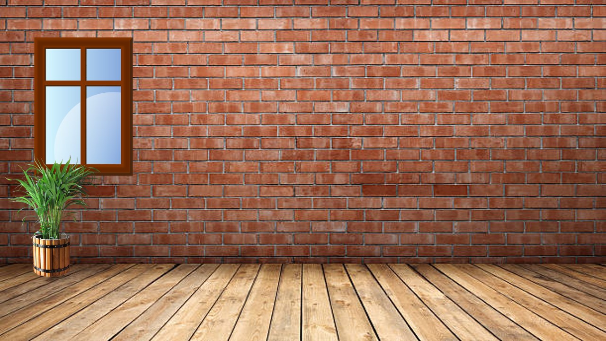
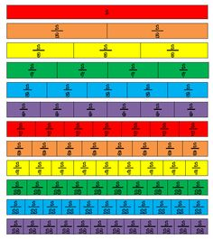
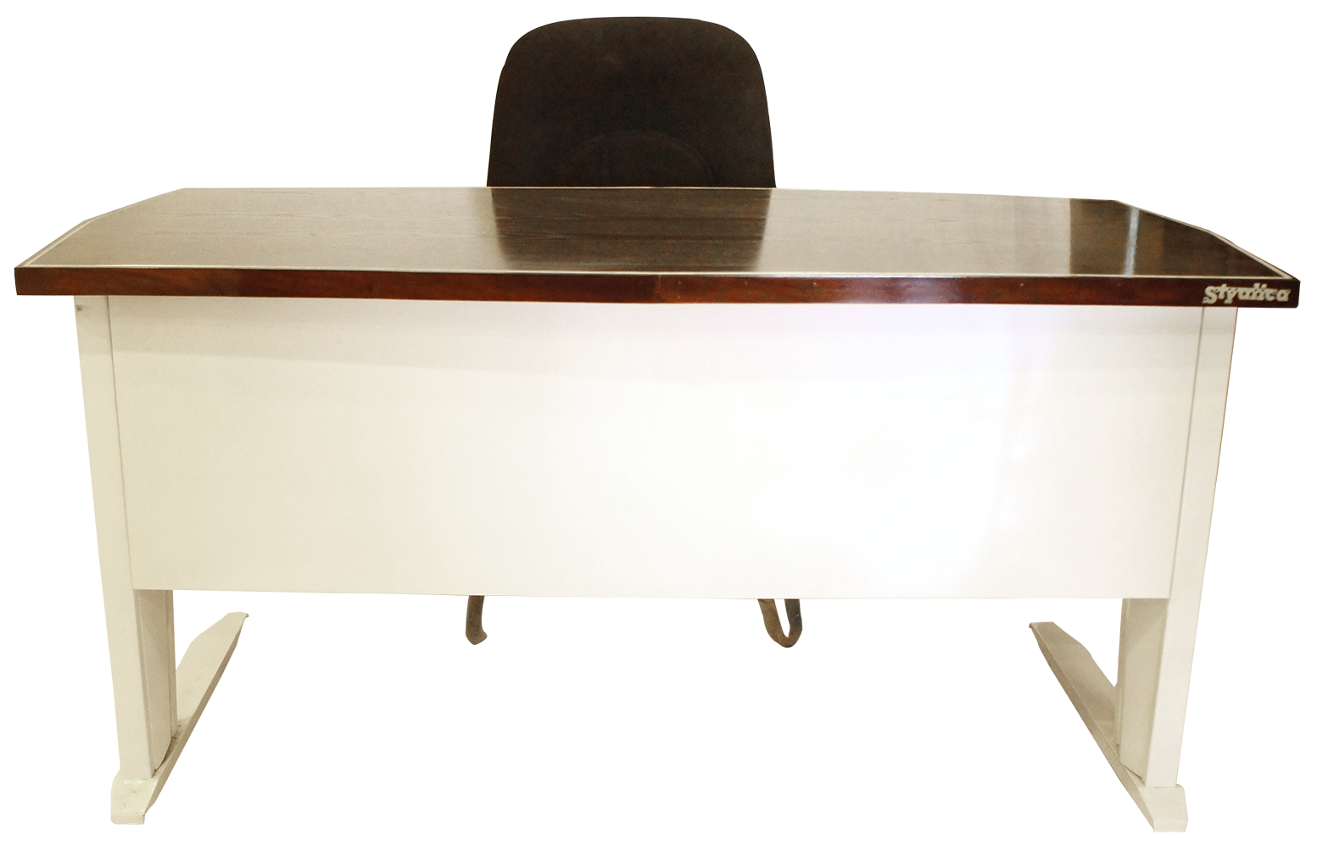
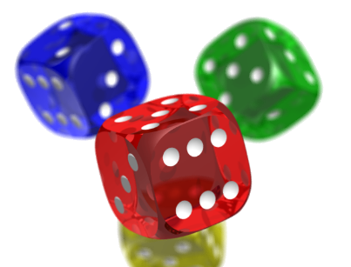
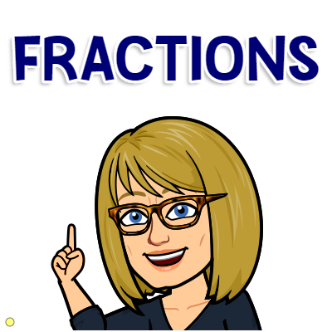
Open in Powerpoint and start the slideshow.
Click on the items below to access the following:
the whiteboard has a video lesson introducing equal fractions on a fraction wall
the books take you to some worksheets involving equal fractions.
the laptop takes you to interactive activities exploring equal fractions
the fraction wall takes you to instructions of how to build your own fraction wall
the dice takes you to a game where you apply your knowledge of equal fractions
<iframe width="560" height="315" ></iframe>
How to use a fraction wall
Mrs Mathintyre’s
Equal fractions 1 for Second level

