Slide 1
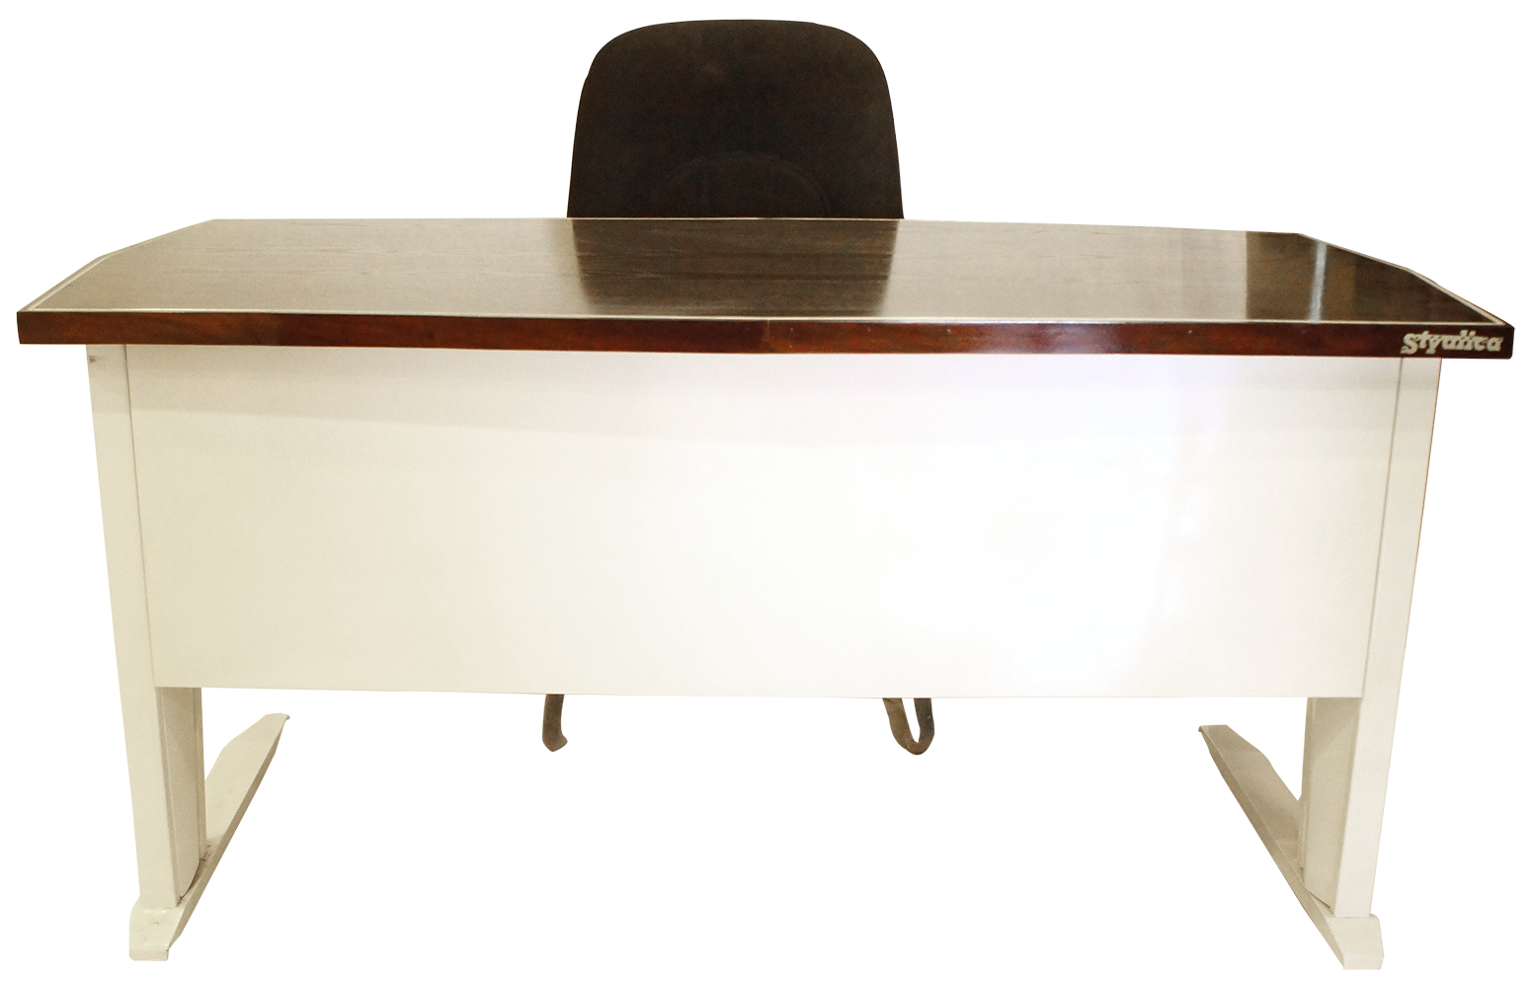
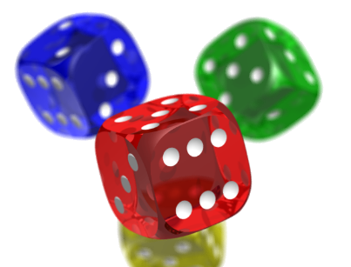
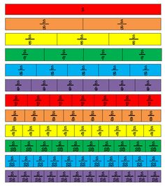
Open in Powerpoint and start the slideshow.
Click on the items below to access the following:
the whiteboard has a video lesson introducing fractions on a numberline
the books take you to some worksheets involving putting fractions on a numberline
the laptop takes you to BBC Bitesize lesson on equal fractions
the fraction wall takes you to instructions of how to build a fraction wall
the dice takes you to a fraction wall challenge
<iframe width="560" height="315" ></iframe>
A fraction on a numberline
Mrs Mathintyre’s
Fraction classroom 2 for First level

