Slide 1
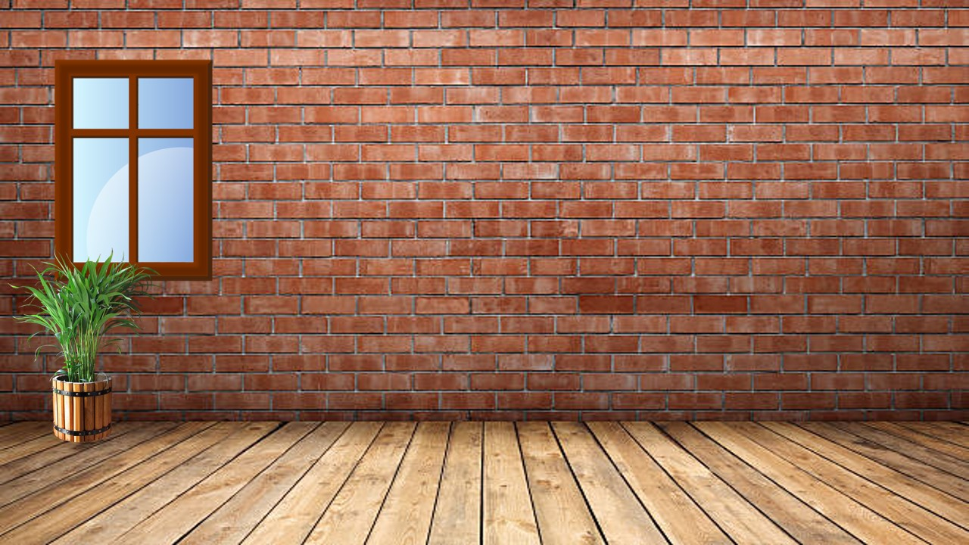
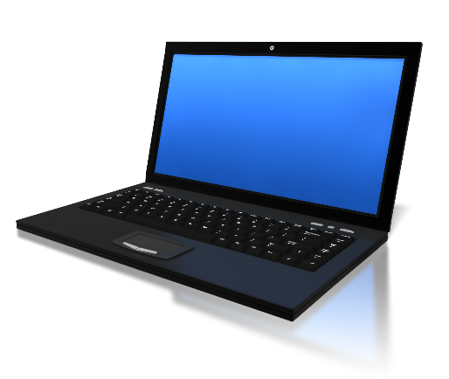
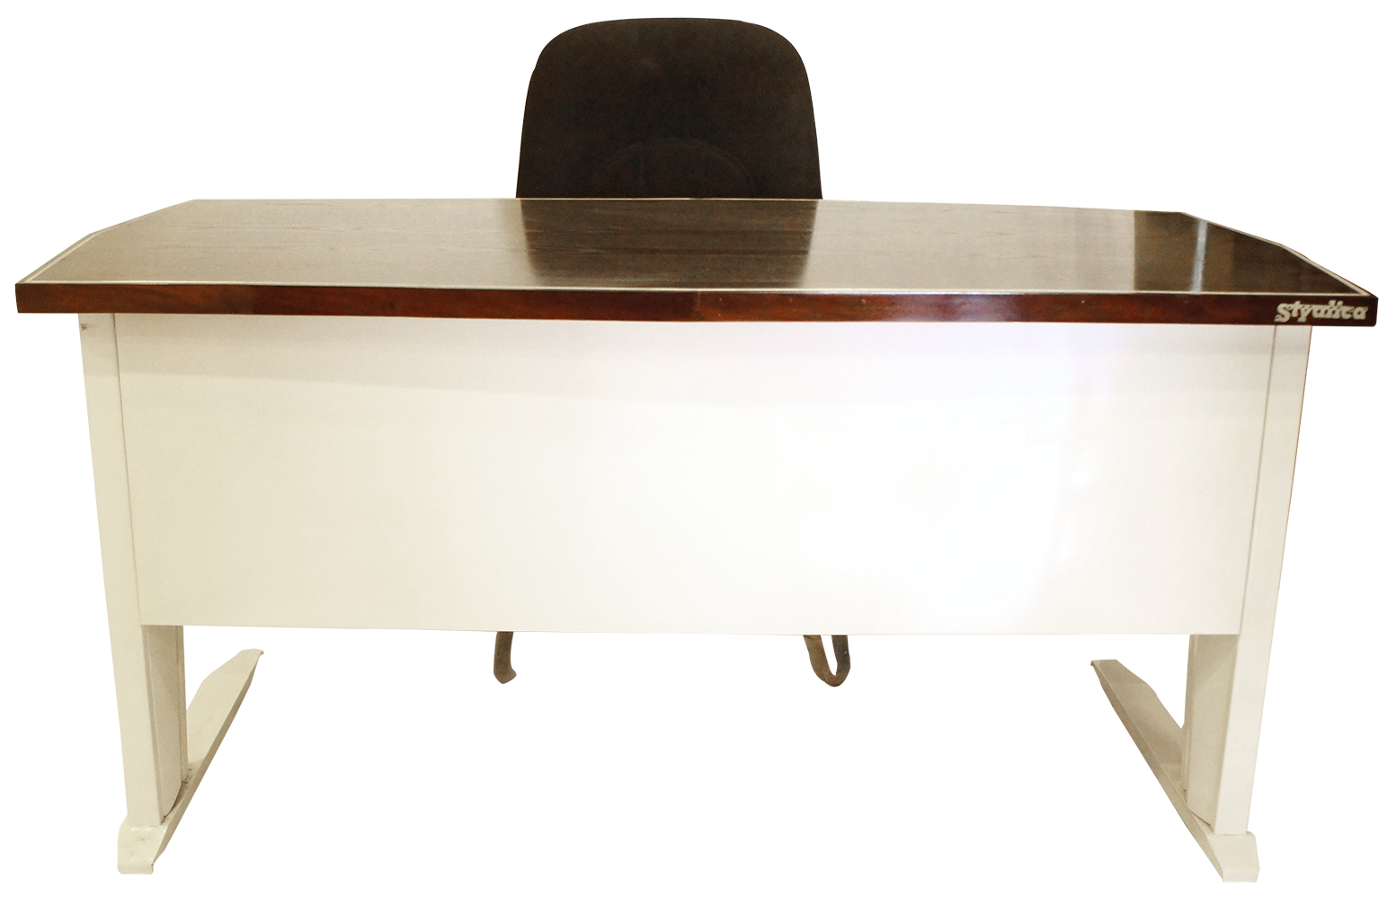
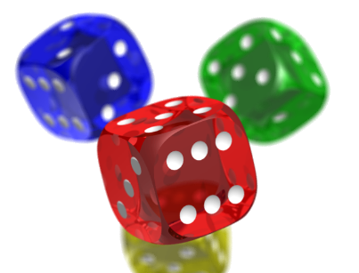
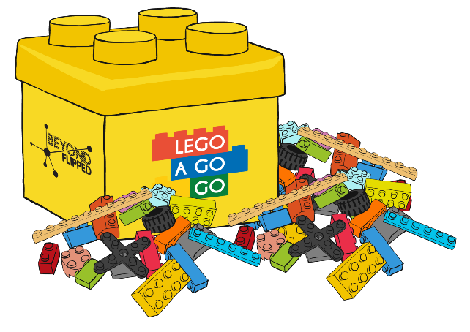
Open in Powerpoint and start the slideshow.
Click on the items below to access the following:
the whiteboard has a video lesson introducing fractions
the Lego takes you to a video showing you fractions in Lego
the pizza takes you to a task involving writing fractions
the books take you to some challenges involving halves and quarters
the laptop takes you to BBC Bitesize lessons
the dice takes you to a game.
<iframe width="560" height="315" ></iframe>
What is a fraction?
Mrs Mathintyre’s
Fraction classroom 1 for First level

