Slide 1
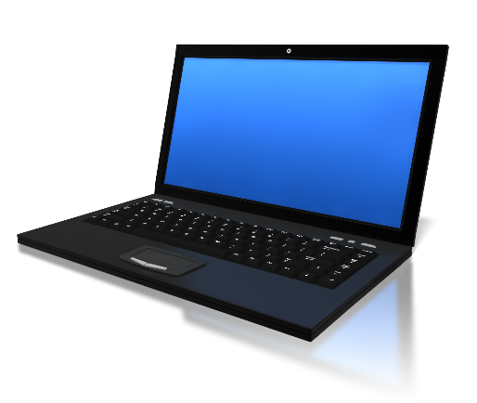
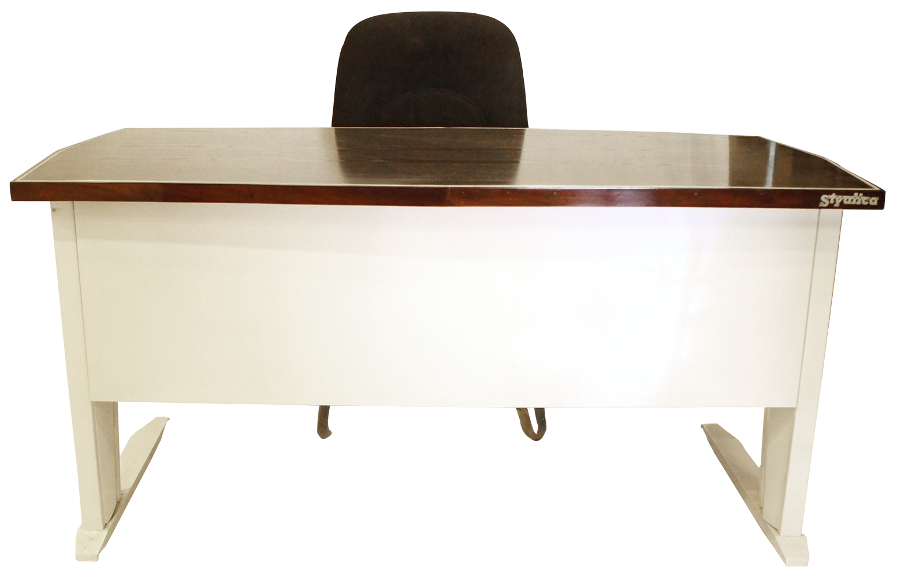
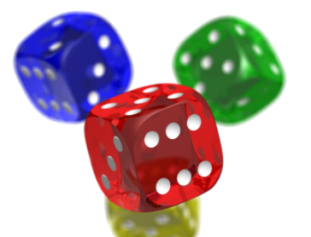
Open in Powerpoint and start the slideshow.
Click on the items below to access the following
the whiteboard has a video lesson
the library takes you to a story
the books take you to some paper based tasks
the laptop takes you to some BBC Bitesize lessons and tasks
the dice takes you to some related games
Money sense lessons
Mrs Mathintyre’s
First /Second level
Money classroom

