Slide 1
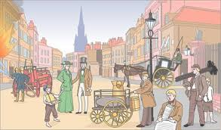
Literacy
Reading
Banded Class Readers & Novel Studies
Reading for Info – IDL related
Reading for Enjoyment
Writing – Narratives, Recounts, Reports
Grammar – Verbs-ed, Apostrophe, Synonyms & Antonyms.
Spelling – NLC Active Literacy Stage 4/6 Phonemes, Spelling Strategies, Word Families
Homework
Spelling –Elkonin Boxes, Diacritical Marking
Spelling Strategies – Fun Spelling, Spelling Rules
Common Words
Home Readers
Maths Worksheets
IDL related Research Tasks
Numeracy
Multiplication & Division
Money
Subtraction
3D Shape
2D Shape
Mental Maths
Count in 10s, 100s 1000s
Doubles & Halves
Problem Solving
P6/5 Shared Planning
November-March 16
Health and Wellbeing
Circle Time
Feelings & Emotions
Energy & Activities
Food Choices
Possession Games
Ball Skills
IDL topic
Amazon Rainforest
The Victorians
Christmas Festival of Lights
The Passover & Sedar Plate
ABC Music
Other Information
Gym Days – Thursday & alternate Friday
Christmas Party – 11/12/15
Nativity – 15/12/15

