Slide 1
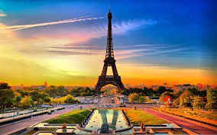
FRANCE!!
By Cameron Boag

Slide 2
Fun facts on france
Population: more than 65.7 million people live in the country (2012)
Capital: Paris, with 2,2 million inhabitants
Name: Republique Francaise (French Republic)
Motto: "Liberte, Egalite, Fraternite" (Liberty, Equality, Fraternity)
Government: Democracy
Language: French

Slide 3
More fun facts
Religion: mainly Christians (Roman Catholics 64%)
Currency: 1 Euro=100cents, until 2002 French Franc
History: In 700-500BC the Celtic Gauls arrive in France. In 58-50BC Roman Emperor Julius Caesar defeats the Gauls and France becomes part of the Roman Empire until 476AD. French was ruled by kings for many centuries until the storming of the Bastille during the French Revolution in 1789. Then Napoleon becomes Emperor of the French Republic until he is sent to exile.

Slide 4
Geography of france
• The western-european country shares borders with Belgium to the North East, Germany and Luxemburg in the East as well as with Switzerland, Italy to the South East. The Pyrenees, a mountain range to the South of France, form a natural border between Spain and France. The highest mountain in France is the Mont Blanc, that is 4,810m high and stands at the border between France and Italy.
Mainland France is divided into 27 regions and these into 101 departments. The Mediterranean island of Corsica belongs to France too as you can see in the outline above. Of the 101 departments there are also 5 ROM (regions d’outre mer or overseas regions) also belonging to France: French Guyana in South America, Guadeloupe and Martinique in the Caribbean, La Reunion and Mayotte in Africa in the Indian Ocean.

Slide 5
Tourist attractions in France
Paris: Eiffel Tower, Notre Dame, Louvre (which you can see in the image to the right), Montmartre, Arc de Triomphe, river Seine and many other great attractions
Versailles : castle of French kings
Lasceaux Caves for 17,000year old rock paintings
Cote d’Azur for turquoise blue sea and great beaches
Corsica: in the Mediterranean sea
French Alps: great skiing and snowboarding
Mont St. Michel: Island with high tide
La Provence for lavender fields and old historic towns like Avignon.

Slide 6
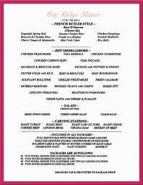
French genuine food menu!

Slide 7
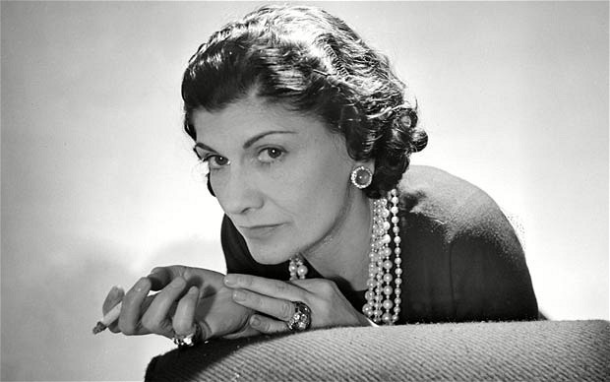
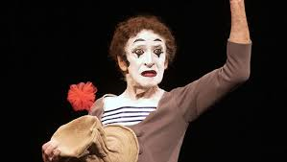
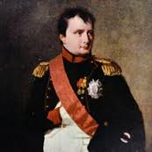
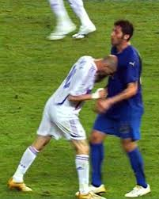
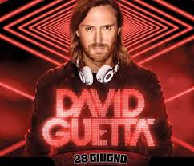
Coco chanel
Napoleon bonaparte
Zinadine zidan
David guetta

