Slide 1
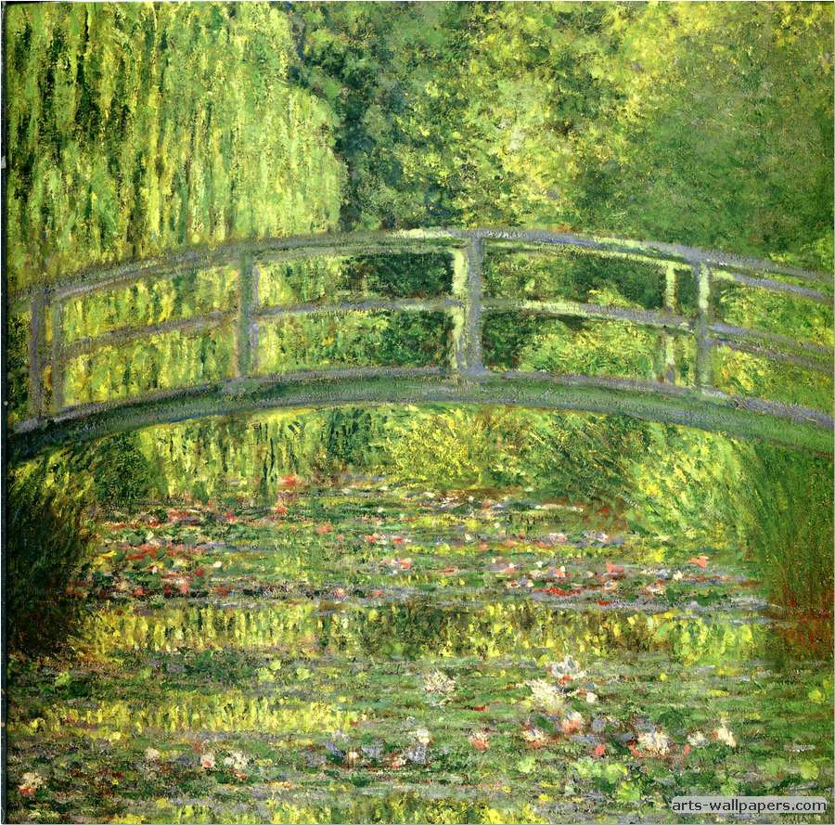
Claude Monet
By Robbie Hughes

Slide 2
Facts about Claude Monet
Claude Monet (1840-1926) was the primary inspiration for the new art movement of impressionism. Along with his contemporaries, he captured the light of nature on canvass in a unique, spontaneous and vivacious style.
Claude Monet was born in 14 November 1840, in Paris, France. His family soon moved to Le Havre where he grew up. His father wished him to become a grocer, but Monet’s aspirations lay in art.

Slide 3
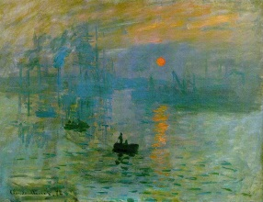
Claude Monet’s Painting’s

Slide 4
CLAUDE MONET

Slide 5
Claude Monet’s Death
Monet was one of the greatest modern painters. His output was prolific and he continued to develop and innovate throughout his long artistic life.
He died from lung cancer in December 1926.

Slide 6
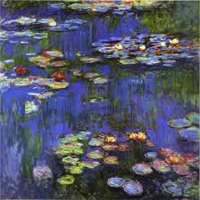
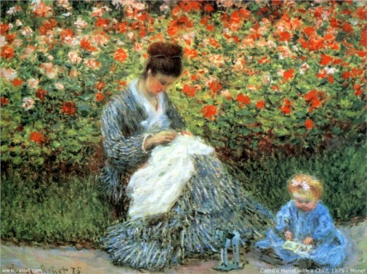
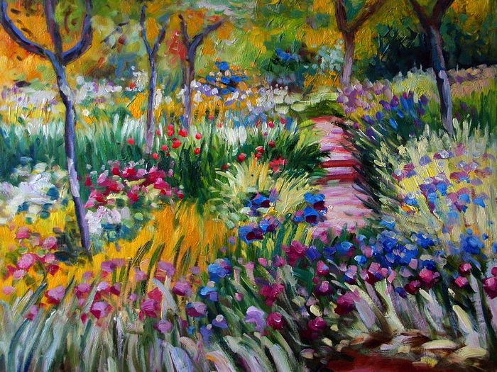
More painting’s

Slide 7
THANK YOU FOR READING and watching a Robbie hughes production

