Slide 1
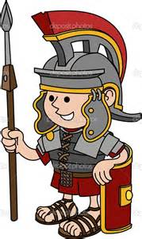
P5/4 Shared Plan
Literacy
Reading
Banded Books and Novel Studies
Spelling
Spelling Rules
Writing – Information reports on the Romans/ life in Roman times.
Recounts on Easter Assembly and school trip.
Numeracy
2D and 3D shapes
Money
Time
Multiplication
Mental Maths Partitioning and counting on and back
IDL
The Romans
The Easter Story (P5 children will be performing this in school)
Health and Wellbeing
Gymnastics
Possession Games
Circle Time
Emotional wellbeing
RME
The Easter Story
Other
Easter Assembly date – 24.3.16

