Slide 1
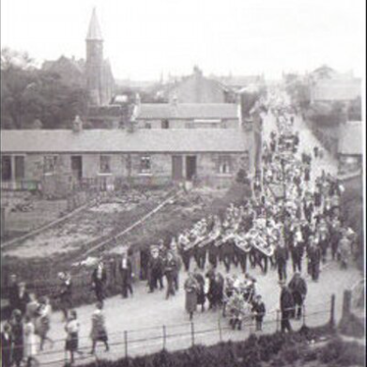
Homework
Onset and Rhyme
Spelling
Maths
Numeracy
Primary 1
Numbers to 20 and beyond!
Addition
Subtraction
Number bonds
Literacy
Primary 1
Onset and Rhyme and Spelling programme.
Early Reading Skills
Listening and Talking
Independent writing
Sounding out words and ‘Having a Try’
Primary 1a & 1b
Mrs Heron and Mrs Murray
May –June 2016
Inter Disciplinary Learning Contexts
My Village
Chapelhall now and in the past.
Scottish Artist
Scottish Artist
Pam Carter
Health and Wellbeing
Games
Wii Dance/Go Noodle
Playground Games
My Body
Sports Day
Fri 3rd June
Special events
P1 assembly Wed 1st June 2pm
School AGM Wed 1st June 7pm
Graduation Mon 27th June 1pm

