Slide 2
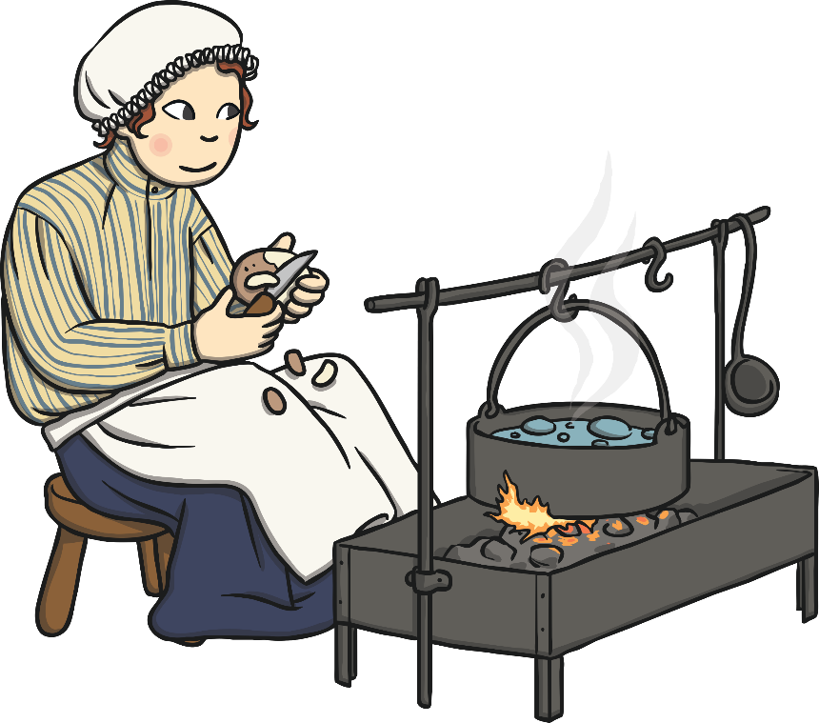
Cook
Duties:
To prepare meals for the family and to keep the kitchen clean.
Must be:
An organised individual who is clean, tidy and efficient.
To apply, complete an application form.

Slide 3
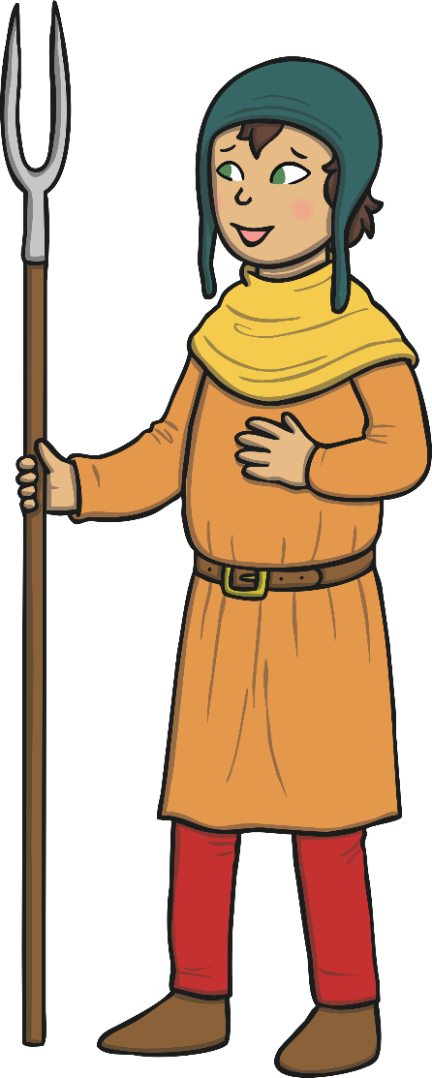
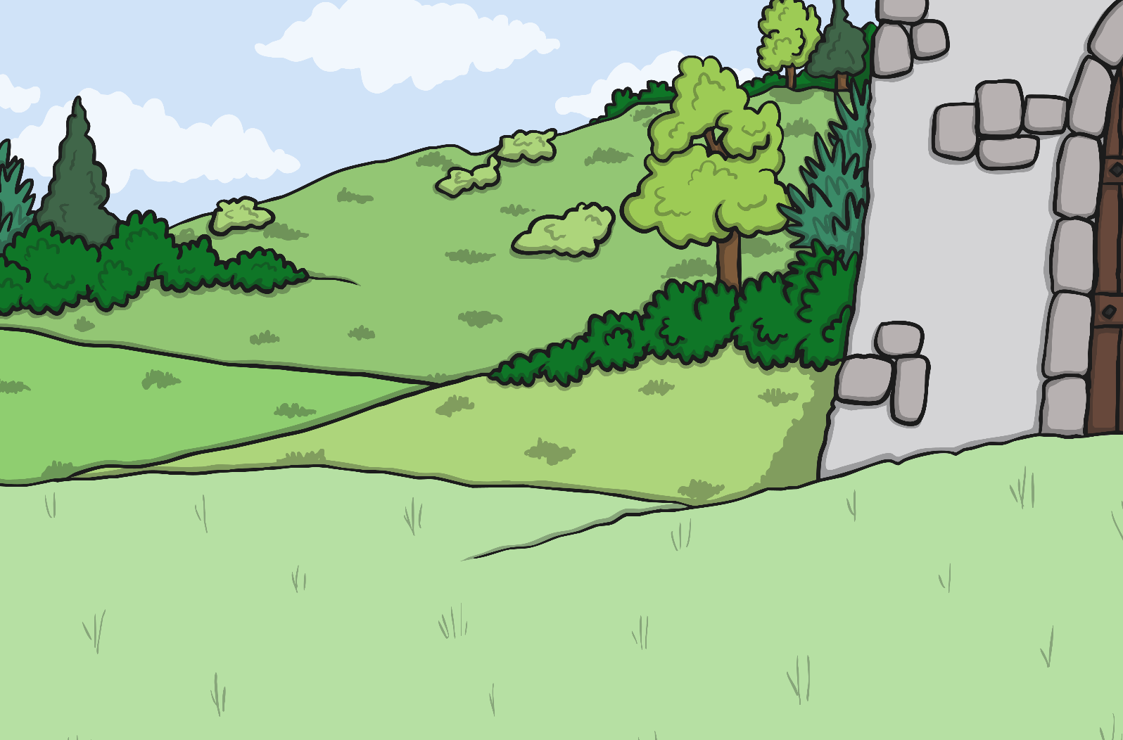
Gardener
Duties:
To ensure the castle gardens are maintained as well as keeping the walls free from ivy.
Must be:
A hardworking individual who is passionate about safety.
To apply, complete an application form.

Slide 4
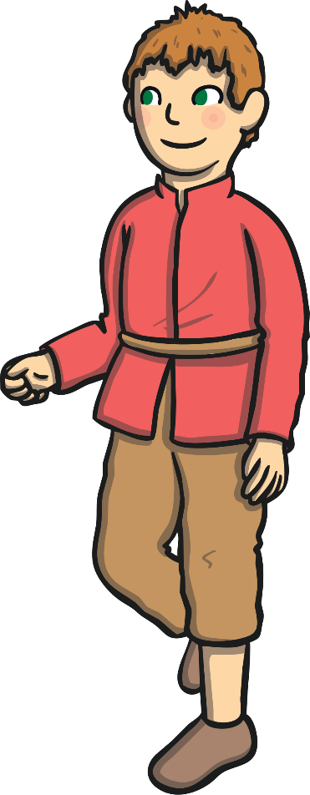
Candlemaker
Duties:
To make candles for use through the entire castle.
Must be:
A skilled craftsman who is able to work efficiently.
To apply, complete an application form.

Slide 5
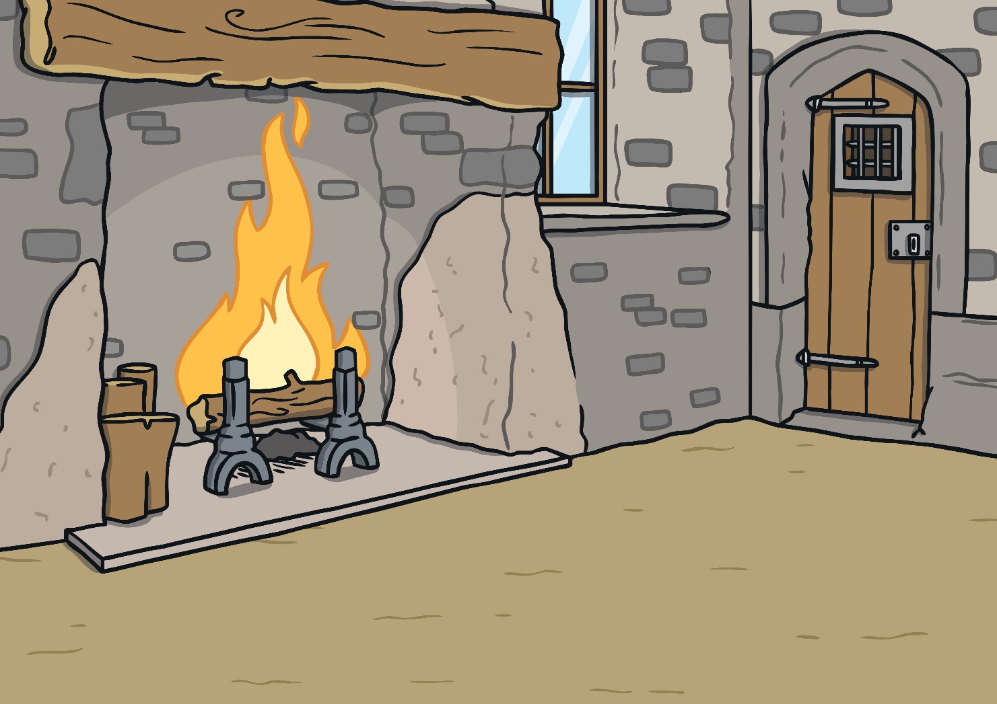
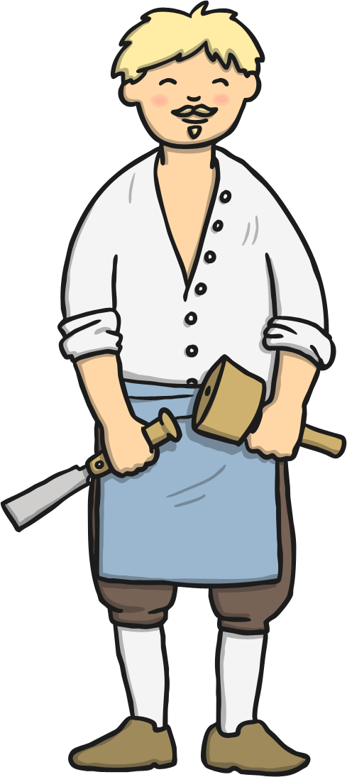
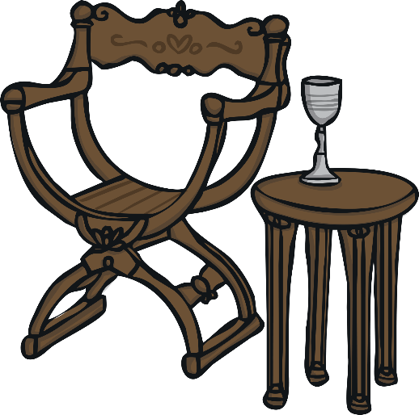
Carpenter
Duties:
To craft things out of wood for use throughout the castle.
Must be:
A highly skilled tradesman who can use tools competently and safely.
To apply, complete an application form.

Slide 6
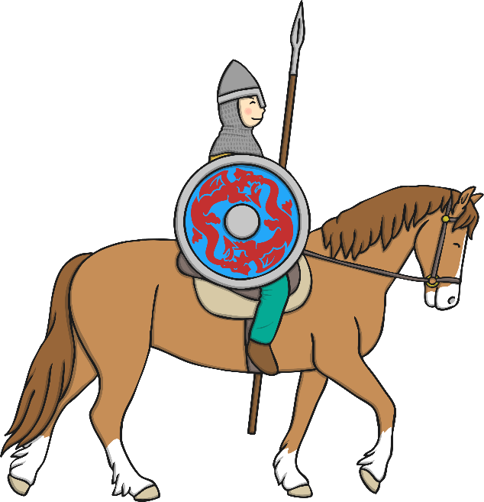
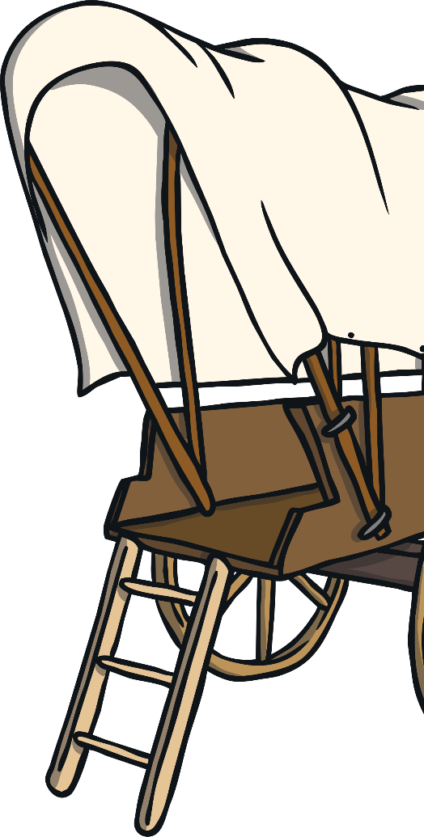
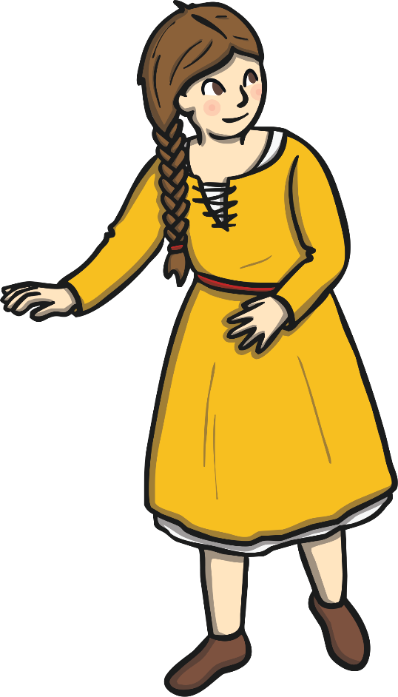
Marshal
Duties:
To be responsible for the household’s horses, carts and wagons as well as the transportation of goods.
Must be:
An organised individual
who is punctual and
hard-working.
To apply, complete an application form.

Slide 7
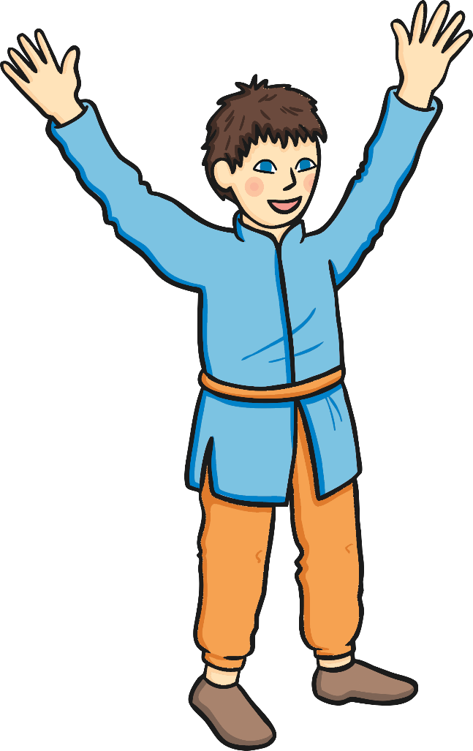
Herald
Duties:
To announce on behalf of the King to the public.
Must be:
A confident individual who is able to speak in front of crowds.
To apply, complete an application form.

Slide 8
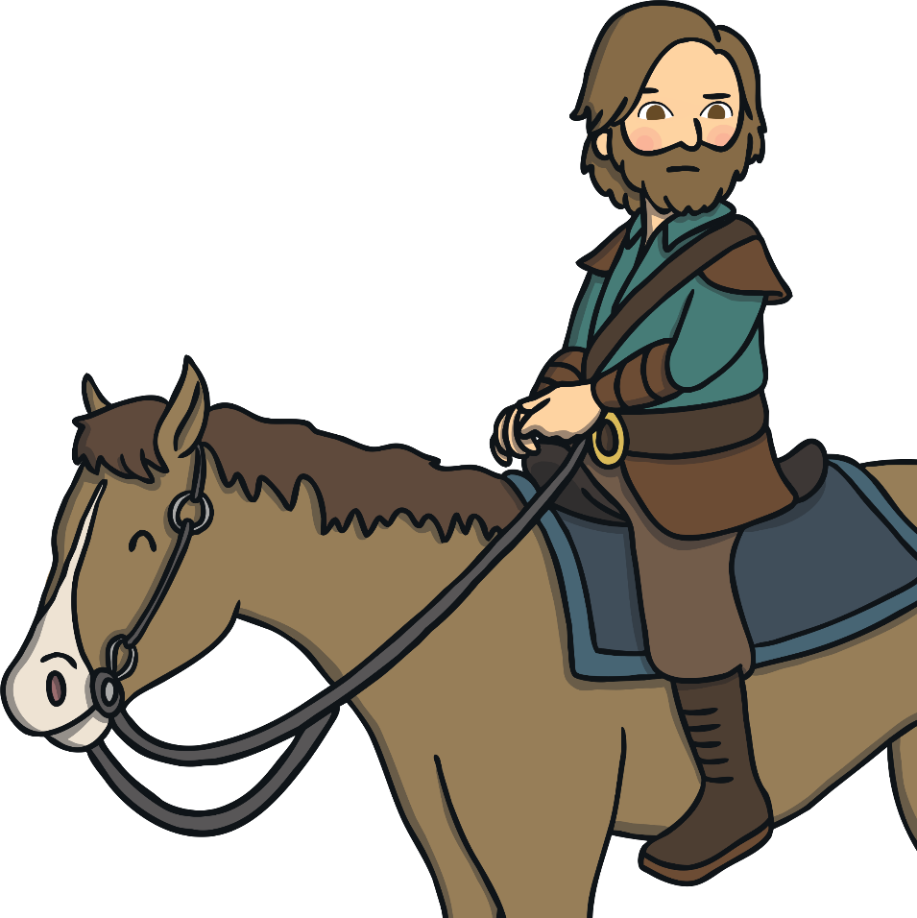
Messenger
Duties:
To carry information to others on behalf of a Lord.
Must be:
A trustworthy individual who is reliable, punctual and efficient.
To apply, complete an application form.

Slide 9
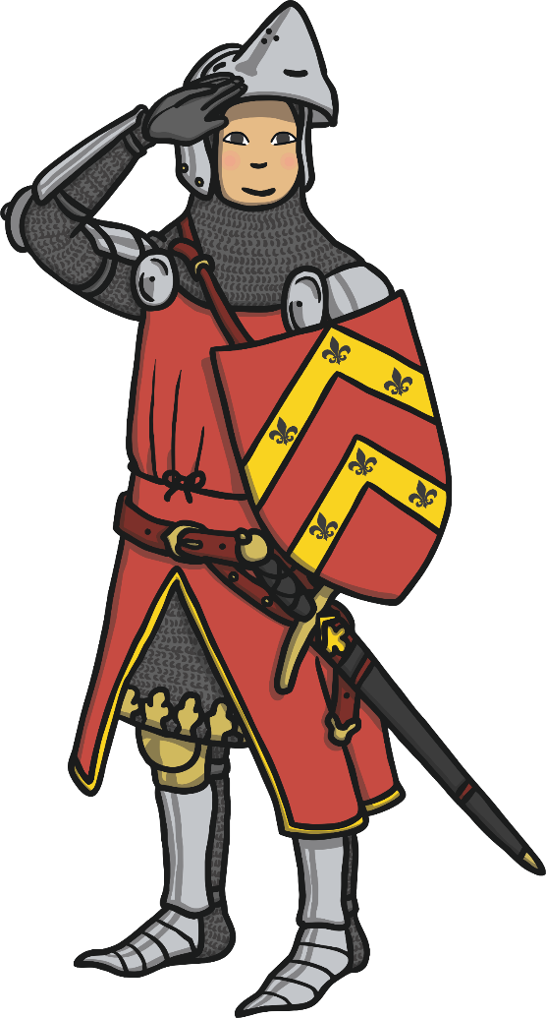
Watchman
Duties:
To be responsible for castle security, ensuring the castle is safe.
Must be:
A trustworthy individual who is hard-working and punctual.
To apply, complete an application form.

