Slide 2
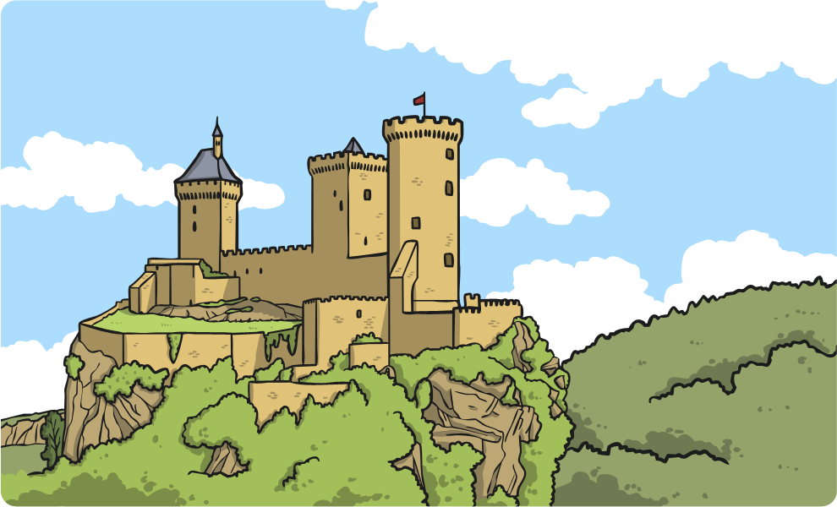
Defence Against Enemies
Castles were built for important and wealthy people to live in. As so many wealthy people lived in castles, there were usually lots of lovely things that people wanted to steal. Sometimes enemies wanted the whole castle!
Because of this, it was very important that castles were protected against enemies.

Slide 3
The Moat
The moat was a deep trench or ditch that was dug all around the outside of the castle walls. Then it was filled with water.
If people wanted to invade the castle they would have trouble crossing the moat.

Slide 4
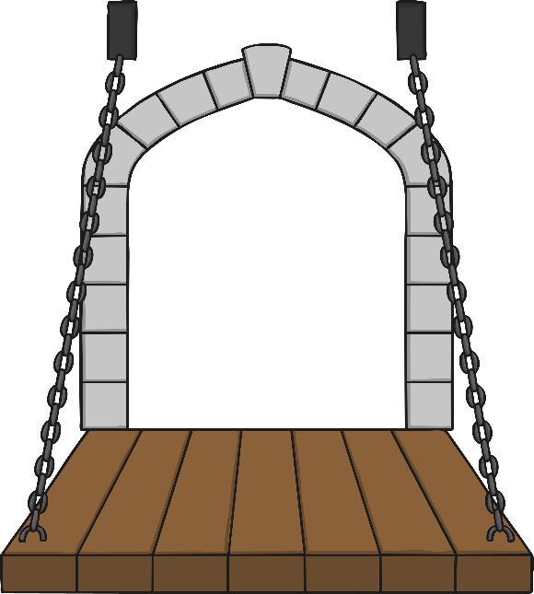
The Drawbridge
A drawbridge was used as a way to prevent or allow people in or out of the castle. It led from the castle gateway, over the moat, to the other side.
The impressive thing about a drawbridge was it could be raised up, so that invaders could not cross the moat or easily get into the castle.

Slide 5
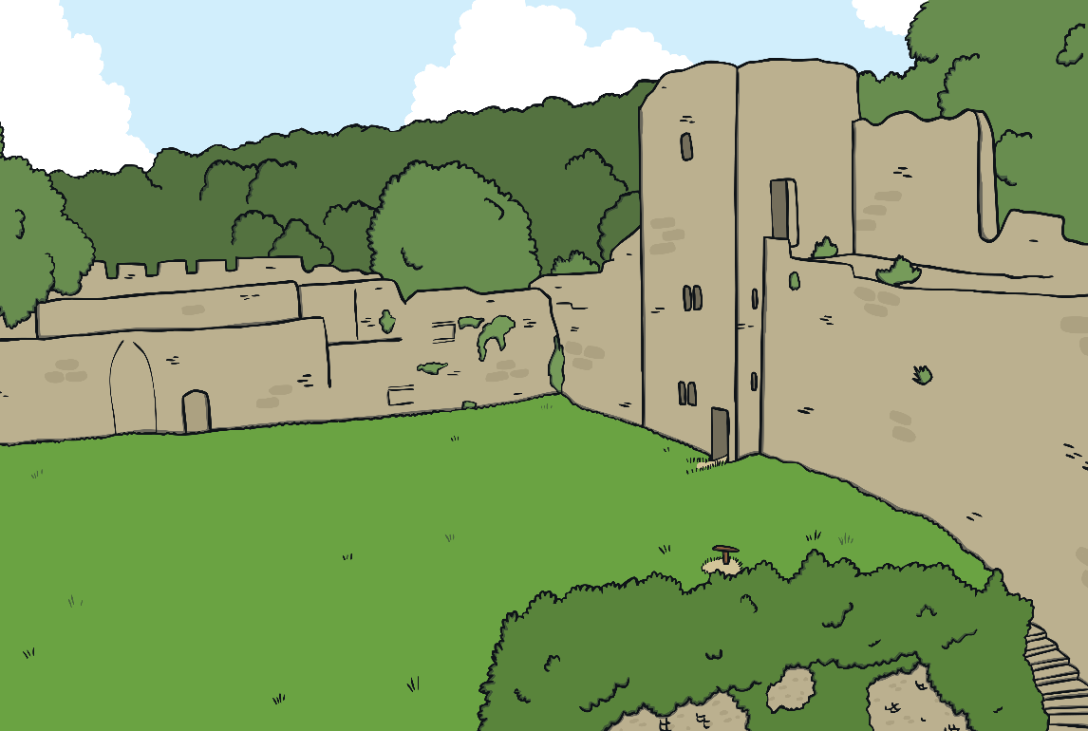
The Bailey
The bailey was an inner courtyard in the middle of the castle. It was a large piece of open ground. The bailey often had different types of castle buildings on it like the kitchens, chapel, barracks, stables, workshops, forges, stores and halls.

Slide 6
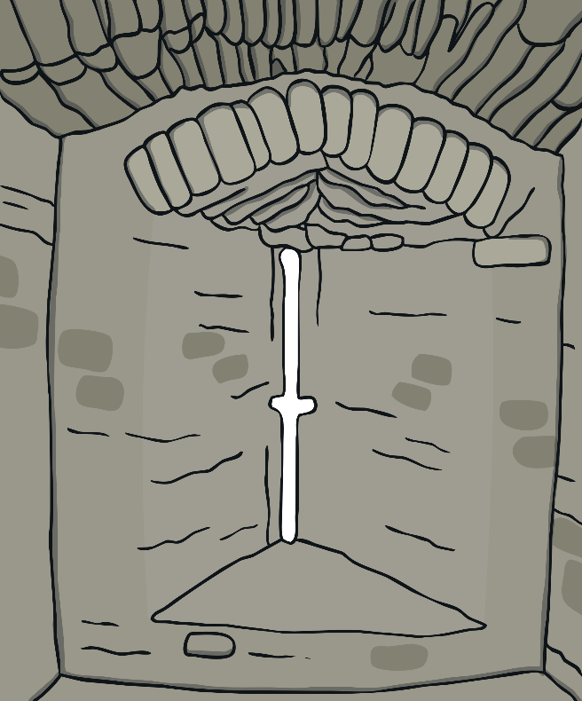
Arrow Loops
Arrow loops, or slits, were used to defend the castle from invaders. These narrow slits were cut into the stone walls and used to shoot arrows through. The flying arrows would come as a big surprise to the invaders down below!

Slide 7
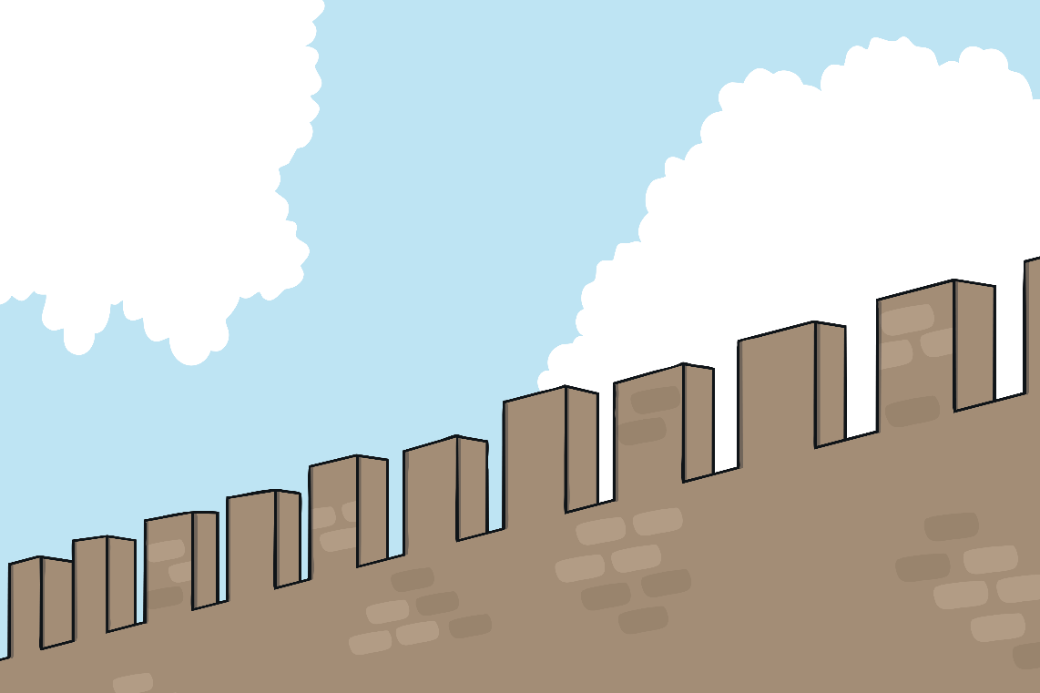
Battlements
Battlements were the square-shaped part of the walls around the top of the castle. They were useful for spying across the fields to check no one was coming to attack the castle. They were also useful for soldiers firing arrows through the gaps, as they offered protection from arrows coming from the enemy.

Slide 8
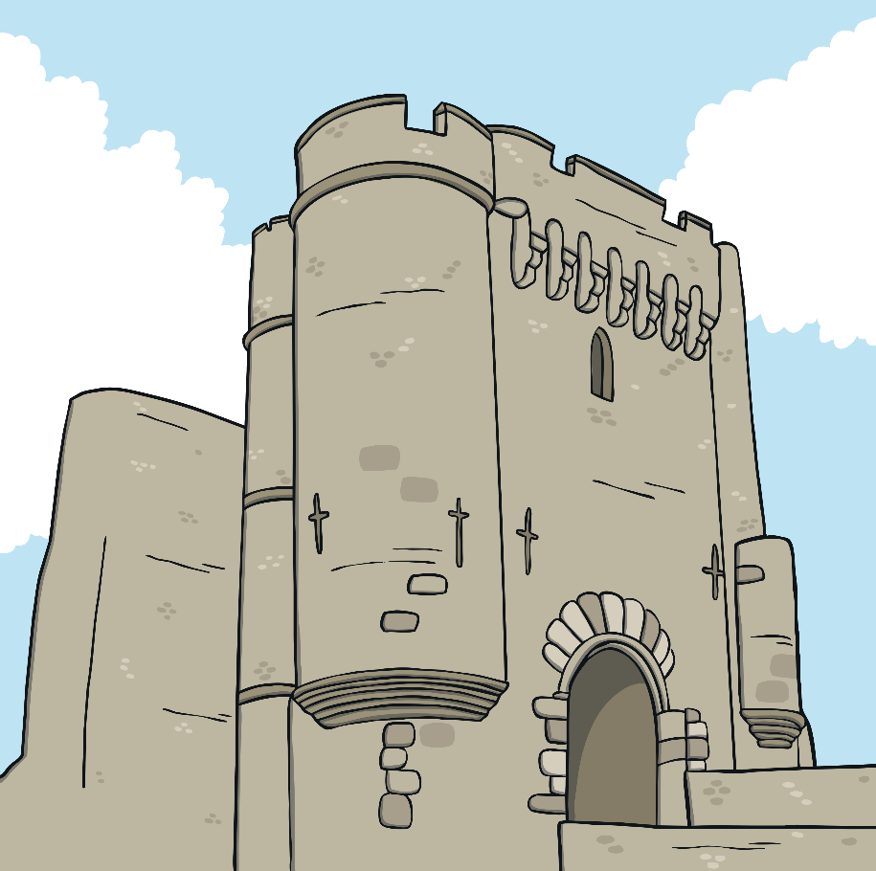
The Barbican
The barbican was a section of wall which jutted out around the gateway. Its main job was to add strength to the gatehouse.

Slide 9
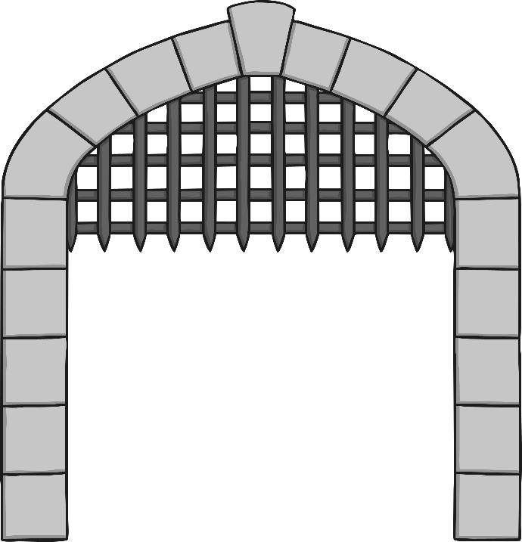
The Portcullis
The portcullis was also an important feature for defence. It was a very heavy gate made of metal and very strong wood. It had jagged ‘teeth’ at the bottom. It lifted vertically, but could also be dropped very quickly, to stop people getting in or easily breaking their way in through the gateway.

Slide 10
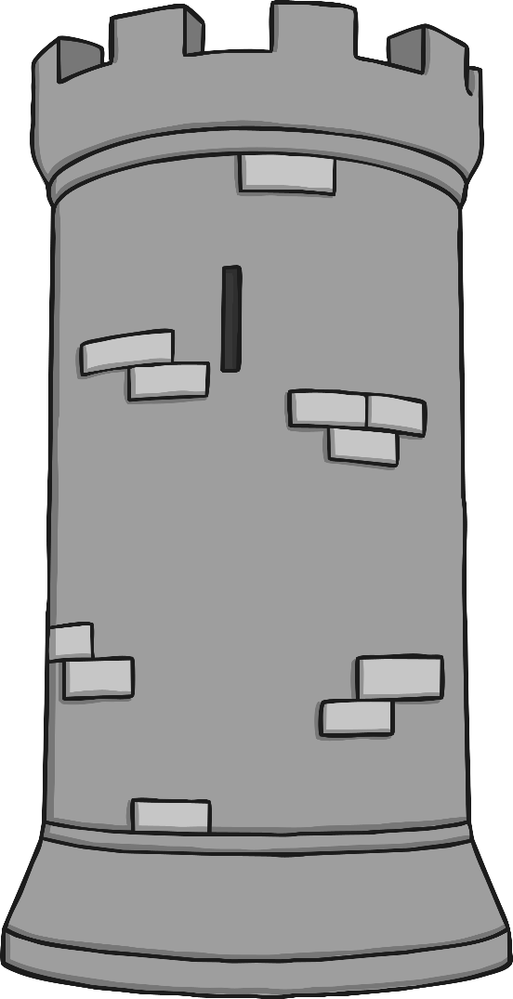
The Tower
The tower was a circular or square building which was used for a lookout and for defence. It made the castle more stable and could even put off attackers trying to invade the castle.

Slide 11
The Turrets
The castle turrets rested on the main towers and were used to see far across the land to warn them when enemies were coming. Small slit-like windows allowed anyone inside to see out and shoot arrows at their enemies, but protected those inside from arrows being shot back.

Slide 12
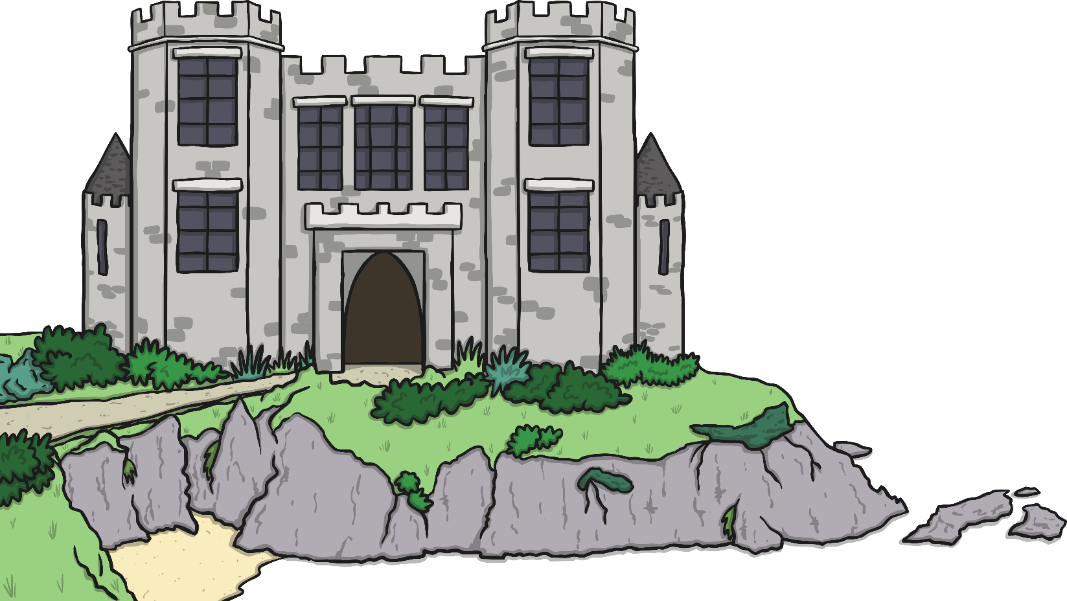
The Keep
The keep is usually found at the heart of a castle. It was a tower built within a castle which was used as a place to live as a last resort during a battle.

