Slide 1
Disney Virtual Trip
Primary 1/2/3

Slide 2
Day 1

Slide 3
Art
Create a passport that you can use during your trip! Remember to include a front cover, your name, a picture of yourself and lots of space for characters names! Each time you see a character this week in a ride, video or song, make sure to write their name in your passport! How many characters will you meet by the end of the week?
Learning Intention: I am learning to create an eye-catching design.
Success Criteria:
I can create a front cover.
I can include: my name and age.

Slide 4
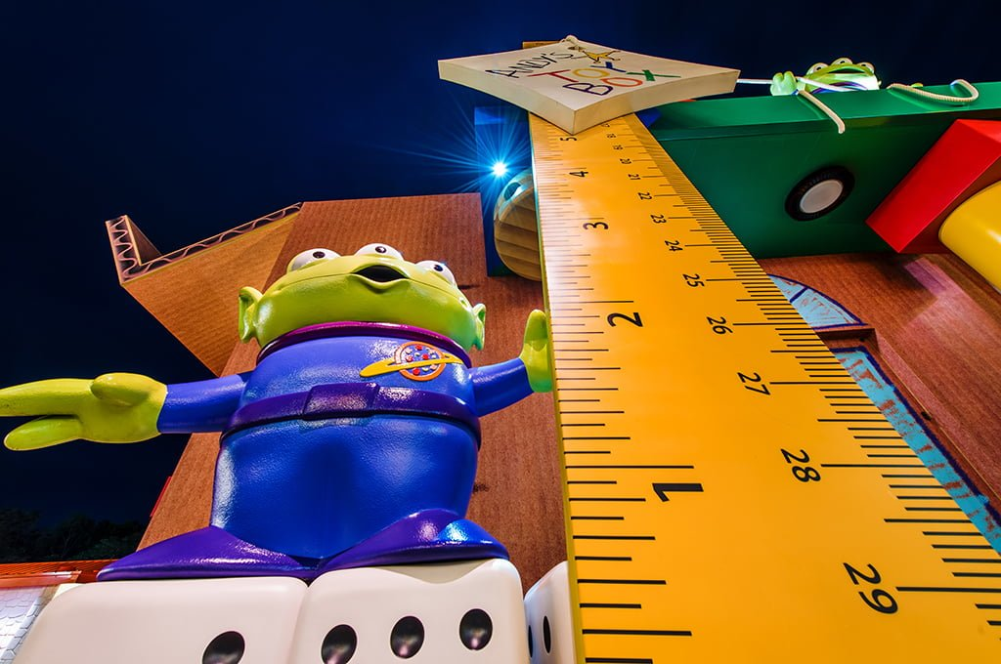
Numeracy
To go on today’s rides you must be taller than:
6 pieces of cutlery
6 of your own shoes/socks
3 books
15 blades of grass
Estimate and then measure whether you are tall enough to ride!
Extension/P2/3: If you have a measuring tape/ruler, you could measure how tall you are. Can you find 3 things that are taller and 3 things that are shorter than you. Measure the height of each thing.
Learning Intention: I am learning to measure and estimate height.
Success Criteria:
P1 - I can estimate the height. I can measure carefully.
P2 – I can use a tape measure/ruler accurately. I can compare heights.

Slide 5
Writing
Take a tour of Donald Duck’s house boat. What can you see? Draw and label 5 things that you can see inside his house.
Challenge: Can you think of a story using Donald Duck’s house as the setting?
P2/3: Write about how Donald Duck’s house is different to yours, for example, my windows are not circles and I do not dry my washing on my roof!
https://www.youtube.com/watch?v=XERRGapwSVQ&t=17s
Learning Intention:
P1: I am learning to sound out words.
P2/3: I am learning to write about a setting.
Success Criteria:
P1 - I can draw in detail. I can sound out short words to add labels.
P2/3 – I can write in sentences. I can identify differences.

Slide 6
IDL
Task: Enjoy the ‘It’s a Small World’ ride. The ride shows many countries and places around the world.
P1: Find out 2 facts about another country. You could add photos/drawings/text to the template or record yourself saying what you have found out.
P2/3: Compare Scotland with another country. You might think about: weather, food, attractions/scenery, events and celebrations, flags or anything else you are interested in. You could present your information in a poster or by speaking
https://www.youtube.com/watch?v=I2Do309e4YU
Learning Intention: I am learning about other countries and cultures.
Success Criteria:
P1: I can find out 3 facts about another country.
P2/3: I can find out information about a country. I can think about how this compares to Scotland.

Slide 7
Reading
Watch the Frozen ride – how many words can you think of that rhyme with snow. Record yourself saying all of the words that you can think of.
https://www.youtube.com/watch?v=J8OHP9OriMA&t=33s
Challenge: Make a silly sentence using as many of the words as you can.
P2/3: Write down your list and create a silly story using lots of rhyming words.
Learning Intention: I am learning to produce rhymes.
Success Criteria:
P1 - I can produce a rhyme.
P2/3 – I can write a silly sentence or story using rhyming words.

Slide 8
Day 2

Slide 9
HWB
Safety Rules
Look at the video of Disney Land. Can you think of any rules or things that you would need to do to keep safe at the park? Think about what you should do on rides, who you would speak to and any extra rules that you can think of.
Extension/P2/3: Create a safety poster to display the rules.
https://www.youtube.com/watch?v=HyZfIlxwsfI
Learning Intention: I am learning to identify ways to keep myself safe.
Success Criteria:
P1: I can explain ways that I can keep myself safe.
P2/3: I can explain how to keep myself and others safe. I can display my ideas in an effective way.

Slide 10
Numeracy
Look at the map of Disney Land. Can you find your way through the map?
1 Start at the Entrance and go to Donald’s house boat.
2 Start at the log flume and go to the rollercoaster.
3 Start at the pond and go to the Frozen ride.
P2/3 Challenge: Can you give detailed directions on how to get from each place to the next. For example, “Turn left then go straight until you get to the pond”.
Learning Intention: I am learning to read a map and give directions.
Success Criteria:
P1: I can use a simple map.
P2/3: I can give detailed directions on how to get somewhere.

Slide 11
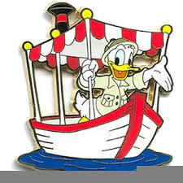
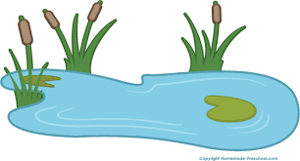
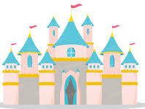
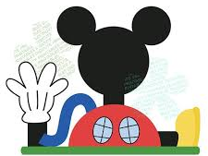
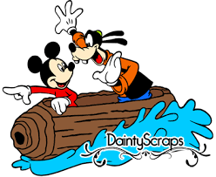

Slide 12
Writing
Watch the Monsters Inc ride clip, it is a 360 degree experience so you can drag the screen to see all around you.
Design your own monster and record yourself describing them. Are they kind, scary, fluffy, angry? Can you think of any other ways to describe them?
Challenge/P2/3 – Create a story where your monster is the main character.
https://www.youtube.com/watch?v=vDNUXa5sIHU
Learning Intention: I am learning to describe a character.
Success Criteria:
P1: I can create a character. I can describe the qualities of a character.
P2/3: I can write a story with a main character.

Slide 13
IDL
Weather
Disney Land is in Orlando in America.
Find out what the weather is like in Orlando today. Is it sunny, cloudy or windy? What is the temperature?
Extension: What is the weather and temperature here? Is it hotter or colder?
P2/3: How many degrees hotter/colder is Orlando than Aberdeen today?
Learning Intention: I am learning to identify and compare the weather in various places.
Success Criteria:
P1: I can identify the weather. I understand the weather is different around the world.
P2/3: I can find out the temperature in various parts of the world. I can compare temperatures.

Slide 15
Reading
Listen to ‘Under the Sea’.
https://www.youtube.com/watch?v=GC_mV1IpjWA
P1: Why does Sebastian think it is better to live under the sea? Record yourself explaining 2 reasons from the song.
P2/3: You could identify 2 reasons as above and then also think about why it might not be better to live on land. You could create your own short song/verse to convince Sebastian if you wish!
Learning Intention: I am learning to listen for understanding.
Success Criteria:
P1: I can listen carefully. I can recall information that I have heard.
P2/3: I can recall information that I have heard. I can question what I have heard – do I agree? Is that really best?

Slide 16
Day 3

Slide 17
Reading
P1: Look closely at the pictures and see if you can spot any sounds/CVC words/common words. Record yourself saying the sounds or reading the words. You could create your own picture and hide words for somebody else to find. There are 3 pictures so that you can choose your challenge.
P2/3: Look closely at the picture and see if you can spot any of your spelling words. Once you have found and read the words, practice each one in your red spelling jotter.
Learning Intention: I am learning to read words.
Success Criteria:
P1: I can blend sounds to read words. I can read some common words.
P2/3: I can read words using the spelling patterns that I have learnt.

Slide 18
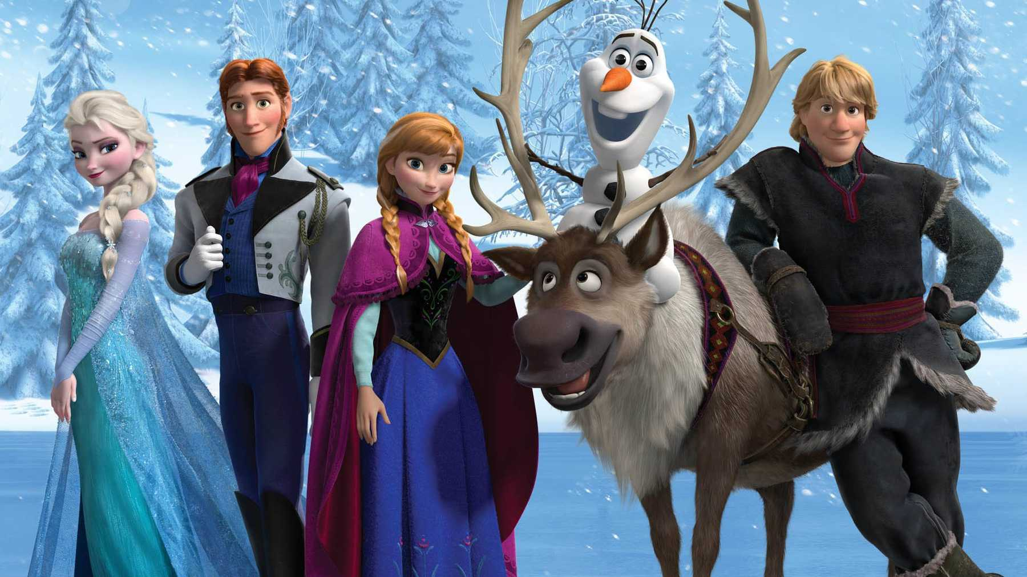
this
got
up
we
go
me
they
she
the
my
them

Slide 19
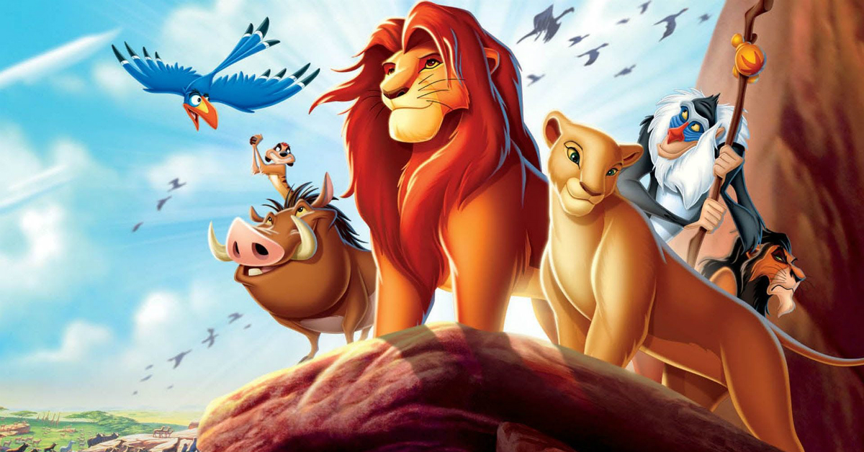
fly
bus
dog
log
leg
fan
red
fin
tin
gap
cub
rip
pig

Slide 20
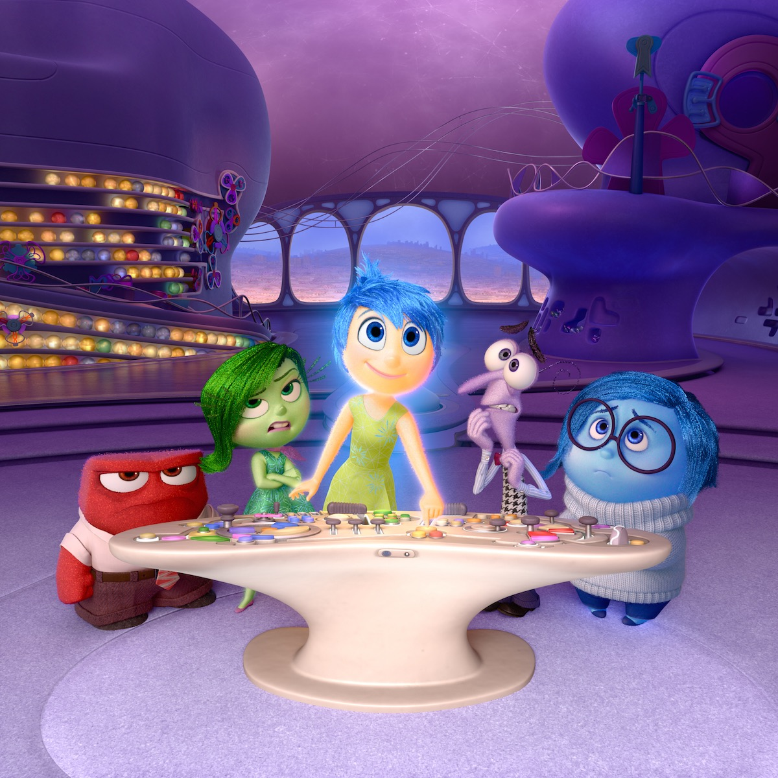
t
e
j
r
a
l
g
f
y
m
q
s
h

Slide 21
Writing
P1: Make a postcard to tell somebody all about your virtual trip to Disney Land! You will need to draw a detailed picture on one side and write your message on the other side. Challenge: Can you write the person’s address?
P2/3: Write a diary entry about your day at Disney Land, remember to include what you did at various times throughout the day. How descriptive can you be?
Learning Intention: I am learning to share my experiences in a postcard/diary.
Success Criteria:
P1: I can share my experiences with others. I can write short words.
P2/3: I can share my experiences. I can add detail to make my writing more interesting.

Slide 22
Numeracy
Here is a snack menu from Disney Land.
P1: Circle the snack that you would like and choose the correct coins to pay for it. There are 3 slides, so you could do this 3 times. Challenge: How much change would you get if you paid with a 10p coin?
P2/3: Circle 2 snacks that you would like, how much will it cost all together? Use the coins to pay for the items. Challenge: How many ice creams could you get for 50p?
Learning Intention: I am learning to use coins to make amounts.
Success Criteria:
I can use coins to make amounts.
I can give change.
I can add amounts together.

Slide 23
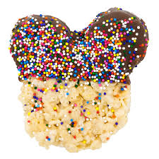
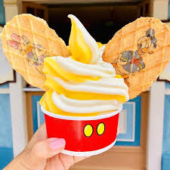
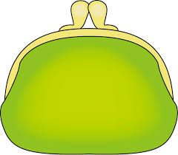
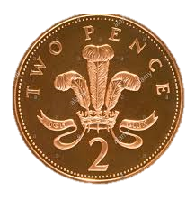
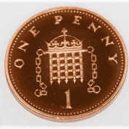
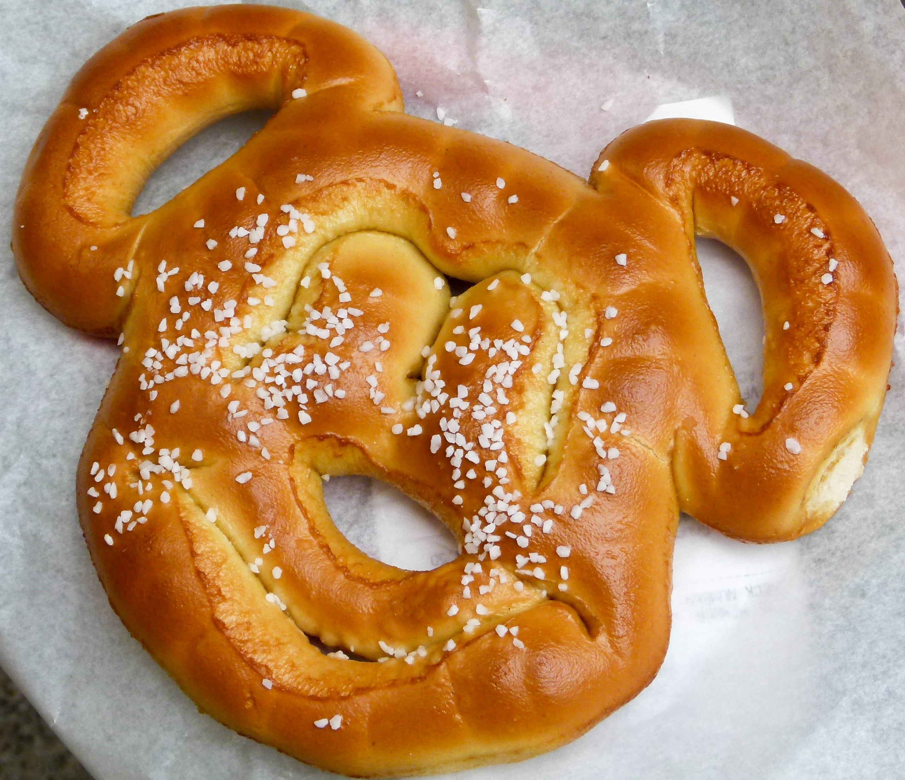
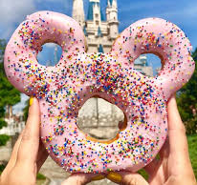
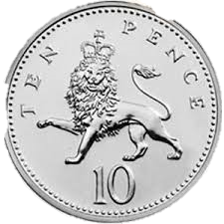
Mickey’s Snack Menu
Aladdin fruit skewers 5p | Pizza 7p
Ice cream 10p | Rice crispy treat 6p
Pretzel 4p | Doughnut 8p

Slide 24
Mickey’s Snack Menu
Aladdin fruit skewers 5p | Pizza 7p
Ice cream 10p | Rice crispy treat 6p
Pretzel 4p | Doughnut 8p

Slide 25
Mickey’s Snack Menu
Aladdin fruit skewers 5p | Pizza 7p
Ice cream 10p | Rice crispy treat 6p
Pretzel 4p | Doughnut 8p

Slide 26
HWB
Watch the clip of Ratatouille. Can you help to prepare a meal or snack today? You could look at a recipe with an adult if they are using one.
https://www.youtube.com/watch?v=jwLKPDJqldw
P2/3 - You could write down the recipe/instructions for somebody to follow.
Learning Intention: I am learning to prepare and cook food.
Success Criteria:
I can follow a recipe.
I can chop, peel and spread.
I can be safe in the kitchen.

Slide 27
IDL
P1: Mickey has asked for your help to design a new ride for Disney Land! You could draw your ride, video yourself describing it, or build it out of blocks, recycling etc.
P2/3: As above and then you could make a poster to advertise your ride if you wish – remember to include the price, height limit and any safety rules that you have.
Learning Intention: I am learning to design a rollercoaster.
Success Criteria:
I can plan my design.
I can think about how to make the ride interesting.
I can think about safety features.

Slide 28
Day 4

Slide 29
Reading
Can you read each character’s name? Can you match them to the correct pictures?
Challenge/P2/3: Match the phrases to the correct pictures.
Learning Intention: I am learning to blend sound in order to read words.
Success Criteria:
I can blend sounds together.
I can match the words to the pictures.

Slide 30
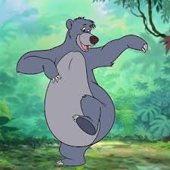
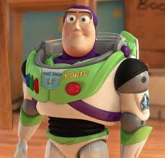
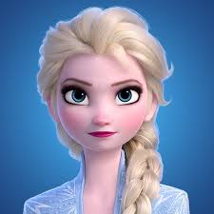
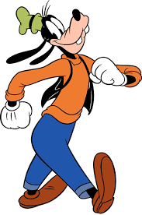
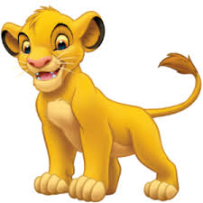
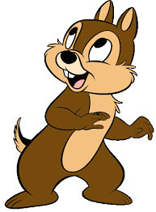
Elsa
Chip
Goofy
Simba
Baloo
Buzz

Slide 31
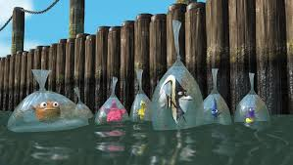
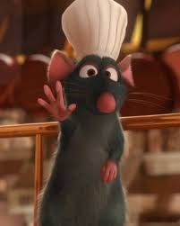
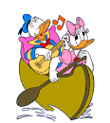
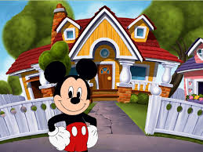
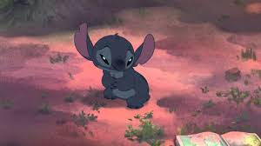
Match the phrases to the correct pictures.
Two ducks in a boat.
A mouse and his house.
There is a rat in a hat.
Stitch is sad.
The fish are in bags.

Slide 32
Writing
Task: We’re Flying Through the Air! Enjoy the Aladdin ride, where you fly through the sky on a magic carpet!
P1: Can you draw pictures/make a list of things that can fly? Challenge: Write a sentence to tell me where you would fly to if you had a magic carpet.
P2/3: Where would you fly to on a magic carpet and why? Describe the setting using your most descriptive words! What would you see, hear, smell, touch and taste in the setting?
https://www.youtube.com/watch?v=fcbWb1FkSC0
Learning Intention:
P1: I am learning to write words.
P2/3: I am learning to describe a setting.
Success Criteria:
P1: I can sound out words. I can form letters correctly.
P2/3: I can use descriptive words. I can describe a setting to the reader.

Slide 33
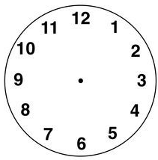
Numeracy: Primary 1
Draw the hour and minute hands to show the time.
The park opens at 9 o’clock.
You go on the log flumes at 11 o’clock.
You visit Mickey’s house at 4 o’clock.
Challenge: The park closes at half past 8.

Slide 34
Numeracy: Primary 2/3
Draw the hour and minute hands to show the time.
The park opens at quarter past 9.
You go on the log flumes at half past 11.
You visit Mickey’s house at quarter to 3.
Challenge: The park closes at 25 past 8.

Slide 35
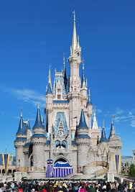
IDL
STEM
Look at the picture of Cinderella’s castle. Can you create your own castle using materials of your choice? You could use sticks, blocks, or anything else that you wish. Be as creative as you can!
Learning Intention: I am learning to build a design.
SC: I can select materials that will work for my design. I can create an interesting design. My design is stable and stays up.

Slide 36
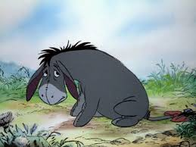
HWB
Eeyore is known for being sad sometimes. What could you do when you are feeling sad to make yourself feel a bit better?
Extension: How could you help a friend who was feeling sad?
Learning Intention: I am learning to identify and manage my emotions.
Success Criteria:
I can explain ways that I could try to cheer myself up when I am sad.
I can think about how to help others too.

Slide 37
Day 5

Slide 38
IDL
Look at this picture from the movie ‘Moana’.
Only 1 in 1000 turtles live to be adults, they need our help!
Can you help the baby turtle to get to the sea by pointing out all of the obstacles.
What do humans need to do when they are on the beach to keep turtles safe?
P2/3: Can you make a leaflet or poster to tell beach-goers how they can protect the environment?
Learning Intention: I am learning to care for the planet and its animals.
Success Criteria:
I can identify risks to the turtles.
I can explain what we can do to look after the turtles/planet.
I can present my ideas clearly through a recording or poster/leaflet.

Slide 39
Reading
Watch the clip from ‘Moana’ and answer the questions:https://www.youtube.com/watch?v=KGqBfyQFG_g
What did Moana find on the beach?
Where did the turtle go?
Why did Moana want to go back to the beach?
P2/3: Make sure you write your answers in sentences. You could think of a question to ask somebody else, to check that they were watching carefully!
Learning Intention: I am learning to answer questions about what I have seen/heard.
Success Criteria:
I can watch and think carefully about what is happening in the clip.
I can answer questions about what I have seen.
P2/3: I can create my own questions.

Slide 40
Writing
Enjoy the Toy Story ride. https://www.youtube.com/watch?v=_oqkZbkZ6gg
The Toy Story characters are all very good friends. Can you write a letter to one of your friends? You might want to tell them a piece of news, or what you enjoy doing with them.
Learning Intention: I am learning to write a letter.
Success Criteria:
P1: I can use “to” and “from”. I can sound out words. I can draw a detailed picture.
P2/3: I can write in sentences. I can use “to” and “from”.

Slide 41
Numeracy
P1: Mickey Addition
Draw yourself a Mickey addition board, like in the example.
Gather some materials to help with your addition – blocks, buttons, rocks etc. Roll a dice and put that many blocks in his ear, roll again and put that many blocks in his other ear. How many are there all together?
Challenge: Write down your sums.
P2/3: Mickey Place Value
Draw yourself a Mickey place value board, like the example. Have an adult choose a number between 10 and 50. Put the number in the middle of the board and use the ears to show how many tens and units the number is made up of.
Learning Intention: P1: I am learning to add numbers together. P2: I am learning to build numbers using tens and ones.
Success Criteria:
P1: I can count carefully. I can use strategies to help me add numbers, such as: number lines, objects or my fingers.
P2/3: I can split a number into its tens and ones.

Slide 42
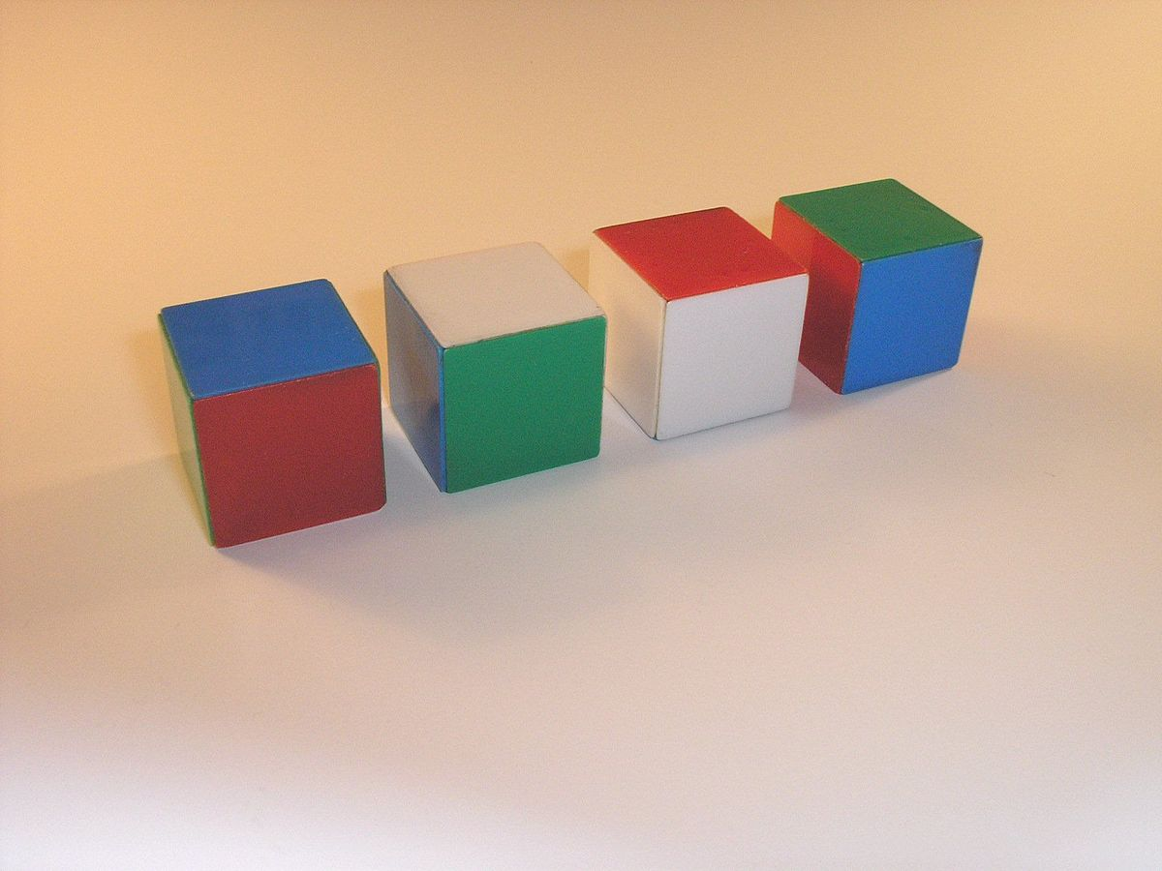
Mickey Addition
Mickey Place Value
4
2
8
42

Slide 43
HWB
Watch the video of the parade. Can you join in with any of the dancing?
https://www.youtube.com/watch?v=rR-KP8KH1Ng
Learning Intention: I am learning to follow movements that I see.
Success Criteria:
I can follow movements.
I can create my own dance.

Slide 44
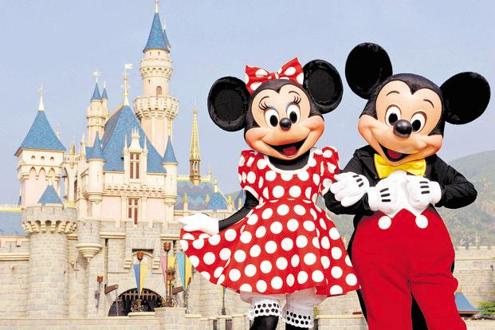
Create a souvenir photo! Take a close photo of your face and add it to the template as your souvenir!

Slide 46
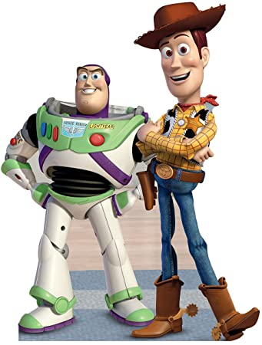

Slide 48
