Slide 1

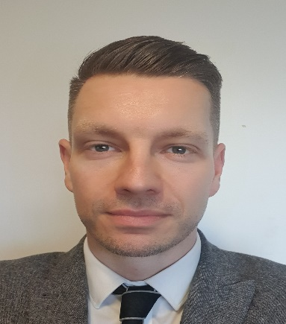
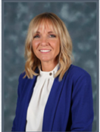
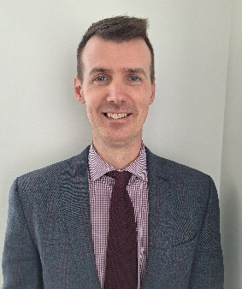
Should you have any concerns related to a potential Child Protection issue involving a pupil from Calderhead High School then these should be directed to Mr David MacPherson, the school’s Child Protection Officer. This should be done with the utmost urgency.
Dealing with a Child Protection Concern
David MacPherson - DHT & Child Protection Co-Ordinator.
In the absence of the child protection officer please notify the following:
Mrs Jennifer Di Mambro – Head Teacher Mr Graeme Russell - DHT
If a child/young person tells you someone may have abused them;
DO DON’T
Stay calm Ask too many questions
Ask only open questions Make false promises
Listen to the child Express shock or anger
Keep questions to a minimum Delay passing on your concerns
Reassure child and explain next steps
Record what the child has said in their own words.
Seek medical attention if this is a matter of urgency
NEVER
Carry out an investigation into an allegation, this is NOT your role.
Making a Referral (Notification of Concern)
Once you have discussed your concerns with the designated Child Protection Co-ordinator in
your establishment they may decide to pass on your concerns to Social Work or the Police.
REMEMBER
YOU SHOULD ALWAYS REFER TO CALDERHEAD/NORTH LANARKSHIRE COUNCIL’S CHILD PROTECTION PROCEDURES AND GUIDANCE

