Slide 1
A warm welcome awaits you

Slide 2
At Calderbridge Primary School…

Slide 3
It’s that time of year when everyone is excited about Santa and presents…

Slide 4
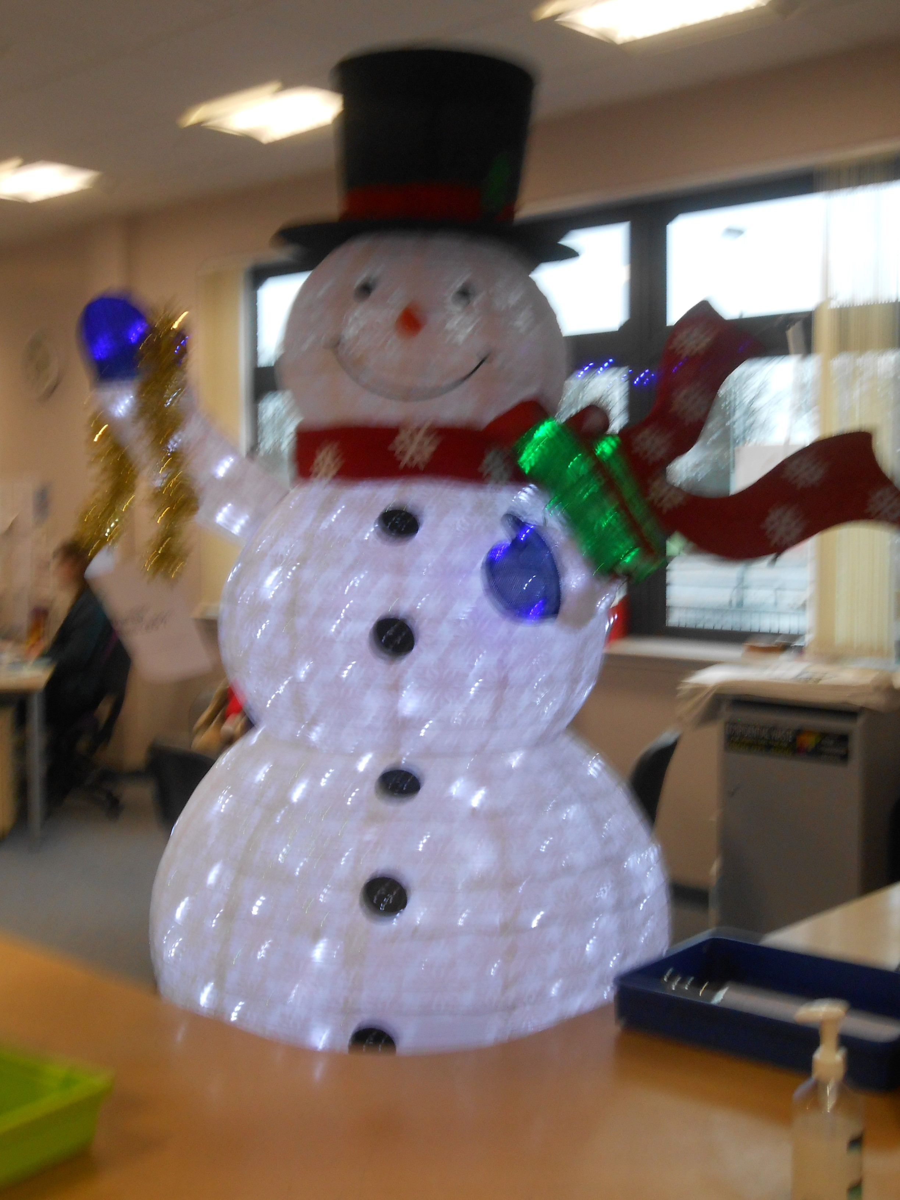
We have the most beautiful tree and a big friendly snowman at our main entrance….

Slide 5
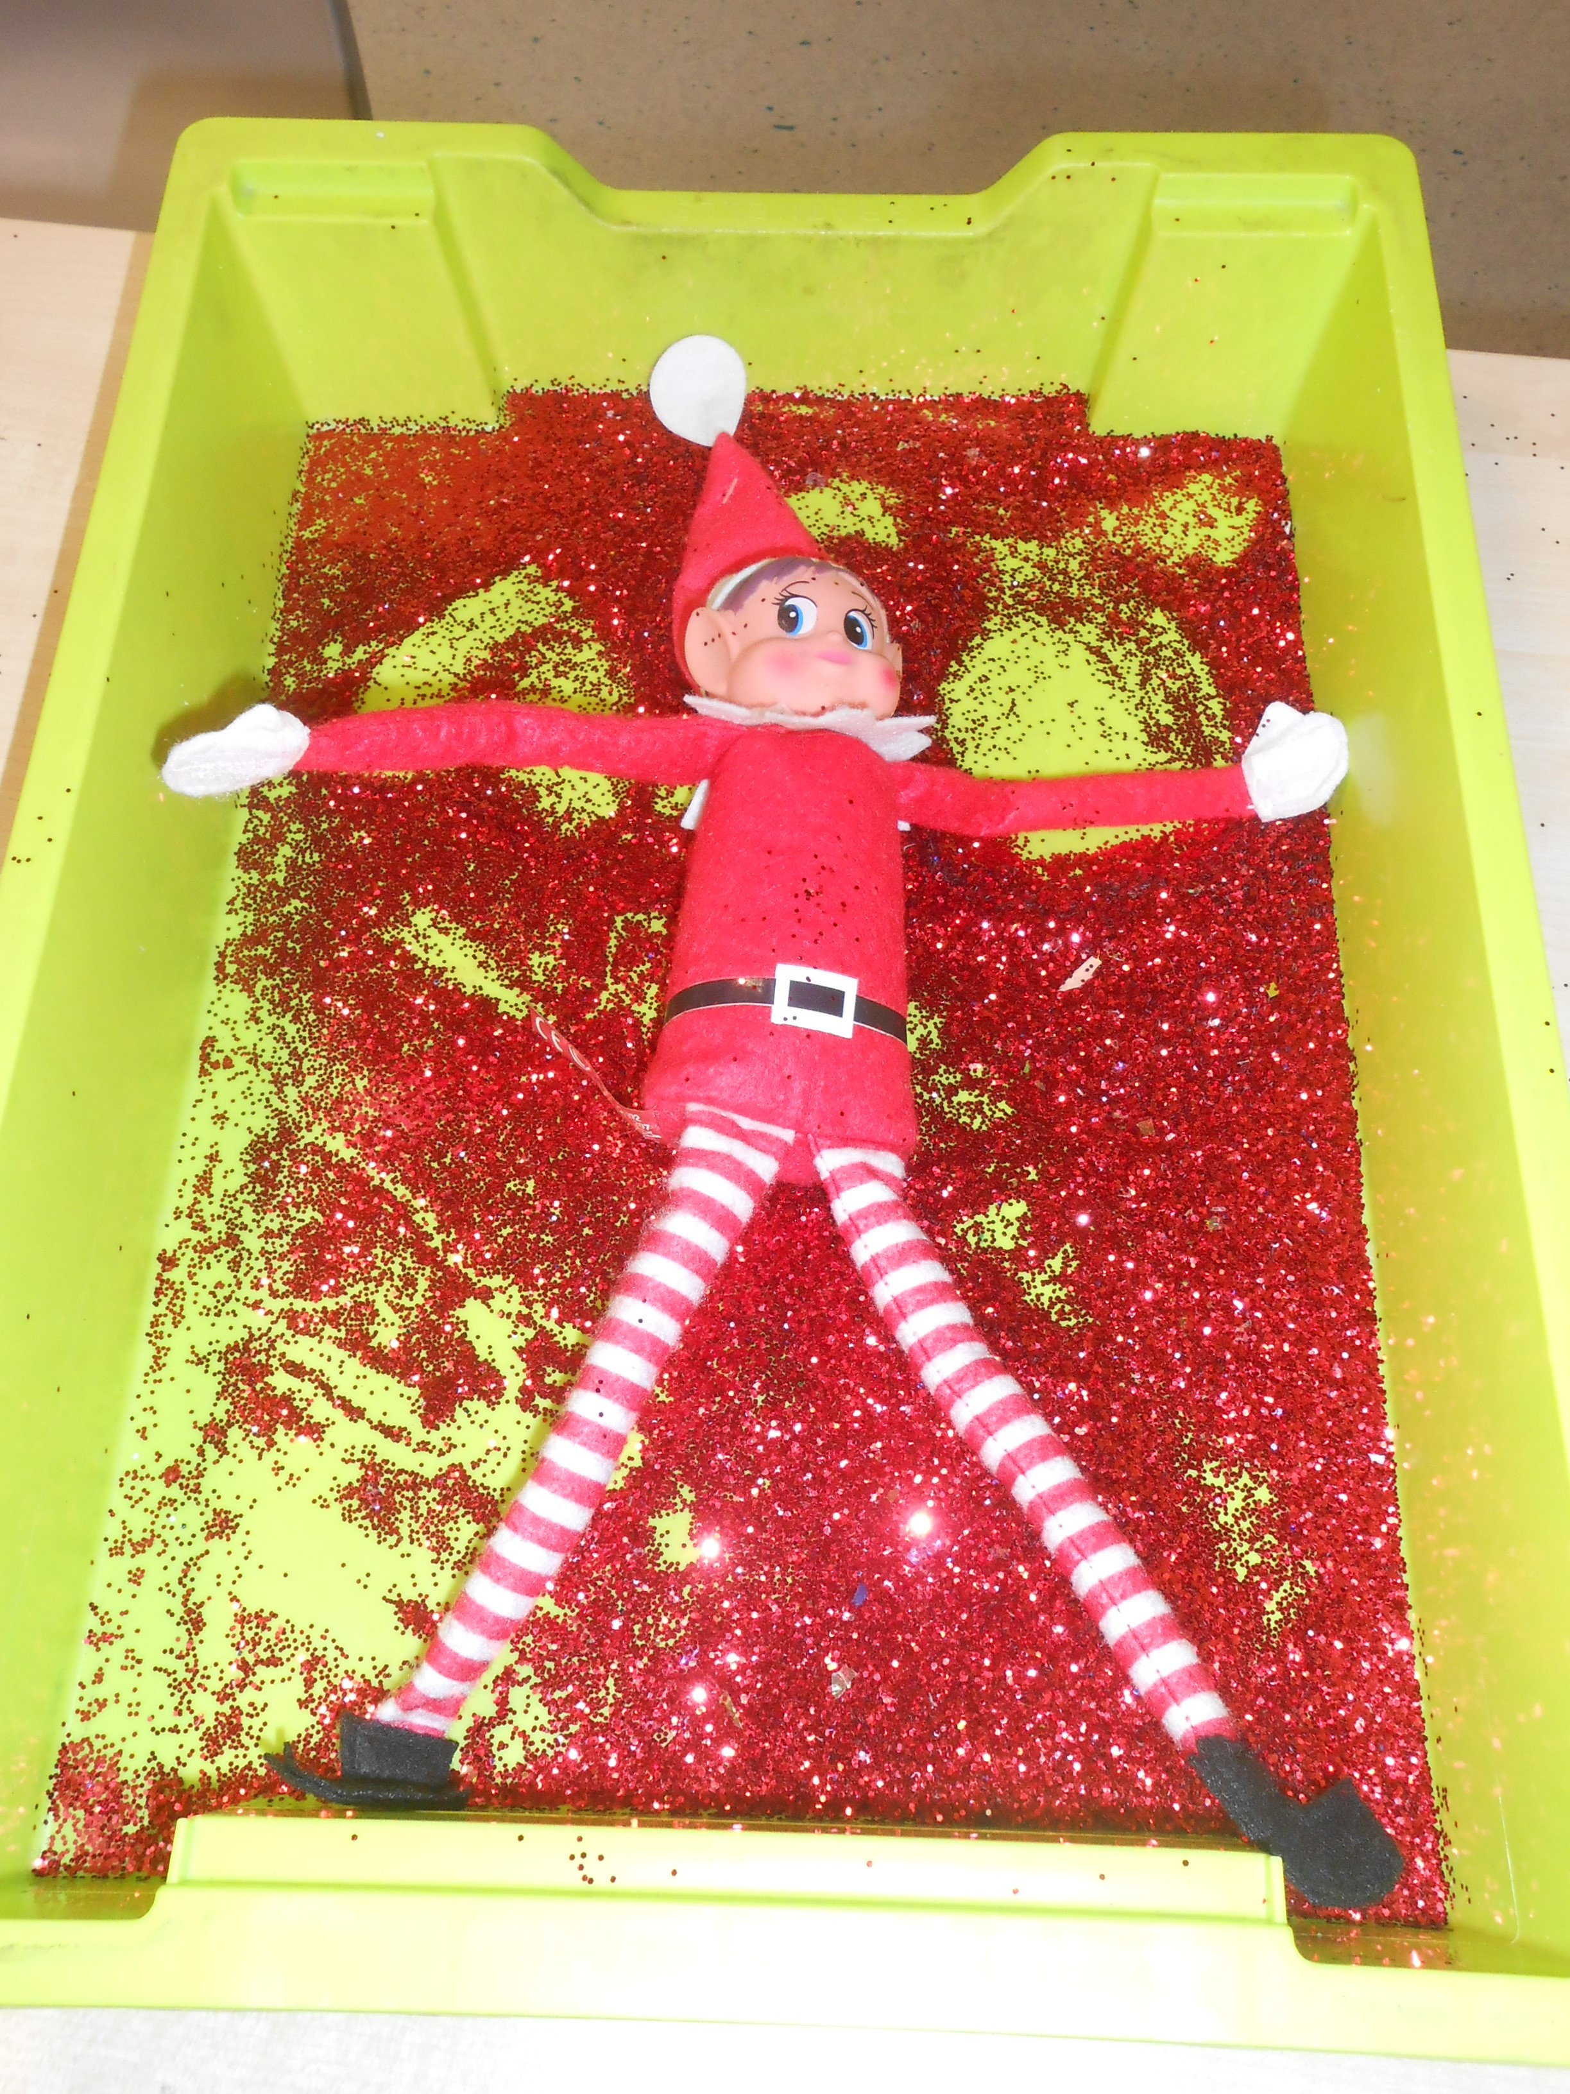
We have a lovely tree in our Nessie wing and a very Naughty Elf who has been up to all sorts of tricks…. He is doing an elf angel today.

Slide 6
Our Primary 1 boys and girls are enjoying lots of fun activities…

Slide 7
But not only that – it’s nearly time for mums and dads to start thinking about enroling their child at school.

Slide 8
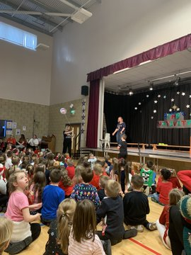
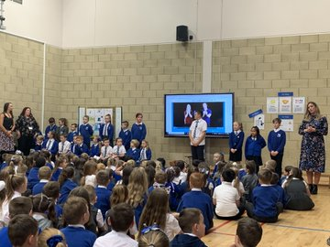
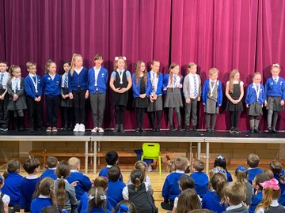
As with everything just now, things are going to be slightly different but the one thing that remains the same is how much we want your child to be part of our Calderbridge family…

Slide 9
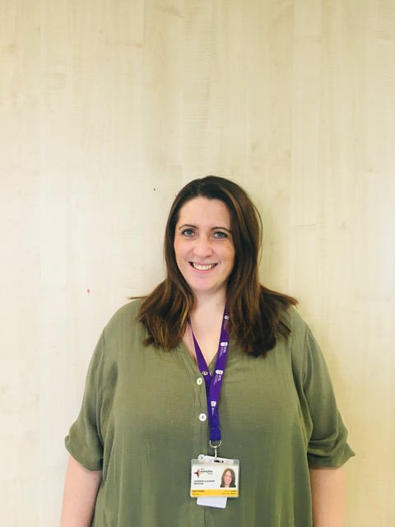
They will learn lots from their teachers. This year Miss Macfarlane and Mrs Roddick have been working with Primary 1.

Slide 10
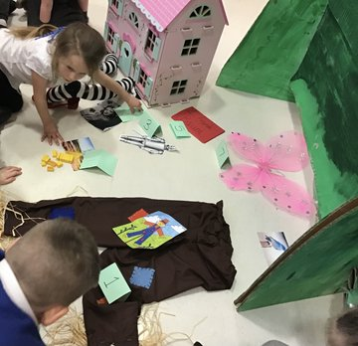
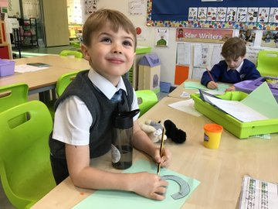
They will make lots of new friends.

Slide 11
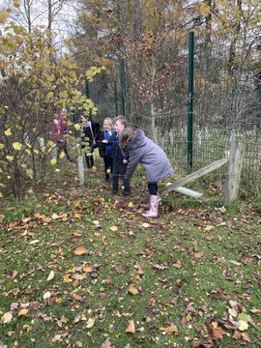
They will play together out in the playground.

Slide 12
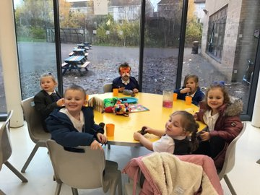
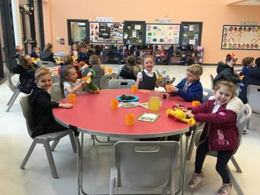
They will enjoy eating their lunch in our dining hall.

Slide 13
Our school values are for our children to be ready, respectful and safe.

Slide 14
We all aspire for Calderbridge Primary to be a school of happiness…
Our FUTURE is BRIGHT
Our FUTURE BEGINS at…

Slide 15
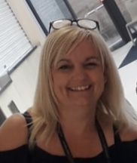
Mrs Osborne is our Head Teacher and Mrs Dowson is our Depute Head Teacher.

Slide 16
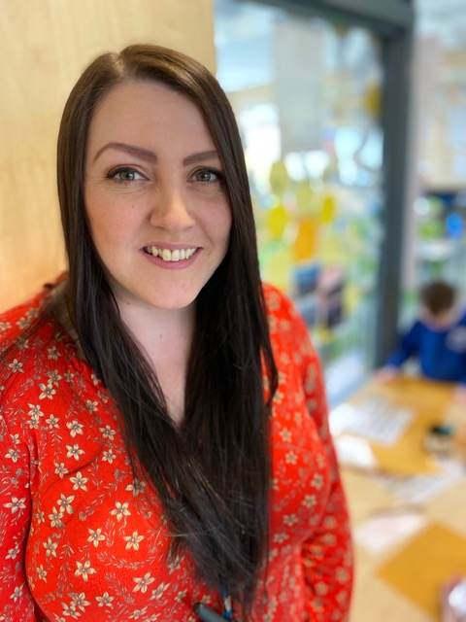
Miss Cairney and Mrs Livingstone are our Principal Teachers.

Slide 17
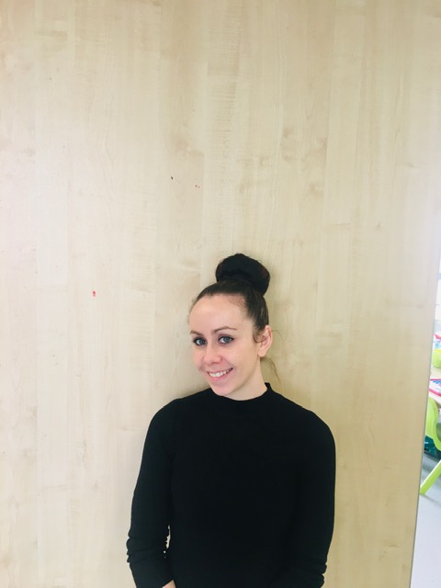
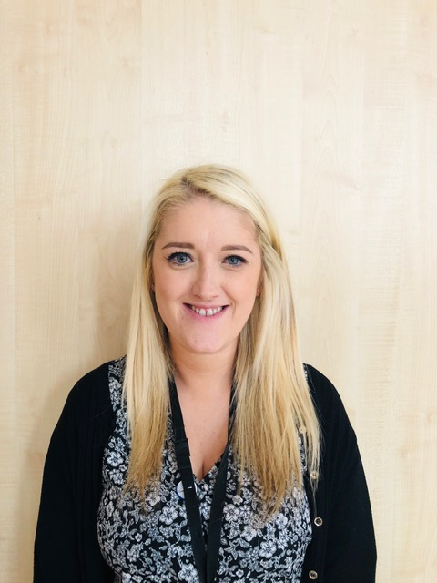
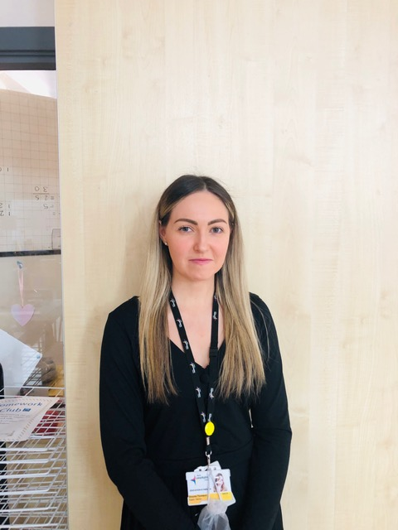
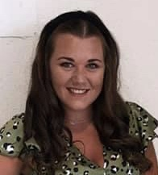
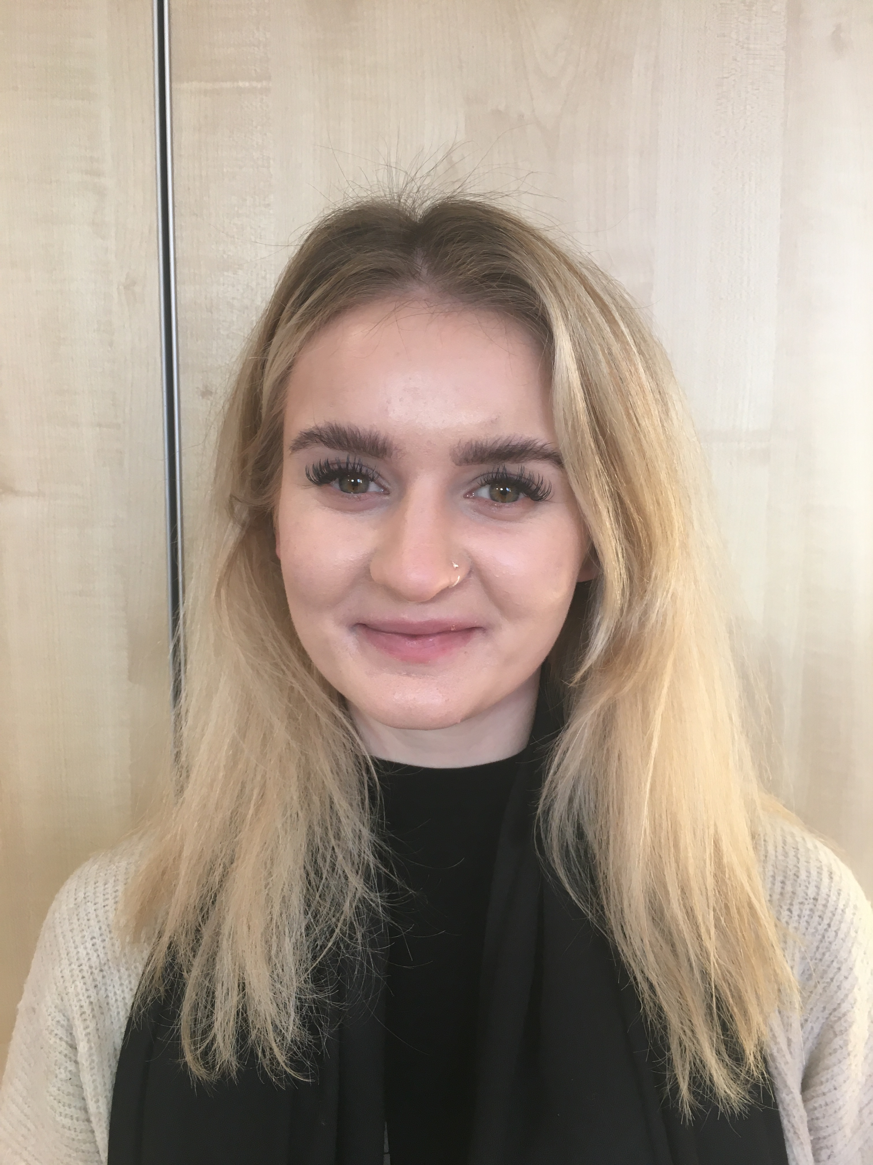
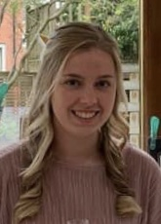
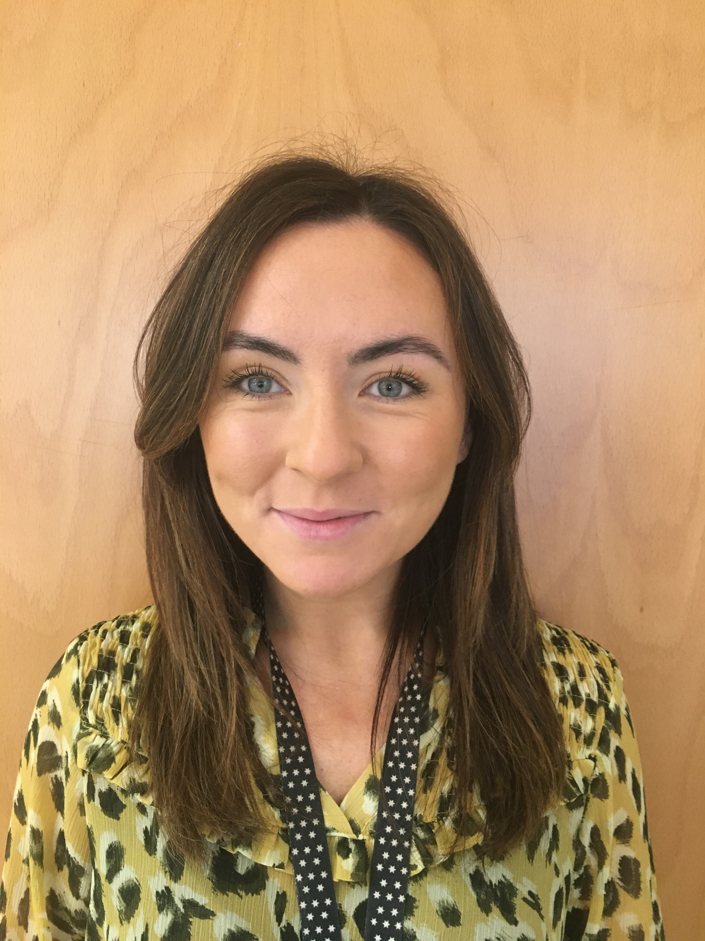
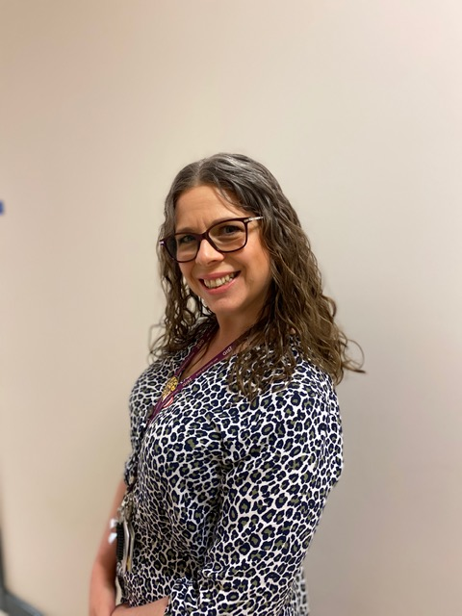
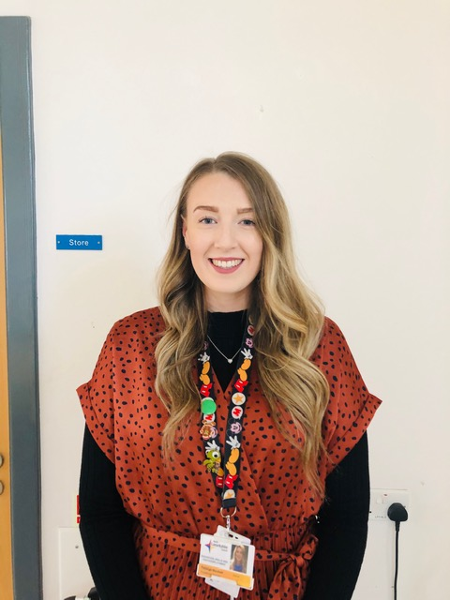
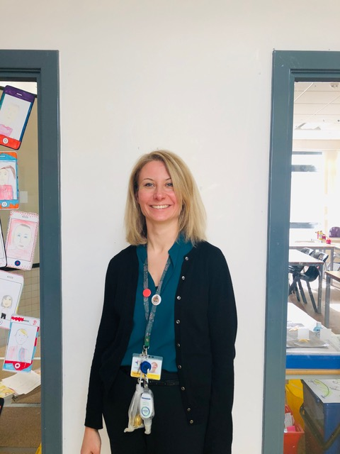
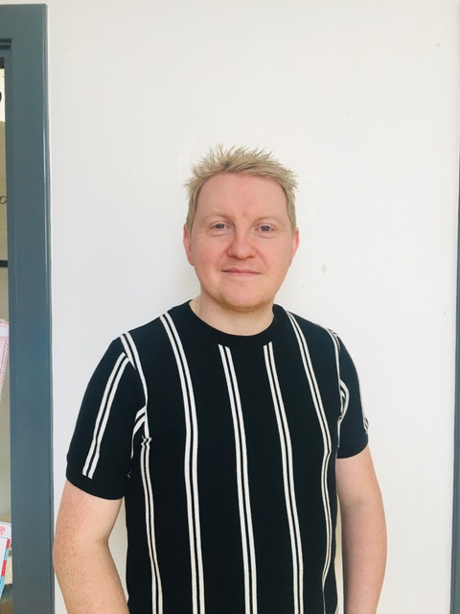
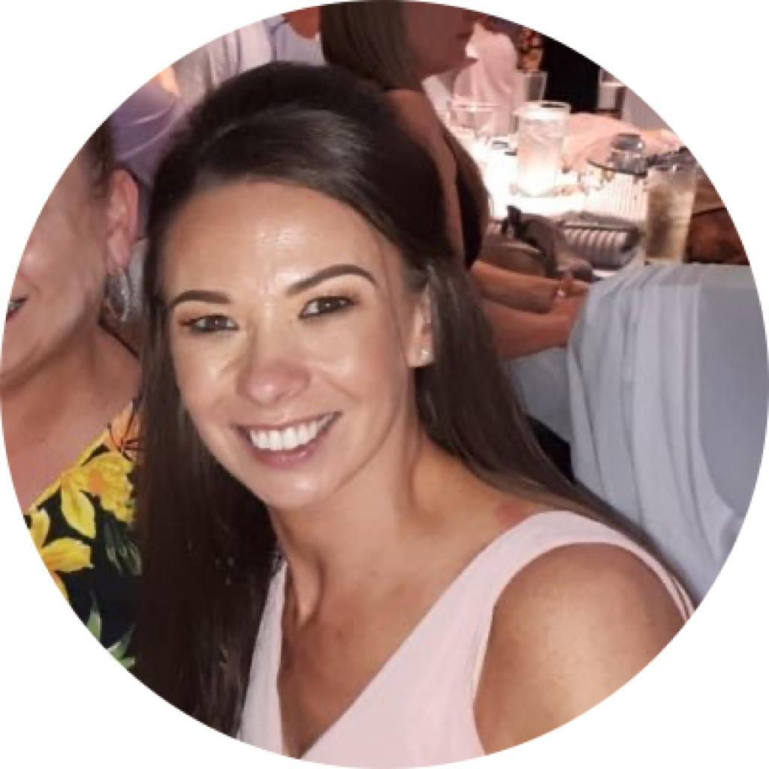
We have lots of teachers that you will get to know.

Slide 18
Mr McKenna keeps our school safe and warm. He will help you in the playground too.

Slide 19
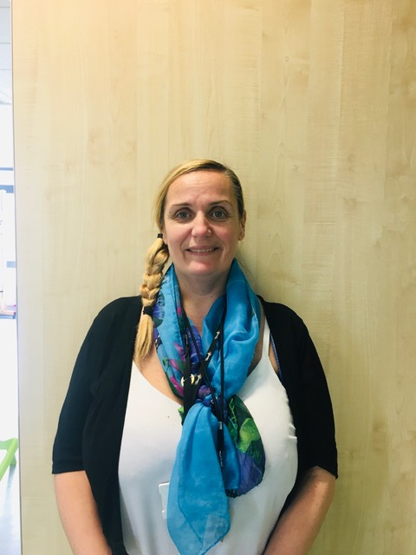
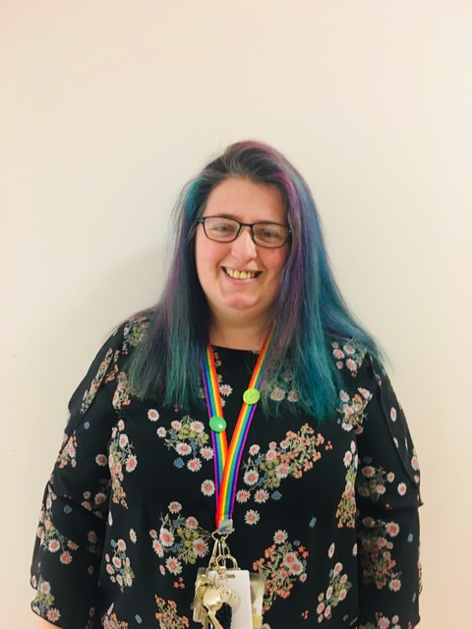
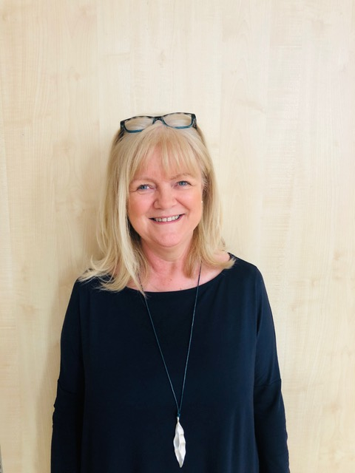
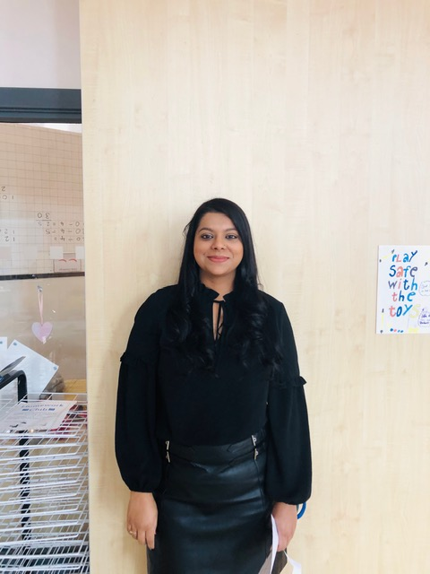
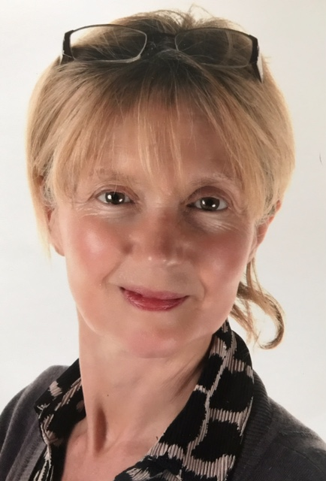
Our Support Staff help us in class and outside too.

Slide 20
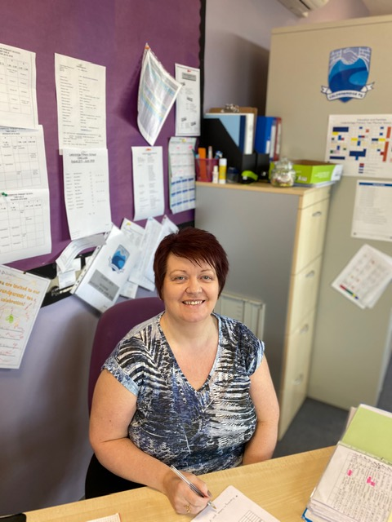
Mrs Hamilton and Mrs Goodbrand work in our School Office.

Slide 21
Very soon your child will be part of the Calderbridge Crew and you have to remember that…..

Slide 22
Thank you for watching – we hope this has given you a bit of information that you can talk about with your wee one at home.
You can find the application form to enrol online at
www.northlanarkshire.gov.uk
Schools and learning
School admissions
Registration of Infant beginners
Register by 24th January 2022 Any questions or queries contact school office by phone on 01698 274918 or by email at enquiries

