Slide 1
Brannock High School Senior Phase Information Evening October 2023
Our Values:
Respect
Hard Work
Ambition

Slide 2
Agenda
Head Teacher's Welcome and Update on Vision, Values and Aims
School performance 2020-23
Latest update from SQA session 2023-24
Senior Phase at Brannock High School
Supporting Positive Destinations
Developing Young Workforce (DYW)- Nicola Stirling
UCAS- Emily MacDonald
Skills Development Scotland Careers Advisor- James Corry
Q&A (tbc)

Slide 3
Vision
For everyone in the Brannock Community to be:
Kind, Happy and Successful.

Slide 4
Values
RESPECT - HARD WORK - AMBITION

Slide 5
Aims
MAXIMUM
POSITIVE
EXCELLENT
ATTENDANCE
ACHIEVEMENT
RELATIONSHIPS
DESTINATIONS
LEARNING
TEACHING &
ASSESSMENT

Slide 6
School Aim
Maximum Achievement

Slide 7
School Aim
Maximum Achievement

Slide 8
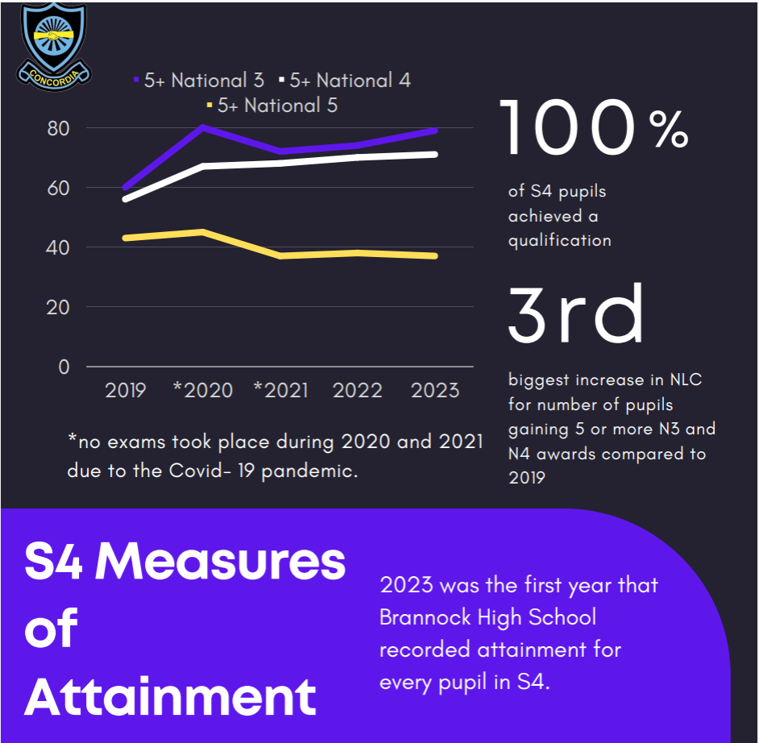
School Aim
Maximum Achievement

Slide 9
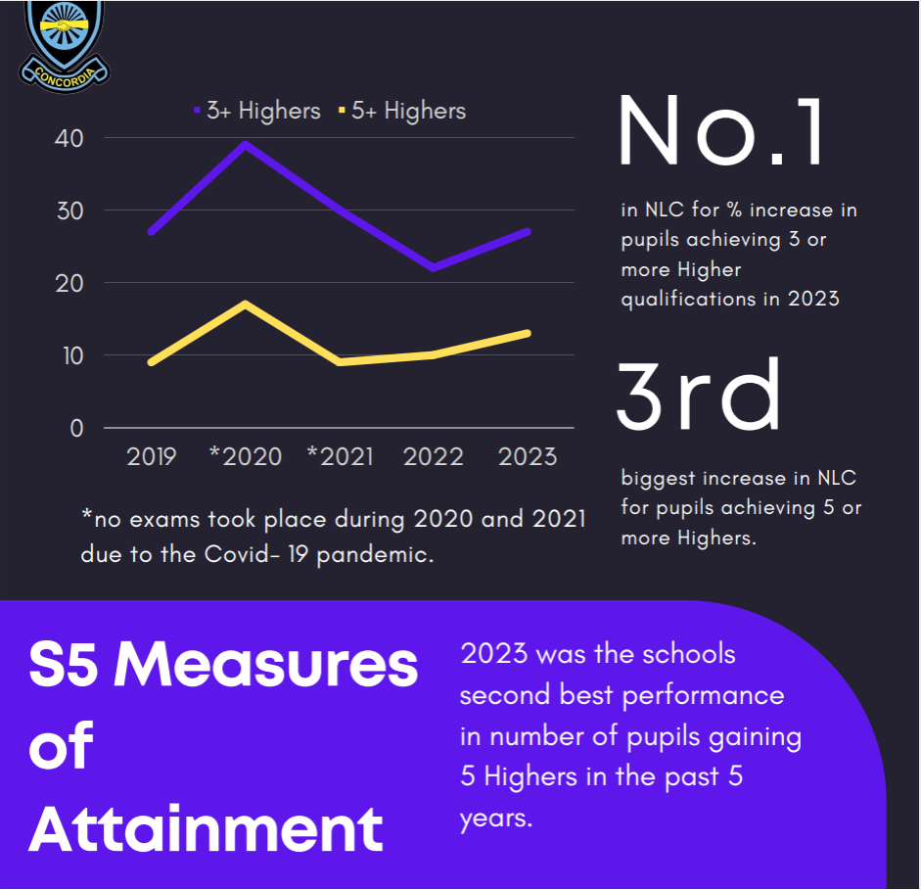
School Aim
Maximum Achievement

Slide 10
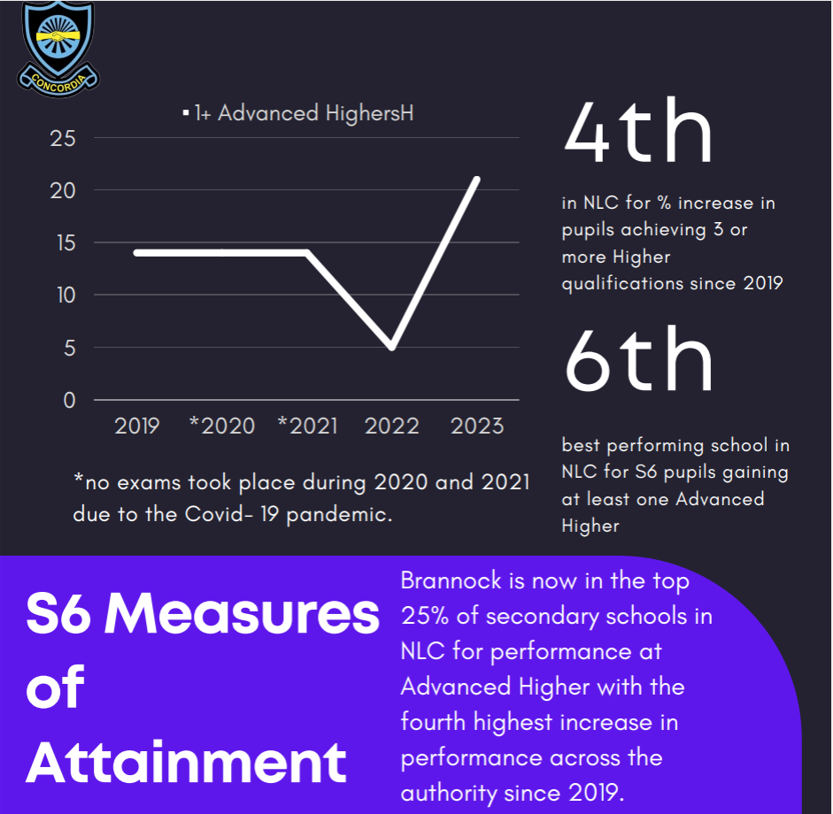
School Aim
Maximum Achievement

Slide 11
Improvement Priorities for session 23-24
Increase number of pupils attaining at least 1, 3 and 5 National 5 qualifications in S4.
Increase number of pupils gaining 1, 3 and 5 Higher qualifications in S5.
Increase number of pupils achieving 3 or more Highers by the end of S6.

Slide 12
Maximum Attendance = Maximum Achievement
Achievement | Average Attendance %
S4 7 National 5s – 15 Pupils | 93.38
S4 0 National 5s - 22 Pupils | 70.06

Slide 13
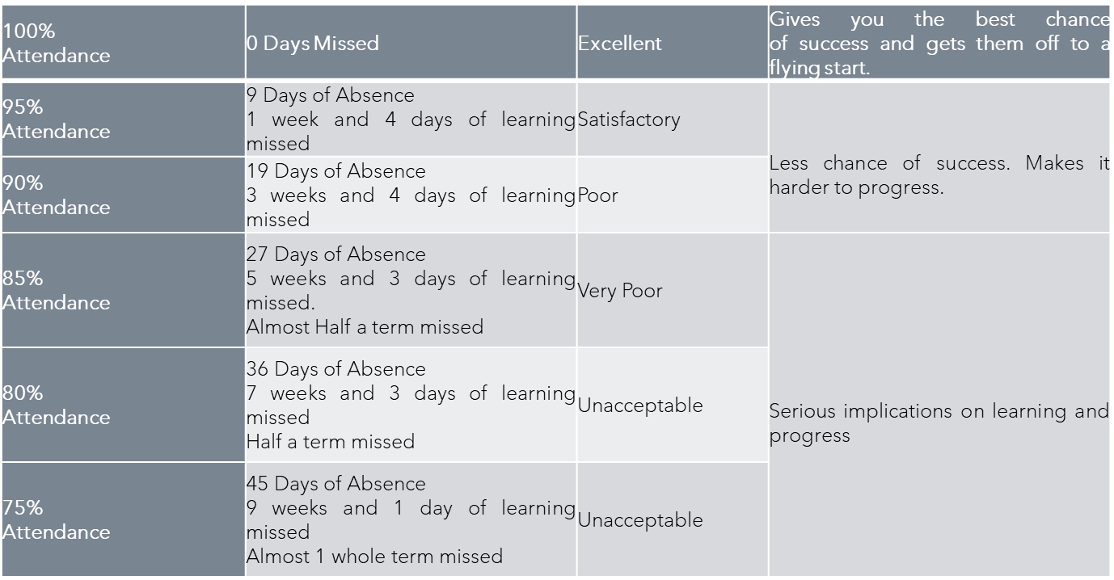
Maximum Attendance = Maximum Achievement
One of the schools aims is MAXIMUM ATTENDANCE. You cannot achieve and reach your full potential if you do not attend school. If your attendance falls below 95% this will have an impact on your progression. It is important to remember EVERY SCHOOL DAY COUNTS as attendance percentages can be misleading.

Slide 14
Latest Update from SQA for 2023-24
The SQA have removed much of the modifications made to SQA qualifications from the past few years.
The SQA website provides a summary of the assessment being used in their courses for this session and staff have already planned for these elements to be back in the course for this session
Assessment of National Courses from 2023-24- SQA

Slide 15
Senior Phase at Brannock High School
S3- 8 subjects (4 periods of English and Maths, 3 periods of the other 6 subjects)
S4- 7 subjects ( 4 periods each)
S5- 5 subjects (6 periods each)
S6:
5 subjects
4 subjects and one study
3 subjects and two study (only if doing at least one advanced higher).

Slide 16
Senior Phase Learning Agreement
Re-introduction of the Senior Phase Learning Agreement with all pupils over school leaving age- this was done prior to Covid.
Minimum expectations placed on all S5 and S6 pupils about what full time education means for them at school.
Agreement made between pupil, school and parent/ carer.
Common across secondary schools in Scotland.
Linked to our school vision of every pupil being Successful.
Linked to our values of Hard Work and Ambition.
Linked to our school aims of Maximising Attendance, Maximum Achievement and Positive Destinations.

Slide 17
Senior Phase Learning Agreement
As a school, we will support young people by:
Ensuring the best possible subject options within the constraints we have.
Offer academic and wellbeing support through a variety of offers i.e. supported study, PSE, counselling etc.
In exceptional circumstances, tailor the curriculum to suit individual needs. This will only be done through discussion with all- parent/ carer, young person and school.

Slide 18
Senior Phase Learning Agreement
In order to realise your full potential and to ensure that you are supported through these final years we expect you as a senior pupil to:
Be punctual at all times.
Ensure that effort and application are always high.
Meet deadlines with regards to homework, assignments, folios and dissertations
Always follow the school dress code.
Show courtesy and consideration to staff, fellow pupils and visitors to the school.
Participate in the life of the school and any opportunities which help to further enhance your personal and social development.
Maintain a full timetable, since that is what colleges, universities and employers expect.
Act as a positive role model for our younger pupils.
Represent the school and wider community in a positive way through your behaviour and actions.

Slide 19
Senior Phase Learning Agreement
You should also understand that:
If deadlines are missed or effort and application are lacking your level of presentation may be changed.
Dropping agreed courses at any stage may result in you having to leave Brannock High School to follow an alternative education provision such as college or employment.
Poor attendance and poor behaviour will adversely impact upon any EMA provision and may result in you being asked to leave school.
Failure to follow the above will lead to loss of rewards and privileges such as attendance at the Prom and Graduation Ceremonies.

Slide 20
Latest Update from SQA for 2023-24
Monday 22 April to Thursday 30 May.
Pupils last day before exam leave will be Friday 19 April. S4 and S5 pupils will return between Tuesday 28 May and Monday 3 June (depending on when their last exam is), moving up to S5 and S6 to begin new qualifications.
The 2024 exam timetable is available online now-Exam timetable and learner apps - SQA
MySQA sign up and MyExams app

Slide 21
Senior Phase at Brannock High School
May/ June 2023 | S4 Pupils started current courses in middle of May with S5/6 beginning on return from study leave.
August 20223 | Subject changes made where requested​
September and October 20223 | Class lists distributed to class teachers to confirm level of study. Early warning Senior Phase Alerts sent to young people and parents/ carers. First round of tracking to parents and carers. Senior Phase information evening​
November 2023 | S4-6 reports issued to parents and carers with comment from the teachers. DHT SQA re-distributes class lists and requests for level changes made.​
December 2023 | Prelim diet. Young people will have study leave at this time (week beginning Monday 12 December)
January and February 2024 | S2-6 pathways evening preparing for subject choices and destinations beyond school. Staff marking of prelims and results distributed to young people. Parent/ Carer Consultation Evenings- start of February.
March 2024 | Second round of tracking issued to parents and carers. DHT SQA re-distributes class lists and request for level changes made. Subject choices for S4/5 pupils begins.​
April 2024 | DHT SQA re-distributes class lists for final check and any final requests for level changes. Third and final round of tracking- estimates for young people gathered from staff- this will be shared with parents/ carers and young people.
April to May 2024​ | SQA exam diet, S4-6 pupils on exam leave. Pupils not sitting any exams i.e. N3/4 courses, will be expected to attend school to complete assessments for course awards.

Slide 22
Positive Destinations- DYW (N Stirling)
Work Experience Opportunities (in Session 2022-2023 over 60 young people from S4-S6 engaged in some form of work placement)
1/3 of those young people achieved additional attainment through an SQA work placement qualification Level 1
Career Information Sessions / Taster Days / Industry Visits
Interview Prep / CV Writing opportunities
Next Steps :
Mock Interview Sessions – construction opportunity next week
Maximise Additional Attainment/Accreditation e.g. Barista Skills Award, increase number of young people who attain through work placements

Slide 23
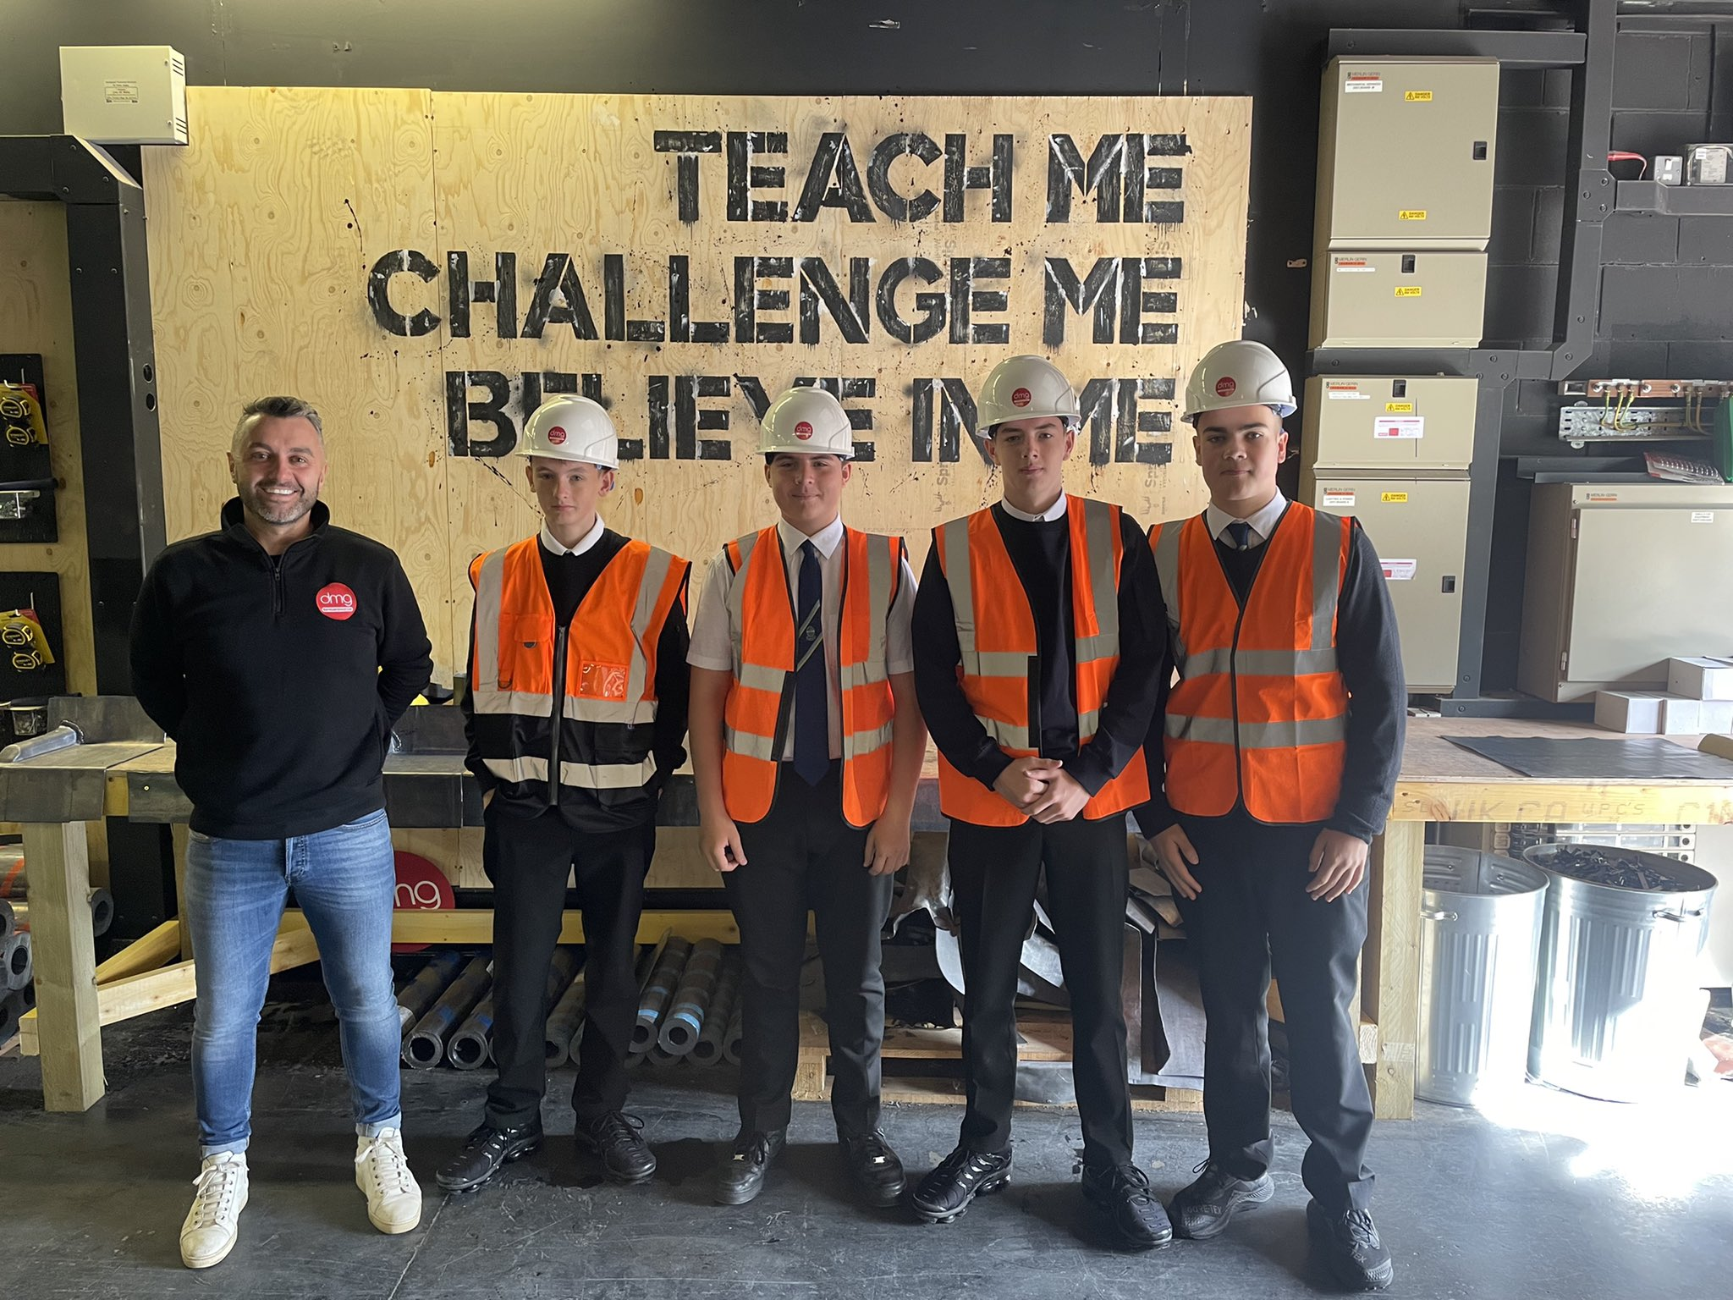
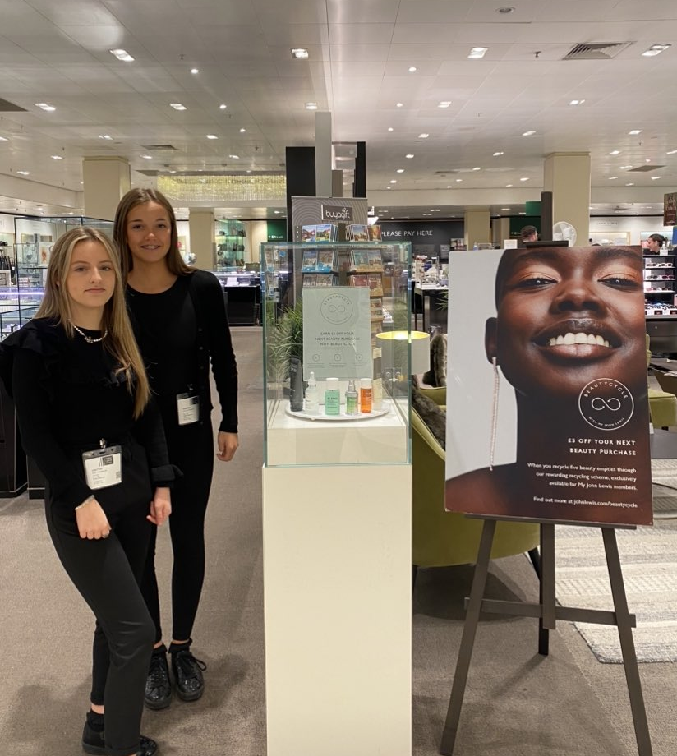
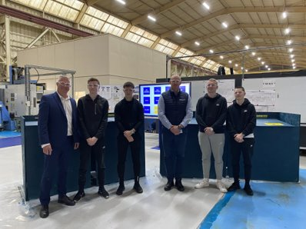
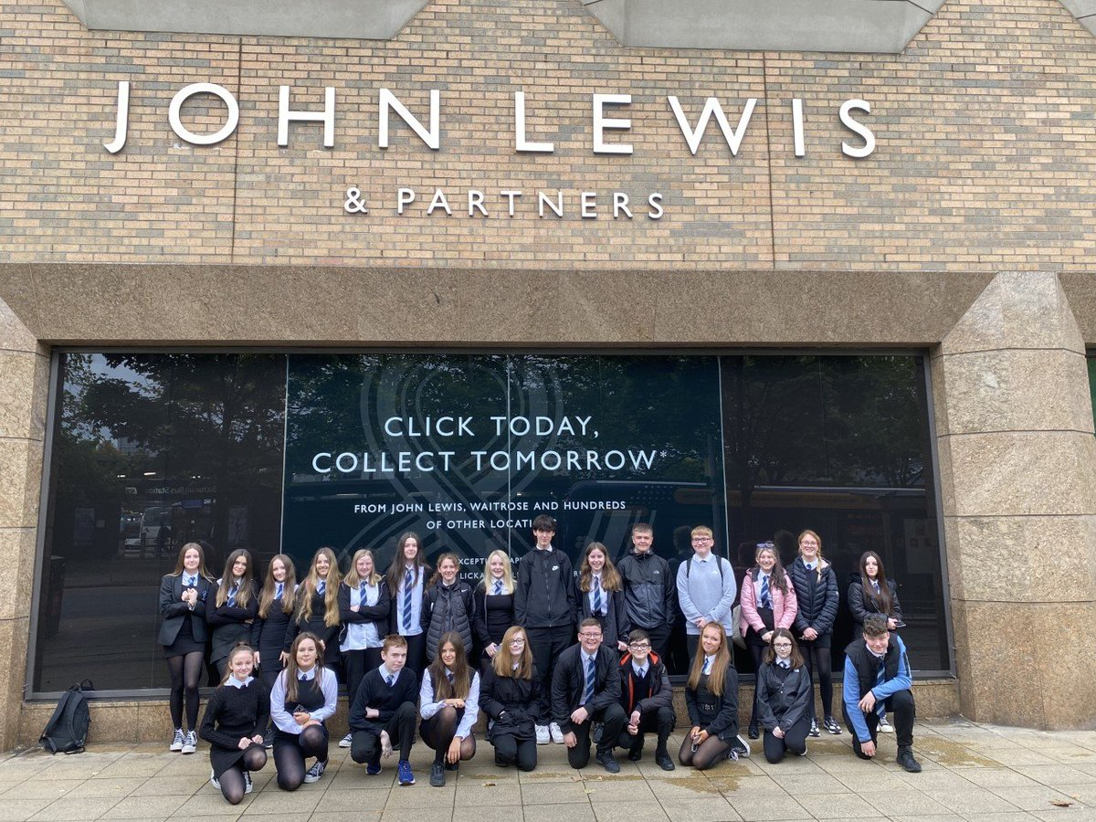
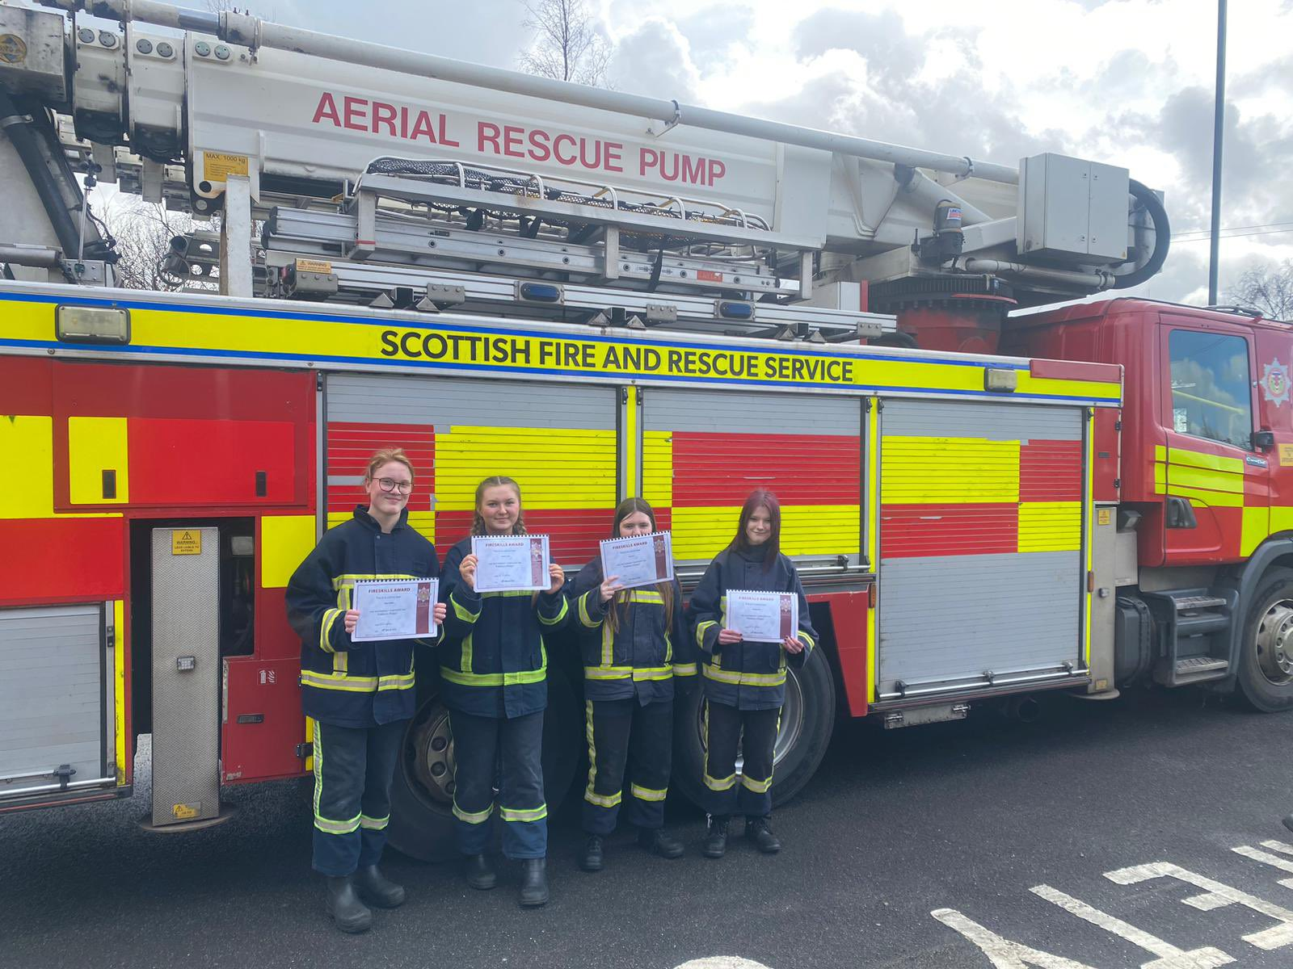
Industry Visits / In-House Opportunities / Work Experience

Slide 24
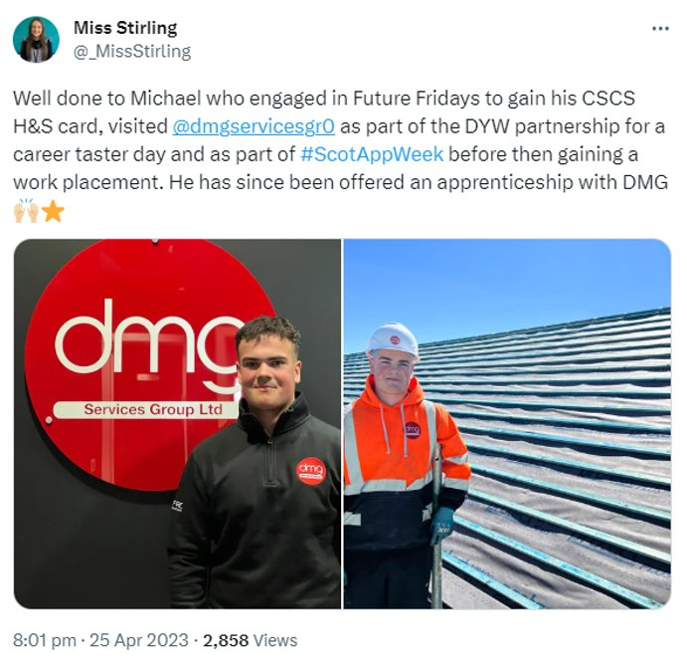
Work Experience - Success Stories

Slide 25
Positive Destinations- UCAS (E MacDonald)
Dedicated class- 1 period per week
Applications are made online
Up to 5 course choices
Personal statement
Teacher reference
Applications should be submitted by end of November
Fee- £27.50
Widening participation- Top-Up programme

Slide 26
Positive Destinations- SDS Careers Advisor James Corry

Slide 27
Brannock High Apprenticeship Family
Parents Evening Info Session
Notes:
Introduce self and session S4 options and routes and pathways beyond school

Slide 28
2021/22 Destinations
Higher Education 28.6%
Further Education 34.5%
Employment 24.4%
Training/A.A./Vol. 6.7%
Unemployed 5%
Unknown 0.8%
Notes:
Context – why we have an LMI team

Slide 30
Apprenticeship Family
https://youtu.be/H9x6uVHMovg
https://youtu.be/AS0nP_Aiy-g
https://youtu.be/ahFNGczEdLs
https://youtu.be/4iz4Z8-RJvU

Slide 31
Modern and Graduate Apprentcieships
https://open.http.mp.streamamg.com/index.php/extwidget/preview/partner_id/3001212/uiconf_id/30025818/entry_id/0_a6wkmw5t/embed/auto?flashvars
https://youtu.be/UIyf68FaXHc

Slide 33
Thank you
james.corry@sds.co.uk
07785517204
Monday ,Tuesday ,Wednesday Thursday.
Notes:
Thank you

