Slide 1
North Lanarkshire HNC Schools Pathway’s

Slide 2
DEVELOPING PATHWAYS, PACKAGES AND PARTNERSHIPS FROM SCHOOL TO EMPLOYMENT
“It’s crucial that we maximise employment opportunities for our young people and this partnership will creates effective packages of learning and support.
“It will align the curriculum to employment opportunities and ensure school leavers have the correct mix of skills to benefit from future job opportunities.
“It’s a genuinely exciting development. It will enable pupils to study for an HNC while still at school, gain relevant industry work-experience and provide the opportunity to progress further towards a degree in their chosen area.”
(Derek Brown, Deputy Chief Executive, North Lanarkshire Council)

Slide 3
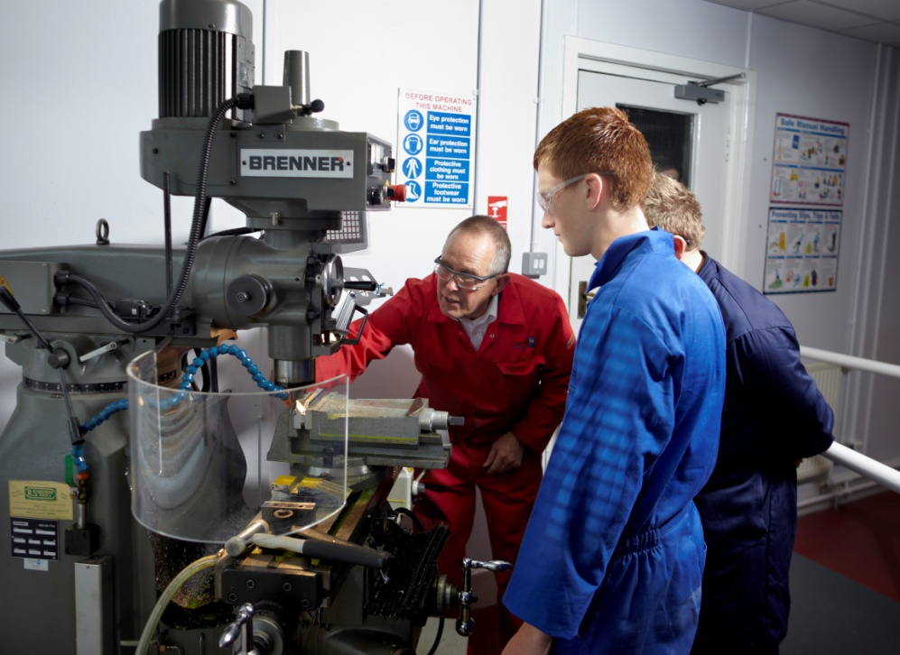
We cannot prepare individuals for this rapid and volatile world of work unless we provide innovative, adaptive life-changing opportunities that is equally rapid, supportive and flexible that develops the future talent, ensuring that they are responsive and resilient to the world around us.
Notes:
As we adjust to the new normal, we have to ensure that we are prepared for this rapid and volatile world of work and can through clear interventions provide innovative, adaptive life-changing opportunities that is equally rapid, supportive and flexible that develops the future talent, ensuring that they are responsive and resilient to the world around us.
By understanding and developing key Vocational Education services and through empowering those within the team to develop sector leading solutions, I envisage that we will develop the right ecosystem that provides life-long learner support and advice based on clear Labour Market Intelligence to continually develop a qualification structure to enable individuals to have the right skills – at ALL stages within their lives, to become the very entrepreneurs and innovators who will create wealth, improve lives and are ambitious enough to have the capabilities to drive the economic growth of the Scotland.

Slide 4
Computer Aided Draughting and Design.
Course Outline This course is designed to give you the practical skills and knowledge to become a successful draughtsperson/designer in the industry of your choosing. Some of the skills you will develop include: 2D draughting to British International standards Knowledge of the design process working through live team projects 3D software packages used in the engineering, manufacturing and construction industries 3D Printing and Scanning technologies and visualisation software
Course Content The knowledge and skills you will develop will focus on: Autodesk Inventor Fusion (Cloud Based CAD) Revit AutoCAD Engineering draughting principles Architectural draughting principles Construction detailing Product Design process 3D modelling 3D printing and scanning Visualisation and rendering Microsoft Office suite You will be given the opportunity to showcase your skills and knowledge as you study the HNC with the completion of an end of year design project. Opportunities are also available to work on real-life projects and take on vendor qualifications such as Autodesk Certified User and professional exams.
SCIENCE & TECH
Higher National Certificate
SCQF Level 7
2 afternoons online and one day a week on campus
Motherwell and Cumbernauld
Entrance requirements: 1 Higher, would be advantageous to have Nat 5 Design for Manufacture or Graphical Communications
Progression: HND at New College Lanarkshire before moving on to a guaranteed 3rd year degree place at UWS
https://www.nclanarkshire.ac.uk/courses/cad/hnc-computer-aided-draughting-and-design

Slide 5
Construction Management.
Course Outline This course is designed to give you the practical skills and knowledge to become a successful manager in the industry of your choice. Some of the skills you will develop include: Construction Materials and Specifications Building Measurement and Cost Studies Building Science Construction Technology: Industrial/Commercial Superstructure Building Services: An Introduction 2D CAD (Computer Aided Design) Health and Safety in Construction
Course Content The knowledge and skills you will develop will focus on: Standard Forms of Construction Contracts Construction Site Surveying Construction Planning Building Services in Large Buildings Site Administration Construction Technology: Substructure Mathematics for the Built Environment Structural Mechanics As part of the course, you will showcase your skills and knowledge gained with the completion of an end of year Graded Unit project. Throughout your studies, you will be given the opportunity to work on real-life projects and undertake additional bolt-on qualifications in Health and Safety and the Site Managers Training Scheme award.
CONSTRCUTION
Higher National Certificate
SCQF Level 7
2 afternoons online and one day a week on Motherwell campus
Entrance requirements: One Higher and it is advantageous to have National 5 Graphical Communications or Design for Manufacture
Progression: HND at New College Lanarkshire before moving on to a guaranteed 3rd year degree place at UWS
https://www.nclanarkshire.ac.uk/courses/construction/hnc-construction-management

Slide 6
Cyber Security.
Course Outline This course is designed to give you the practical skills and knowledge to become a successful cyber security specialist in the area of your choice. Some of the skills you will develop include: Operating system configuration Computer networking Ethical hacking Digital forensics Data security Coding Team working Legal and Ethical Implications
Course Content The knowledge and skills you will develop will focus on: Relevant contemporary cyber security tools Virtualisation Legal and ethical issues Microsoft Office suite Operating system configuration Computer networking Ethical hacking Digital forensics Data security Coding Team working You will be given the opportunity to take on vendor qualifications such as CISCO, Microsoft and CompTIA professional exams. These additional, highly sought after qualifications will enhance your skills and boost your employability.
COMPUTING
Higher National Certificate
SCQF Level 7
2 afternoons online and one day a week on campus
Motherwell and Coatbridge
Entrance requirements: Working towards relevant National Qualifications ( Computer Science, Maths, Sciences) or Equivalent NPAs at Levels 5 or 6 and/or recommendation from Pupil Support Teacher
Progression: HND at New College Lanarkshire before moving on to a guaranteed 3rd year degree place at UWS
https://www.nclanarkshire.ac.uk/courses/computing-and-digital-technologies/hnc-cyber-security

Slide 7
Social Services.
Course Outline Interested in a career as a carer, social worker, addiction worker, team leader or perhaps interested in nursing? Our HNC Social Services course could be perfect for you! This course can help you gain employment in a number of fields including: Mental Health Nursing, Learning Disability Nursing and Adult Nursing Social Work and a host of other social services opportunities. The course is a combination of taught units and workplace experience, and as such it is very much “hands-on”.
Course Content The course includes the mandatory units of the SVQ Level 3 Social Services and Health Care. Other units delivered include: Care in Contemporary Society Health, Wellbeing and Safeguarding Lifespan Development: Theoretical Approaches Leadership Starts with Me Also includes the Graded Unit.
SOCIAL CARE
Higher National Certificate
SCQF Level 7
2 afternoons online and one day a week on campus
Motherwell and Coatbridge
Entrance requirements: Entrance requirements: Working towards relevant National Qualifications or Equivalent NPAs at Levels 5 or 6 and/or recommendation from Pupil Support Teacher
Progression: HND at New College Lanarkshire before moving on to a guaranteed 3rd year degree place at UWS
https://www.nclanarkshire.ac.uk/courses/health-care-and-social-services/hnc-social-services

Slide 8
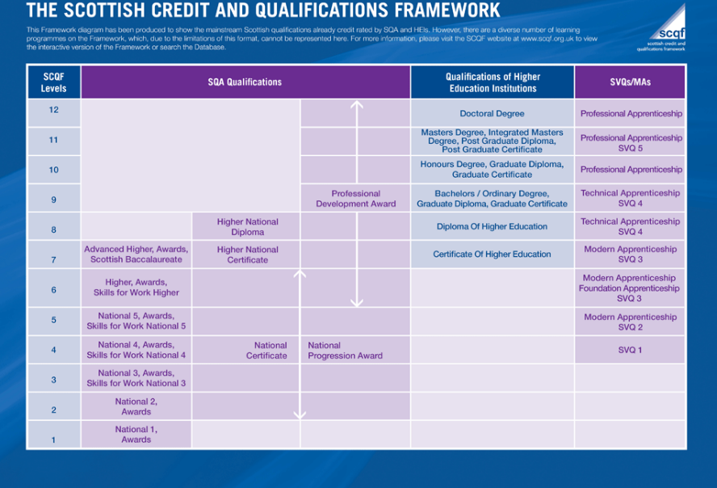
DEVELOPING PATHWAYS, PACKAGES AND PARTNERSHIPS FROM SCHOOL TO EMPLOYMENT: new thinking

Slide 9
Feedback from students has been overwhelmingly positive
* “This course…has helped me feel a lot more comfortable about transitioning into university/college, because it gives you that grounding you need, so that you're not just thrown in (at) the deep end.”
* “My college experience has been good, as it has allowed me to be out of school and be in a better environment…being treated more like an adult.”
* “It has made me more responsible with my time, and better prepared for (the) future studying at university.”
* “The college experience is great - I love being treated as an adult, and the atmosphere is great!”

Slide 10
The Whole is Greater than the Sum of its Parts
Learning for the future should not be limited to a classroom at all - an “excellent well developed curriculum” would go beyond the traditional boundaries and offer real-world experiences….

