Slide 1
Learning to Learn Study Support for Parent/Carers
Miss MacDonald
Mr Connor
Mr Crichton

Slide 2
Agenda
Equity around Brannock
Study timetables
Optimal conditions for study
4 step revision process
Useful revision techniques

Slide 3
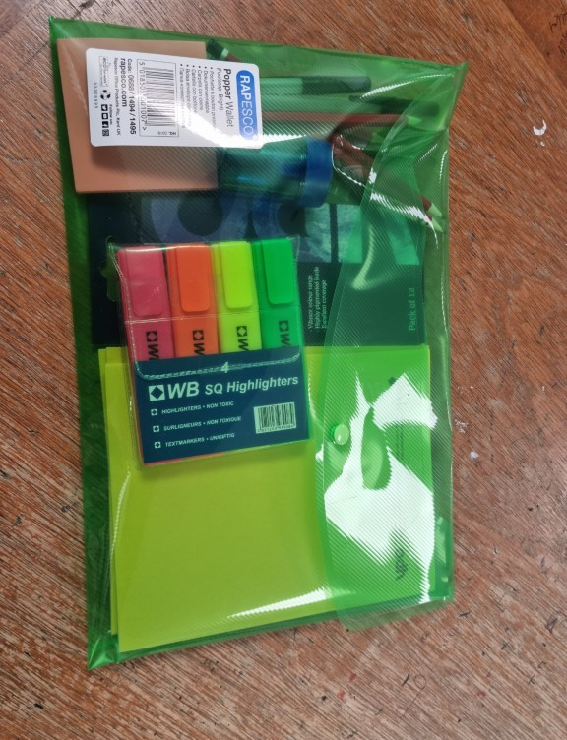
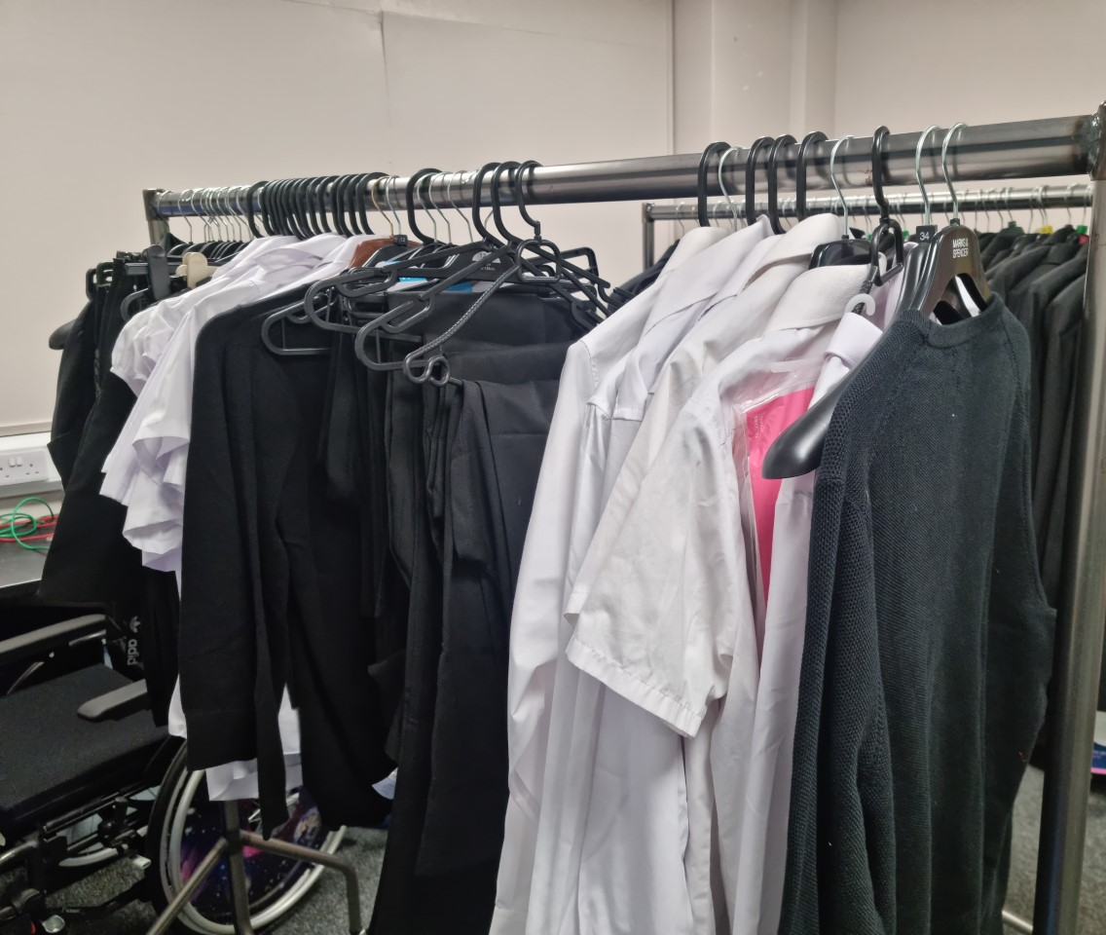
Notes:
Equity is a policy concept and approach that aims to focus on treating people fairly and providing additional or different support where required.
Equity in education means that personal or social circumstances are not obstacles to achievement and that all children and young people are well supported and have the same opportunities to succeed.

Slide 4
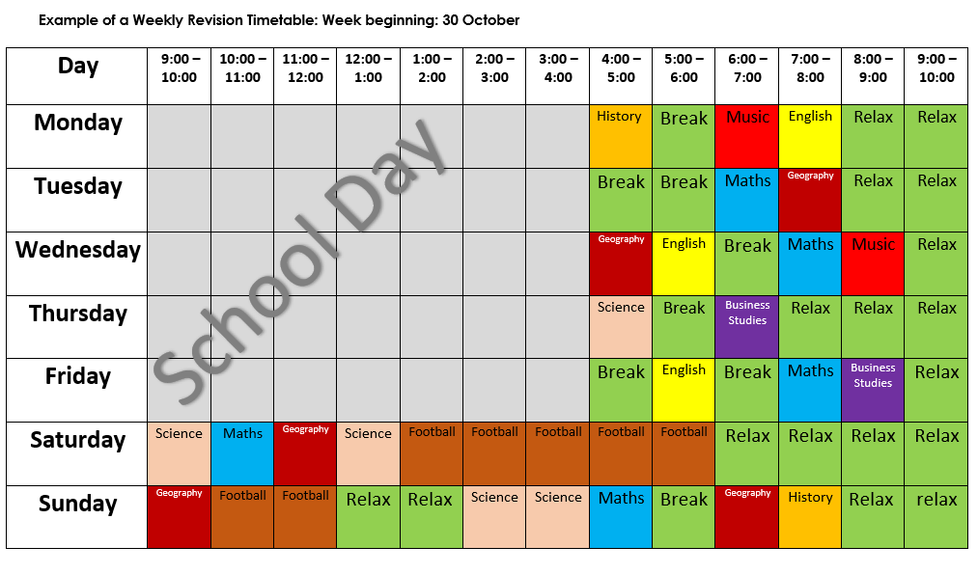
Study Timetable

Slide 5
Study Timetable
Be flexible and realistic
Prioritise certain subjects
Include study breaks
Include hobbies/commitments (dancing, football, job etc.)
Include relaxation time
Study time should be over and above normal homework
Notes:
NICOLA

Slide 6
Conditions for Study
Phone AWAY
Take short breaks
Quiet space, away from distractions e.g. people, iPads, TV, Netflix etc.
Music?
Be organised and have resources ready
Discuss study timetable
Give encouragement
Sleep is important
Notes:
NICOLA

Slide 7
Studying: How to make it happen in 4 easy steps
Take the time to think about what you are trying to grasp. How does it relate to you? Are you listening in class? If you don’t get it yet, then ask for help. How is your attendance? Are you submitting homework and catching up on missed work?

Slide 8
Supported Study Timetable- Twitter/website

Slide 9
Studying: How to make it happen in 4 easy steps
It's not possible to remember everything. Make it smaller and more manageable with coloured notes, mind maps or post it notes to organise key points.

Slide 10
Studying: How to make it happen in 4 easy steps
Rather than just reading the notes, make things more memorable by using your imagination with funny stories, rhymes or songs that help you relate to the topic.

Slide 11
Studying: How to make it happen in 4 easy steps
Break the forgetting curve! Make time to come back and review after a day, then a week and a month to help it stick in your long term memory. Test yourself or ask someone to test you, don’t let all your hard work drain away.

Slide 12
Reviewing
Final stage of the process where we assess how effective our studying has been
Important to approach this phase with a growth mindset – recognise success and highlight areas that need to improve
Lots of options to review including completing questions from class, asking people at home to test young people using the aids they have prepared and completing SQA past papers
Notes:
Final step of the process – test progress. Grow mindset and honesty is important. If something is going really well then great keep doing that! If something is not working ask why? Maybe time to ask for help or try different study strategies. Important not to be disheartened when you aren't there YET and to recognise improvements in performance.

Slide 13
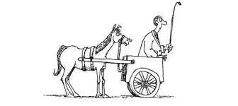
SQA Past Papers
Up to five years of past exam papers available from the SQA website.
Excellent way to review and assess your progress when used appropriately
Important to try building knowledge and understanding of the subject before attempting the past papers
Marking schemes are also available!
Notes:
Past papers probably best way to review progress but time consuming and limited number. Very little benefit in doing past papers and having no idea why something is right or wrong. If getting something wrong in past papers/finding a particular area hard, move back up the study cycle.

Slide 14
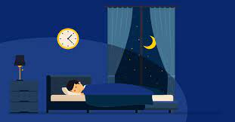
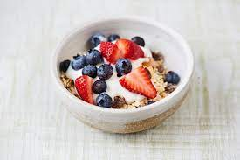
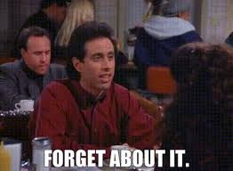
Exam Day – The Final Countdown
Notes:
1) Get an early night! Staying up until 4am wont help you be at your best for the exam. 2) Make sure you eat breakfast/lunch - fuel the body and mind is important. 3) arrive in plenty of time – exams are stressful enough without worrying about being late! 4) bring all the correct equipment – prep this the night before, one less thing to worry about on the day. 4) when in the exam slow down, take a deep breath and read the questions carefully no extra marks for finishing early. 5) when the exam is over – forget about it! The exam period is marathon not a sprint, focus on what's in front not behind

Slide 15
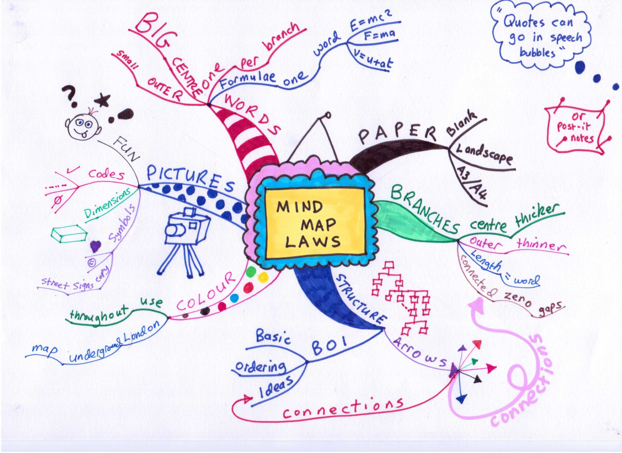
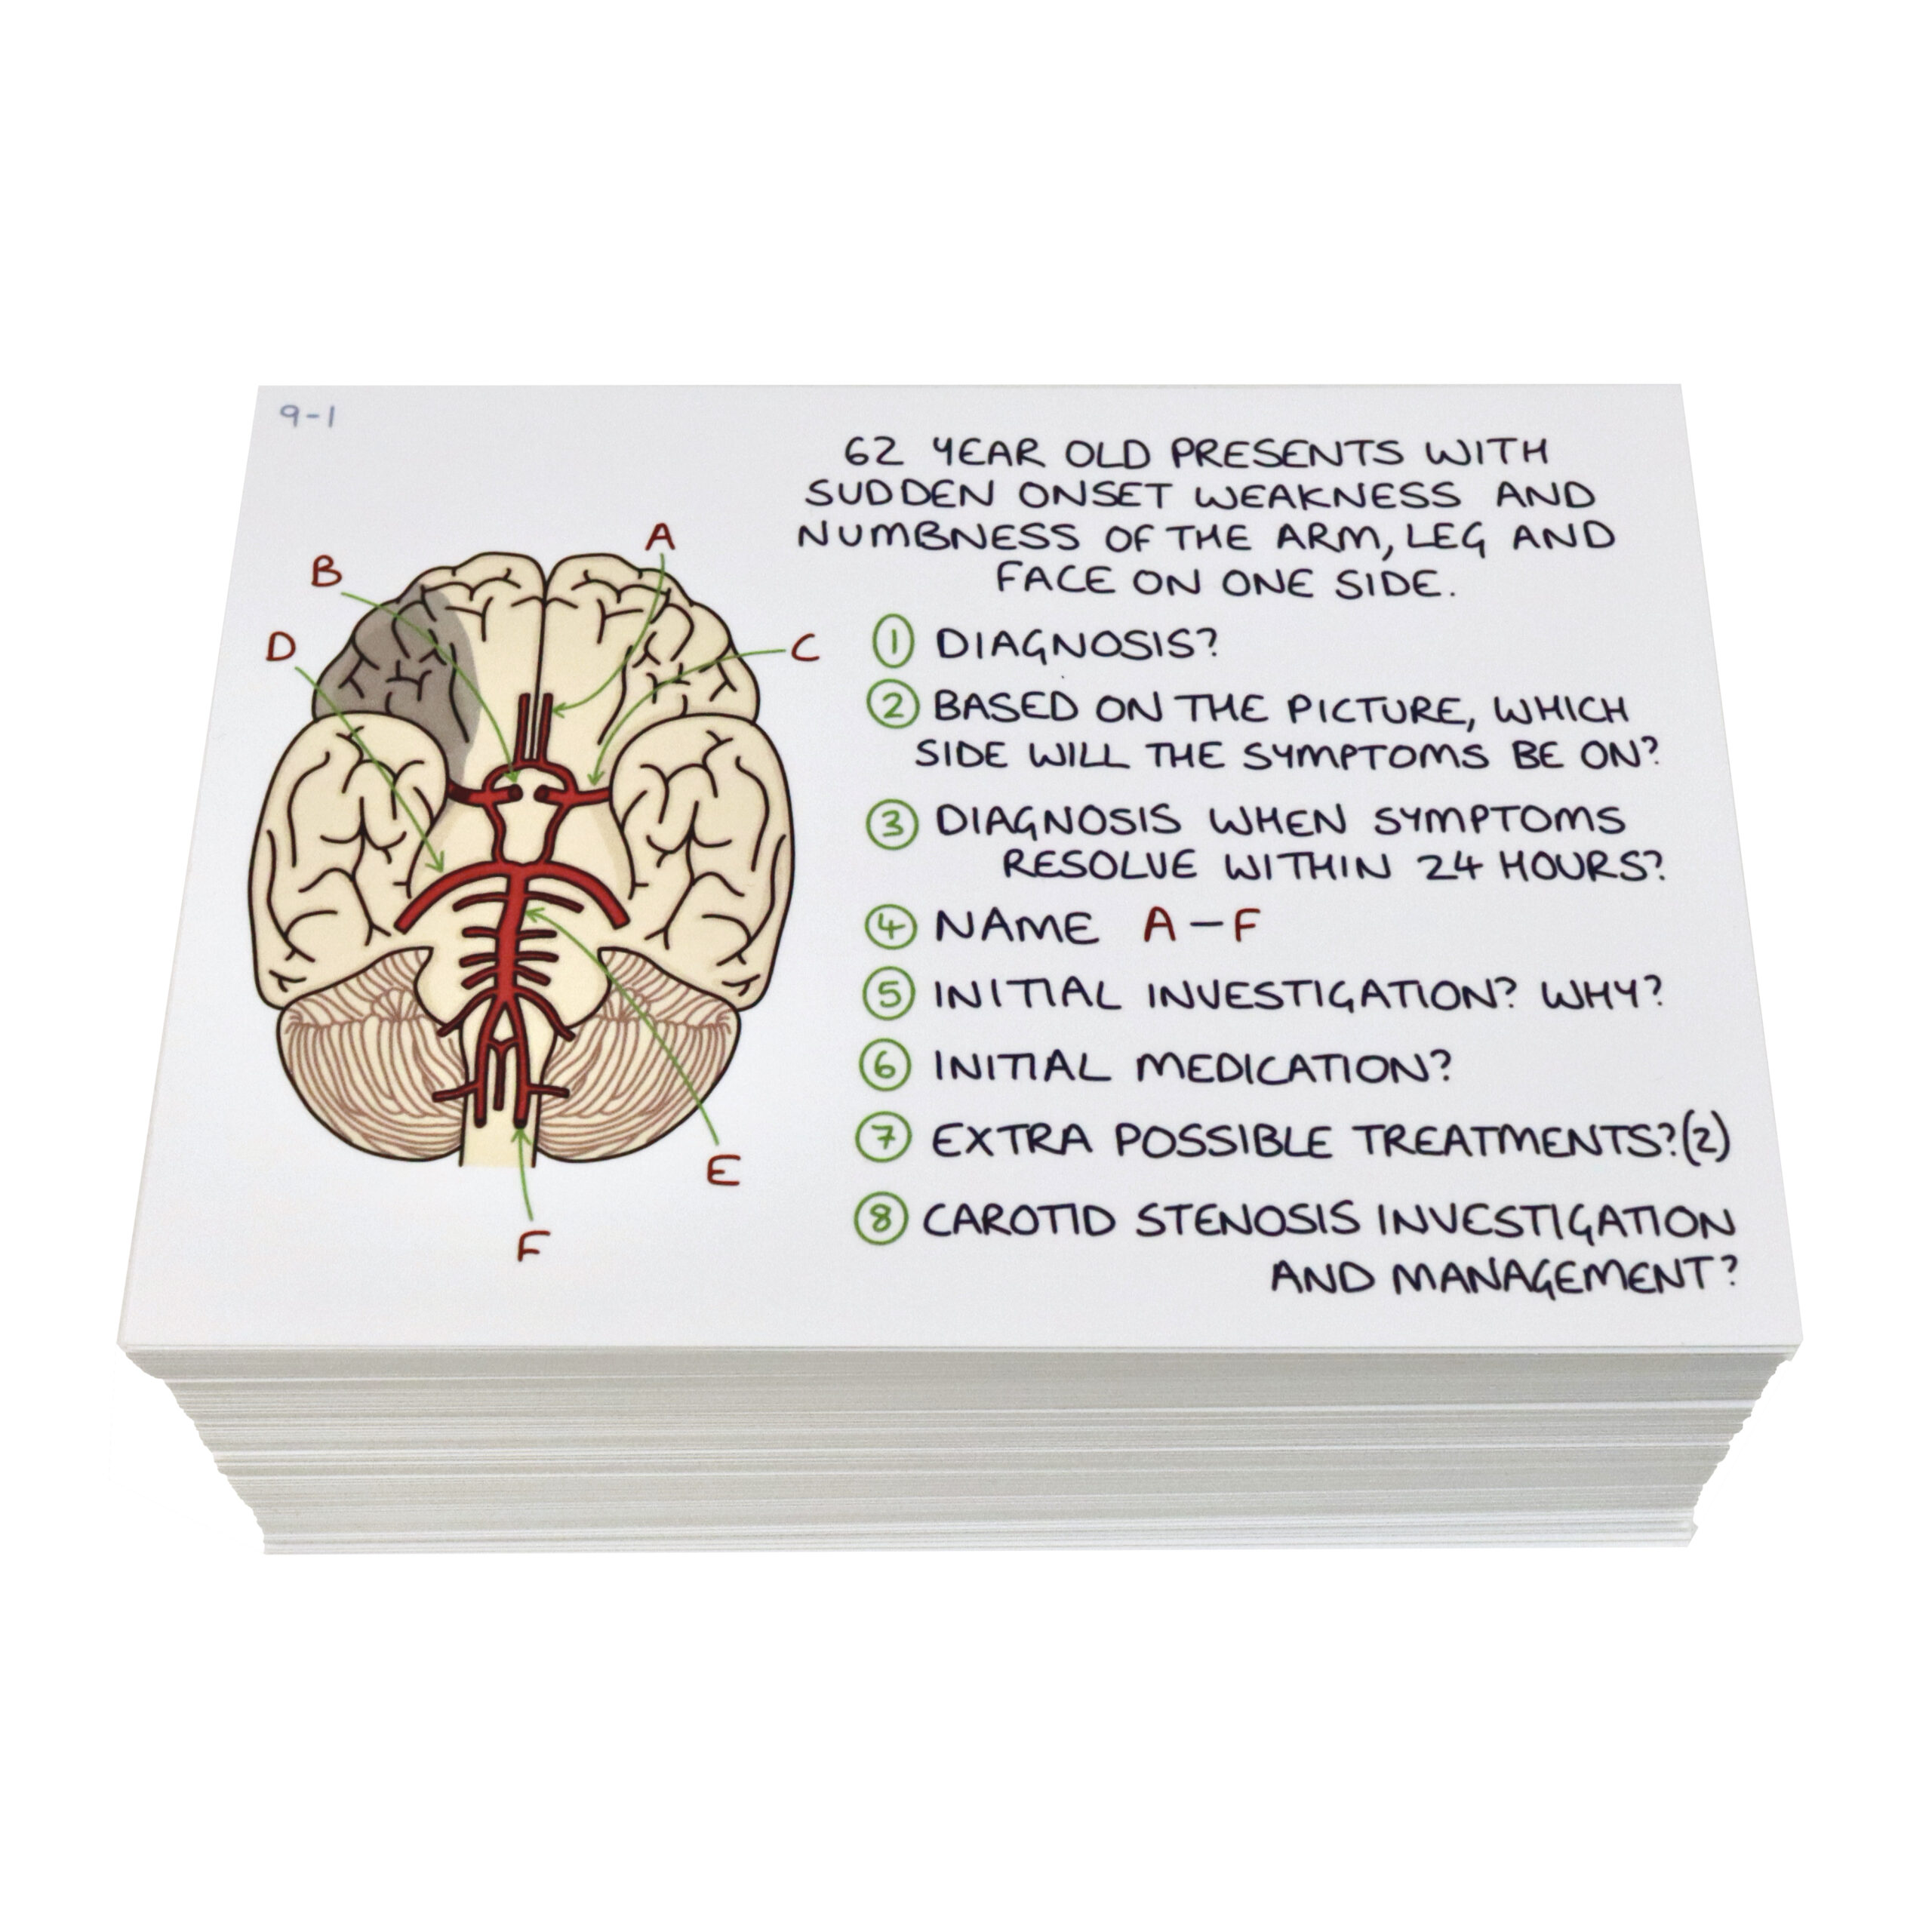
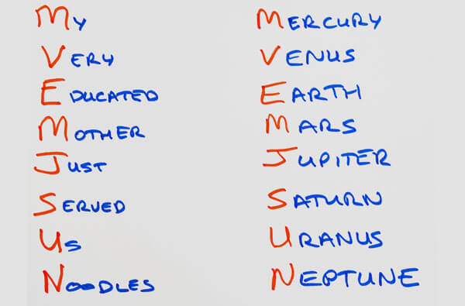
Useful Revision Techniques
Mind maps
Flashcards
Other memory techniques

Slide 16
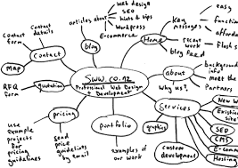
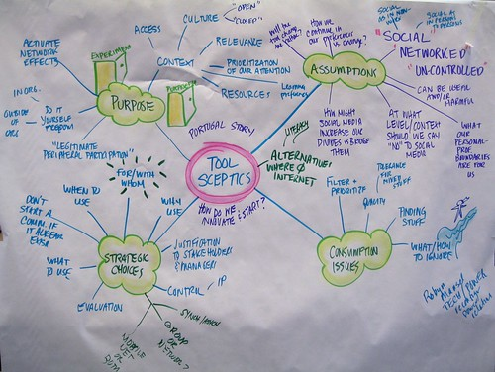
Mind Maps
Blank sheet of paper
Choose a central topic
Create branches using subtopics
Summarise/condense the key points around the branches
Use your own words
Use colour (pens, pencils, highlight) and diagrams
Review and memorise (read, record, display, test)

Slide 17
Other Condensing and Memorising Techniques

Slide 18
Before we start...
A quick memory test
You will see 10 pictures for 30 seconds. We will then wait for 15 seconds then try to write down as many as we can.

Slide 20
Mnemonics/acronyms
These approaches are particularly effective when trying to memorise facts or lists of information
Planets of the solar system: Mercury, Venus, Earth, Mars, Jupiter, Saturn, Uranus, Neptune, Pluto(?)

Slide 21
Mnemonics/acronyms
Some other examples:
Order of operations in maths: Diatomic elements in chemistry:
Brackets
Over
Multiplication
Division
Adding
Subtracting
Our
Friend
Claire
Has
No
Irn
Bru

Slide 22
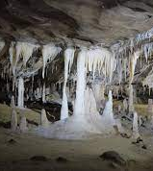
Match Information with Sounds or Letters
Finding clues in a word can help us to remember facts, for example:
“Necessary” has one “c” and two “s’s”, just as a shirt has one collar and two sleeves
Stalagmites grow from the ground. Stalactites grow from the top of the cave

Slide 23
Creating a story - Visualisation
Creating a funny or absurd story or picture can help us to memorise facts
This method connects otherwise random bits of information and so recalling one part of the story/image can trigger other pieces to come with it.

Slide 24
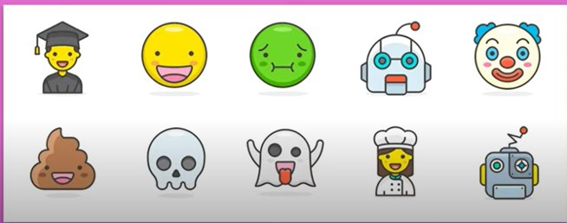
A SECOND MEMORY TEST

Slide 25
Flashcards
Notes:
NICOLA

Slide 27
Flashcards
Make your own (this is revision in itself as you are having to find information and select it for the card)
Can use the technique of summarising when making your cards
Can be visual or words
On one side = meaning, factual information
On other side = key word or prompt
Self-testing
Non-specialist can test you e.g family member
Notes:
NICOLA

Slide 28
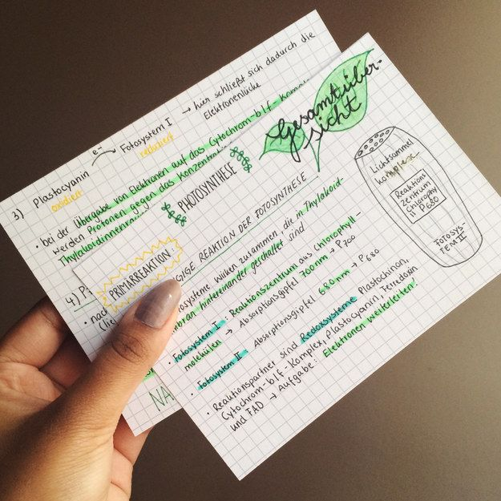
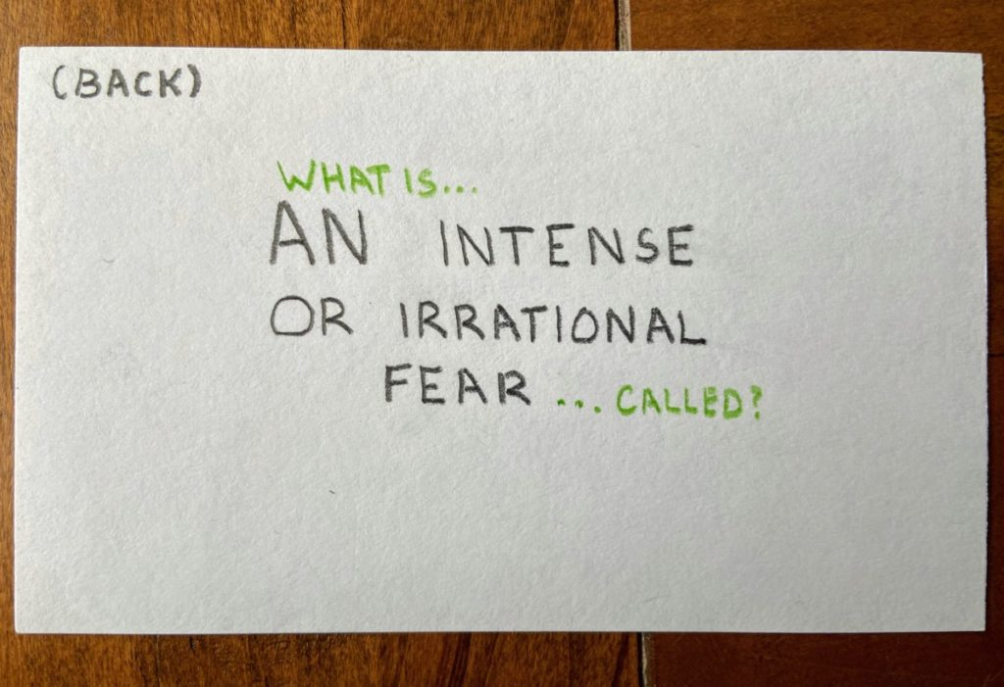
Keep it simple ….
Or make them more detailed ...
Notes:
NICOLA

Slide 29
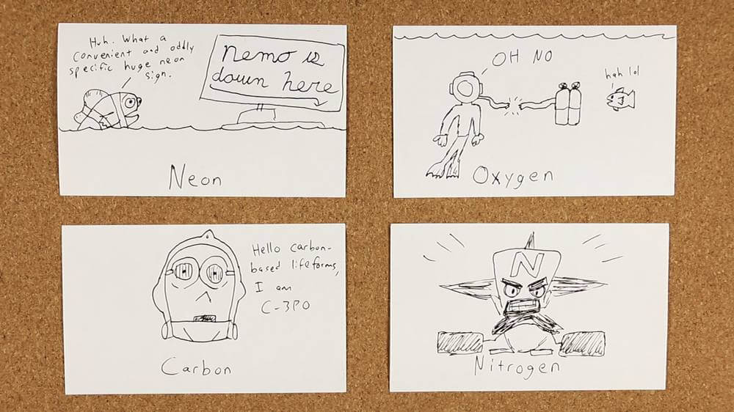
Task
Choose a subject that you have resources for
Select a key term/question/definition that you need to know
Create your own flashcard
Look at the examples to help you
s subject that you have resources for
Notes:
NICOLA

Slide 30
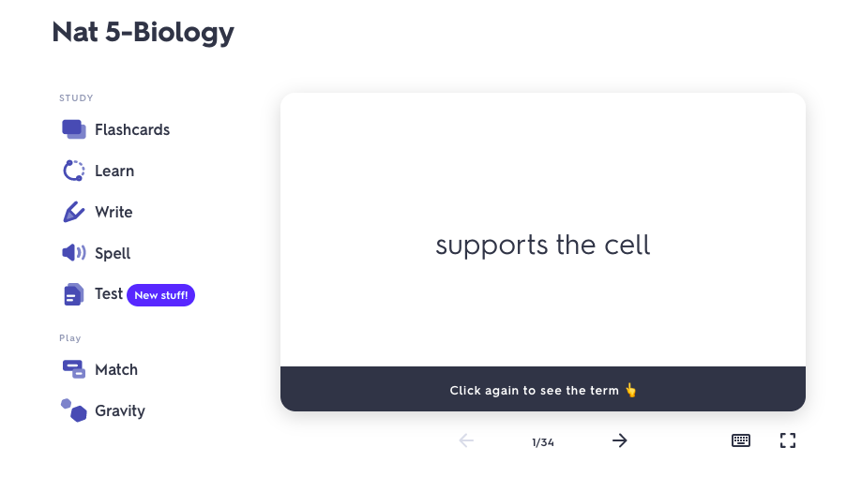
Digital Flashcards – Quizlet
https://quizlet.com/en-gb
Sign-up is free
Create your own digital set of flashcards
Test yourself, play fun games
https://quizlet.com/173360201/nat-5-biology-flash-cards/
Notes:
NICOLA

Slide 31
Reviewing your cards

