Slide 1
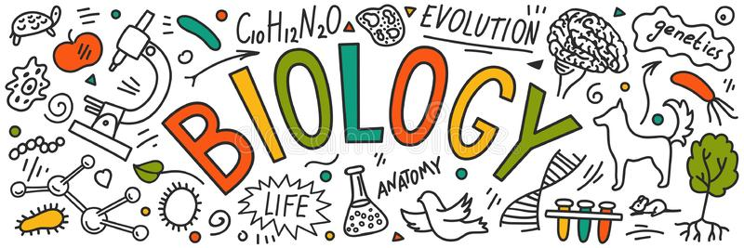
Brannock High School
Options Information

Slide 2

Why study biology?
Biology, the study of living organisms, plays a crucial role in our everyday existence, and is an increasingly important subject in the modern world. Advances in technologies have made biology more exciting and more relevant than ever.
Biology affects everyone and aims to find solutions to many of the world’s problems. It explores the use of genetic modification to produce new plants and drugs, curing genetic diseases, and developing new sources of food.

Slide 3

The Course
The national 3, 4 and 5 biology course is made up of three units.
Cell Biology
Multicellular Organisms
Life on Earth
In S3 we focus on units 1 and 3.

Slide 4
Added Value Unit/Assignment
As part of the national 4/5 course you will compete an AVU or assignment.
This involves researching an area of biology and planning and carrying out an experiment. You will then write your findings in the form of a report.
Most of this will be completed as homework.

Slide 5


Homework
Homework will be issued on a regular basis.
You will be expected to revise independently as you progress through the course. This will improve your knowledge and develop your study skills.

Slide 6
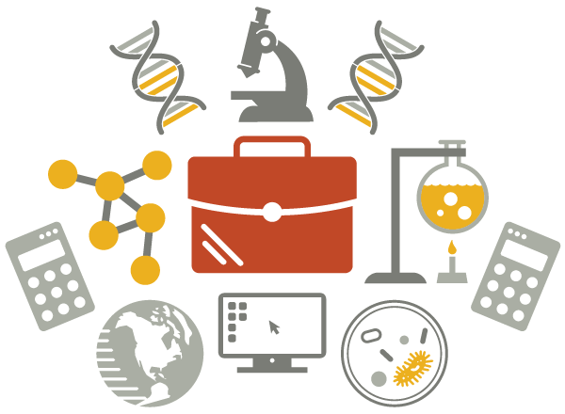
Careers
There are thousands of different careers in biology.
Healthcare (medicine, nursing, dentistry, psychology)
Sport (Sports science, physiotherapy)
Environment (conservation, zoology, marine biology)
Research (immunology, microbiology, pharmacology)

