Slide 1
Why choose Physics?

Slide 2
Physics is the science that tells us about the universe and how it works. It includes the study of:
Dynamics - How things move and interact
2) Matter – The structure of the things that make up the universe from particles smaller than atoms to stars and galaxies
3) Space and astrophysics – What happened at the start of the universe, how does our sun give out energy,
4) Energy – How things happen, how light behaves, how other parts of the electromagnetic
spectrum are useful
5) Electricity – How electrical and electronic circuits operate and how to design and build useful circuits.

Slide 3
Some reasons to study physics
Studying physics helps to develop your problem solving skills which will be useful for
you across a whole range of subjects
Physics is sometimes called the fundamental science because the processes
that happen in Chemistry and Biology can be explained fundamentally and at a deep level using physics.
3) Many businesses like to see that someone has studied physics because they realise
that this helps develop skills which are transferable. This is particularly true of the finance sector.
4) Physics is at the forefront of new technologies including quantum computing, driverless vehicles, and many others.
5) Physics careers tend to pay well, even when people are just starting out without much experience.

Slide 4
In third year topics include:
Waves – How energy is transferred from one place to another, why waves behave in certain ways and have different properties.
The electromagnetic spectrum – There are a range of waves that all travel at the speed of light but can be used for lots of different things such as transmitting information, cutting steel, healing injured muscles, killing cancer cells etc.
Atoms and Nuclear Radiation – Studying what makes up an atom and the types of radiation that can be given out from the centre of atoms. Uses of nuclear radiation from smoke detectors to tracing blood flow in the body. The ways that radiation can be measured. How nuclear power stations work and the development of nuclear fusion power stations.
Kinematics – The rules that govern how objects move and interact. Newton’s 3 laws of motion. How forces affect objects. The difference between objects moving in space and on earth
Space – Projectile motion, how satellites stay in orbit. What type of objects there are in space. How distant objects are in space

Slide 5
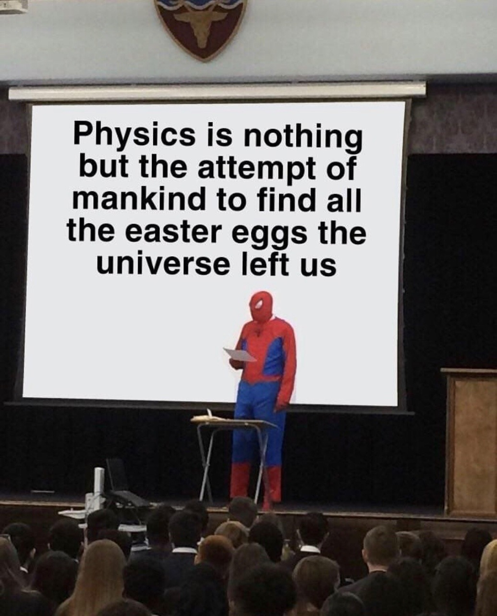
What has Physics done for you lately?

Slide 6


Slide 7
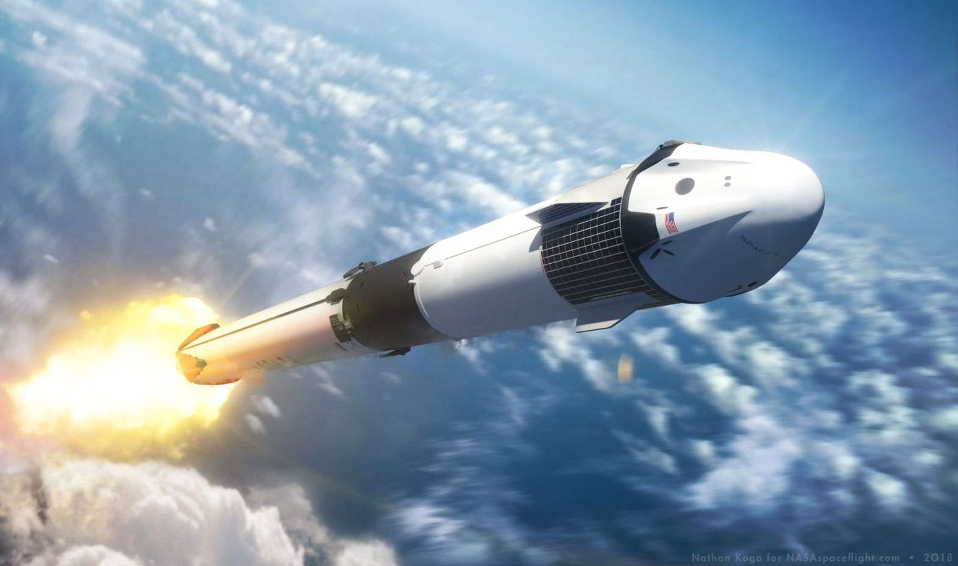
What has Physics been doing THIS YEAR?

Slide 8
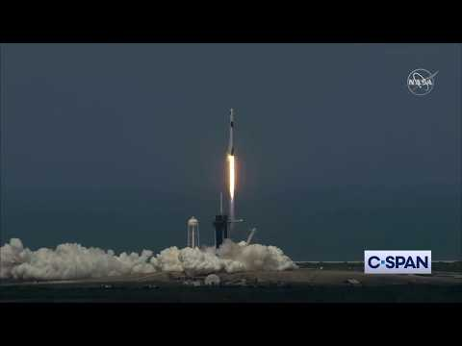
MAY
Dragon 2 Capsule launches crew to ISS. First launch ever by a private space travel company and first US launch of astronauts since 2011.

Slide 9
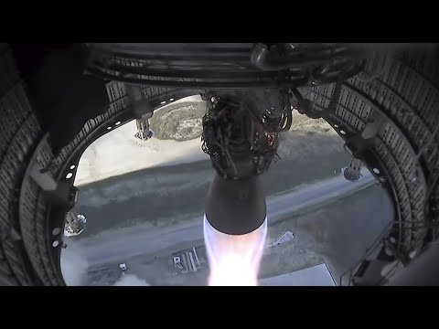
AUGUST
A ‘hop’ by the first stage of Starship: designed to colonise MARS.
Being an astronaut has never been more possible!
Notes:
The 500-foot (150-meter) “hop” test was the first of a Starship rocket with full-size propellant tanks, and it sets the stage for a series of progressively higher atmospheric demonstration flights with future vehicles. Eventually, SpaceX aims to shoot the Starship into orbit on top of an even taller booster rocket named the “Super Heavy” to deliver to space huge cargo loads, satellites, telescopes, and science probes.
SpaceX’s longer-term roadmap includes an in-orbit refueling capability to make trips to the moon possible. NASA selected SpaceX’s Starship vehicle as one of three contenders — alongside Blue Origin and Dynetics — for a human-rated lunar lander the space agency will fund for crewed moon missions later this decade.
And the Starship is central to the vision of Elon Musk, SpaceX’s billionaire founder, who established the company with a mission of sending people to Mars. Future Starships could cruise to Mars with up to 100 people, Musk says.
“Mars is looking real,” Musk tweeted after Tuesday’s test flight. “Progress is accelerating.”

Slide 10

Earth Travel by Starship
But if you really don’t fancy going to space, check this out!

Slide 11
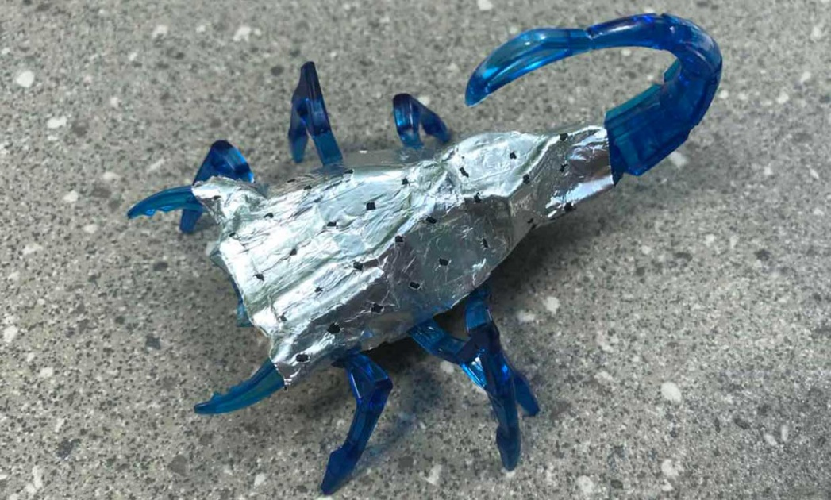
Biomorphic zinc batteries
This robot scorpion’s body is made of its battery, just like our body structure is partly made of our energy reserves.
Notes:
Like biological fat reserves store energy in animals, a new rechargeable zinc battery integrates into the structure of a robot to provide much more energy, a team led by the University of Michigan has shown.
This approach to increasing capacity will be particularly important as robots shrink to the microscale and below -- scales at which current stand-alone batteries are too big and inefficient.
Applications for mobile robots are exploding, from delivery drones and bike-lane take-out bots to robotic nurses and warehouse robots. On the micro side, researchers are exploring swarm robots that can self-assemble into larger devices. Multifunctional structural batteries can potentially free up space and reduce weight, but until now they could only supplement the main battery.
"No other structural battery reported is comparable, in terms of energy density, to today's state-of-the-art advanced lithium batteries. We improved our prior version of structural zinc batteries on 10 different measures, some of which are 100 times better, to make it happen
"This is not the limit, however. We estimate that robots could have 72 times more power capacity if their exteriors were replaced with zinc batteries, compared to having a single lithium ion battery,"
To demonstrate their batteries, the researchers experimented with regular-sized and miniaturized toy robots in the shape of a worm and a scorpion. The team replaced their original batteries with zinc-air cells. They wired the cells into the motors and wrapped them around the outsides of the creepy crawlers.
"Batteries that can do double duty -- to store charge and protect the robot's 'organs' -- replicate the multifunctionality of fat tissues serving to store energy in living creatures," said Ahmet Emre, a doctoral student in biomedical engineering in Kotov's lab.

Slide 12
What has Physics been doing THIS DECADE?

Slide 13
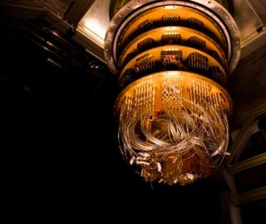
Sycamore
Google’s 53 qubit quantum computer
Notes:
The quantum computer completed the complex computation in 200 seconds. That same calculation would take even the most powerful supercomputers approximately 10,000 years to finish, the team of researchers, led by John Martinis, an experimental physicist at the University of California, Santa Barbara, wrote in their study published Wednesday (Oct. 23) in the journal Nature.
Ordinary computers perform calculations using "bits" of information, which, like on-and-off switches, can exist in only two states: either 1 or 0. Quantum computers use quantum bits, or "qubits," which can exist as both 1 and 0 simultaneously. This bizarre consequence of quantum mechanics is called a superposition state and is the key to the quantum computer's advantage over classical computers.
For example, a pair of bits can store just one of four possible combinations of states (00, 01, 10 or 11) at any given time. A pair of qubits can store all four combinations simultaneously, because each qubit represents both values (0 and 1) at the same time. If you add more qubits, your computer's power grows exponentially.
Three qubits store eight combinations, four qubits store 16, and so on. Google's new computer with 53 qubits can store 253values, or more than 10,000,000,000,000,000 (10 quadrillion) combinations. This number gets even more impressive when another fundamental and equally bizarre property of quantum mechanics enters the show: entangled states.

Slide 14
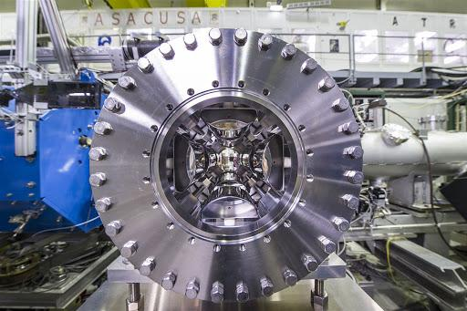
Antimatter factory at CERN
Notes:
Successfully create anti-hydrogen to experiment on it - testing the forces of the universe on it to see if it behaves the same.

Slide 15
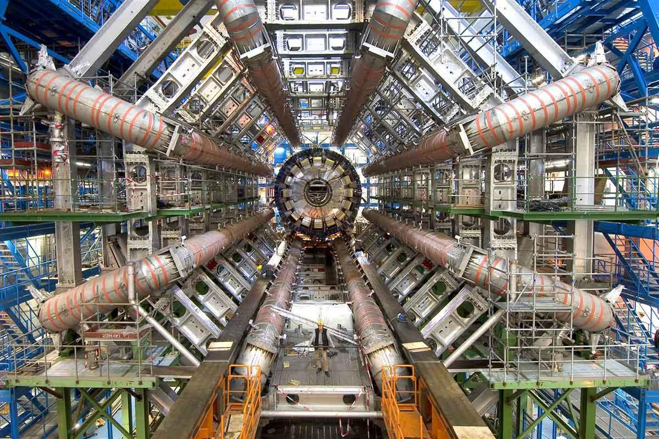
LHC at CERN discovers the Higgs Boson
Notes:
To make this more relatable here are just SOME of the technologies developed in the process of finding the Higgs:
Click this link to show them all the tech start-ups: https://kt.cern/cern-technologies-society just scroll down to show how applicable big experiments like this are.
Modern radiotherapy treatments - particularly proton and neutron accelerators now making their way into hospitals.
Superconducting magnet technology responsible for modern MRI
Modern radiation safety: detectors for situations on Earth and dealing with the radiation for space travel.
Modern CT scans
Rapid information sharing and anomaly identification networks - CERN developed the web originally but their more modern systems are being partnered with world banks and markets to be able to analyse the changes to economies and financial markets.
Fast learning AI is now being used in self-driving systems

Slide 16
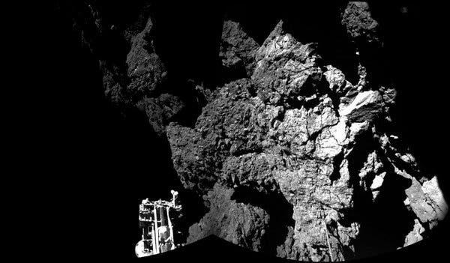
Landed the Rosetta probe on a COMET
Notes:
Took 10 years to get there. The comet is 511 million km from Earth and only 4km long and wide.

Slide 17
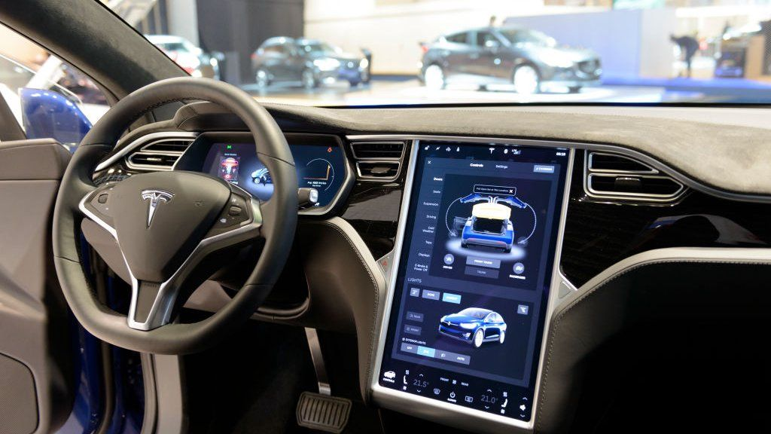
Self-driving cars
Notes:
The three primary autonomous vehicle sensors are camera, radar and lidar. Working together, they provide the car visuals of its surroundings and help it detect the speed and distance of nearby objects, as well as their three-dimensional shape.
Radar sensors can supplement camera vision in times of low visibility, like night driving, and improve detection for self-driving cars.
Traditionally used to detect ships, aircraft and weather formations, radar works by transmitting radio waves in pulses. Once those waves hit an object, they return to the sensor, providing data on the speed and location of the object.
However, for full driverless capability, lidar — a sensor that measures distances by pulsing lasers — has proven to be incredibly useful.
Lidar makes it possible for self-driving cars to have a 3D view of their environment. It provides shape and depth to surrounding cars and pedestrians as well as the road geography. And, like radar, it works just as well in low-light conditions.
By emitting invisible lasers at incredibly fast speeds, lidar sensors are able to paint a detailed 3D picture from the signals that bounce back instantaneously. These signals create “point clouds” that represent the vehicle’s surrounding environment to enhance safety and diversity of sensor data. - NEXT SLIDE
ALSO much of the super fast anomaly spotting software is a partnership with CERN who developed it to spot the two beauty quarks after a proton collision which exist only for fractions of a second and the LHC had 40 million collisions per second!

Slide 18
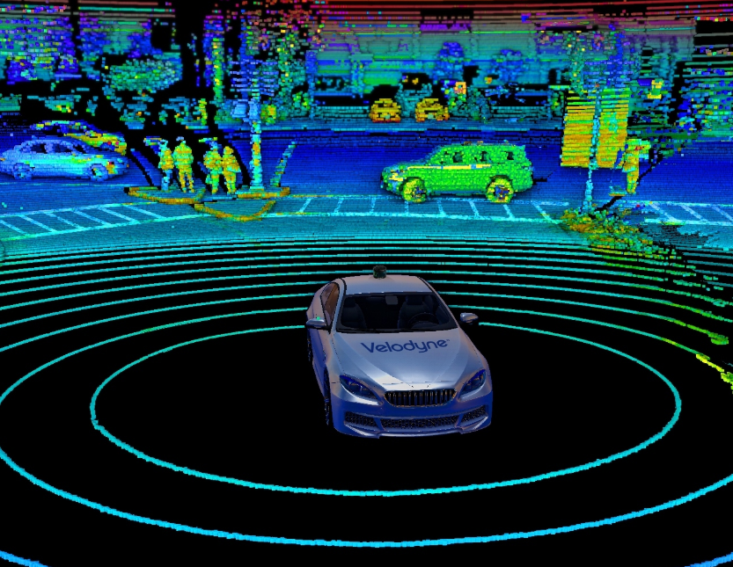
LIDAR

Slide 19
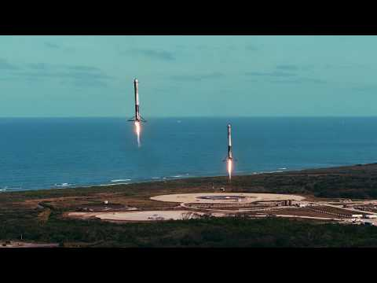
Falcon Heavy

Slide 20
Coming soon in Physics . . .

Slide 21
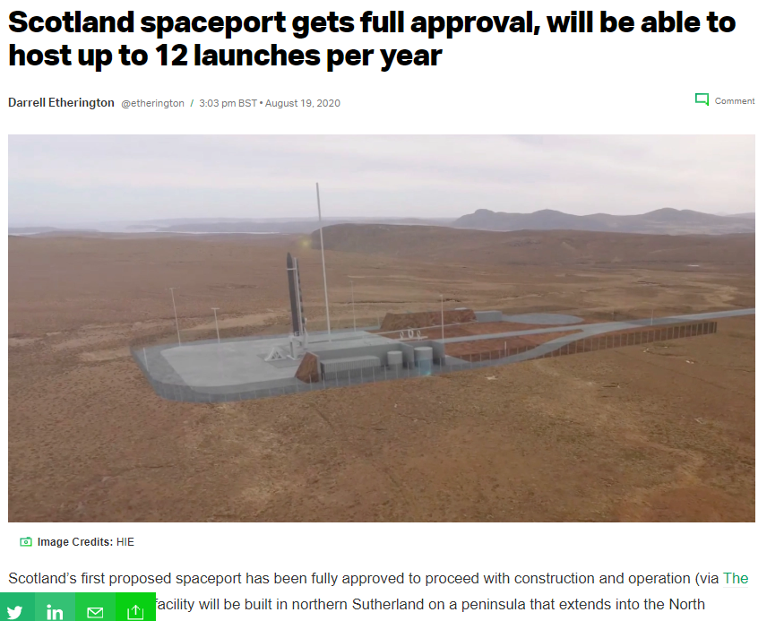
Notes:
Hopefully we’ll have a Spacex office here!!

