Slide 1
Book Recommendations

Slide 2
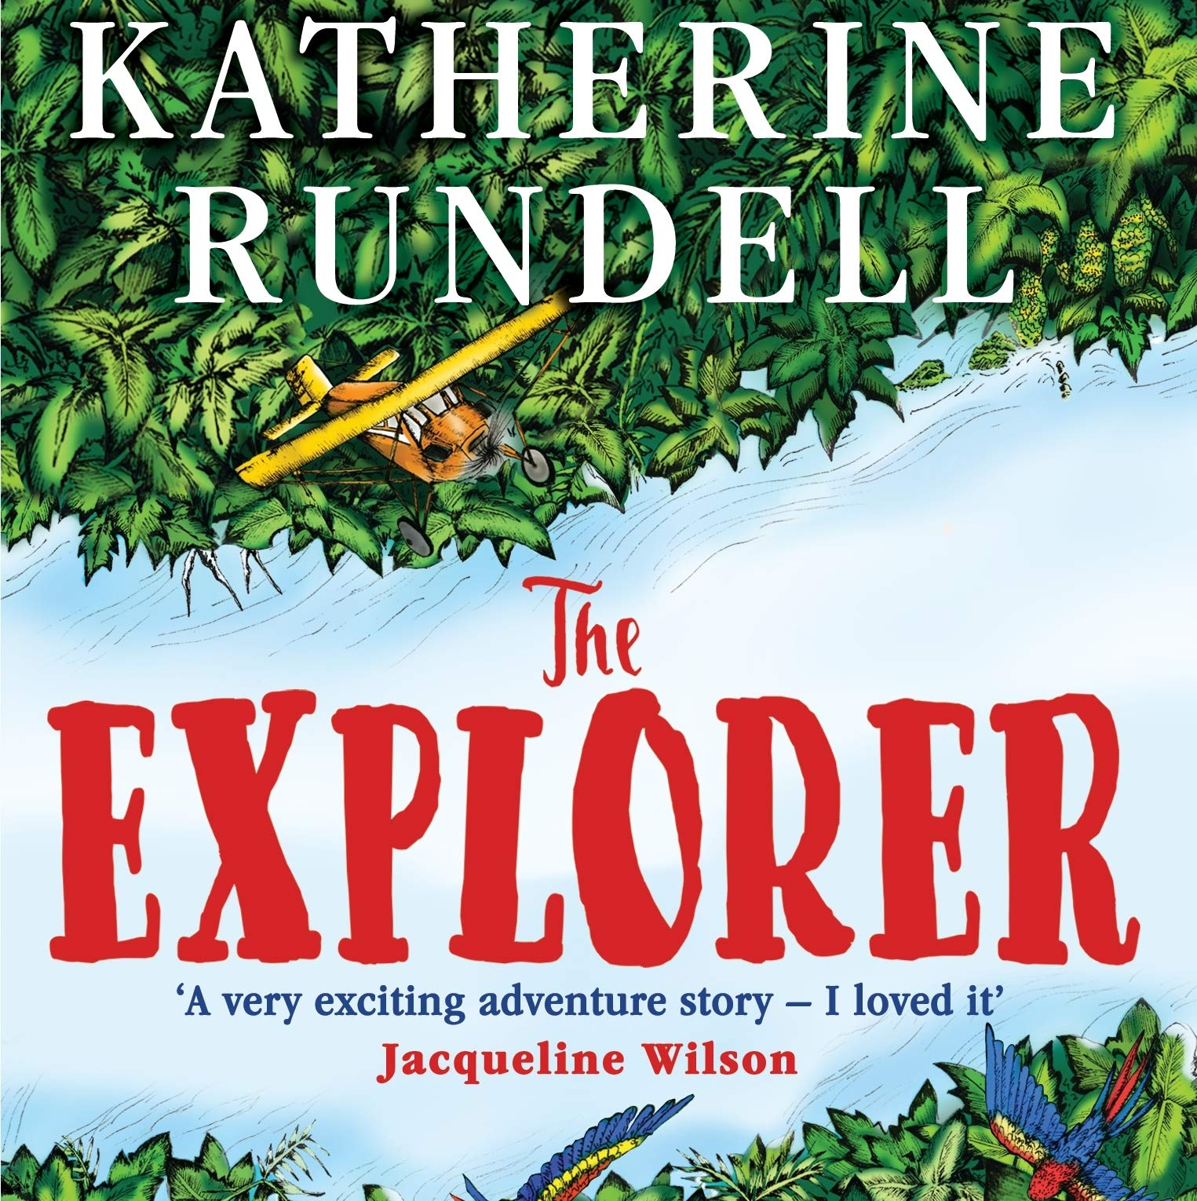
Adventure
Trash by Andy Mulligan
Sky Song by Abi Elphinstone
The Explorer by Katherine Rundell

Slide 3
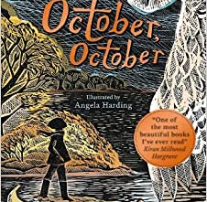
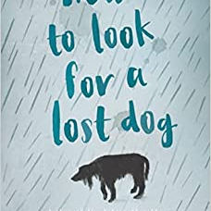
Animal
October October by Katya Balen
Spy Pups by Andrew Cope
How to Look for a Lost Dog by Ann Martin

Slide 4
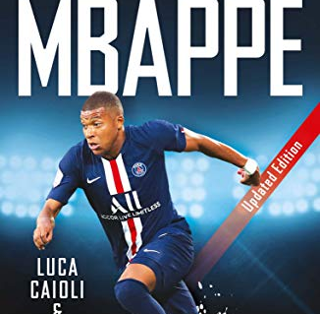
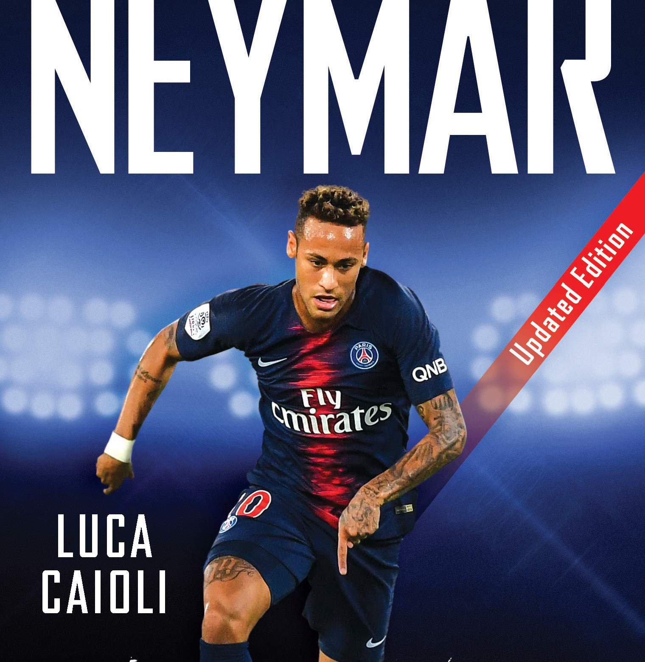
Biography
Neymar by Luca Caioli
Mbappe by Luca Caioli
Greta’s Story by Valentina Camerini

Slide 5
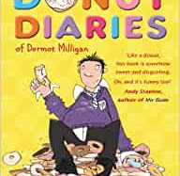
Comedy
Sputnik’s Guide to Life of Earth by Frank Cottrell Boyce
Doctor Proctor’s Fart Powder: Time Travel Bath Bombs by Jo Nesbo
The Donut Diaries by Dermot Milligan

Slide 6
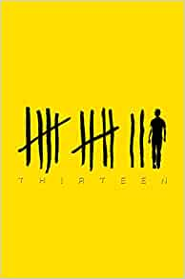
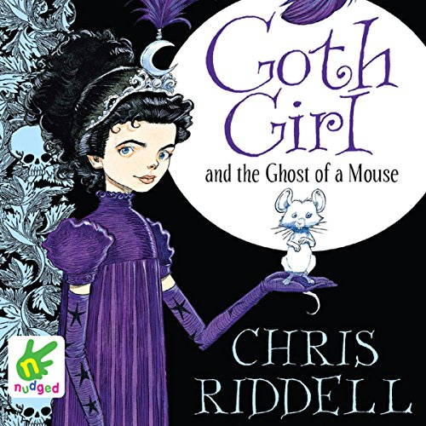
Crime/Mystery
Thirteen by Tom Hoyle
Young Sherlock by Andrew Lane
Goth Girl by Chris Riddell

Slide 7
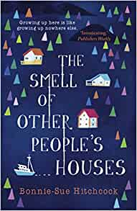
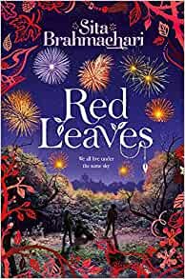
Family/School
Red Leaves by Sita Brahmachari
Apple and Rain by Sarah Crossan
The Smell of Other People’s Houses by Bonnie Sue Hitchcock

Slide 8
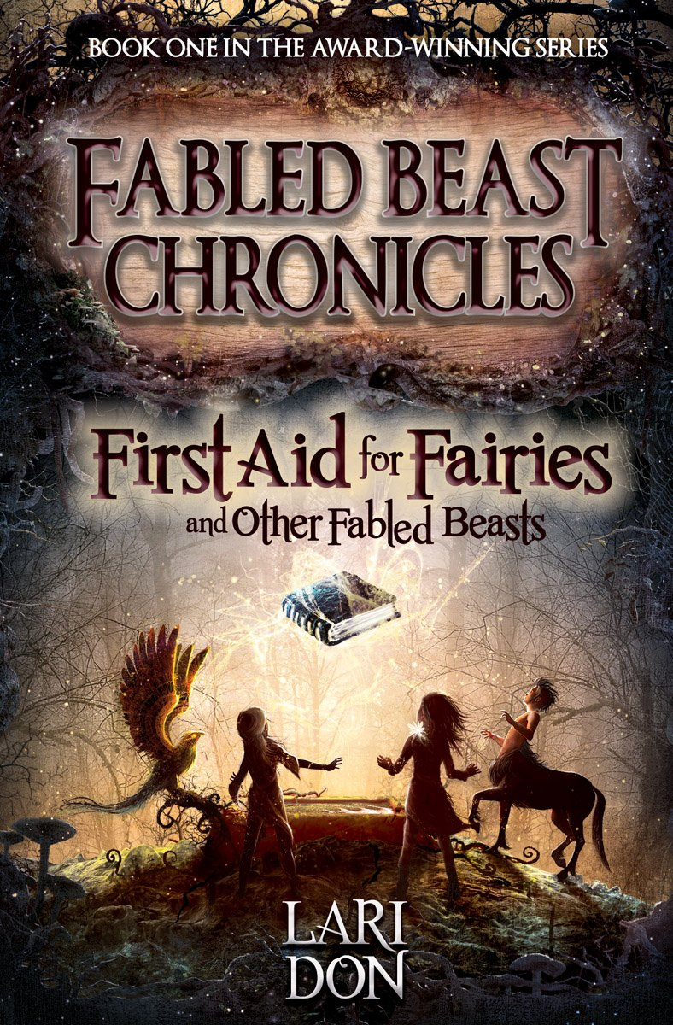
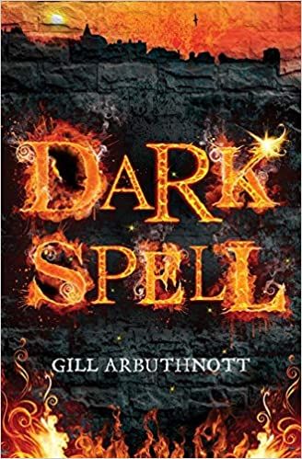
Fantasy
Dark Spell by Gill Arbuthnott
First Aid for Fairies by Lari Don
The Owl Service by Alan Garner

Slide 9
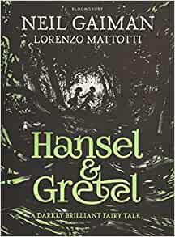
Graphic Novels/Manga
Naruto by Masashi Kishimoto
Hansel and Gretel by Neil Gaiman
Maus by Art Spiegelman

Slide 10
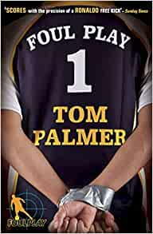
Sport
Stadium School by Jefferies & Goffe
Billy the Kid by Michael Morpurgo
Foul Play by Tom Palmer

Slide 11
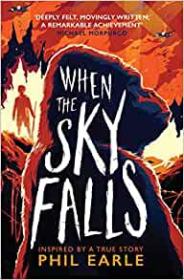
War/History
Looking at the Stars by Jo Cotterill
When the Sky Falls by Phil Earle
The Skylark’s War by Hilary McKay

Slide 12
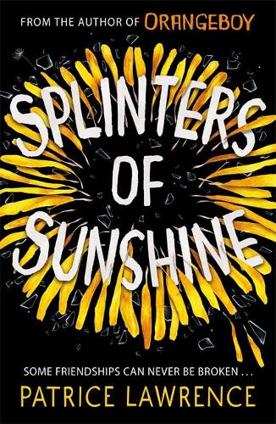
Teen
Cinderella is Dead by Kalynn Bayron
Dancing Jax by Robin James
Splinters of Sunshine by Patrick Lawrence

