Slide 1
Genre taster
Holocaust Memorial Day – January 27th 2022

Slide 2
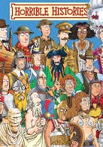
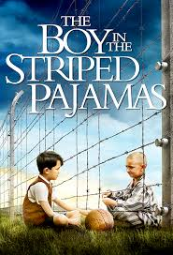
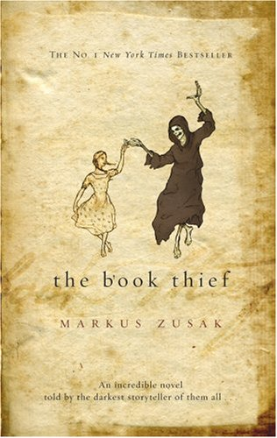
War/History
The War/History section is a fantastic genre.
If you like thrilling action stories set in Roman times, or during the two World Wars, or even if the humorous ‘Horrible Histories’ which include stories on everything from the Stone Age to Queen Victoria, then a War/History story may be for you.
There are also War/History stories in Teen Fiction.
Please consider this genre when you are next borrowing a book

Slide 3
War/History Trailers
Horrible Histories: The Rotten Romans
The Book Thief
War Horse
Boy in the Striped Pyjamas

Slide 4
War/History Keywords & Descriptions
Battles
Heroes vs. Villains or Good vs. Evil
The Past – different time periods
Adventure
Relationships
Risk/Danger
Interesting
Knowledge

Slide 5
War/History
In the school library you will find an entire collection dedicated to War/History fiction.
The school library also has a very good selection of non fiction books containing information on many different time periods and historical events.

Slide 6
Books you may like….
I am David
- A young boy escapes a concentration camp and journeys across Europe to find his mother. Written by Anne Holm.
Heroes
A soldier with no face, on a mission of vengeance. Written by Robert Cormier.
Death or Glory Boys
A terrifying thriller that challenges our response to terrorism and to soldiers fighting the keep the peace with the weapons of war. Written by Theresa Breslin.
Deadly Skies
- Part war story, part fact book, that reveals what I was really like to fly a plane and fight in the Battle of Britain. Written by J Eldridge.

Slide 7
Quick Task – Create a Book Menu
From the books you have read from the school library whilst at school, or any books you have read at home or at primary school, you are going to create a book menu.
You must choose three of your favourite books – one for your starter, one for your main course, and one for your dessert. And be ready to say why you have chosen them.
The best and most interesting menus will be displayed online.
Here is my book menu.

