Slide 1
Genre taster

Slide 2
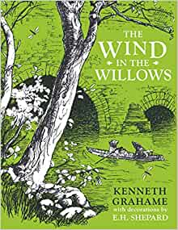
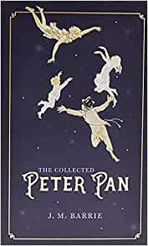
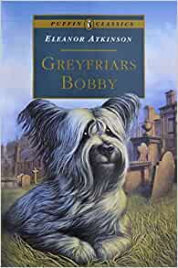
Scottish Stories
All available from the school library.

Slide 3
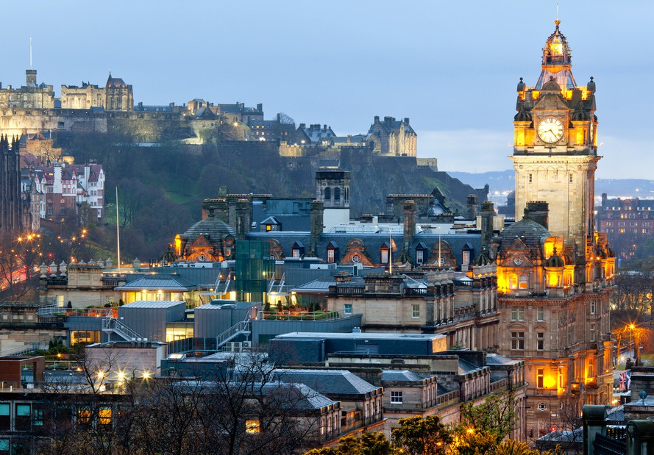
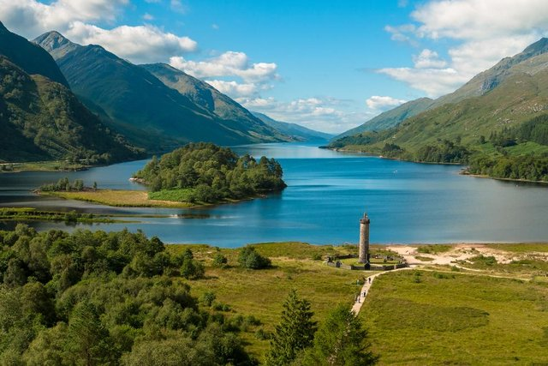
Scottish Stories
A story written by a Scottish author.
A story set in Scotland
A story whose main character/s are Scottish.
Scotland has a very rich literary history.

Slide 4
Scottish Books that have been adapted into films
Peter Pan
Greyfriars Bobby
The Water Horse

Slide 5
Other books you may enjoy…
Dear Dell by Alison Prince
Stories from Scotland edited by Lindsey Fraser and Kathryn Ross
The Flawed Glass by Ian Strachan
The Stronghold by Mollie Hunter

Slide 6
Now let’s take our ‘Book Personality Quiz’ to help you find out what type/s of books you may like to borrow……. Then we can have a quick book talk

