Slide 1
Genre taster

Slide 2
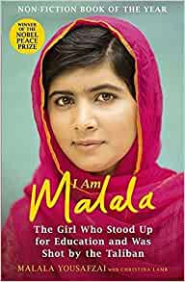
Multicultural Stories

Slide 3
Multicultural Stories
A story written by an author of colour.
A story set in a non-western location e.g.: Africa, Asia etc
A story whose main character/s are people of colour.
These stories increase our empathy for the lives led by people of colour and also give us an insight into their culture, religion and heritage etc.
These stories also increase the representation of people of colour in books, TV and films.

Slide 4
Multicultural Films / TV shows
I am Malala
Noughts and Crosses
Roots

Slide 5
Other books you may enjoy…
Walkabout by James Vance Marshall
White Stranger by Susan Gates
The Jaws of the Dragon by Alan Gibbons
Mosi’s War by Cathy Macphail

Slide 6
Now let’s watch a short film on being Black and Scottish.
Whilst we are watching we can complete our Black History posters

