Slide 1
Genre taster

Slide 2
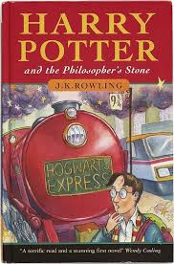
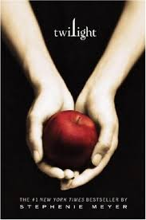
Fantasy

Slide 3
Fantasy Stories
The biggest genre collection in the library.
Most fantasy stories have adventure, mystery and sometimes horror elements to them – they are a bit of everything.
A real work of the imagination. A flight of fancy.
For S2 there are also Fantasy stories in Teen Fiction.
We also have some fantasy audio books and easy reads as well.
Please consider this genre when you are next borrowing a book.

Slide 4
Fantasy Films / TV Shows
A Wrinkle in Time
Chaos Walking: The Knife of Never Letting Go
His Dark Materials: Northern Lights

Slide 5
Fantasy Keywords
Magical
Quest
Good versus evil
Different worlds
Mysterious
Action Adventure
Battles

Slide 6
Other books you may enjoy…
The Merman by Dick King Smith
The BFG by Roald Dahl
Another Me by Cathy Macphail
The School of Good and Evil by Soman Chanani
*Remember the library also has plenty of fantasy audio books and easy reads.*

Slide 7
Now let’s have class book talk……
Discuss
Questions

