Slide 1
Dyslexia
Learn all about dyslexia in this PowerPoint.

Slide 2
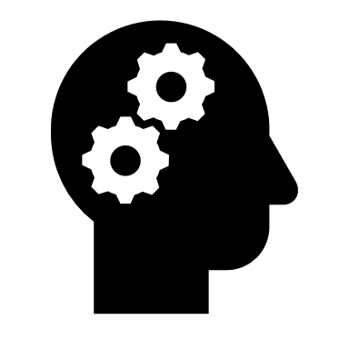
What is dyslexia?
Dyslexia is not a disease, it is something a person is born with and usually runs in families. It is something that affects how the brain handles information, sees and hears. Dyslexia is when someone has a new way of understanding or doing things.
Dyslexics may find it hard to spell words or they might see letters moving when their reading. Dyslexia may also make it difficult for a person to match letters and sounds. Sometimes, dyslexics have trouble telling left from right and even organising themselves can be a struggle. Dyslexics may need a little more time to think of the right word.

Slide 3
Why dyslexia isn’t a bad thing
Everyone with dyslexia is different from each other. Dyslexics might get frustrated, angry or sad if they find something difficult that other people think is easy. Some people with dyslexia try to hide their difficulties because they’re worried about what others will think about them.
However, thinking differently is a good thing. Dyslexics have lots of skills as well, they can be good at visual thinking or being very creative and practical. Dyslexics can also be very good at coming up with new ideas and solving puzzles and problems.

Slide 4
More about dyslexia
Signs of dyslexia usually become apparent when a child starts school and begins to focus more on learning how to read and write
But people with dyslexia often have good skills in other areas such as creative thinking and problem solving.
As well as national dyslexia charities such as the British Dyslexia Association (BDA)
For more information check www.nhs.uk

Slide 5
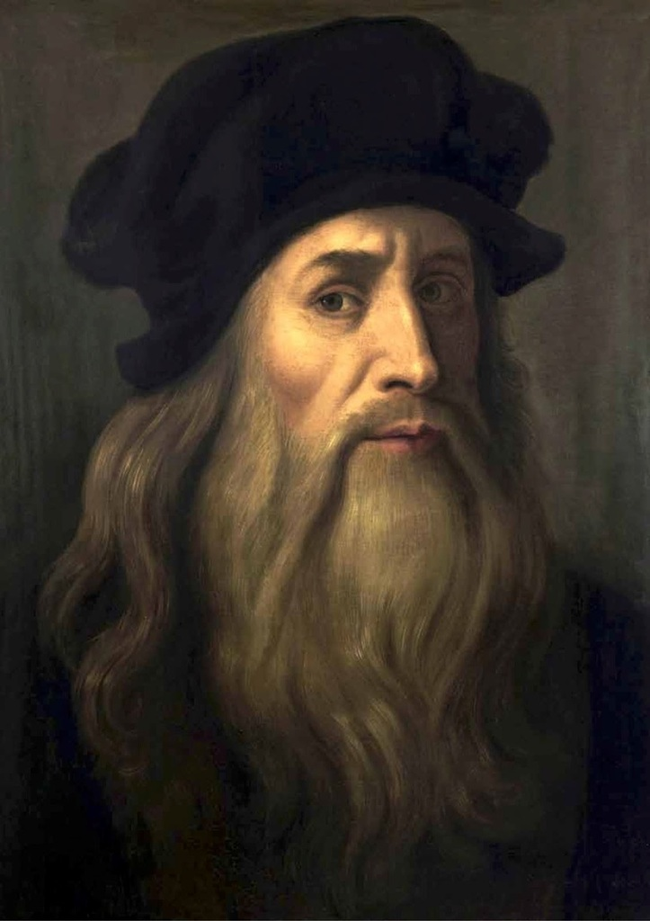
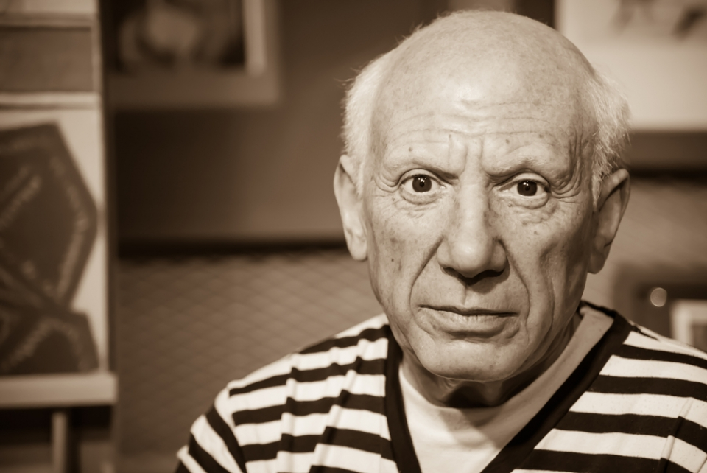
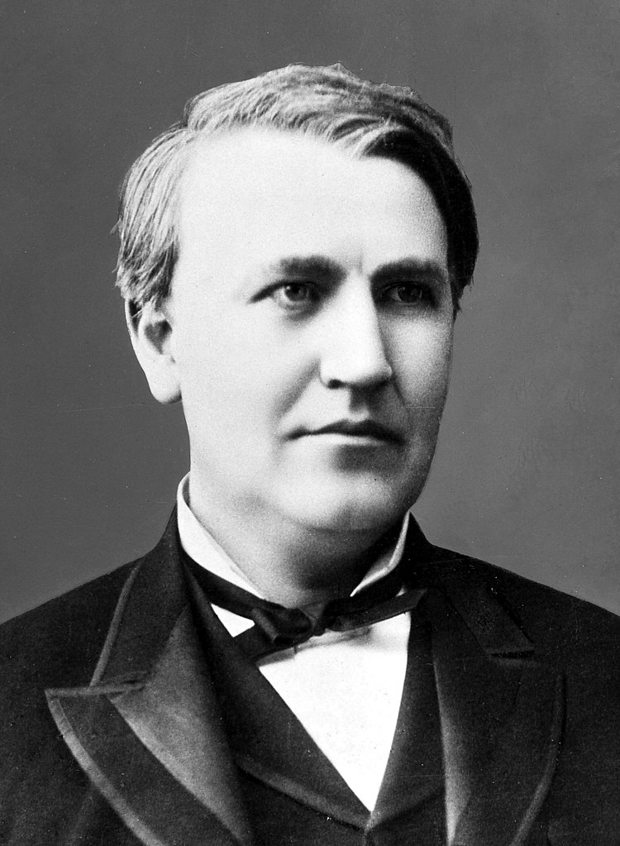
Famous people with dyslexia
A lot of famous people have dyslexia and that proves that dyslexia isn’t such a bad thing after all.
Some famous dyslexic people are…
Tom Cruise
Walt Disney
Leonardo Da Vinci
Thomas Eddison
Albert Einstein
George Washington
Pablo Picasso
These people changed the world and didn’t let dyslexia stop them.

