Slide 1
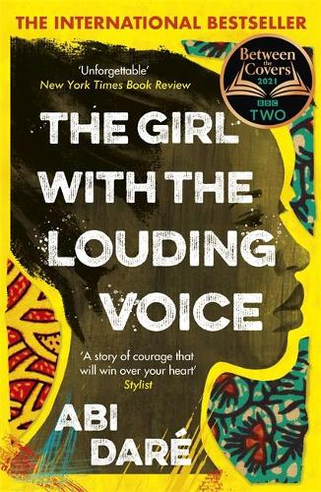
ABI DARÉ
The unforgettable, inspiring story of a teenage girl growing up in a rural Nigerian village who longs to get an education so that she can find her “louding voice” and speak up for herself, The Girl with the Louding Voice is a simultaneously heart-breaking and triumphant tale about the power of fighting for your dreams.
Abi (Abimbola) Daré is a Nigerian author who now lives in Essex, England. In 2018 she won the Bath Novel Award and was a finalist in the Literary Consultancy Pen Factor 2018. Her debut novel The Girl with the Louding Voice was published in 2020.

Slide 2
Thomas Sowell born June 30, 1930, is an American economist, social theorist. Sowell has written more than thirty books, and his work has been widely anthologized. He is a National Humanities medal recipient for innovative scholarship which incorporated history, economics and political science.
THOMAS SOWELL
Black Rednecks and White Liberals is a collection of six essays by Thomas Sowell. The collection, published in 2005, explores various aspects of race and culture, both in the United States and abroad. The first essay, the book's namesake, traces the origins of the "ghetto" African American culture to the culture of Scotch-Irish Americans. The second essay, "Are Jews Generic?", discusses middleman minorities. The third essay, "The Real History of Slavery," discusses the timeline of abolition of slavery and serfdom. The last three essays discuss the history of Germany, African-American education, and a criticism of multiculturalism.

Slide 3
Oyinkan Braithwaite
Oyinkan Braithwaite (born 1988) is a Nigerian-British novelist and writer. She was born in Lagos and spent her childhood in both Nigeria and the UK. Braithwaite's debut book, My sister the serial killer was published by Doubleday Books in 2018 to wide acclaim.
In Lagos, Nigeria, Korede is a nurse with a close relationship with her younger sister, Ayoola. Ayoola is the more beautiful, favored sister, and possibly sociopathic. For the third time in a row, Ayoola has stabbed her boyfriend to death, supposedly in self-defense. (If not, this officially makes her a serial killer.)

Slide 4
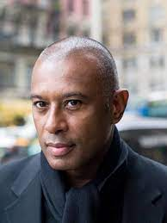
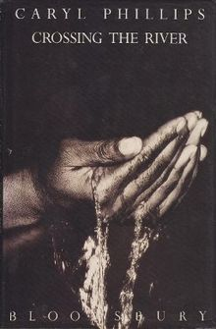
CARYL PHILIPS
Caryl Phillips (born 13 March 1958) is a Kittitian-British novelist, playwright and essayist. Best known for his novels Phillips is often described as a Black Atlantic writer, since much of his fictional output is defined by its interest in, and searching exploration of, the experiences of peoples of the African Diaspora in England, the Caribbean and the United States.
Crossing the River is a novel, published in 1993. “A fearless reimagining of the geography and meaning of the African diaspora”

