Slide 1
Black History
Month

Slide 2
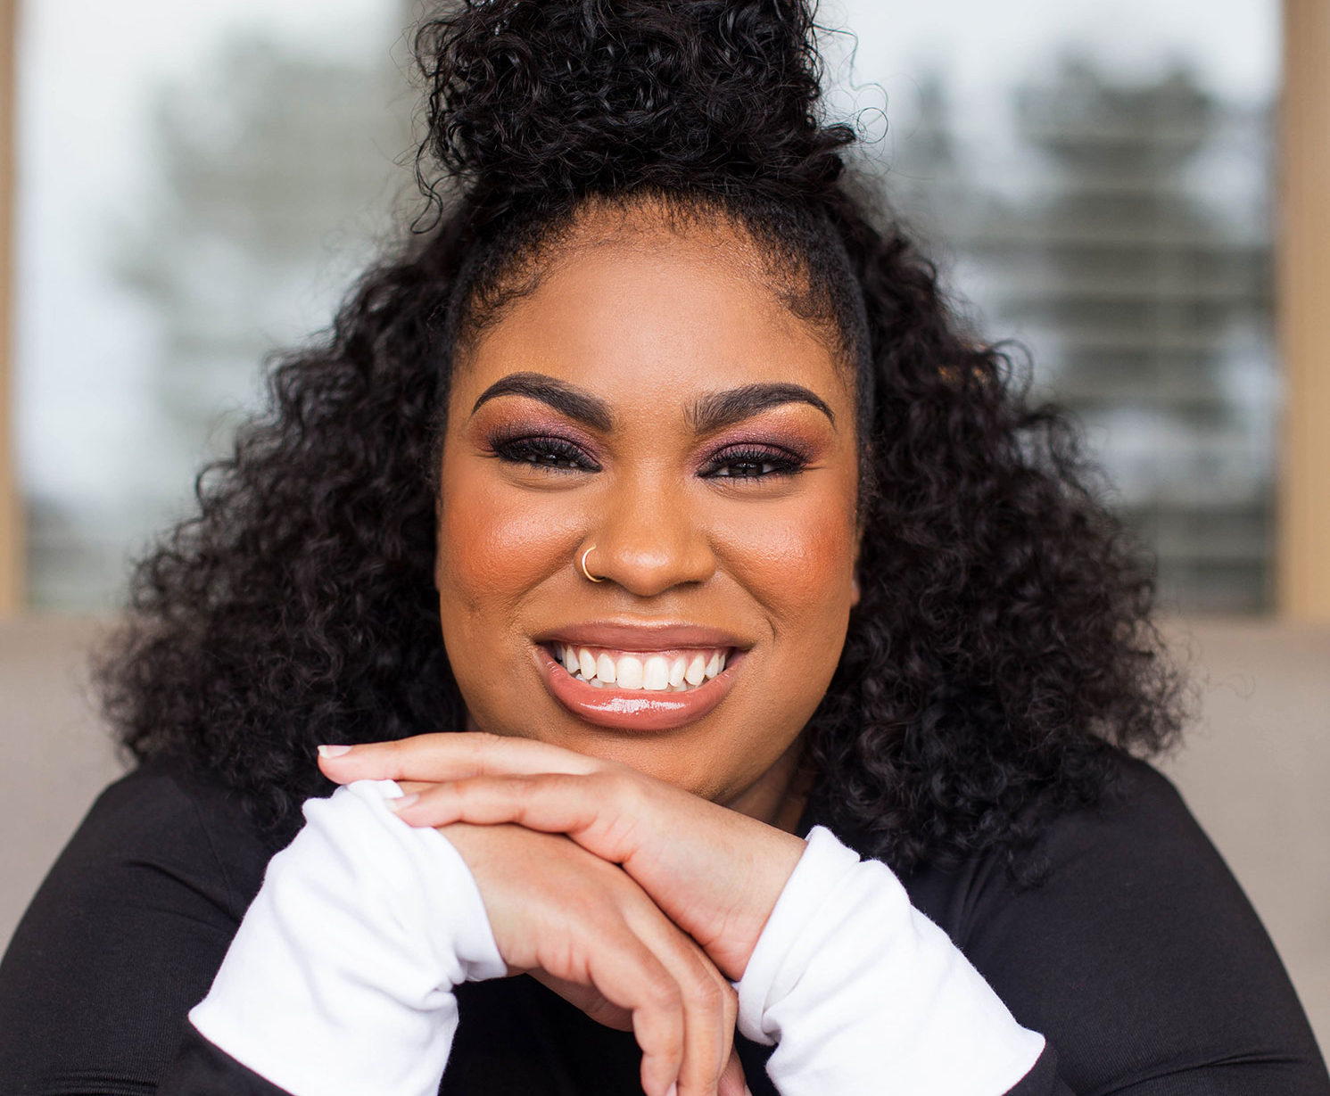
Angie Thomas
Sixteen-year-old Starr Carter moves between two worlds: the poor neighborhood where she lives and the fancy suburban prep school she attends.

Slide 3
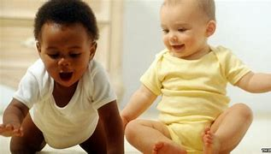

Slide 4
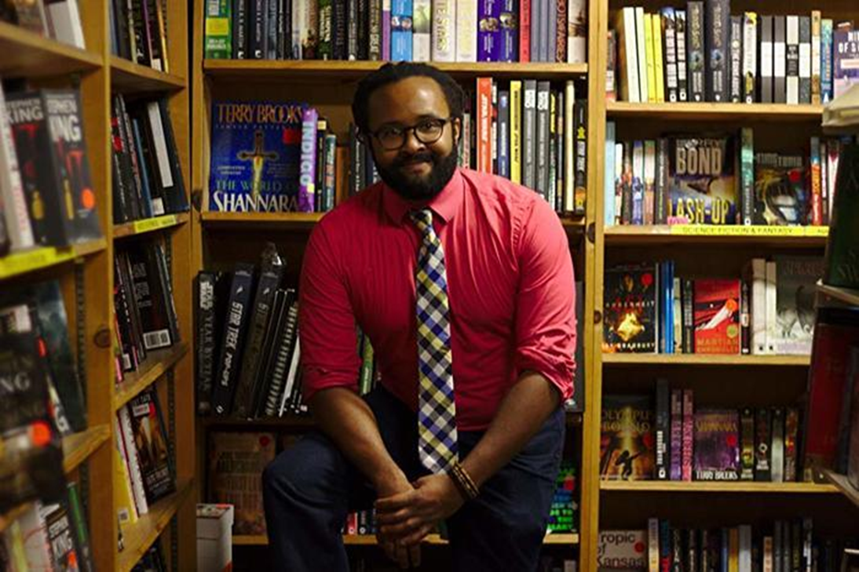
Trapped in a dead-end job in his Ohio hometown, watching the girl of his dreams move on to a glamorous new life in a big city—Donald McDougal’s aimlessness has held him back for a long time.
Charlie J. Eskew

Slide 6
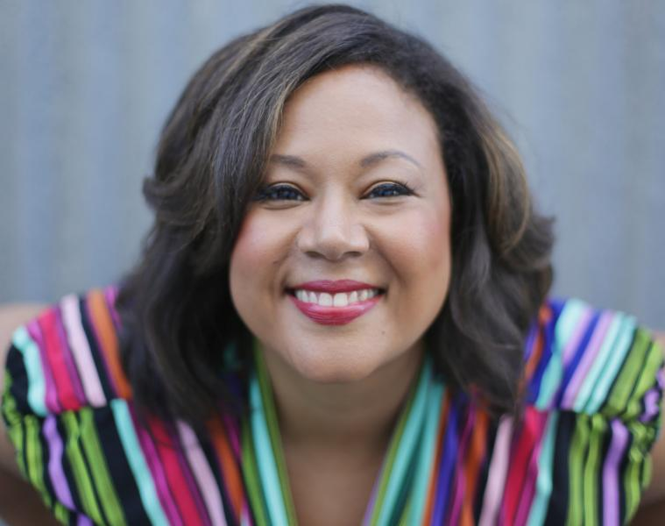
Jasmine Guillory
Agreeing to go to a wedding with a guy she gets stuck with in an elevator is something Alexa Monroe wouldn't normally do. But there's something about Drew Nichols that's too hard to resist.

Slide 7
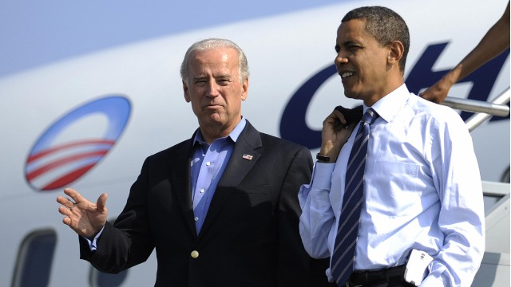
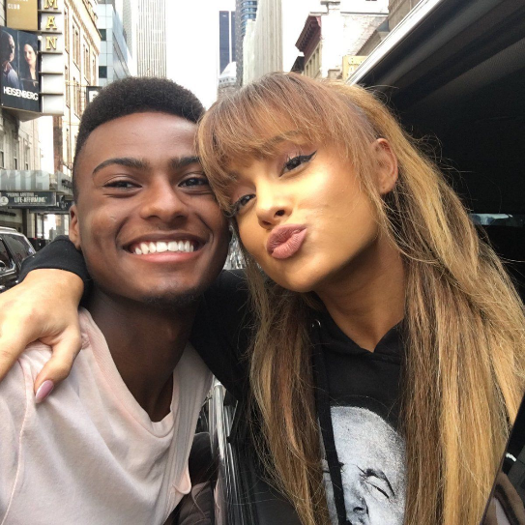

Slide 8
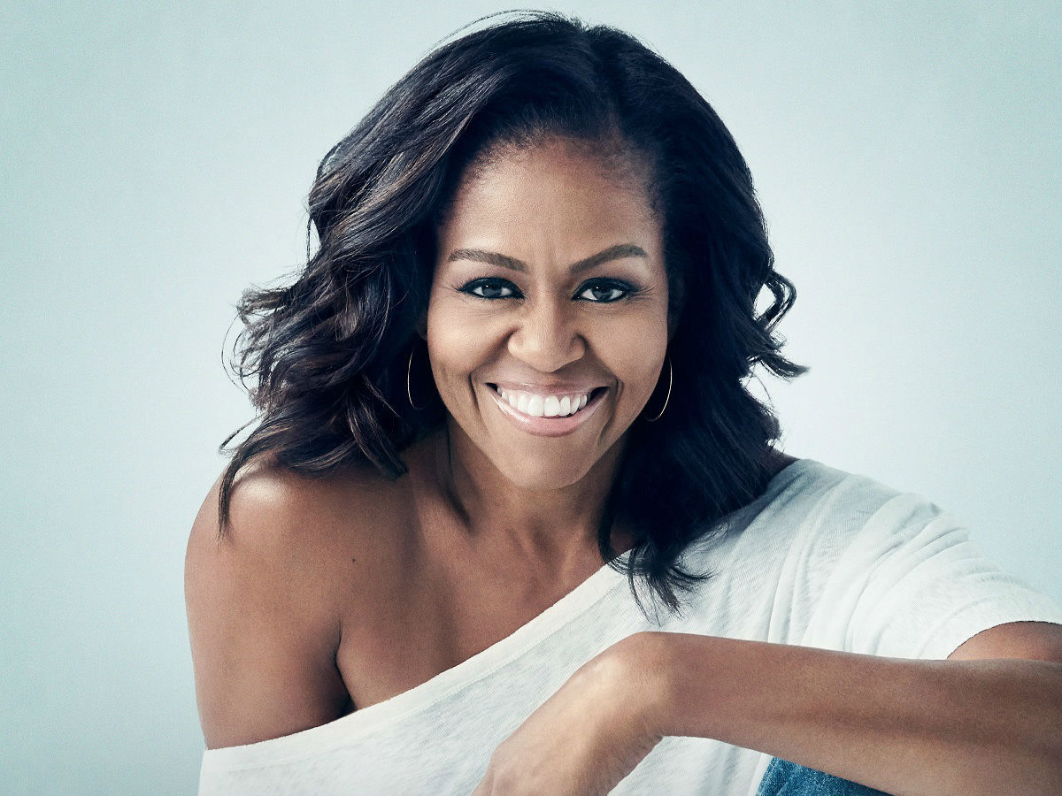
In a life filled with meaning and accomplishment, Michelle Obama has emerged as one of the most iconic and compelling women of our era. As First Lady of the United States of America - the first African-American to serve in that role.
Michelle Obama

