Slide 1
Staff Reading Recommendations
To help celebrate Libraries Week 2018 staff were asked to recommend a book of their choice to pupils.
These are the books they have chosen.

Slide 2
Libraries Week 2018 – celebrating the power of libraries and reading.

Slide 3
Dr Gardner Recommends ‘Blur: 3862 Days’ by Stuart Maconie.

Slide 4
Linda McGurk Recommends ‘Danny the Champion of the World’ by Roald Dahl.

Slide 5
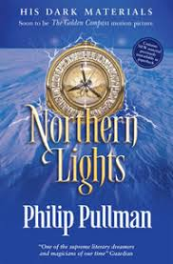
Miss Galloway Recommends ‘Northern Lights’ by Philip Pullman.

Slide 6
Miss Kerr Recommends ‘Pippi Longstocking’ by Astrid Lindgren.

Slide 7
Miss Lennox Recommends ‘The Girl from Aleppo’ by Christine Lamb and Nujeen Mustafa.

Slide 8
Miss Logan Recommends ‘The Perks of Being a Wallflower’ by Stephen Chbosky.

Slide 9
Miss McKenna Recommends ‘The Lovely Bones’ by Alice Sebold.

Slide 10
Miss Watson Recommends ‘The Thirteen Problems’ by Agatha Christie.

Slide 11
Mr Brandon Recommends ‘The Tattooist of Auschwitz

Slide 12
Mr Campbell Recommends ‘A Clockwork Orange’ by Anthony Burgess.

Slide 13
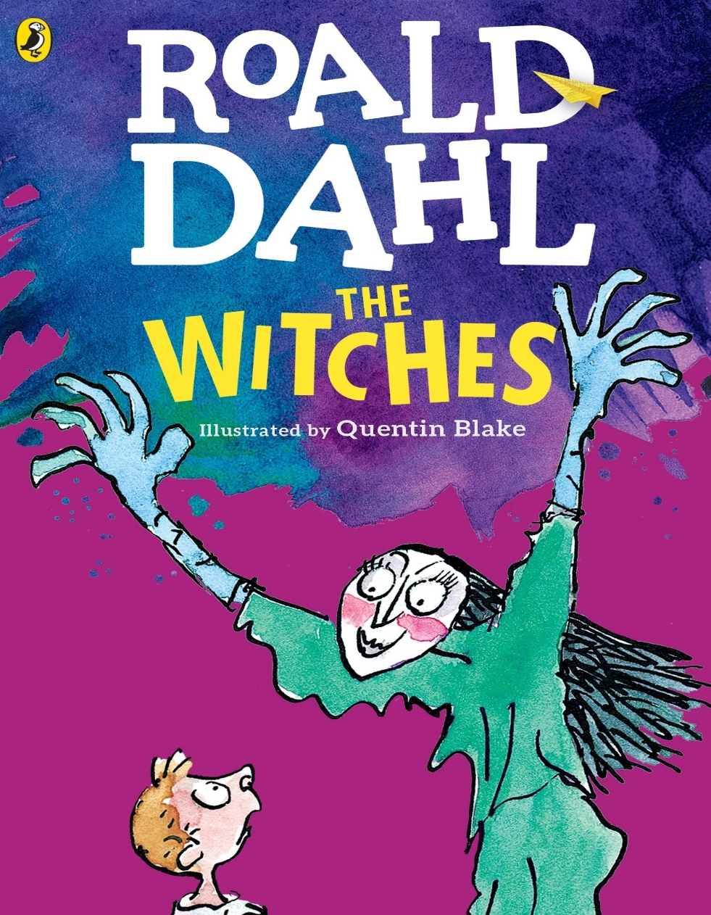
Mr Clark Recommends ‘The Witches’ by Roald Dahl.

Slide 14
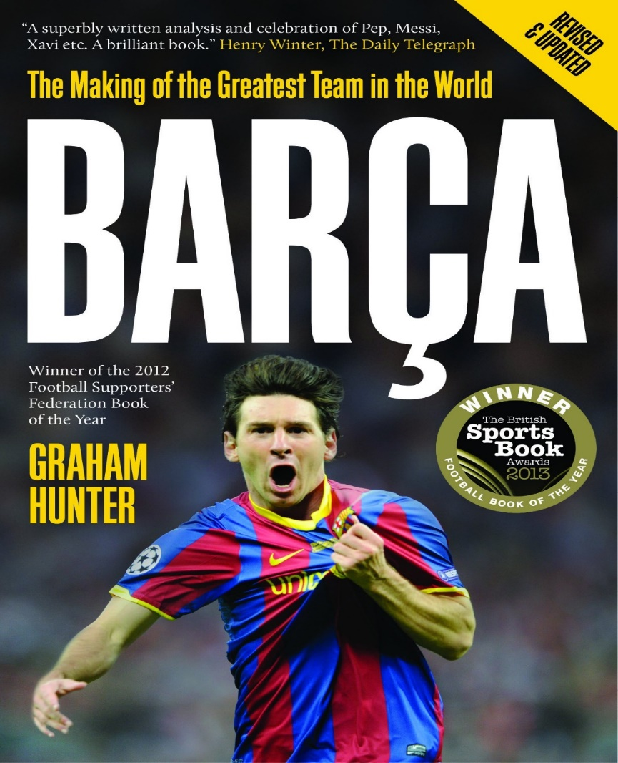
Mr Clarke Recommends ‘Barca’ by Graham Hunter.

Slide 15
Mr Crawford Recommends ‘The Circle’ by Dave Eggers.

Slide 16
Mr Egan Recommends ‘All Quiet on the Western Front’ by Erich Maria Remarque.

Slide 17
Mr Gardiner Recommends ‘Ender’s Game’ by Orson Scott Card.

Slide 18
Mr Hamilton Recommends ‘Bounce’ by Matthew Syed.

Slide 19
Mr Littley Recommends ‘The Redemption of Althalus’ by David and Leigh Eddings.

Slide 20
Mr McAllister Recommends ‘Into the Wild’ by Jon Krakauer.

Slide 21
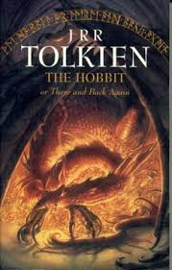
Mr Mearns Recommends ‘The Hobbit’ by J.R.R Tolkien.

Slide 22
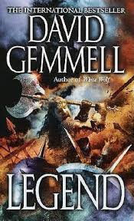
Mr Mitchell Recommends ‘Legend’ by David Gemmell.

Slide 23
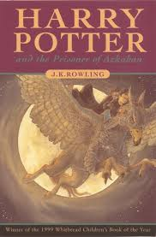
Mr Paterson Recommends ‘Harry Potter and the Prisoner of Azkaban’ by J.K Rowling.

Slide 24
Mrs Allan Recommends ‘Wuthering Heights’ by Emily Bronte.

Slide 25
Mrs Ballantyne Recommends ‘Me Before You’ by Jojo Moyes.

Slide 26
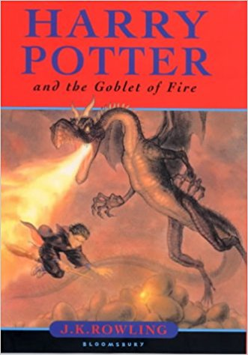
Mrs Cochrane Recommends ‘Harry Potter and the Goblet of Fire’ by J.K Rowling.

Slide 27
Mrs Currie Recommends ‘Wonder’ by R.J Palacio.

Slide 28
Mrs Hunter Recommends ‘Abomination’ by Robert Swindells.

Slide 29
Mrs Jeffrey Recommends ‘Peace at Last’ by Jill Murphy.

Slide 30
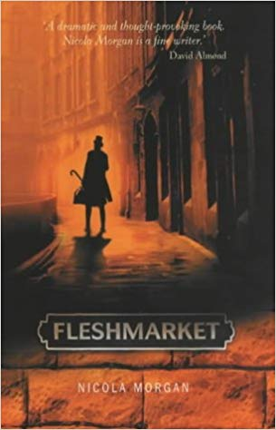
Mrs Kinnaird Recommends ‘Fleshmarket’ by Nicola Morgan.

Slide 31
Mrs Magowan Recommends ‘Cannery Row’ by John Steinbeck.

Slide 32
Mrs McAra Recommends ‘To Kill a Mockingbird’ by Harper Lee.

Slide 33
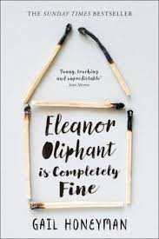
Mrs McHugh Recommends ‘Eleanor Oliphant is Completely Fine’ by Gail Honeyman.

Slide 34
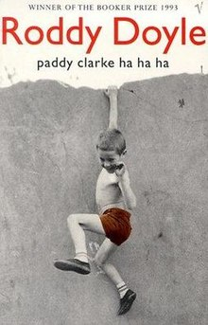
Mrs McKenna Recommends ‘Paddy Clarke, Ha, Ha, Ha’ by Roddy Doyle.

Slide 35
Mrs Neilson Recommends ‘The Hunger Games’ by Suzanne Collins.

Slide 36
Mrs Paterson Recommends ‘A Clockwork Orange’ by Anthony Burgess.

Slide 37
Mrs Reilly Recommends ‘My Sword Hand is Singing’ by Marcus Sedgwick.

Slide 38
Mrs Ritchie Recommends ‘Goodnight Mister Tom’ by Michelle Magorian.

Slide 39
Mrs Rooney Recommends ‘The Fault in our Stars’ by John Green.

Slide 40
Mrs Scott Recommends ‘To All the Boys I’ve Loved Before’ by Jenny Han.

Slide 41
Mrs Sweeney Recommends ‘Charlotte’s Web’ by E.B White.

Slide 42
Mrs Swinburne Recommends ‘The Call of the Wild’ by Jack London.

Slide 43
Mrs Taggart Recommends ‘Twilight’ by Stephenie Meyer.

Slide 44
Mrs Tonner Recommends ‘Harry Potter and the Prisoner of Azkaban’ by J.K Rowling.

Slide 45
Ms Anderson Recommends ‘The Hunger Games Trilogy’ by Suzanne Collins.

Slide 46
Ms Gorman Recommends ‘The Diary of Two Nobodies’ by Mary Killen and Giles Wood.

Slide 47
Ms Lyttle Recommends ‘Twilight’ by Stephenie Meyer.

Slide 48
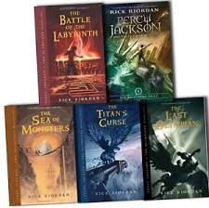
Ms Mackie Recommends ‘The Percy Jackson Series’ by Rick Riordan.

Slide 49
Ms Main Recommends ‘Of Mice and Men’ by John Steinbeck.

Slide 50
Ms O’Donovan Recommends ‘Native’s: Race and Class in the Ruins of Empire’ by Akala.

Slide 51
Ms Young Recommends ‘The Lovely Bones’ by Alice Sebold.

Slide 52
Thank you for all of your fantastic book recommendations. *Get Reading* *Strictly Come Dancing Voice*

