Slide 1
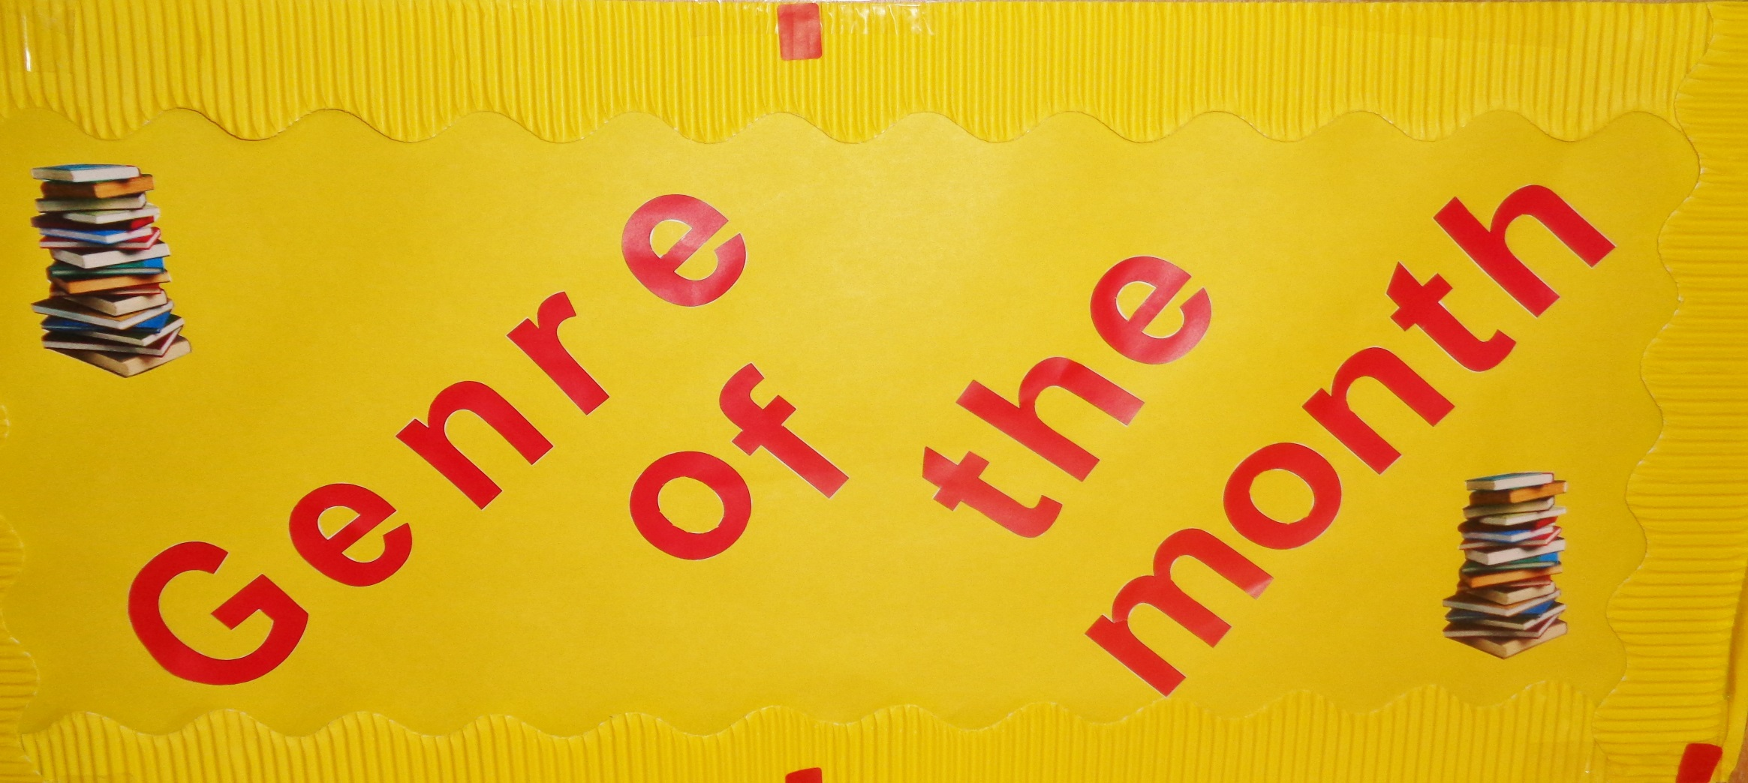

Slide 2
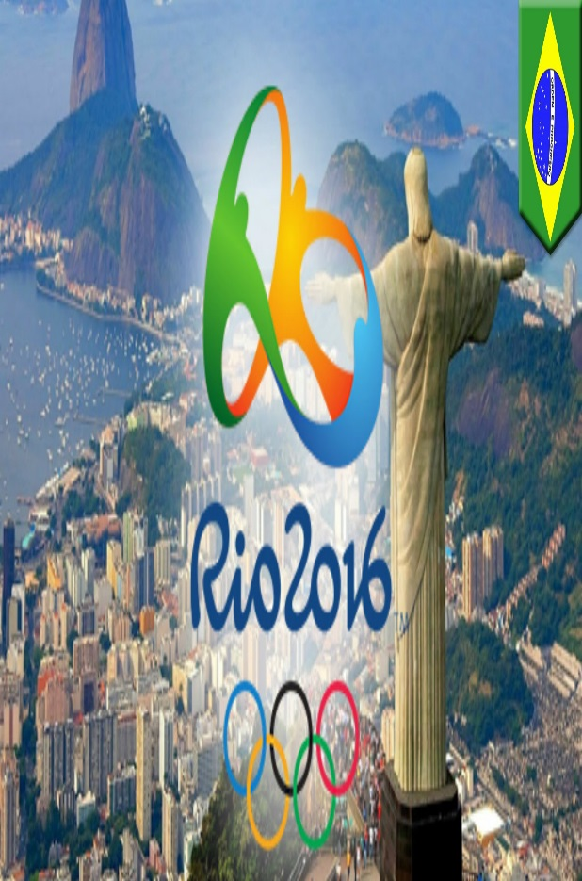
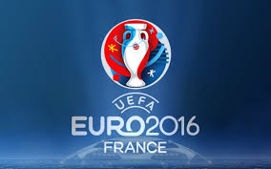
Sport

Slide 3
2016 Summer of Sport
Andy Murray wins Wimbledon for the second time and retains his title at the Rio Olympics.
Chris Froome wins the Tour de France for the third time.
Lewis Hamilton leads the F1 drivers competition including a win at the British Grand Prix Silverstone.
Team GB win a total of 67 medals at the Rio 2016 Olympic Games including 27 Golds.

Slide 4
Favourite Medals
Usain Bolt wins Gold in Athletics 100m Sprint
Mo Farah wins Gold in Athletics 5,000m

Slide 5
Sport
In the school library you will find an entire collection dedicated to Sport fiction.
You will also find lots of sporting biographies in the Biography collection e.g.: Ronaldo, Andy Murray, Lewis Hamilton, Serena Williams etc.
The school library also has a very good selection of non fiction books on a wide variety of sports from football to gymnastics and from badminton to rugby.

Slide 6
Books like these….
Goal! The Dream Begins
Based on the first book of the ‘Goal’ series by Robert Rigby.
Bend it Like Beckham
Based on the novel by Narinder Dhami.

