Slide 1
Databases

Slide 2
Lesson Aims
By the end of this lesson you will be able to:
Describe what a database is
Including its structure
Describe the difference between data and information

Slide 3
Data and Information
DATA
INFORMATION
6 years 5 Months?
Car Reg?
65
DD3 0HB
65cm?
Postcode

Slide 4
What is a database?
A database is a collection of related information about a set of persons or objects. They can be paper based or electronic

Slide 5
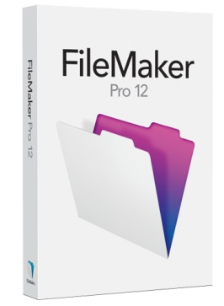
Electronic Databases
They can also be electronic. A DBMS (Database Management System) will be used to create and manipulate the database Such as Microsoft Access® FileMaker®

Slide 6
Disadvantages of paper databases
Storage of paper records was very bulky

Slide 7
Disadvantages of paper databases
Easy to mis-file a record, or records to be lost or damaged

Slide 8
Disadvantages of paper databases
Data often duplicated in several records Keeping records up-to-date was difficult and time consuming, Duplicated values were updated in one record but not in others

Slide 9
Advantages of Computerised Databases
Searching, sorting and calculating operations can be performed much more quickly and easily.
Information is more easily available to users
And multiple people at the same time
Easier to edit data
Easier to backup
Less physical space needed

Slide 10
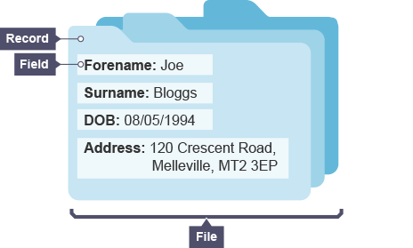
Electronic Database Structure
A database consists of three parts. The file, records and fields.
A database file stores all of the information on a particular subject. It is made up of records.
A record stores all the information about one person/thing. It is one completed row of fields.
A field stores one piece of information, for example, first name, surname etc..

Slide 11
Summary
Data is raw unprocessed facts and figures. Information is data that has been processed and given meaning. Paper Databases
Storage of paper records was very bulky
Easy to mis-file a record, or lose a record
Data often duplicated
Keeping records up-to-date was difficult and time consuming. Can lead to inconsistency

Slide 12
Summary – Electronic Databases
Electronic Databases
Searching, sorting and calculating operations can be performed much more quickly and easily.
Information is more easily available to users And multiple people at the same time
Easier to edit data
Easier to backup
Less physical space needed

Slide 13
Database Development: Analysis Stage
During the analysis stage of database development, the following requirements should be identified:
End-user requirements
Functional requirements
These requirements will help to:
Clarify the design
Identify features to be included
Evaluate if it is fit for purpose once completed

Slide 14
End-User and Functional Requirements
End-user requirements
The end users are the people who are going to be using the database
Their requirements are the tasks they expect to be able to do using the database
Functional requirements
Processes and activities that the system has to perform
Information that the system has to contain to be able to carry out its functions

Slide 15
Your Task
Pupil Share
Business & ICT
Computing
National 4 & 5
S4, S5, S6
Databases
Database Analysis

