Slide 1
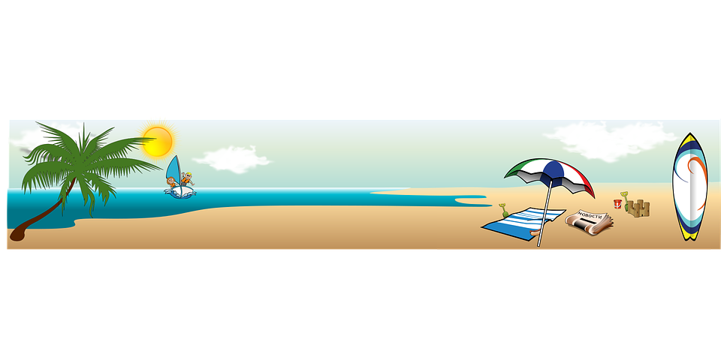
P6/7 Homework Grid Choose at least 2 tasks per week to complete.
Reading | Spelling | Numeracy | Topic | STEM | Other
Write a review of your favourite reading book. | Practise your spelling words by writing them in chalk on the pavement or in your garden. (Ask permission) | Practice timestables with an adult. https://www.topmarks.co.uk/maths-games/hit-the-button | Create a poster about a topic which you have covered in class this year. | Paint different designs on paper using different brands of sun cream. Leave the paper out in the sun. What do you notice? | Make your own ice lollies by using diluting juice, lollipop sticks and a freezer. You could also make some using fruit and yoghurt.
Listen or read your favourite book. | Spelling tennis – Ask someone at home to play spelling tennis with you. Take it in turns to spell each letter in each of your spelling words. | Complete tasks on Sumdog. | Design a powerpoint about a topic you are passionate about. Must include 4 slides. | Scotland to Northern Ireland Bridge- Design a bridge that could span 21 to 28 miles to cross the Irish Sea. Research different types of bridges that span a similar distamce and across water. Design your own bridge and label materials you would include.
June
2024

